Slide 1
Post Lab Quiz 3 Review
Assignment 2 Help
Interrupts

Slide 2
Mixture of Q2 and Q4 on Midterm
Using PF interrupts on a Blackfin
  Count the number of times a door is opened
  On the press of a button, print out the information
SPI and LCD , Copyright M. Smith, ECE, University of Calgary, Canada
<number> / 30

Slide 3
What do we need to know?
How are switches hooked to Blackfin?
How to handle 2 interrupt ISRs?
  How to acknowledge the hardware ISR request
  How to test the ISR
How to make ISR fast (no printf permitted)?
How do we initialize Blackfin PF interrupts?
How do we start the interrupts controllably
SPI and LCD , Copyright M. Smith, ECE, University of Calgary, Canada
<number> / 30

Slide 4
Do easy stuff first
Need to do just one print when master switch is pressed
Connect to PF8 input.
Works like in Lab 1 -- switch press causes PF8 input to go high
  NOTE: I DID NOT say – switch press causes PF8 bit to go high – I said the input went high
SPI and LCD , Copyright M. Smith, ECE, University of Calgary, Canada
<number> / 30

Slide 5
Do easy stuff first
Need to increment count by when door opened
Connect to PF9 input.
Works like in Lab 1 – door opencauses PF9 input to go low
  NOTE: I DID NOT say – switch press causes PF9 bit to go low – I said the input went low
SPI and LCD , Copyright M. Smith, ECE, University of Calgary, Canada
<number> / 30

Slide 6
Plan the main
Main( )
InitPF( ) – like Lab 1 – given
InitPFInterrupts( ) – uses Lab 1 ideas but turns on stuff normally turned off
OtherCode( )
StartPFInterrupts( )
while (1)
// If master switch pressed – print once
SPI and LCD , Copyright M. Smith, ECE, University of Calgary, Canada
<number> / 30

Slide 7
Plan the ISR
Ex_Interrupt_Handler(PF_Interrupts)
// Only gets here on PF interrupts
if PF8 interrupt
Acknowledge PF8 interrupt
DoSomething_PF8
if PF9 interrupt
Acknowledge PF9 interrupt
DoSomething_PF9
SPI and LCD , Copyright M. Smith, ECE, University of Calgary, Canada
<number> / 30

Slide 8
Try again -- main and ISR communicate by globals
volatile int PF9interrupt_doPrint = 0;
volatile int PF8interrupt_countDoorOpens = 0;
main( )
InitPF( ) – like Lab 1 – given
InitPFInterrupts( ) – uses Lab 1 ideas but turns on stuff normally turned off
OtherCode( )
StartPFInterrupts( )
while (1) {
if PF9interrupt_doPrint != 0 {
printf(PF8interrupt_countDoorOpens);
PF9interrupt_doPrint = 0;
PF8interrupt_countDoorOpens = 0;
}
}
SPI and LCD , Copyright M. Smith, ECE, University of Calgary, Canada
<number> / 30

Slide 9
Plan the ISR
extern volatile int PF9interrupt_doPrint;
extern volatile int PF8interrupt_countDoorOpens;
Ex_Interrupt_Handler(PF_Interrupts)
// Only gets here on PF interrupts caused by edges
if PF8 interrupt
Acknowledge PF8 interrupt
PF8interrupt_countDoorOpens++
if PF9 interrupt
Acknowledge PF9 interrupt
PF9interrupt_doPrint = 1;
SPI and LCD , Copyright M. Smith, ECE, University of Calgary, Canada
<number> / 30

Slide 10
ISR rules
If PF8 input goes from lo-to-high
  PF set using InitPF from Lab 1
  And edge register set to PF8 edge
  And polar register set to PF8 normal
  And mask-A register set to PF8
  And IMASK is set correctly
  And SIC_IMASK is set correctly
Then PF8 is set to 1 and interrupt occurs
SPI and LCD , Copyright M. Smith, ECE, University of Calgary, Canada
<number> / 30

Slide 11
ISR rules
If PF9 input goes from high-to-low
  PF set using InitPF from Lab 1
  And edge register set to PF9 edge
  And polar register set to PF9 opposite to normal
  And mask-A register set to PF9
  And IMASK is set correctly
  And SIC_IMASK is set correctly
Then PF9 is set to 1 and interrupt occurs
NOTE PF9 input goes low by PF9 goes high
SPI and LCD , Copyright M. Smith, ECE, University of Calgary, Canada
<number> / 30

Slide 12
ISR rules – specific to PF interrupts
It is possible for two interrupts to happens at once
You clear the PF8 interrupt by clearing the PF8 bit to zero
  It will stay zero even if the PF8 level input stays high (because you said ‘edge’ interrupts and not level)
You clear the PF9 interrupt by clearing the PF9 bit to zero
  It will stay zero even if the PF9 level input stays low (because you said ‘edge’ interrupts and not level)
SPI and LCD , Copyright M. Smith, ECE, University of Calgary, Canada
<number> / 30

Slide 13
Plan the ISR
extern volatile int PF9interrupt_doPrint;
extern volatile int PF8interrupt_countDoorOpens;
Ex_Interrupt_Handler(PF_Interrupts)
// Only gets here on PF interrupts caused by edges
int flags = *pFIO_FLAG_D
if (Flags & 0x0100) {
*pFIO_FLAG_D = *pFIO_FLAG_D & ~0x0100
// Acknowledge PF8 interrupt
PF8interrupt_countDoorOpens++
}
if PF9 interrupt -- you handle it
Acknowledge PF9 interrupt
PF9interrupt_doPrint = 1;
SPI and LCD , Copyright M. Smith, ECE, University of Calgary, Canada
<number> / 30

Slide 14
InitPFInterrupts( )
Assume PF8, PF9 set as enable,
polar = 0, interrupts off, direction input – like Lab 1
*pFLAGS_MASKA // Prepare PF interrupts
= *pFLAGS_MASKA | (0x0100 | 0x0200)
*pFLAGS_EDGE // Prepare PF interrupts
= *pFLAGS_EDGE | (0x0100 | 0x0200)
// PF9 is on ‘down edge’ – use POLAR
*pFLAGS_POLAR // Prepare PF interrupts
= *pFLAGS_POLAR | (0x0200)
SPI and LCD , Copyright M. Smith, ECE, University of Calgary, Canada
<number> / 30

Slide 15
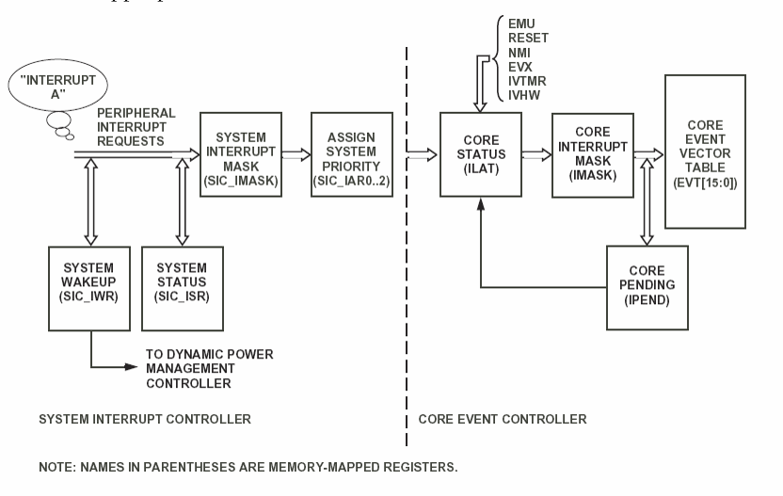
ActivateInterrupts( )
This is not in the labs, only in the lecture notes
SPI and LCD , Copyright M. Smith, ECE, University of Calgary, Canada
<number> / 30

Slide 16
Follow the chain
If PF set up correctly
(DONE)
Then Interrupt A occurs on switch presses automatically – already
If SIC_IMASK is set (???)
And Priority set (SIC_IAR0) (???)
Then ILAT is set automatically
then is IMASK is set (???)
And event vector table is set (???)
Then an PF interrupt will occur
SPI and LCD , Copyright M. Smith, ECE, University of Calgary, Canada
<number> / 30

Slide 17
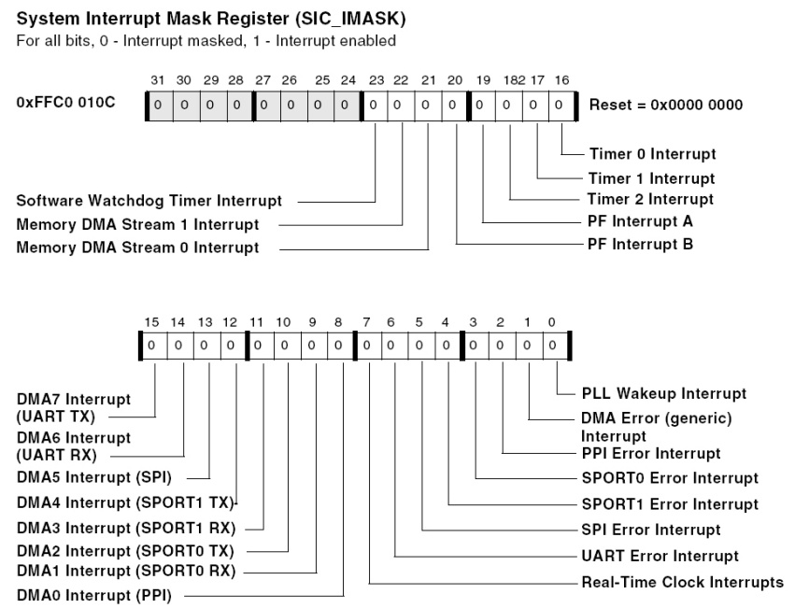
Time to look at reference sheet
So we need
*pSIC_IMASK = *pSIC_IMASK
| 0x00080000
PF Interrupt
SPI and LCD , Copyright M. Smith, ECE, University of Calgary, Canada
<number> / 30

Slide 18
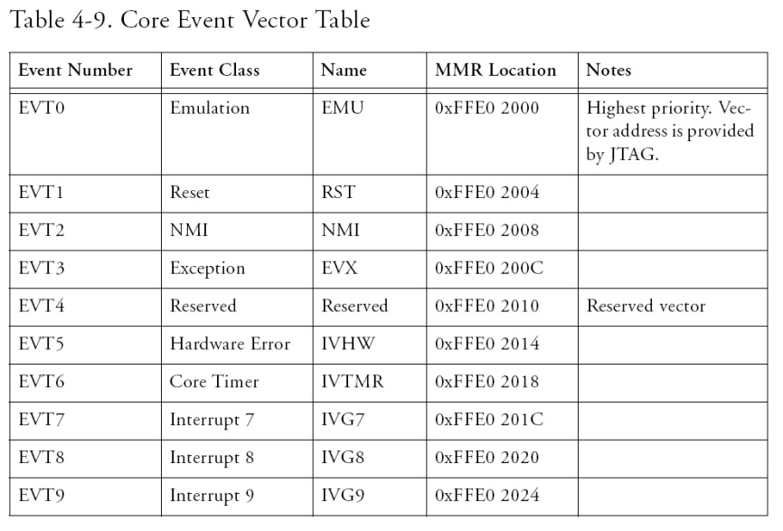
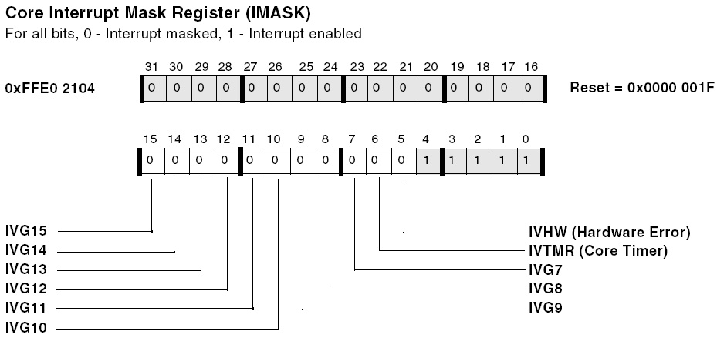
Problems – need to know about an IV???? to handle the next bit?
SPI and LCD , Copyright M. Smith, ECE, University of Calgary, Canada
<number> / 30

Slide 19
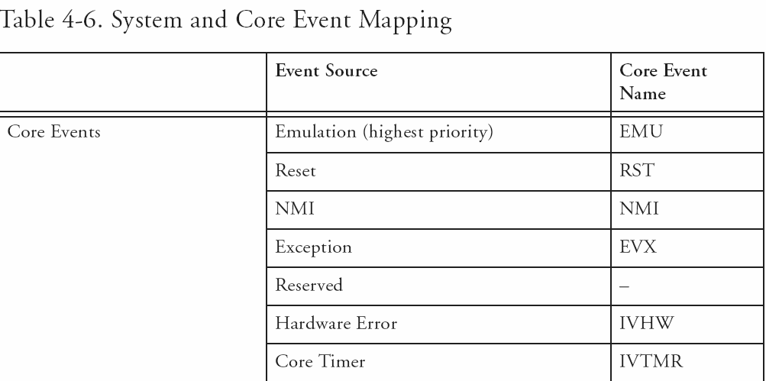
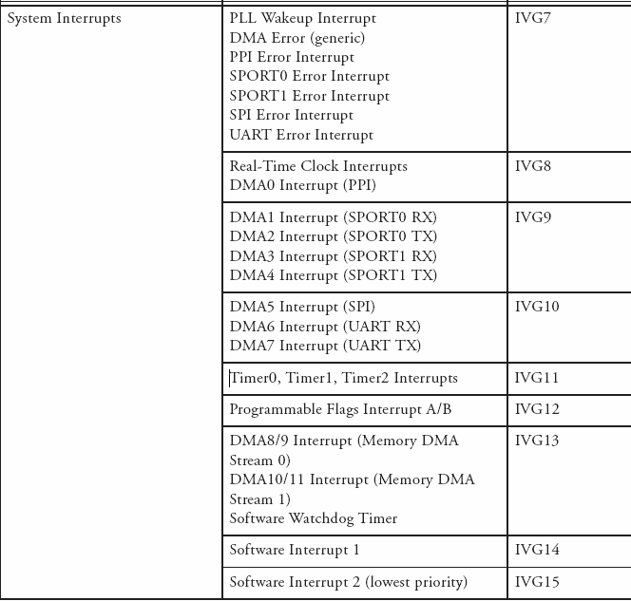
SPI and LCD , Copyright M. Smith, ECE, University of Calgary, Canada
<number> / 30

Slide 20
InterruptActivate( )
*pSIC_IMASK = *pSIC_IMASK
| 0x00080000;
ssync( ); // PF Interrupt
*pIMASK = *pIMASK
| 0x00001000;
Ssync( ); // IVG_12
register_handler(k_IVG12, PF_Interrupts);
SPI and LCD , Copyright M. Smith, ECE, University of Calgary, Canada
<number> / 30

Slide 21
Planning over – lets doit
Use VDSP help to find out what files need including for interrupt handling
Why does the help page have 2 defects
#include <sys/exception.h>
static int number_of_interrupts;
EX_INTERRUPT_HANDLER(my_isr)
{
number_of_interrupts++;
}
SPI and LCD , Copyright M. Smith, ECE, University of Calgary, Canada
<number> / 30

Slide 22
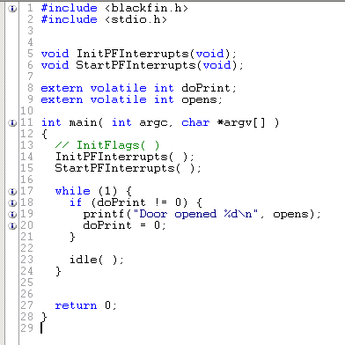
SPI and LCD , Copyright M. Smith, ECE, University of Calgary, Canada
<number> / 30

Slide 23
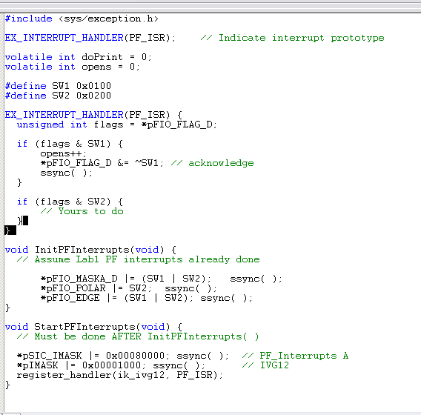
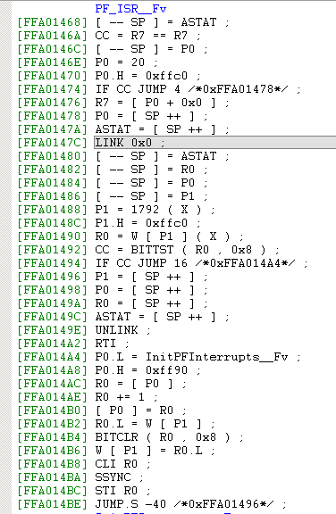
SPI and LCD , Copyright M. Smith, ECE, University of Calgary, Canada
<number> / 30

