Slide 1
The Impact of Quantum Computing on RSA
Stephen Campbell

Slide 2
Goal
Explore and understand the algorithms and methodologies behind RSA and the quantum computing “lightsaber” that cripples its integrity.

Slide 3
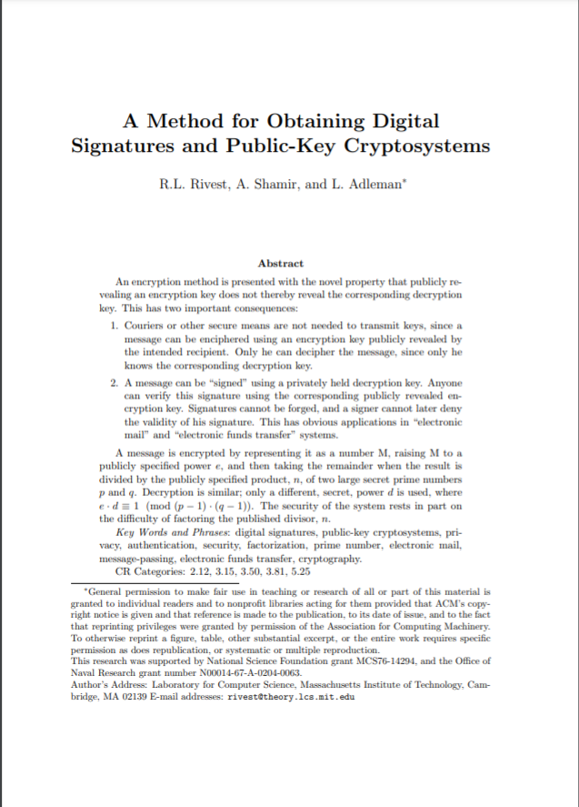
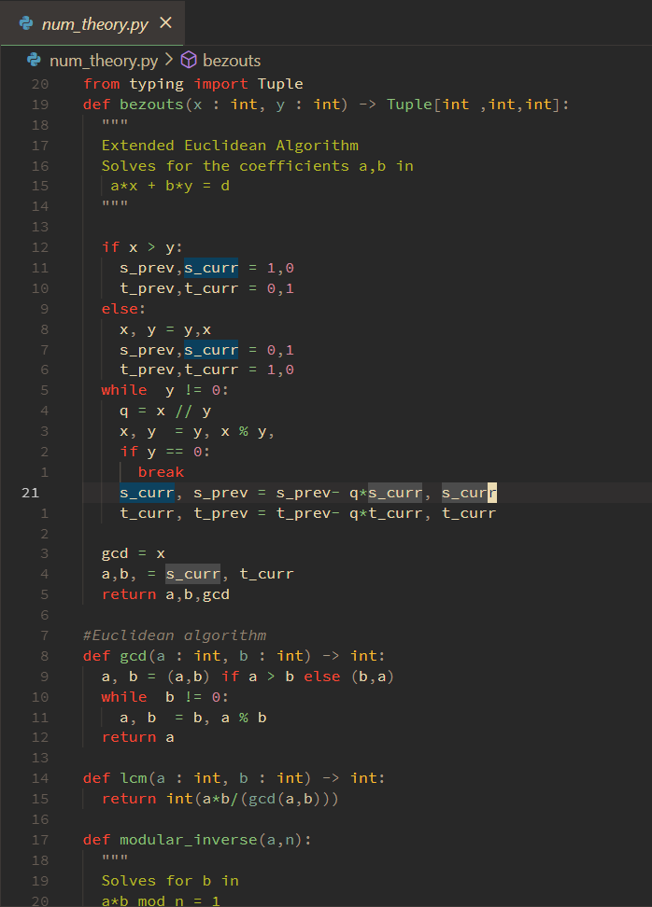
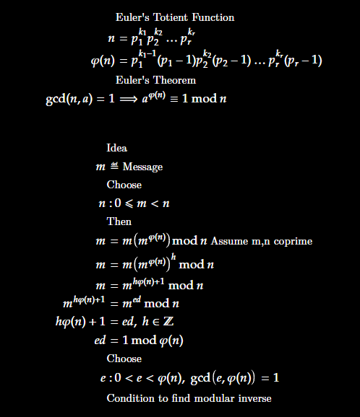
Approach
Research
Implement
Analyze

Slide 4
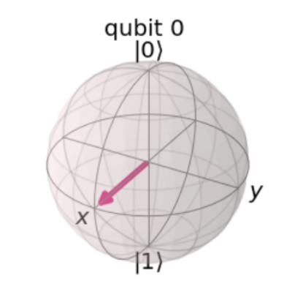
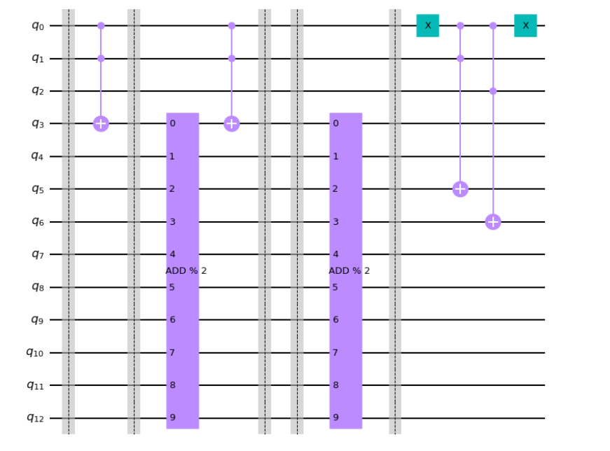
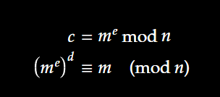
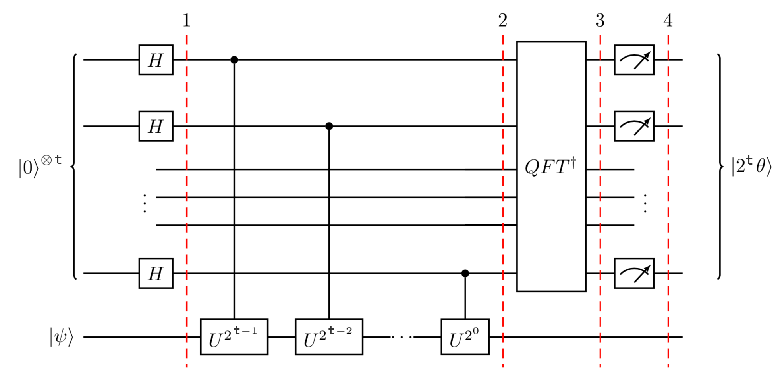
Process
RSA
QC Fundamentals
QC Building Blocks
Shor’s Algorithm

Slide 5
Motivation for Prime Factorization: RSA
Goal: Create replica cryptosystem in python
Public Key Cryptosystems
Euclidean Algorithm (Finding greatest common divisor)
Modular Arithmetic
Bezout’s Identity and finding modular inverses
Fermat’s Little Theorem, large random prime generation
Euler Totient Function, Euler’s Theorem (Key Generation)

Slide 6
Quantum Computing
Terminology: qubit, quantum gate, quantum computer
Idea of reversible computing
Building quantum computation blocks
Fundamental gates e.g. Hadamard, Toffoli, CNOT, Pauli Family
Quantum Fourier Transform
Quantum Phase Estimation
Quantum Modular Exponentiation

Slide 7

Shor’s Algorithm
Takeways
The goal of Shor’s algorithm : Find period of the function
That period can probably be used to find a factor of n

Slide 8


Shor’s Algorithm
Classical Asymptotic Running Time
Quantum Asymptotic Running Time
Implementation: QPE on modular exponentiation [a]

Slide 9
Conclusion
Phenomenal quantum computing educational materials
Number Theory Motivation
Quantum computing has large overlap with digital logic

Slide 10
Resources
Repo
[a] Qiskit

Slide 11
References
[1] A. Helwer, Quantum computing for computer scientists , Youtube, Apr. 2018. [Online]. Available: https://youtu. be/F_Riqjdh2oM .
[2] P. W. Shor, “Polynomial-Time Algorithms for Prime Factorization and Discrete Logarithms on a Quantum Computer,” SIAM Journal on Computing, vol. 26, no. 5, pp. 1484–1509, Oct. 1997, arXiv: quantph/9508027, ISSN: 0097-5397, 1095-7111. DOI: 10.1137/ S0097539795293172. [Online]. Available: http://arxiv. org/abs/quant-ph/9508027 (visited on 12/06/2021).
[3] R. L. Rivest, A. Shamir, and L. Adleman, “A method for obtaining digital signatures and public-key cryptosystems,” Communications of the ACM, 1978.
[4] P. Zimmermann, “Factorization of rsa-250,” N/A, 2020. [Online]. Available: https://listserv.nodak.edu/cgi- bin/ wa.exe?A2=NMBRTHRY;dc42ccd1.2002 .
[5] V. Vedral, A. Barenco, and A. Ekert, “Quantum Networks for Elementary Arithmetic Operations,” Physical Review A, vol. 54, no. 1, pp. 147–153, Jul. 1996, arXiv: quantph/9511018, ISSN: 1050-2947, 1094-1622. DOI: 10.1103/ PhysRevA.54.147. [Online]. Available: http://arxiv.org/ abs/quant-ph/9511018 (visited on 12/06/2021).

Slide 12
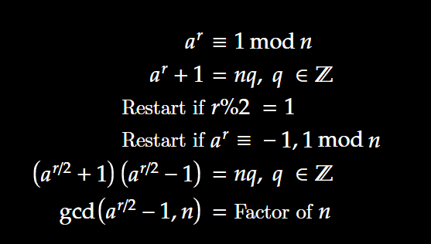
Backup

Slide 13
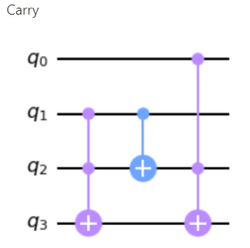
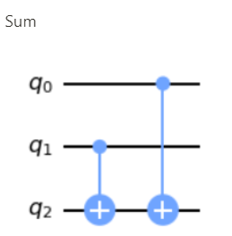

Slide 14
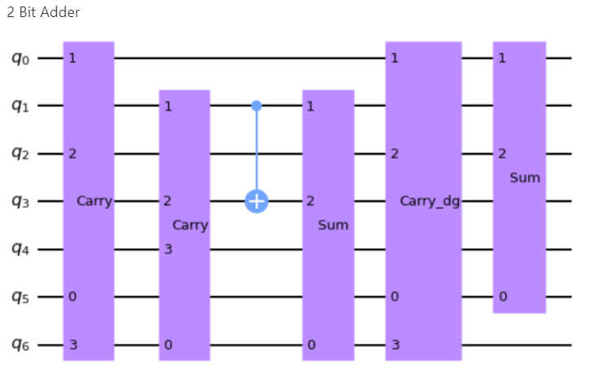

Slide 15
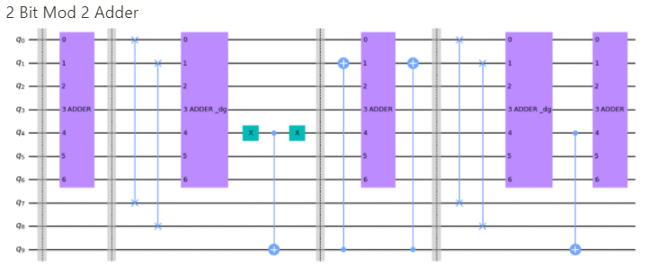

Slide 16
