Slide 1
Project 2 Proposal
Digital Lab:
Cong
Mike
Irene
Boran

Slide 2
Overall Ratings Page
Select players to visualize:
Top 10
Top 20
Top 50
Bar Chart
Y axis:
Elo score;
Age;
dan;
Bar color:
country
Table
List Rank;
Name
(link to player page);
Nationality;
Gender;
Elo score
Pie Chart
Distribution of nationality
Player Names

Slide 3
Player Page (only for top 20 player)
photo
Line chart
Description:
Country, birth day, dan level,
overall game record (win, lose, %)
Vs Top 10 players (win, lose, %)
Vs non-Top 10 players (win, lose, %)
Elo score
Date
Drop list add a line
Or multiple lines
Player 2
Add
Recent games
Analysis:
10 games
20 games
30 games
Table
Total win, loss, ratio%;
Black win, loss, ratio%;
White win, loss, ratio%
Bar graph with tooltip:
Opponent name; Elo score; country

Slide 4
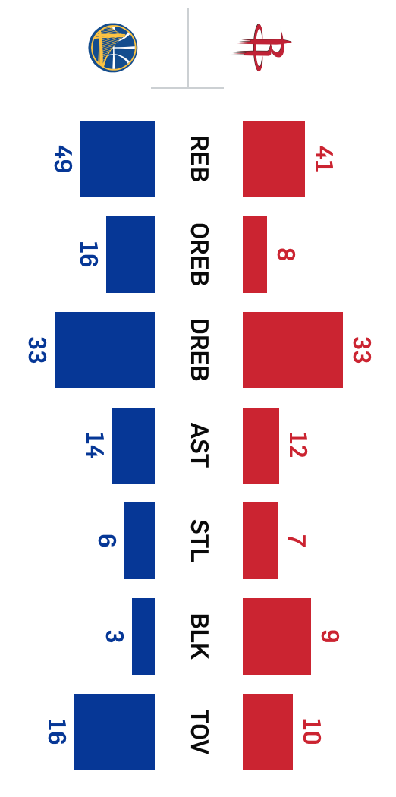
Team Game Page (this is an option)
vs
5 players
10 players
25 players
Select players pool size
Game history
Analysis:
China
S.Korea
Player name
Game 1
Player name
Table
Game player pair;
Name, rank,
Total game played;
Win rate$=%
Prediction of score:
China: 16
S.Korea: 9
name
Game 2
name
name
Game 3
name
name
Game 4
name
name
Game 5
name
name
name
Game 6
name
name
Game 7

Slide 5
New JavaScript Library to use: chart.js
documentation: http://www.chartjs.org/docs/latest/
CDN : https://cdnjs.cloudflare.com/ajax/libs/Chart.js/2.7.2/Chart.min.js
Responsibility break down
Overall ratings page (template, chart, table): Boran & Irene
Player page (template, chart, table): Mike & Cong
Web scraping & database development: Mike & Cong
Database QC & use: everybody
Flask endpoints setup: Mike
Hint:
Use partial data or fake data to generate charts before database done;
Try to use the chart.js;

Slide 6
Database Document Structure
{
"_id" : ObjectId("5b0f79cdd48d385ca7d8bc00"),
"Link" : "https://www.goratings.org/en/players/1090.html",
"Name" : "Park Junghwan",
"Gender" : "Male",
"Nation" : "kr",
"Elo" : "3665",
"Rank" : "1",
"Wins" : "553",
"Losses" : "221",
"Total" : "774",
"Birthday" : "1993-01-11",
"Games" : {
"Date" : [ "2018-05-30”,
"2018-05-28", … ],
"Rating" : [ "3665",
"3665", …. ],
"Color" : [ “Black”,
“White”, …. ],
"Result" : [ “Win”,
“Loss”, …. ],
"Opponent" : [ "Shibano Toramaru",
"Gu Zihao", …. ],
"Op_Ranking" : [ “3365”,
“3526”, …. ]
}
}

Slide 7
Steps updating database:
Delete local mongo database:
Run mongod in terminal,
Initiate new tab in terminal, run mongo, then:
use GOplayers_db;
db.dropDatabase();
Scrape data by run Scrape_n_MongoDB.ipynb:
change range of for loop in last cell to 1:101 for 100 players,
In mongo shell use GOplayers_db, then run either of following to check progress:
db.players.count();
db.players.find({}, {_id:0, Name:1, Rank:1, Elo:1, Nation:1});
Export mongo database to json file:
open a new tab in terminal (not in mongo shell),
mongoexport --db GOplayers_db --collection players --out GOplayers.json
Update mlab:
Login to mlab, delete all documents in goplayers_db/players, then go back to terminal,
mongoimport -h ds241570.mlab.com:41570 -d goplayers_db -c players -u thisiscc --file GOplayers.json
Input password and hit enter.
Modify html files in template folder (change Update date to correct date), git push to the Github repo, then go to https://dashboard.heroku.com/apps choose goplayerviz app, from Deploy tab, scroll down, click Deploy Branch button and deploy the app again.
Go to https://goplayerviz.herokuapp.com to check the updated information, can compare with goratings.org.

