Slide 1

MBArk and BlindBox: Securely Outsourcing Middleboxes to the Cloud
Chang Lan, Justine Sherry,
Raluca Ada Popa, Sylvia Ratnasamy, Zhi Liu
(MBArk is under Submission)

Slide 2
Typical Enterprise Networks
Middleboxes!
Notes:
Nowadays, in a enterprise network there are not only traditional network devices such as switches and routers.
In addition, according to our survey, there are a large amount of middleboxes inside enterprise networks, including nat, firewalls, intrusion detection system, proxies, and wan optimizers.
All these devices increase the complexity of the network. To deal with this problem, reseachers and industry have proposed to outsource these middleboxes.

Slide 3
A move to the cloud
Basic “Bounce” Redirection in APLOMB
Making Middleboxes Someone Else's Problem: Network Processing as a Cloud Service.
J. Sherry, S. Hasan, C. Scott, A. Krishnamurthy, S. Ratnasamy, V. Sekar. ACM SIGCOMM 2012.
Notes:
For example, the APLOMB paper published in 2012, propose to move the middleboxes to the cloud provider.
In this model, all the enterprise traffic goes thru a gateway located at the border of the enterprise network, and the middleboxes are located in the cloud.

Slide 4
A move to the cloud
Gateway redirects the enterprise traffic to the cloud
The cloud process the traffic
Basic “Bounce” Redirection in APLOMB
Making Middleboxes Someone Else's Problem: Network Processing as a Cloud Service.
J. Sherry, S. Hasan, C. Scott, A. Krishnamurthy, S. Ratnasamy, V. Sekar. ACM SIGCOMM 2012.
Notes:
Instead of directly sending traffic out, the gateway first redirect the traffic to the cloud.
The cloud then process the traffic and the send it back.
Finally the gateway sends the traffic to its destination.

Slide 5
NFV Model
Gateway redirects the enterprise traffic
The edge process the traffic
Notes:
Similarly, In the NFV vision, the middleboxes service are implemented as virtual network functions, provided by local carrier rather than a cloud provider.
The middleboxes are located at the edge of the network. Because it is much closer, It actually help reduce the latency between the end user and the middleboxes.

Slide 6
NFV Model
☺ Economies of scale and pay-per use
☺ Simplifies configuration and deployment
☺ Redundant resources for failover
Notes:
These proposals bring a lot of benefits.
By outsourcing their middleboxes, enterprises cut down the high capital and operating expenses,
and their operation team will spend much less time on configuration those middleboxes.
Finally the middlebox service provider can provide failover with cost effective solution.

Slide 7

NFV Model
☹ No confidentiality
Traffic may contain confidential information about the enterprise
Also seen in context of cloud computing and storage
Notes:
However, since middleboxes need to process the traffic, they have to see the plaintext. This means users are going to give up confidentiality if they decide to outsource their middleboxes.
We have seen this tension in the context of cloud computing and storage, and it is one of the primary reasons that enterprises are reluctant to migrate to the cloud.
Therefore, we can forsee that it will slow down the adoption of middlebox outsourcing as well.

Slide 8
Question: Can a third-party perform network processing while preserving the confidentiality?
We design MBArk, the first system that enables running a wide range of middleboxes at a cloud,
while maintaining the confidentiality of the traffic.
Notes:
To deal with this problem, a straightforward question is, Can a third-party perform network processing while preserving the confidentiality
Our answer is yes.
To answer this question, We design MBArk, the first system that enables running a wide range of middleboxes at a cloud, and maintains the confidentiality of the traffic.

Slide 9
MBArk: Big Idea
Enterprise encrypts the traffic.
Middleboxes perform operations over the encrypted traffic.
The edge process the encrypted traffic
Gateway encrypts and redirects the enterprise traffic
Notes:
The big idea of MBArk is that,
Before redirecting the traffic to the middleboxes, the gateway encrypts the traffic
Then, the middleboxes directly process the encrypted traffic, such that the middleboxes can achieve their original functionality, but cannot learn anything beyond that.

Slide 10
MBArk: Big Idea
Enterprise encrypts the traffic.
Middleboxes perform operations over the encrypted traffic.
We design new encryption schemes
that support network processing.
Notes:
we all know that common encryption schemes don't support such functionality.
The reason that it becomes possible, is that we design new encryption schemes that support network processing, without leaking extra information
---

Slide 11
Supported Middleboxes
IP Firewall
NATs
HTTP Proxy / Cache
Load Balancers
IDS
Notes:
MBArk can support a wide range of middleboxes,
Including firewalls, nats, Proxy, load balancers and IDS. In the following parts of this talk, we will primarily use IP firewall as the example, to illustrate how Mbark works

Slide 12
General Approach
Header
Payload
Longest Prefix Matching
Packet Classification
Deep Packet Inspection (DPI)
(Supported by BlindBox)
BlindBox: Deep Packet Inspection over Encrypted Traffic.
J. Sherry, C. Lan, R. A. Popa, S. Ratnasamy.
Proc. ACM SIGCOMM, 2015 (To appear).
Notes:
The general approach of MBArk, is to encrypt the different parts of the packet differently. Basically, we can divide the packet into the header and the payload.
Many middleboxes only look at the header part of the packet, and the most common operation is the longest prefix matching and packet classification. Most middleboxes we mentioned before, except IDS, fall into this category.
The other category of middleboxes also look at the payload, and the operation they performed is deep packet inspection.
MBArk as a system, support both type of middleboxes. However, the support for DPI is non trivial, so we already wrote a separate paper called BlindBox to describe our technique. It is accepted into the SIGCOMM this year, please see the paper if you are interested in the DPI. In this talk, we will mostly focus on the first type.

Slide 13
Example: Firewall
Key K
Notes:
let’s take the firewall as an example and see how Mbark work step by step
First of all, the gateway holds a secret key K for encrypting the traffic.

Slide 14
Example: Firewall
Rule R
allow
src 195.114.80.0/24
dst 202.96.101.0/24
block
src 195.114.80.128/26
dst 202.96.101.128/26
Key K
Notes:
Suppose we have a original rule R. For example, this rule could be a set of firewall rules.
In this example, the first rule allow the packets matching its criteria, and the second rule blocks the packets matching its criteria.
When the traffic match both rules, the latter rule applies.

Slide 15
Example: Firewall
Rule R
R’ = E’(R, K)
allow
src 195.114.80.0/24
dst 202.96.101.0/24
block
src 195.114.80.128/26
dst 202.96.101.128/26
Key K
allow
src 1.0.0.0/8
dst 2.0.0.0/8
block
src 1.128.0.0/10
dst 2.128.0.0/10
Notes:
However, the firewall is not using the original rule. What is really in effect inside the firewall is another set of rules.
They are transformed from the original rules by the enterprise. In other words, the enterprise will preprocess all the middlebox rules before using the service.

Slide 16
Example: Firewall
Rule R
Packet P
P’ = E(P, K)
R’ = E’(R, K)
allow
src 195.114.80.0/24
dst 202.96.101.0/24
block
src 195.114.80.128/26
dst 202.96.101.128/26
Key K
allow
src 1.0.0.0/8
dst 2.0.0.0/8
block
src 1.128.0.0/10
dst 2.128.0.0/10
Notes:
When a packet P comes in, the gateway encrypt its related content with key K, producing P’. P’ is going to be processed by the middlebox

Slide 17
Example: Firewall
Rule R
Packet P
P’ = E(P, K)
R’ = E’(R, K)
src 195.114.80.1
dst 202.96.101.1
src 1.23.38.61
dst 2.123.87.247
allow
src 195.114.80.0/24
dst 202.96.101.0/24
block
src 195.114.80.128/26
dst 202.96.101.128/26
✓
✗
Key K
allow
src 1.0.0.0/8
dst 2.0.0.0/8
block
src 1.128.0.0/10
dst 2.128.0.0/10
✓
✗
Notes:
For example, suppose we have a packet with the src and dst ip address. Apparently, this packet matches this first rule.
Then the packet is encrypted by the gateway, producing an encrypted packet with randomized addresses.
The encrypted packet can still be processed by the firewall, because its address matches the first transformed rule.
Therefore the firewall can still process the traffic, since it’s using the transformed firewall rules.

Slide 18
Example: Firewall
P’ = E(P, K)
R’ = E’(R, K)
Key K
Notes:
So, the key thing is to design the encryption schemes that fits our needs.

Slide 19
Design Goals
Middleboxes do not see unencrypted packets.
Minimal change to middleboxes
Minimal performance overhead
Notes:
We have 3 design goals.
----- Meeting Notes (5/13/15 11:14) -----
to design the encryption schemes and the whole system

Slide 20
How to encrypt
Strawman: fully homomorphic encryption (FHE)
FHE is not practical
Observation
Middleboxes only requires a small set of computations.
2 core operations that underlie middlebox processing:
Range matching that determines if a value x is in an interval [x1, x2]
Keyword matching that identifies if a keyword appears in a byte stream
We have new encryption schemes to support above operations.
Notes:
You may already heard about fully homomorphic encryption. Fully homomorphic encryption allows arbitrary computation over the ciphertext. Unfortunately, fully homoporphic encryption is still a theoretical concept and doesn’t have practical implementation. We evaluated a state-of-the-art scheme, and it takes a day to encrypt a single value.
Fortunately, we observed that middleboxes only require a small set of computations. Therefore, our strategy is to design encryption schemes that support much more restrictive computations.

Slide 21
How to encrypt
Strawman: fully homomorphic encryption (FHE)
FHE is not practical
Observation
Middleboxes only requires a small set of computations.
2 core operations that underlie middlebox processing:
Range matching that determines if a value x is in an interval [x1, x2]
Keyword matching that identifies if a keyword appears in a byte stream
We have new encryption schemes to support above operations.
Notes:
As we showed before, we classify middleboxes into 2 categories. The first only examine the header and the second performs deep packet inspection. We found 2 core operations that corresponds to those 2 categories…
Then we design new encryption schemes to support above operations. In this talk, we will mostly focus on our scheme that supports range matching, since the scheme for keyword matching can be found in the BlindBox paper.

Slide 22
Range Matching
Prefix matching is a special instance of range matching.
192.168.0.0/24
[192.168.0.0, 192.168.0.255]
By supporting range matching we can support packet classification, which is the basic operation of many network devices.
allow
src 195.114.80.0/24
dst 202.96.101.0/24
block
src 195.114.80.128/26
dst 202.96.101.128/26
Notes:
This firewall rule require prefix matching on two fields, and prefix matching is a special instance of range matching.
For example, this /24 prefix is the same as this range of addresses.
Therefore, by support range matching we can support packet classification.

Slide 23
Range Matching
202.96.101.255
Rule A
allow
src 195.114.80.0/24
dst 202.96.101.0/24
IP Dst
202.96.101.0
195.114.80.0
195.114.80.255
IP Src
Notes:
Let’s take a look at an example about how to support packet classification. Suppose we want to match packets with 2 fields, namely ip src and ip dst
And we have a firewall rule. A rule can be represented as a rectangle.
Ip src range is from x_a1 to x_a2,
Similarly, ip dst range is from y_a1 to y_a2.

Slide 24
Range Matching
Rule A
block
src 195.114.80.128/26
dst 202.96.101.128/26
202.96.101.191
Rule B
202.96.101.128
IP Dst
195.114.80.128
195.114.80.191
IP Src
Notes:
Then we have a another rule B.
We show this rule using a smaller red rectangle, because it is covered by the first rule.
Its ip src starts from .128
to .191
Similarly, ip dst start from .128
To .191

Slide 25
Range Matching
Rule A
Rule B
IP Dst
src 195.114.80.1
dst 202.96.101.1
IP Src
Notes:
Finally we have a packet with the above addresses.
We use a point to represent the packet.
Now, packet classification will find out which rectangle does the point belong to.

Slide 26
Range Matching
Rule A
Rule B
IP Dst
IP Src
Randomize but preserve the ordering!
Notes:
So our problem is, how to move this point and rectangles around, such that packet classification will give us the same result.
Here we show our intuition. If we can randomize these coordinate but preserve the ordering, we won’t change their topological relation. Now let’s do it for the x-axis.

Slide 27
Range Matching
Rule A
Rule B
IP Dst
IP Src
Randomize but preserve the ordering!
Notes:
So here is the result.

Slide 28
Range Matching
Rule A
Rule B
IP Dst
IP Src
Randomize but preserve the ordering!
Notes:
We apply the same thing to the y-axis

Slide 29
Range Matching
Rule A
Rule B
IP Dst
IP Src
Randomize but preserve the ordering!
Notes:
And this is our final result.

Slide 30
Range Matching
Rule A
Rule B
block
src 1.128.0.0/10
dst 2.128.0.0/10
IP Dst
src 1.23.38.61
dst 2.123.87.247
allow
src 1.0.0.0/8
dst 2.0.0.0/8
IP Src
Notes:
Now if you can still remember what we describle how the firewall works at the beginning, you can see that this is the visualization of the transformed rules and the encrypted packet.
The block sizes and positions are randomized, and the point position is also randomized. Firewall couldn’t tell the original addresses, but it will give the same result.

Slide 31
Range Matching
Equivalent!
Notes:
Now let’s compare our final result with the original rules and packet. We can see that they look quite different. But the packet classification will give us the same result.
In this sense, they are equivalent.

Slide 32
Range Matching
How does this compare to state of the art?
Order Preserving Encryption (OPE)
State-of-the-art Scheme: Boldyreva-Chenette-Lee-O'Neill
Slow!
~10ms for encrypting a single value
Why is our range match faster than OPE?
The ordering among values across packets does not matter.
Sparser encoding space
Rule updates are infrequent.
Mutable encoding
Notes:
We just showed the intuition of our scheme.
With that intuition, how do we find an appropriate scheme to use? Order preserving encryption is the most straightforward candidate.
However, the state-of-the-art OPE scheme is slow for networking. It takes about 10ms to encrypt a single value.

Slide 33
Range Matching
How does this compare to state of the art?
Order Preserving Encryption (OPE)
State-of-the-art Scheme: Boldyreva-Chenette-Lee-O'Neill
Slow!
~10ms for encrypting a single value
Why is our range match faster than OPE?
The ordering among values across packets does not matter.
Sparser encoding space
Rule updates are infrequent.
Mutable encoding
Faster scheme (2us) that enables packet classification!
(5000x improvement from OPE)
Notes:
Therefore, base on the observations from our application, we designed a optimized scheme.
The first observation is the order among values across packets does not matter. OPE preserve the ordering between every values, even across difference packets. However in our application we don’t need to preserve the ordering between different packets. This gives us a sparser encoding space.
The second is that, rule updates are infrequent, therefore we can relax our constraint a bit to allow mutable encoding.
As a result, we have a much faster scheme that only takes about 1us to encrypt a value. More details of our scheme is in our paper.

Slide 34
Keyword Matching
Detect if an encrypted keyword matches an encrypted data item
Searchable Encryption
Do not learn anything about the encrypted strings, other than which strings match the keyword.
A well-studied problem with efficient schemes
[Song-Wagner-Perrig]
BlindBox
Use the scheme from BlindBox
Notes:
The support for keyword matching enable deep packet inspections over encrypted traffic.
This can be formulated as a searchable encryption problem. The security guarantee given by searchable encryption is that the middlebox doesn’t learn
And Searchable Encryption is a well-studied problem with efficient schemes
For MBArk, we use the scheme from BlindBox

Slide 35
Evaluation
Gateway
2.6 GHz Xeon E5-2650 cores
128 GB RAM
10 GbE Intel 82599 NIC with DPDK
Middleboxes
Amazon EC2
Notes:
We implemented the MBArk gateway in our testbed, and deploy middleboxes service on ec2.

Slide 36
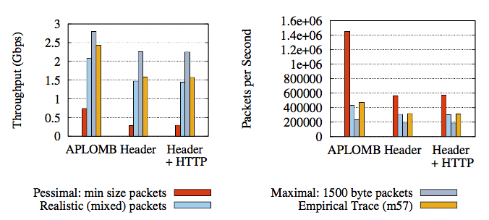
Evaluation: Gateway
How many servers does a typical enterprise require to outsource traffic to the cloud?
MBArk gateway achieves 1.5 Gbps per core for empirical traffic
With IDS support, the throughput dropped to 240Mbps per core.
Notes:
The first part of our evaluation is on the gateway. we want to know …
We compare MBArk with aplomb. Here we show the single core performance for APLOMB, MBArk with Header Only encryption, and MBArk with HTTP header encryption. We test against synthetic workload and empirical traces.
MBArk achieves …
We also evaluate MBArk with IDS support (acceptable because snort is slow as well)

Slide 37
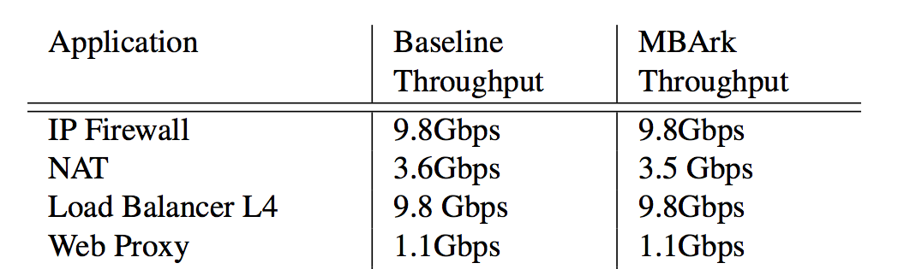
Evaluation: Middleboxes
Is throughput reduced at the middleboxes due to MBArk?
MBArk does not reduce middlebox throughput!
Notes:
Second, we evaluated the middleboxes in order to know…
The good thing about MBArk is that, these fastpath of middleboxes can remain unchanged. As we can see from the chart, the throughput of these middleboxes are unaffected.

Slide 38
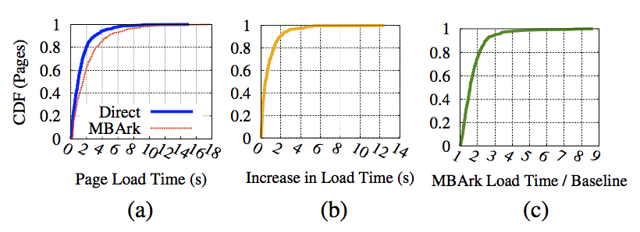
Evaluation: End-to-end
How does the redirection inflates page load time?
At the 90th percentile, page loads increase by 2 seconds.
Notes:
To echo the concern about the latency, we deploy middleboxes to EC2 and test how the redirection inflates the page load time. We test loading alexa top 1000 sites with direct connection and with MBArk redirection, and show the page load time distribution. The takeaway from the graphs is that, tt the 90th percentile, page loads increase by 2 seconds.
Since the inflation comes from the architecture rather than the encryption. we can reduce the latency by placing the service at the edge.
20ms

Slide 39
Summary
Data confidentiality is a challenge when enterprises outsource their middleboxes.
MBArk is the first system that enables running a wide range of middleboxes at a cloud provider while maintaining the confidentiality of traffic with competitive performance.

Slide 40
Thanks!

