Slide 1

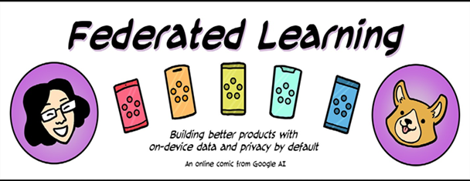

Advanced Federated Learning: From Academia to Industry
Federated Learning Comic
Yi LIU
Department of Computer Science, City University of Hong Kong
yiliu247@cityu.edu.hk
Sept. 2021

Slide 2
Outline
General Problem Setting
Challenges
Security and Privacy Issues
Expensive Communication Issues
Non-IID issues
Federated Learning Applications in Industry
Open problems and Future Directions

Slide 3
Advanced Federated Learning in Academia
[1] McMahan H B. Advances and Open Problems in Federated Learning[J]. Foundations and Trends® in Machine Learning, 2021, 14(1).

Slide 4
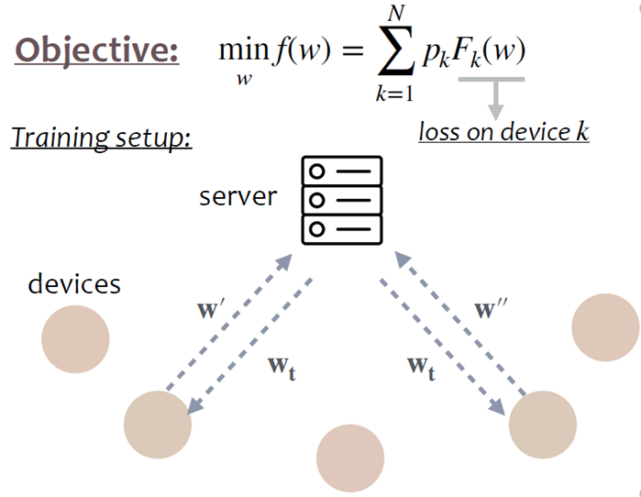
General Problem Setting
1
one central server and N clients
2
each client holds M data (for simplicity)
3
the clients can communicate with the central server but cannot connect with other clients
4
there is a global model on the server, and the clients communicates with the server to update the model
[1] McMahan H B. Advances and Open Problems in Federated Learning[J]. Foundations and Trends® in Machine Learning, 2021, 14(1).

Slide 5
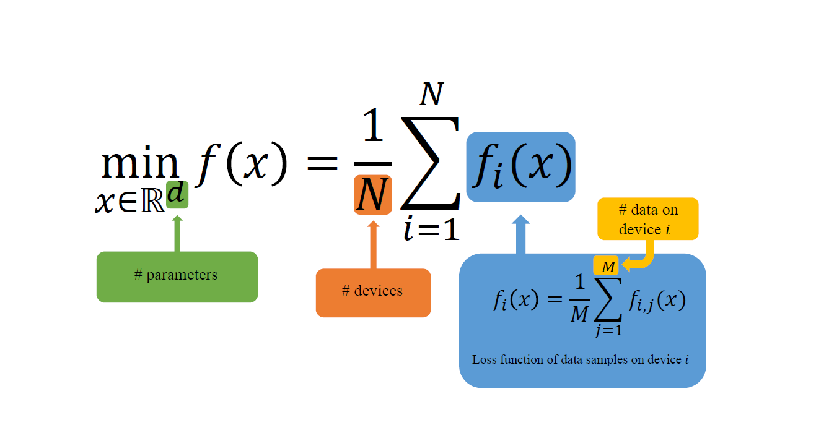
General Problem Setting

Slide 6
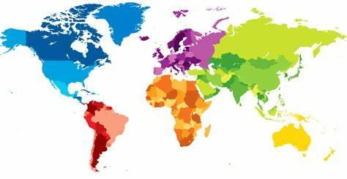
Challenges
Communication is expensive
Challenges
Data are
heterogeneous
Security and privacy issues

Slide 7


New Attack Surfaces
Lazy (passive) free rider
Skip local training
Low-quality updates
Poorly trained model
Central Server
Insecure
aggregation
Output
Model Performance Attacks
Injection of malicious updates
Backdoor models
Active data inference
Damaged model security
Fake updates
Malicious
updates
Normal
updates
…
Data Privacy Attacks
Free Rider
Attacker
Extract information
Memorize some contributions
Gradient leakage
Data privacy breach
Data
7
7
[2] Lyu L, Yu H, Zhao J, et al. Threats to Federated Learning[M]//Federated Learning. Springer, Cham, 2020: 3-16.

Slide 8
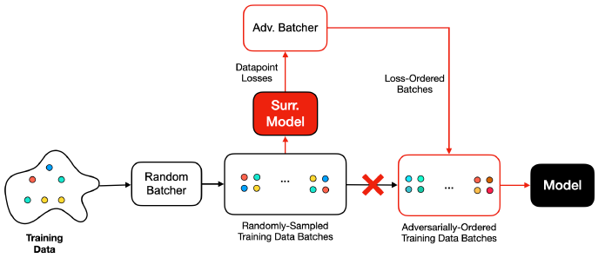
Data Ordering Attack Against to Federated Learning
Data ordering attack [3] aims to allow an attacker to affect the performance of the model by simply changing the order in which batches or data points are provided to the model during training.
Figure 1: The attacker reorders the benign randomly supplied data based on the surrogate model outputs. Attacker co-trains the surrogate model with the data that is supplied to the source model.
[3] Shumailov I, Shumaylov Z, Kazhdan D, et al. Manipulating SGD with data ordering attacks[J]. arXiv preprint arXiv:2104.09667, 2021.

Slide 9
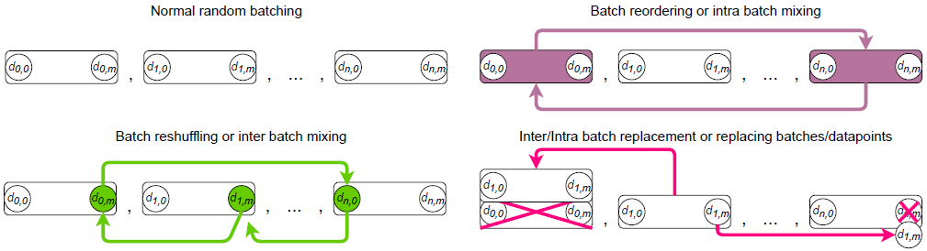
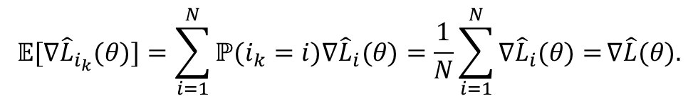
Data Ordering Attack Against to Federated Learning
Expectation mini-batch SGD:
$$𝔼[∇{\hat{L}}_{i_{k}}(θ)]=\sum_{i=1}^{N}{ℙ(i_{k}=i})∇{\hat{L}}_{i}(θ)=\frac{1}{N}\sum_{i=1}^{N}{∇{\hat{L}}_{i}(θ)=}∇\hat{L}(θ).$$
The explicit stochastic assumption opens a new attack surface for the attacker to influence the learning process. In particular, let us consider the effect of N SGD steps over one epoch [4]:
How to implement it in a distributed manner?
Figure 2: Taxonomy of Batch Reordering, Reshuffling, and Replacing Attacks.
[4] Smith S L, Dherin B, Barrett D G T, et al. On the origin of implicit regularization in stochastic gradient descent[J]. arXiv preprint arXiv:2101.12176, 2021.

Slide 10
State-of-the-art Methods for Expensive Communication Issues
Related Work
Compression Methods
Gradient Compression [6-8], Quantization [9][10], and Sketching [11]
Accelerate Convergence Methods
Variance Reduction Methods [12][13], Adaptive Methods [14]
-Second-order Methods
Newton-Type Methods [15]
[6] Sattler F, Wiedemann S, Müller K R, et al. Robust and communication-efficient federated learning from non-iid data[J]. IEEE transactions on neural networks and learning systems, 2019, 31(9): 3400-3413.
[7] Chen M, Shlezinger N, Poor H V, et al. Communication-efficient federated learning[J]. Proceedings of the National Academy of Sciences, 2021, 118(17).
[8] Xu J, Du W, Jin Y, et al. Ternary compression for communication-efficient federated learning[J]. IEEE Transactions on Neural Networks and Learning Systems, 2020.
[9] Reisizadeh A, Mokhtari A, Hassani H, et al. Fedpaq: A communication-efficient federated learning method with periodic averaging and quantization[C]//International Conference on Artificial Intelligence and Statistics. PMLR, 2020: 2021-2031.
[10] Sun J, Chen T, Giannakis G B, et al. Lazily aggregated quantized gradient innovation for communication-efficient federated learning[J]. IEEE Transactions on Pattern Analysis and Machine Intelligence, 2020
[11].Rothchild D, Panda A, Ullah E, et al. Fetchsgd: Communication-efficient federated learning with sketching[C]//International Conference on Machine Learning. PMLR, 2020: 8253-8265.
[12] Karimireddy S P, Kale S, Mohri M, et al. Scaffold: Stochastic controlled averaging for federated learning[C]//International Conference on Machine Learning. PMLR, 2020: 5132-5143.
[13] Johnson R, Zhang T. Accelerating stochastic gradient descent using predictive variance reduction[J]. Advances in neural information processing systems, 2013, 26: 315-323.
[14] Duchi J, Hazan E, Singer Y. Adaptive subgradient methods for online learning and stochastic optimization[J]. Journal of machine learning research, 2011, 12(7).
[15] Rustem Islamov, Xun Qian and Peter Richtárik Distributed second order methods with fast rates and compressed communication, ICML 2021.

Slide 11
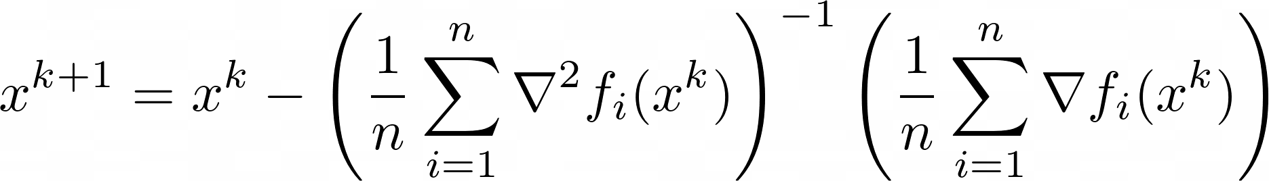





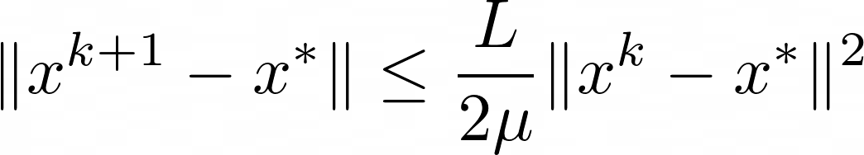

Making Newton-Type Methods Applicable to Federated Learning
Can be computed locally
Can be computed locally
Expensive to communicate:
Easy to communicate:
O(d) communication cost per round
Hessian Lipschitz constant
Implementability in practice
Local quadratic convergence rate
independent of the condition number
Local quadratic rate
Strong convexity constant

Slide 12
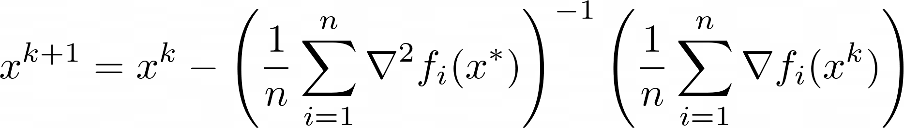

Making Newton-Type Methods Applicable to Federated Learning
Rustem Islamov, Xun Qian and Peter Richtárik
Distributed second order methods with fast rates and compressed communication,
ICML 2021.
Can NOT be computed locally
Can be computed locally
Single communication of
Easy to communicate:
O(d) communication cost per round
Hessian Lipschitz constant
Implementability in practice
Local quadratic convergence rate
independent of the condition number
Local quadratic rate
Strong convexity constant

Slide 13
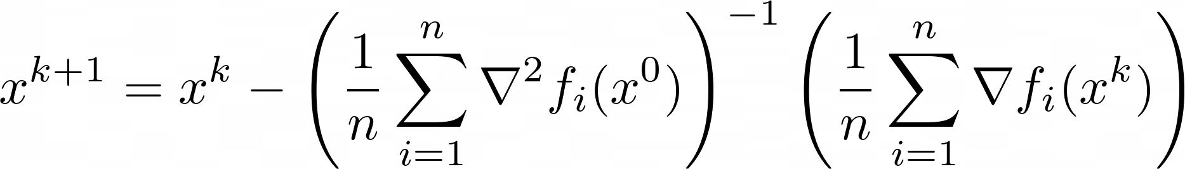

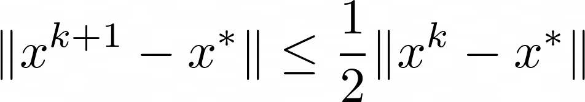

Making Newton-Type Methods Applicable to Federated Learning
Can be computed locally
Can be computed locally
Single communication of
Easy to communicate:
O(d) communication cost per round*
Implementability in practice
Local quadratic convergence rate
Strong convexity constant
Local (fixed) linear rate:
Hessian Lipschitz constant

Slide 14
State-of-the-art Methods for Non-IID Issues
Related Work
Aggregation Methods
FedBN [16], FedProx [17], and FedNova [18]
Optimization Methods
Reinforcement Learning [19] and Client Selection [20]
Data Valuation Methods
Shapley Value [21-24]
[16] Li X, JIANG M, Zhang X, et al. FedBN: Federated Learning on Non-IID Features via Local Batch Normalization[C]//International Conference on Learning Representations. 2020.
[17] Li T, Sahu A K, Zaheer M, et al. Federated optimization in heterogeneous networks[J]. arXiv preprint arXiv:1812.06127, 2018.
[18] Wang J, Liu Q, Liang H, et al. Tackling the objective inconsistency problem in heterogeneous federated optimization[J]. arXiv preprint arXiv:2007.07481, 2020.
[19] Wang H, Kaplan Z, Niu D, et al. Optimizing federated learning on non-iid data with reinforcement learning[C]//IEEE INFOCOM 2020-IEEE Conference on Computer Communications. IEEE, 2020: 1698-1707.
[20] Nishio T, Yonetani R. Client selection for federated learning with heterogeneous resources in mobile edge[C]//ICC 2019-2019 IEEE International Conference on Communications (ICC). IEEE, 2019: 1-7.
[21] Liu Z, Chen Y, Yu H, et al. GTG-Shapley: Efficient and Accurate Participant Contribution Evaluation in Federated Learning[J]. arXiv preprint arXiv:2109.02053, 2021.
[22] Efficient Participant Contribution Evaluation for Horizontal and Vertical Federated Learning, ICDE22
[23] Wang T, Rausch J, Zhang C, et al. A principled approach to data valuation for federated learning[M]//Federated Learning. Springer, Cham, 2020: 153-167.
[24] Xue Y, Niu C, Zheng Z, et al. Toward Understanding the Influence of Individual Clients in Federated Learning[J]. arXiv preprint arXiv:2012.10936, 2020. AAAI 22

Slide 15
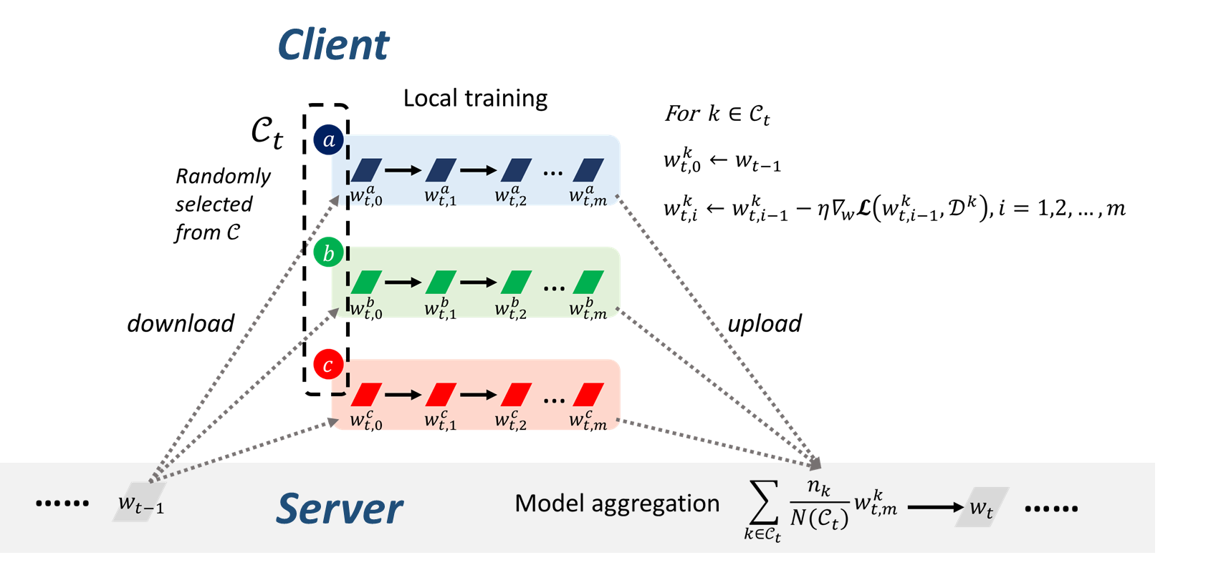

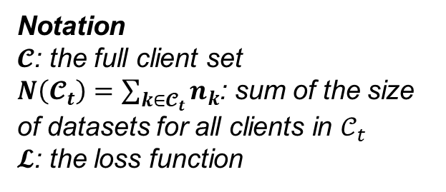
Data Valuation in Federated Learning
At the $t$-th communication round
Notation
$𝓒$: the full client set
$N\left(𝓒_{t}\right)=\sum_{k∈𝓒_{t}}{n_{k}}$: sum of the size of datasets for all clients in $𝒞_{t}$
$𝓛$: the loss function
1
2

Slide 16
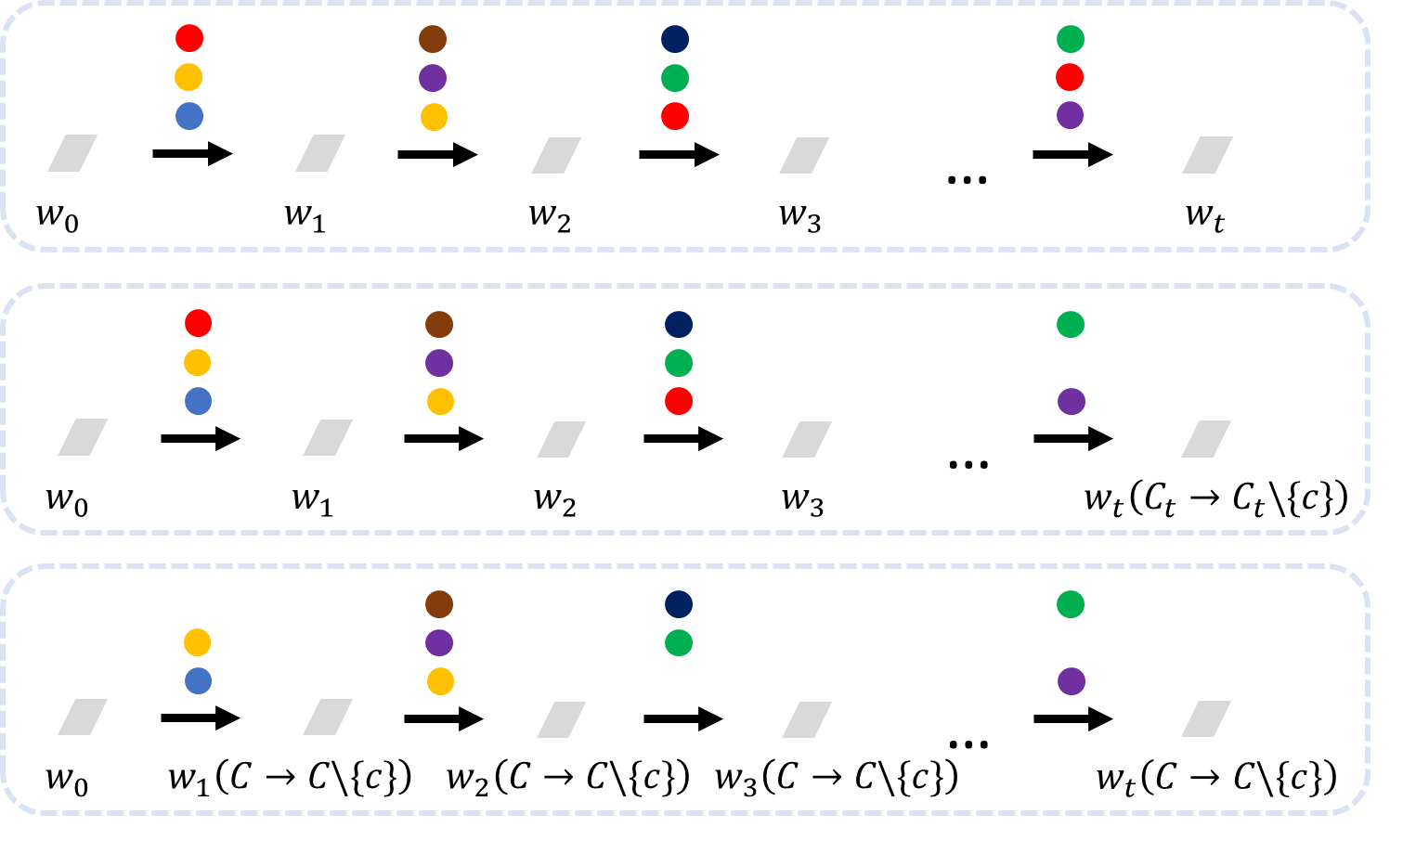

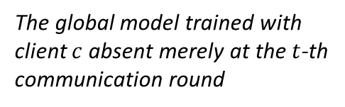

Data Valuation in Federated Learning
The original training process
The global model trained with client $c$absent merely at the $t$-th communication round
Leave-One-Out
If we did not have client $c$ …

Slide 17
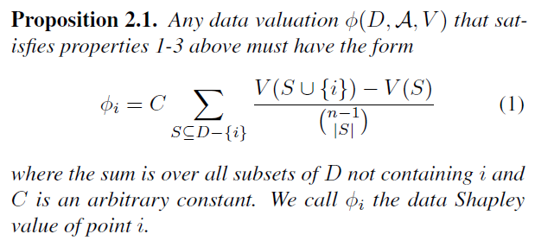
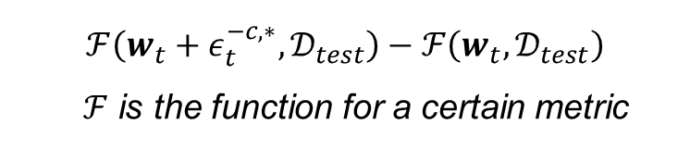

Data Valuation in Federated Learning
Definition: Data Shapley Value
On Performance
Fed-Influence on Parameter (FIP)
$$ε_{t}^{−c,∗}≝w_{t}(𝒞→𝒞\backslash \{c\})−w_{t}$$
On Parameter
FIL
Fed-Influence on model performance
e.g. Fed-Influence on Loss (FIL),
Fed-Influence on Accuracy (FIA), etc.
$$ℱ\left(w_{t}+ε_{t}^{−c,∗}, 𝒟_{test}\right)−ℱ\left(w_{t}, 𝒟_{test}\right)$$
$ℱ$ is the function for a certain metric
FIP
FIA
…
[25] Ghorbani A, Zou J. Data shapley: Equitable valuation of data for machine learning[C]//International Conference on Machine Learning. PMLR, 2019: 2242-2251.

Slide 18
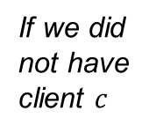




Data Valuation in Federated Learning
$$k$$
Original training process
$$w_{t−1}$$
$$k$$
If we did not have client $c$
$$w_{t−1}+ε_{t−1}^{−c,∗}$$

Slide 19

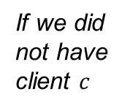

Data Valuation in Federated Learning
$$w_{t,0}^{k}$$
$$k$$
Original training process
download
$$w_{t−1}$$
$$w_{t,0}^{k}+ε_{t−1}^{−c,∗}$$
$$k$$
If we did not have client $c$
download
$$w_{t−1}+ε_{t−1}^{−c,∗}$$

Slide 20
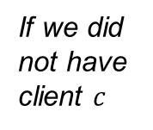
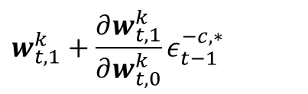

Data Valuation in Federated Learning
$$w_{t,1}^{k}$$
$$k$$
Original training process
download
$$w_{t−1}$$
$$w_{t,1}^{k}+\frac{∂w_{t,1}^{k}}{∂w_{t,0}^{k}}ε_{t−1}^{−c,∗}$$
First-order approximation
$$k$$
If we did not have client $c$
download
$$w_{t−1}+ε_{t−1}^{−c,∗}$$

Slide 21

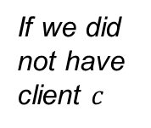
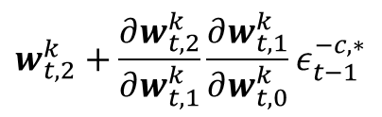
Data Valuation in Federated Learning
$$w_{t,2}^{k}$$
$$k$$
Original training process
download
$$w_{t−1}$$
$$w_{t,2}^{k}+\frac{∂w_{t,2}^{k}}{∂w_{t,1}^{k}}\frac{∂w_{t,1}^{k}}{∂w_{t,0}^{k}}ε_{t−1}^{−c,∗}$$
$$k$$
If we did not have client $c$
download
$$w_{t−1}+ε_{t−1}^{−c,∗}$$

Slide 22
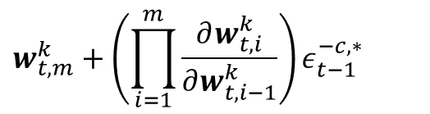
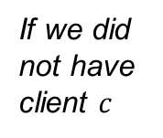

Data Valuation in Federated Learning
$$w_{t,m}^{k}$$
$$k$$
…
Original training process
download
upload
$$w_{t−1}$$
$$w_{t,m}^{k}+\left(\prod_{i=1}^{m}{\frac{∂w_{t,i}^{k}}{∂w_{t,i−1}^{k}}}\right)ε_{t−1}^{−c,∗}$$
$$k$$
…
If we did not have client $c$
download
upload
$$w_{t−1}+ε_{t−1}^{−c,∗}$$

Slide 23
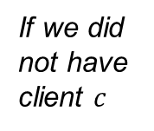
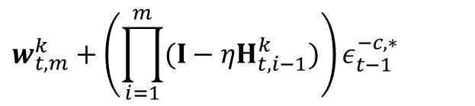
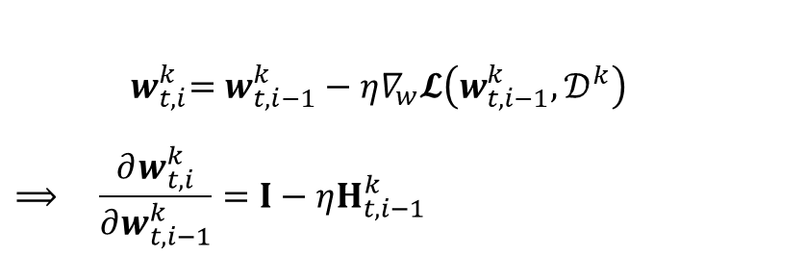
Data Valuation in Federated Learning
$$w_{t,m}^{k}$$
$$k$$
…
Original training process
download
upload
${ w}_{t,i}^{k}=w_{t,i−1}^{k}−η∇_{w}𝓛\left(w_{t,i−1}^{k},𝒟^{k}\right)$
$$⟹ \frac{∂w_{t,i}^{k}}{∂w_{t,i−1}^{k}}=I−ηH_{t,i−1}^{k}$$
$$w_{t−1}$$
$$w_{t,m}^{k}+\left(\prod_{i=1}^{m}{(I−ηH_{t,i−1}^{k})}\right)ε_{t−1}^{−c,∗}$$
$$k$$
…
If we did not have client $c$
download
upload
$$w_{t−1}+ε_{t−1}^{−c,∗}$$

Slide 24
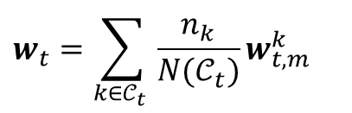




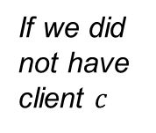
Data Valuation in Federated Learning
$$k$$
…
Original training process
download
upload
$$w_{t}=\sum_{k∈𝒞_{t} }{\frac{n_{k}}{N(𝒞_{t})}w_{t,m}^{k}}$$
$$w_{t−1}$$
$$k$$
…
If we did not have client $c$
download
upload
$$w_{t}\left(C→C\backslash \{c\}\right)≈\sum_{k∈𝒞_{t}\backslash \{c\}}{\frac{n_{k}}{N(𝒞_{t}\backslash \{c\})}w_{t,m}^{k}}+\sum_{k∈𝒞_{t}\backslash \{c\}}{\frac{n_{k}}{N(𝒞_{t}\backslash \{c\})}\left(\prod_{i=1}^{m}{(I−ηH_{t,i−1}^{k})}\right)ε_{t−1}^{−c,∗}}$$
$$w_{t−1}+ε_{t−1}^{−c,∗}$$

Slide 25


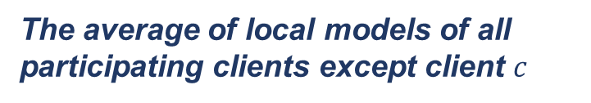
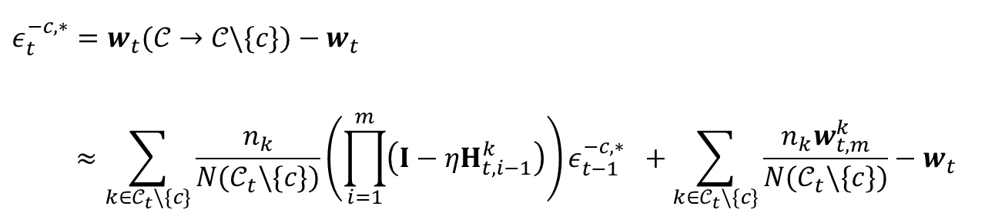
Data Valuation in Federated Learning
$$ε_{t}^{−c,∗}=w_{t}(𝒞→𝒞\backslash \{c\})−w_{t}$$
$$≈\sum_{k∈𝒞_{t}\backslash \{c\}}{\frac{n_{k}}{N(𝒞_{t}\backslash \{c\})}}\left(\prod_{i=1}^{m}{\left(I−ηH_{t,i−1}^{k}\right)}\right)ε_{t−1}^{−c,∗} +\sum_{k∈𝒞_{t}\backslash \{c\}}{\frac{n_{k}w_{t,m}^{k}}{N(𝒞_{t}\backslash \{c\})}−w_{t}}$$
$$M_{t}^{−c}$$
The average of local models of all participating clients except client $c$

Slide 26
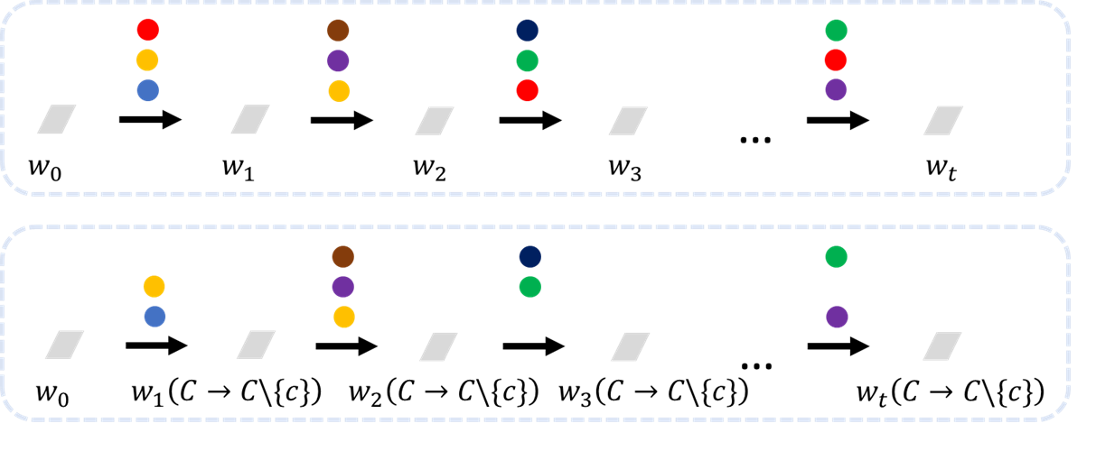

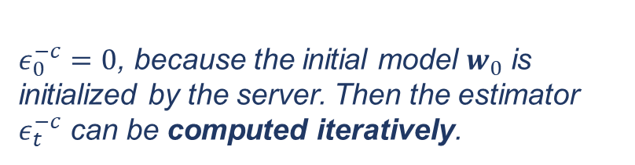
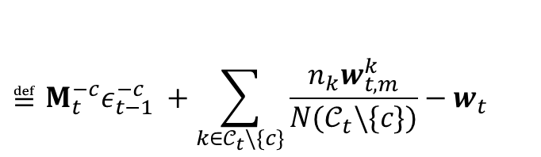
Data Valuation in Federated Learning
Now we have derived a basic estimator of $ε_{t}^{−c,∗}$, denoted by $ε_{t}^{−c}$
$$≝M_{t}^{−c}ε_{t−1}^{−c} +\sum_{k∈𝒞_{t}\backslash \{c\}}{\frac{n_{k}w_{t,m}^{k}}{N(𝒞_{t}\backslash \{c\})}−w_{t}}$$
$$ε_{t}^{−c}$$
$ε_{0}^{−c}=0$, because the initial model $w_{0}$ is initialized by the server. Then the estimator $ε_{t}^{−c}$ can be computed iteratively.

Slide 27
Advanced Federated Learning Applications in Industry
[27] Yang Q, Liu Y, Cheng Y, et al. Federated learning[J]. Synthesis Lectures on Artificial Intelligence and Machine Learning, 2019, 13(3): 1-207.

Slide 28
Federated Learning Framework
Brief Comparison with Open-source Federated Learning Frameworks
Open-source FL Framework | TensorFlow Federated | FATE | PaddleFL | PySyft
Audience Targeting | Research | Industry/Research | Research | Research
Institution | Google | WeBank | Baidu | OpenMined
FL Type | HFL | All | HFL / VFL | HFL
Federated Feature Engineering | None | Feature selection … | None | None
ML Algorithm | LR, DNN, etc | LR, GBDT, and DNN | LR, DNN, etc | LR, DNN, etc
Security Protocol | DP | HE, RSA, Secret Share | DP, HE | DP, HE
Online Inference | No | Yes | No | No
Kubernetes | No | Yes | No | No
GitHub | https://github.com/tensorflow/federated | https://github.com/FederatedAI/FATE | https://github.com/PaddlePaddle/PaddleFL | https://github.com/OpenMined/PySyft

Slide 29
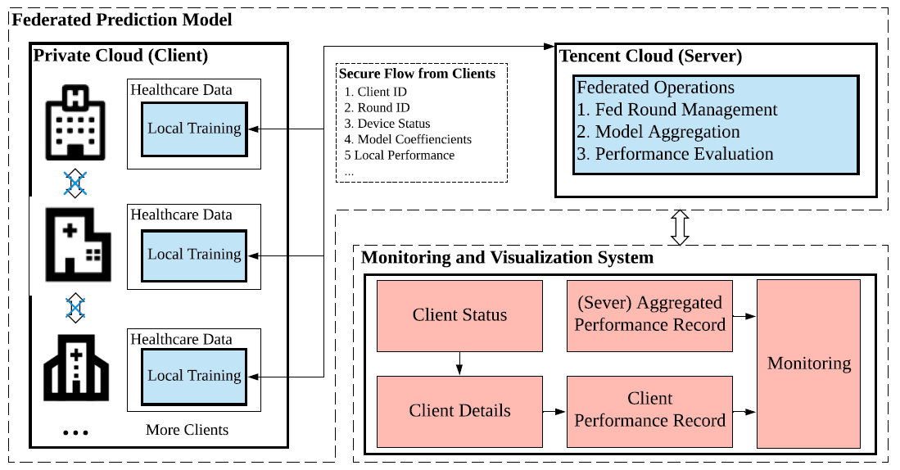
Tencent – Federated Learning for Medical AI
Federated learning utilized the feature of keeping data locally to break through the predicament of medical data privacy, and is an efficient integration solution for the last mile of medical AI.
[28] Ju C, Zhao R, Sun J, et al. Privacy-preserving technology to help millions of people: Federated prediction model for stroke prevention[J]. arXiv preprint arXiv:2006.10517, 2020.

Slide 30
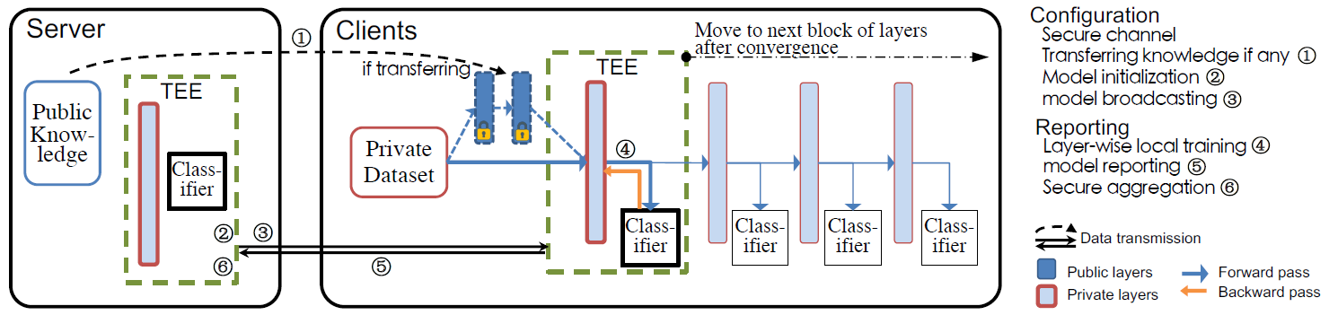
Tencent – Federated Learning with TEE
Leveraging the widespread presence of Trusted Execution Environments (TEEs) in high-end and mobile devices, this paper utilizes TEEs on clients for local training, and on servers for secure aggregation, so that model/gradient updates are hidden from adversaries.
Layer-wise Training and Aggregation
[29] Fan Mo, Hamed Haddadi, Kleomenis Katevas, Eduard Marin, Diego Perino, and Nicolas Kourtellis. 2021. PPFL: privacy-preserving federated learning with trusted execution environments. In Proceedings of the 19th Annual International Conference on Mobile Systems, Applications, and Services (MobiSys '21). Association for Computing Machinery, New York, NY, USA, 94–108. Best Paper Award!
https://cloud.tencent.com/developer/article/1511840
https://github.com/mofanv/PPFL

Slide 31

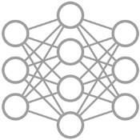
WeBank - Federated Recommendation System
AI Precision Marketing: Federated Recommendation Systems (FRS)
Content
FRS
User
Data party A:
User browsing history
Data party C:
Basic user information
Data party B:
Platform back-end data
Data party D:
Other platform information
AI Model
Private data cannot be exchanged
Federated Recommendation Systems (FRS) Framework
[30] Yang L, Tan B, Zheng V W, et al. Federated recommendation systems[M]//Federated Learning. Springer, Cham, 2020: 225-239.
[31] Liu S, Xu S, Yu W, et al. FedCT: Federated Collaborative Transfer for Recommendation[C]//Proceedings of the 44th International ACM SIGIR Conference on Research and Development in Information Retrieval. 2021: 716-725.
[32] Guo Y, Liu F, Cai Z, et al. PREFER: Point-of-interest REcommendation with efficiency and privacy-preservation via Federated Edge leaRning[J]. Proceedings of the ACM on Interactive, Mobile, Wearable and Ubiquitous Technologies, 2021, 5(1): 1-25.

Slide 32
Open problems and Future Directions
Security and Privacy
Federated Unlearning [33], Client Selection
Poisoning Attacks Against to FRS [34], Distributed Data Ordering Attack
Communication is Expensive
Adaptive Second-order Method, Newton-Type Methods
Fairness and Non-IID
Efficient Federated Shapley Value [35]
Learning Methods
Multimodal [36], Semi-Supervised, and Multi-task [37] Federated Learning
Applications
- FRS, Medical AI, Federated Learning + Natural Language Processing (FL+NLP), including Automatic Speech Recognition (ASR)
[33] Bourtoule L, Chandrasekaran V, Choquette-Choo C A, et al. Machine unlearning[C]//2021 IEEE Symposium on Security and Privacy (SP). IEEE, 2021: 141-159.
[34] Hai Huang, Jiaming Mu, Neil Zhenqiang Gong, Qi Li, Bin Liu, and Mingwei Xu. "Data Poisoning Attacks to Deep Learning Based Recommender Systems". In NDSS, 2021.
[35] Fan, Zhenan et al. “Improving Fairness for Data Valuation in Federated Learning.” (2021).
[36] Zhao, Yuchen et al. “Multimodal Federated Learning.” ArXiv abs/2109.04833 (2021): n. pag.
[37] Hu, Shengyuan, Zhiwei Steven Wu, and Virginia Smith. "Private Multi-Task Learning: Formulation and Applications to Federated Learning." arXiv preprint arXiv:2108.12978 (2021).

