Slide 1
SoK: Towards Scalable Blockchain

Slide 2
Schedule
Blockchain background
Scaling throughput
Internally: consensus and sharding
Externally: cross-chain and off-chain
Reduce storage cost
Light client
Stateless consensus

Slide 3
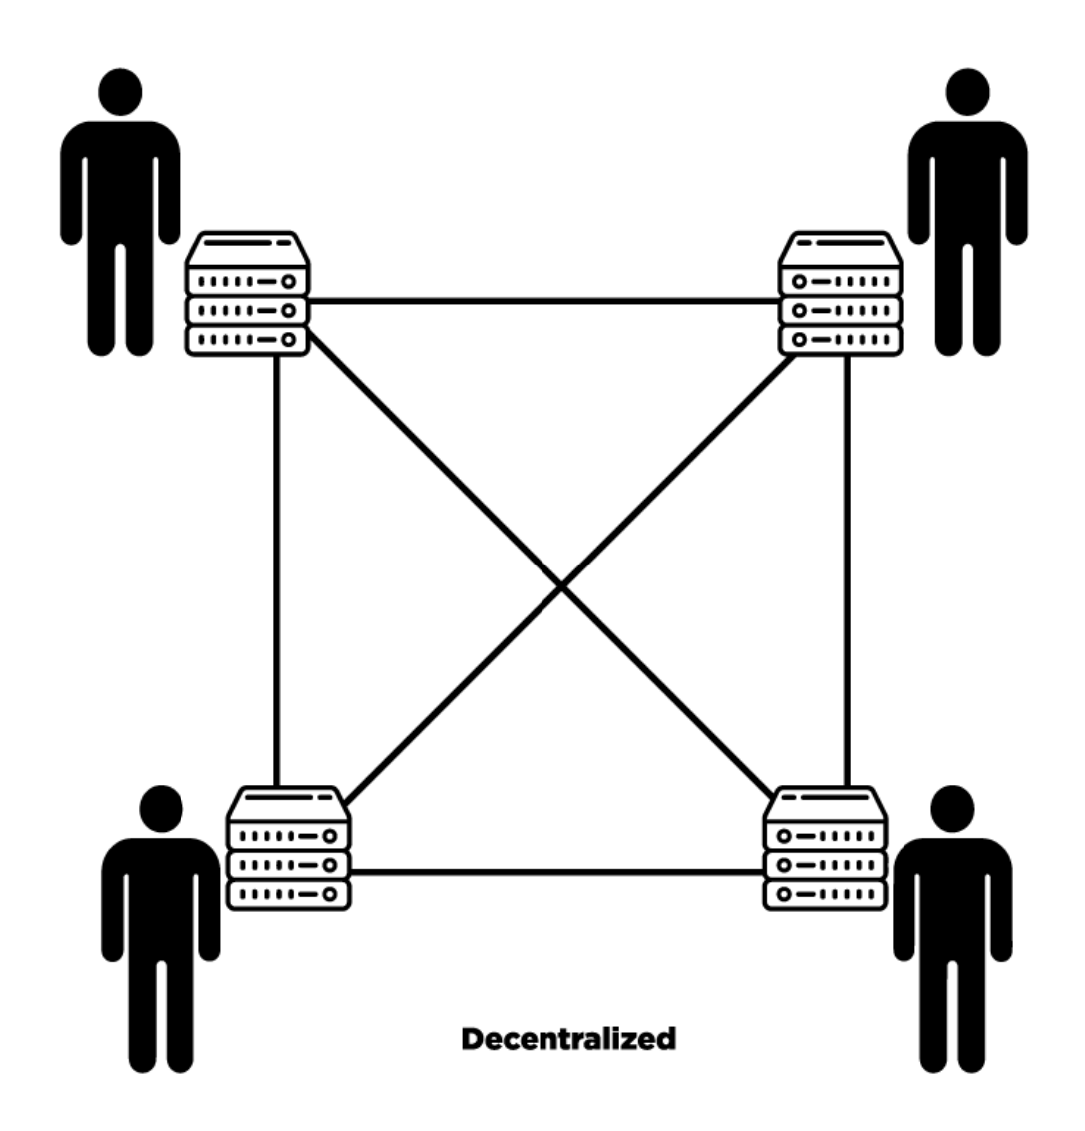
Blockchain system
A system of decentralized database
Consist of replicated database and decentralized consensus
Every node has the same database
Jointly decide the operations updating the database via consensus

Slide 4
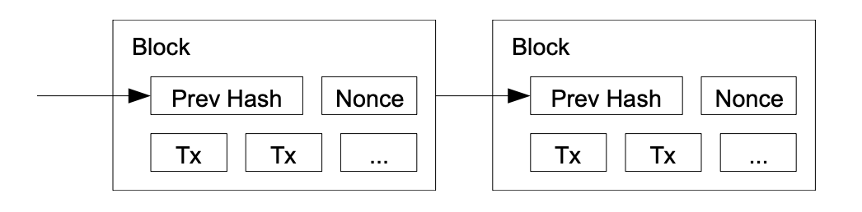
Bitcoin blockchain
Bitcoin database: record users’ balances
Transaction: an operation that updates the database
Block: pack many transactions for batch processing
Blockchain: a chain of blocks linked by hash values
Consensus: decide appending which block to blockchain

Slide 5
Bitcoin scalability issues
Low throughput: ~7 transactions per sec
High storage cost: ~355GB in Bitcoin as per Sept. 2021

Slide 6
Scaling throughput internally
Need to change blockchain protocol
Improve throughput by scaling up and scaling out
Consensus is to scale up: design better consensus
Sharding is to scale out: parallel consensus

Slide 7
Bitcoin consensus
Proof of work consensus
Deciding which node to add a new block by computing power, i.e., the first node finding a nonce with H(block, nonce) < difficulty
Majority assumption: at least 51% honest computing power
Fork and longest chain rule
A node can receive different versions of blockchain due to adversaries and network latency
Choose the blockchain with highest difficulty

Slide 8
What affects Bitcoin throughput
Block size: how many transactions in a block
Few thousands
Block time: interval of appending a new block
About 10 minutes
Higher throughput = larger block size or shorter block time?

Slide 9
Problem due to network latency
Take time for a node to receive a block
Time increases with larger block size and shorter block time
Honest nodes waste computing power on an old blockchain
But, blockchain needs at least 51% useful honest computing power
Larger block size or shorter block time = weaker security!

Slide 10
Scale up consensus: Prism
Larger block size means more transactions can be processed
But in Bitcoin, larger block size = weaker blockchain security
Can the number of transactions to process unrelated to the blockchain security?
Do not consensus on transactions, consensus on hash!
A hash value has a small size, but can refer to many transactions
[1]: Bagaria et al. Prism: Deconstructing the blockchain to approach physical limits. CCS’19

Slide 11
Consensus on hash
Functions of a Bitcoin block
Store transactions
Decide which transactions to add in blockchain
Scaling throughput by just storing hash
Use a new type of a block, transaction block, to store transactions
Bitcoin block now uses hash to refer to transaction blocks
Bitcoin block with a small size still can “contain” many transactions

Slide 12
How to generate transaction blocks
Need control the rate of generating transaction blocks
Otherwise, no enough network bandwidth to receive the blocks
Reuse PoW to generate the transaction block
e.g., If H(block, nonce) falls in some range => Output bitcoin block
If H(block, nonce) falls in another range => Output transaction block
Besides throughput, Prism also reduces Bitcoin confirmation latency
The idea is to further decouple the functions of a Bitcoin block
Refer to the paper for details

Slide 13
Discussion
Consensus on hash is also applicable to other BFT protocols
Issue 1: transaction blocks may contain duplicated transactions
Blockchain nodes may meanwhile receive the same transactions. Prism allocates transactions to q lists and randomly pick a list to generate a transaction block. However, q needs to be very large to be collision resistant. It may take a long time for a specific list to be picked.
Issue 2: transaction blocks pointed by hash may not exist
In Prism, honest nodes always broadcast transaction blocks. Consensus is done on hash only after receiving transaction blocks. However, broadcasting is costly. An alternative way is to use erasure code to ensure the data availability while reducing the transmission cost.

Slide 14
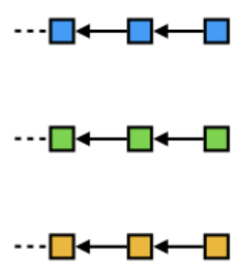
Scale out consensus: Omniledger
A simple idea is to use many sub-blockchains
Similar to use many servers for scaling out
But more sub-blockchains => weaker security
Computing power of honest nodes are dispersed
Easier for one to get > 51% computing power in one sub-blockchain
Idea of sharding:
A shard is a sub-blockchain
Randomly assign nodes to shards
[1]: Kokoris-Kogias et al. Omniledger: A secure, scale-out, decentralized ledger via sharding. SP’18

Slide 15
Challenge and discussion
Cross-shard transaction is costly
Need coordination among shards
Many transactions are cross-shards!
Future direction
Better protocols for cross-shard coordination
Reduce cross-shard transactions
[1]: Kokoris-Kogias et al. Omniledger: A secure, scale-out, decentralized ledger via sharding. SP’18

Slide 16
Scaling throughput externally
No or minor change on the blockchain protocol
Offload work to the components outside the blockchain
Cross-chain: use independent blockchains
Off-chain: use a single party or a quorum

Slide 17
Cross-chain
Offload a blockchain’s work to independent blockchains
Challenge: cross-chain communication
Impossible without a third party for coordination
Existing protocols for coordination are still costly
Future direction
Better protocols for coordination, e.g., leveraging different trust models on the third party.
A third party may only be used for one cross-chain application. May consider cross-application communication.

Slide 18
Off-chain
Offload a blockchain’s work to a third party
Existing landscape and challenge
Per-application third party (e.g., Ekiden, ACE, Commit-chain)
Asynchronous or cross-application communication: ACE
Data privacy: Ekiden
Off-chain data availability: Commit-chain
Future direction: Better protocols for
Cross-application communication
Off-chain data availability
[1]: Cheng et al. Ekiden: A platform for confidentiality-preserving, trustworthy, and performant smart contracts. EuroS&P’19
[2]: Wüst et al. ACE: Asynchronous and concurrent execution of complex smart contracts. CCS’20
[3]: Khalil et al. Commit-chains: Secure, scalable off-chain payments. Cryptology ePrint Archive, 2018

Slide 19
Reduce storage cost
Reduce the storage cost to join in or use the blockchain
Stateless consensus: reduce the cost of consensus nodes (or miners)
Light client: reduce the cost of clients (or users)

Slide 20
Stateless consensus
Storage cost for consensus
Blockchain’s states: data required for executing transactions
About few GBs in Bitcoin and Ethereum
Solution idea
Miners mainly store block headers and the commitments of states
To send a transaction, the client also send states to miners
Miners verify with the commitments and execute transactions

Slide 21
Existing work and discussion
Existing landscape
Design more efficient commitments [1]
Additional off-chain storage nodes [2, 3]
Future direction
Sharding the off-chain storage nodes.
The nodes may be used for generating transaction blocks as Prism
[1]: Tomescu et al. Aggregatable Subvector Commitments for Stateless Cryptocurrencies. SCN’20
[2]: Ponnapalli et al. RainBlock: Faster Transaction Processing in Public Blockchains. ATC’21
[3]: Xu et al. SlimChain: scaling blockchain transactions through off-chain storage and parallel processing. VLDB’21

Slide 22
Light client
A client may only wanna send a transaction
However, blockchain has a large size, e.g., 355 GBs in Bitcoin
Query existing miners is enough
Only store block headers to verify data
However, block header’s size is linear with blockchain’s length

Slide 23
Super light client: logarithmic block header
NiPPoW: accumulating block difficulties in super headers
Assume constant PoW difficulty. A super header may have the difficulty of 8/32/1024 blocks. Clients can share super headers
FlyClient: A client randomly sample block headers to verify
Not limited to constant difficulty. The sampled block headers cannot be re-used
Future direction
Since many PoS protocols are customized, may have new design spaces for logarithmic PoS lightclient
[1]: Kiayias et al. Non-interactive proofs of proof-of-work. In International Conference on Financial Cryptography and Data Security. FC’20
[2]: Bünz et al. Flyclient: Super-light clients for cryptocurrencies. SP’20

