Slide 1
Classification
python

Slide 2
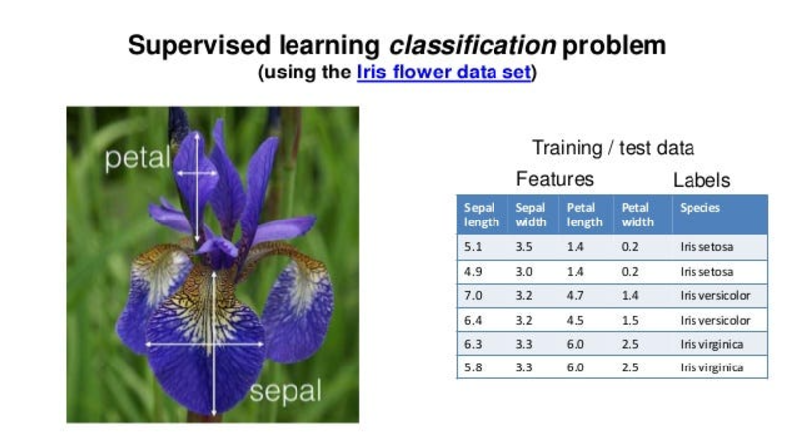
Iris data

Slide 3
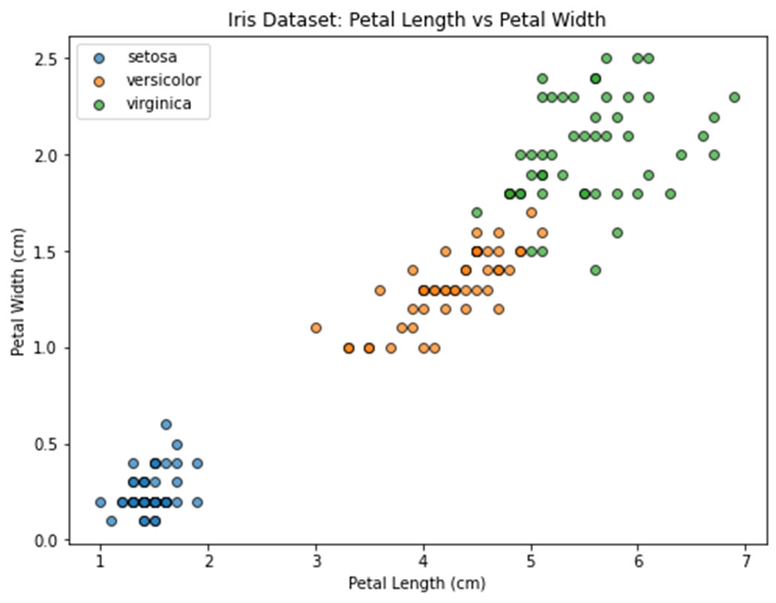

Slide 4
code
from sklearn.datasets import load_iris
from sklearn.tree import DecisionTreeClassifier, plot_tree
import matplotlib.pyplot as plt
import seaborn as sns
# Load the Iris dataset
data = load_iris()
X = data.data
y = data.target
feature_names = data.feature_names
target_names = data.target_names
# Scatter plot: petal length vs petal width
plt.figure(figsize=(8, 6))
for i, target_name in enumerate(target_names):
plt.scatter(
X[y == i, 2], X[y == i, 3],
label=target_name, alpha=0.7, edgecolors='k'
)
plt.title("Iris Dataset: Petal Length vs Petal Width")
plt.xlabel("Petal Length (cm)")
plt.ylabel("Petal Width (cm)")
plt.legend()
plt.show()

Slide 5
Classification algorithms
Simple Models:
Logistic Regression, Naive Bayes
Tree-Based Models:
Decision Tree, Random Forest
Distance-Based Models:
K-Nearest Neighbors (KNN)Support Vector Machine (SVM)
Deep Learning:
Convolutional Neural Networks (CNN)

Slide 6
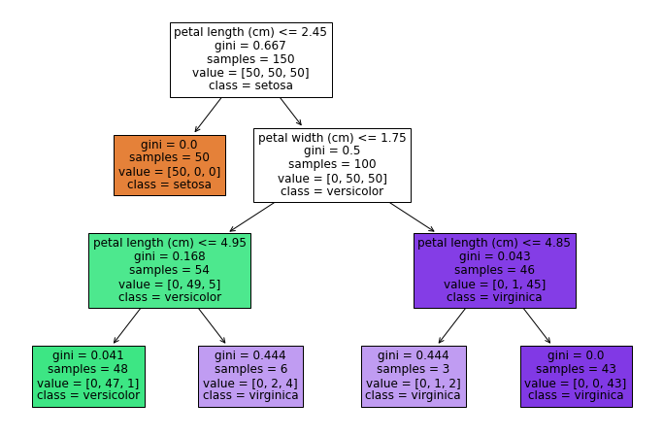
Decision Tree
A Decision Tree is a supervised machine learning algorithm used for classification and regression tasks. It works by recursively splitting the data into subsets based on the value of input features, forming a tree-like structure of decisions.

Slide 7
algorithm
Start at the Root Node:Consider the entire dataset as the root node.
Select the Best Feature for Splitting:Use a splitting criterion (e.g., Gini Index, Entropy, Information Gain) to determine which feature divides the data best.
Split the Data:Divide the dataset into child nodes based on the selected feature and its thresholds.
Repeat for Each Child Node:Treat each child node as a new dataset and recursively split further until a stopping condition is met (e.g., no more features, pure nodes, or max tree depth).
Assign Class Labels to Leaf Nodes:At the end of the process, assign a class label to each leaf node based on the majority class of the samples within that node.

Slide 8
code
# Load dataset
data = load_iris()
X, y = data.data, data.target
# Create and train the model
model = DecisionTreeClassifier(max_depth=3, random_state=42)
model.fit(X, y)
# Visualize the tree
plt.figure(figsize=(12, 8))
plot_tree(
model,
feature_names=data.feature_names,
class_names=data.target_names.tolist(), # Convert to list
filled=True
)
plt.show()

Slide 9
How to read the tree
Splitting Condition:Specifies the feature and threshold used to split the data at that node.
Gini:Gini Impurity measures the impurity (or disorder) of a node.
Samples:Number of samples (data points) that reached this node.
Values:The count of samples from each class in the node.
Class:The majority class in the node, which the model predicts for samples in this node.

Slide 10
Training and testing
import numpy as np
import pandas as pd
import matplotlib.pyplot as plt
import seaborn as sns
from sklearn.model_selection import train_test_split
from sklearn.metrics import accuracy_score, confusion_matrix, classification_report
from sklearn.datasets import load_iris
from sklearn.tree import DecisionTreeClassifier, plot_tree
#
data = load_iris()
X = pd.DataFrame(data.data, columns=data.feature_names)
y = pd.Series(data.target, name="target")
X_train, X_test, y_train, y_test = train_test_split(X, y, test_size=0.2, random_state=42)
#
tree_model = DecisionTreeClassifier()
tree_model.fit(X_train, y_train)

Slide 11
# Visualize the tree
plt.figure(figsize=(12, 8))
plot_tree(
tree_model,
feature_names=data.feature_names,
class_names=data.target_names.tolist(), # Convert to list
filled=True
)
plt.show()
# Predict on the test set
y_pred = tree_model.predict(X_test)
# 1. Accuracy score
accuracy = accuracy_score(y_test, y_pred)
print(f"Accuracy: {accuracy:.2f}")
# 2. Confusion matrix
cm = confusion_matrix(y_test, y_pred)
print("Confusion Matrix:")
print(cm)
# 3. Classification report (Precision, Recall, F1-score)
cr = classification_report(y_test, y_pred, target_names=data.target_names)
print("Classification Report:")
print(cr)

Slide 12
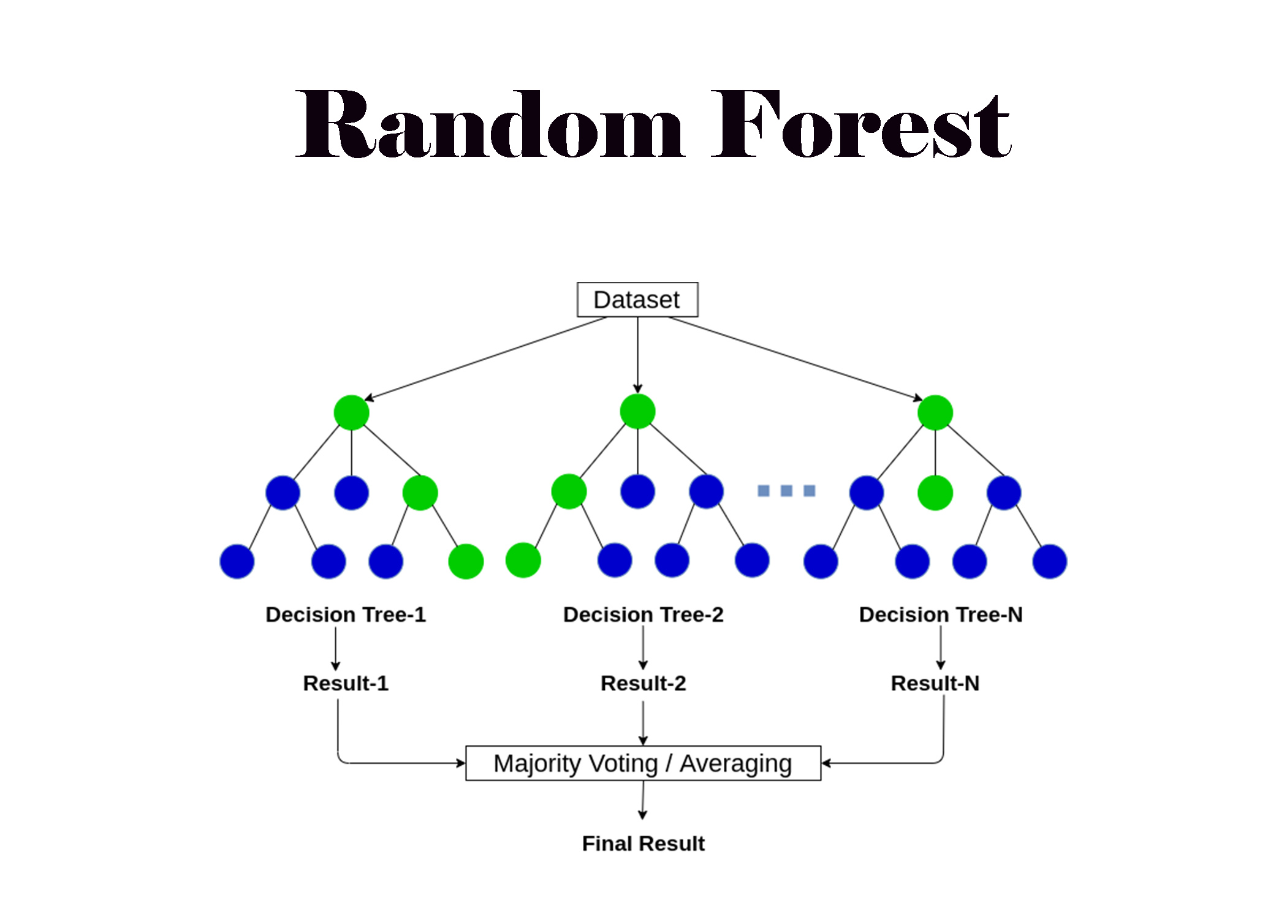
Random forest
Random Forest is a powerful and versatile machine learning algorithm that is widely used for both classification and regression tasks. It is based on the concept of ensemble learning, where multiple models (in this case, decision trees) are combined to improve the overall performance.

Slide 13
Algorithm
Bootstrapping:The algorithm creates multiple subsets of the original dataset by sampling with replacement. Each subset is used to train an individual decision tree.
Random Feature Selection:When splitting nodes in a tree, only a random subset of features is considered, ensuring diversity among the trees and reducing overfitting.
Training:Each decision tree is trained independently on a different subset of the data.
Prediction:For classification tasks: Each tree votes for a class, and the majority class is chosen.For regression tasks: The predictions of all trees are averaged.

Slide 14
Code
import numpy as np
import pandas as pd
import matplotlib.pyplot as plt
import seaborn as sns
from sklearn.model_selection import train_test_split
from sklearn.metrics import accuracy_score, confusion_matrix, classification_report
from sklearn.datasets import load_iris
from sklearn.ensemble import RandomForestClassifier
# Load the Iris dataset
data = load_iris()
X = pd.DataFrame(data.data, columns=data.feature_names)
y = pd.Series(data.target, name="target")
# Split the data into training and test sets
X_train, X_test, y_train, y_test = train_test_split(X, y, test_size=0.2, random_state=42)

Slide 15
# Initialize and train the Random Forest model
rf_model = RandomForestClassifier(n_estimators=100, random_state=42)
rf_model.fit(X_train, y_train)
# Make predictions on the test set
y_pred = rf_model.predict(X_test)
# Evaluate the model
print(f"Accuracy: {accuracy_score(y_test, y_pred):.2f}")
print("Confusion Matrix:")
print(confusion_matrix(y_test, y_pred))
print("Classification Report:")
print(classification_report(y_test, y_pred, target_names=data.target_names))

