Slide 1
Python Data Visualization
Kuo-chen Li

Slide 2
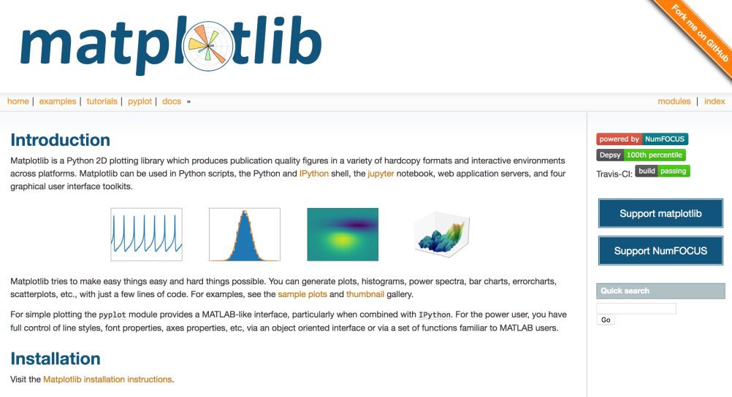
Data Visualization tools
Matplotlib
Seaborn
Plotly

Slide 3
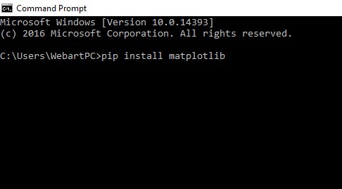
Steps of using modules
Install the corresponding package(modules)
Import the library
Use the module

Slide 4
How to checked installed packages
help("modules")

Slide 5
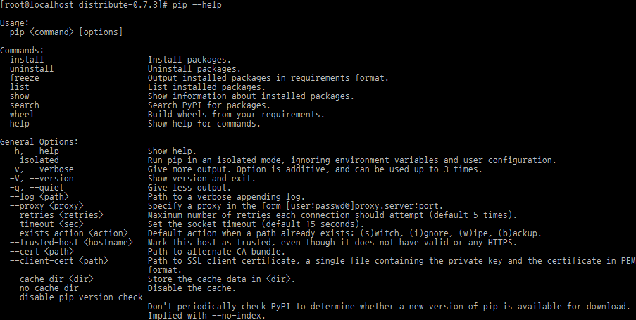
Install package-- pip
standard package-management system
Python(3.4 and above) comes with pip preinstalled
Install script:
pip Install some-package-name
Uninstall script:
pip uninstall some-package-name

Slide 6
To find what python interpreter my IDLE is running

Slide 7
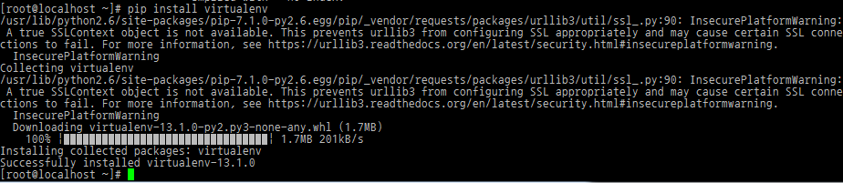
Install package
python -m pip install numpy
python -m pip install scipy
python -m pip install matplotlib

Slide 8
Import and use
import numpy as np
import matplotlib.pyplot as plt
fig = plt.figure()
ax1 = fig.add_subplot(111)
t = np.arange(0.01, 10.0, 0.01)
s1 = np.exp(t)
ax1.plot(t, s1, 'b-')
ax1.set_xlabel('time (s)')
# Make the y-axis label and tick labels match the line color.
ax1.set_ylabel('exp', color='b')
for tl in ax1.get_yticklabels():
tl.set_color('b')
ax2 = ax1.twinx()
s2 = np.sin(2*np.pi*t)
ax2.plot(t, s2, 'r.')
ax2.set_ylabel('sin', color='r')
for tl in ax2.get_yticklabels():
tl.set_color('r')
plt.show()

Slide 9
matplotlib
import matplotlib.pyplot as plt
plt.plot([1,2,3,4,5])
plt.show()

Slide 10
plot
plt.plot([1,2,3,4,5],[2,3,4,6,8])
plt.ylabel(“y axis”)
plt.xlabel(“x axis”)
plt.show()

Slide 11
plot
plt.plot([1,2,3,4,5],[2,3,4,6,8],”bo”)
plt.ylabel(“y axis”)
plt.xlabel(“x axis”)
plt.show()

Slide 12
references
Documentation

Slide 13
Plot
plt.plot([1,2,3,4,5],[2,3,4,6,8],"g^",[1,3,4,5,7],[3,4,5,6,7],"b-")
plt.ylabel("y axis")
plt.xlabel("x axis")
plt.show()

Slide 14
others
Smooth curve

Slide 15
Bar
x=['a','b','c','d']
y=[4,5,12,3]
plt.bar(x,y)
plt.show()

Slide 16
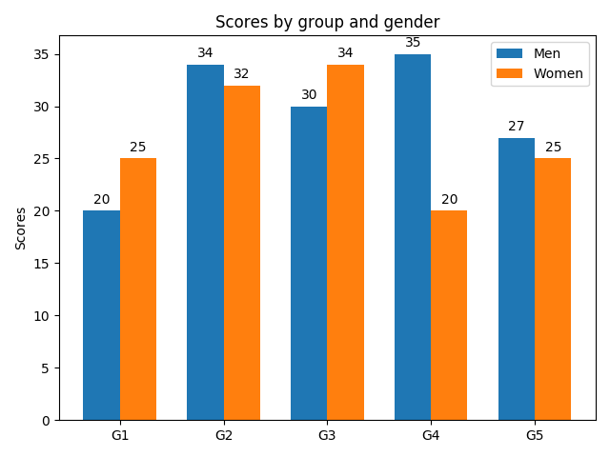
More about bar
import matplotlib
import matplotlib.pyplot as plt
import numpy as np
labels = ['G1', 'G2', 'G3', 'G4', 'G5']
men_means = [20, 34, 30, 35, 27]
women_means = [25, 32, 34, 20, 25]
x = np.arange(len(labels)) # the label locations
width = 0.35 # the width of the bars
fig, ax = plt.subplots()
rects1 = ax.bar(x - width/2, men_means, width, label='Men')
rects2 = ax.bar(x + width/2, women_means, width, label='Women')
# Add some text for labels, title and custom x-axis tick labels, etc.
ax.set_ylabel('Scores')
ax.set_title('Scores by group and gender')
ax.set_xticks(x)
ax.set_xticklabels(labels)
ax.legend()
def autolabel(rects):
"""Attach a text label above each bar in *rects*, displaying its height."""
for rect in rects:
height = rect.get_height()
ax.annotate('{}'.format(height),
xy=(rect.get_x() + rect.get_width() / 2, height),
xytext=(0, 3), # 3 points vertical offset
textcoords="offset points",
ha='center', va='bottom')
autolabel(rects1)
autolabel(rects2)
fig.tight_layout()
plt.show()

Slide 17
Scatter plot
x = [3, 5, 4, 3, 1]
y = [4, 8, 7, 3, 10]
plt.scatter(x,y)
plt.show()

Slide 18
More about scatter plot
import numpy as np
import matplotlib.pyplot as plt
# Fixing random state for reproducibility
np.random.seed(19680801)
N = 50
x = np.random.rand(N)
y = np.random.rand(N)
colors = np.random.rand(N)
area = np.pi * (15 * np.random.rand(N))**2 # 0 to 15 point radii
plt.scatter(x, y, s=area, c=colors, alpha=0.5)
plt.show()

