Slide 1
Apriori Algorithm
Kuo-chen Li

Slide 2
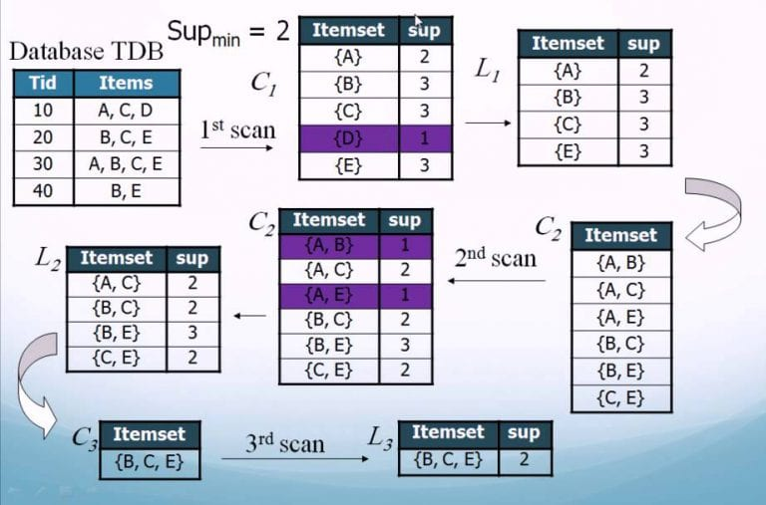

Slide 3
code
from apyori import apriori
data = [['r', 'z', 'h', 'j', 'p'],
['z', 'y', 'x', 'w', 'v', 'u', 't', 's'],
['z'],
['r', 'x', 'n', 'o', 's'],
['y', 'r', 'x', 'z', 'q', 't', 'p'],
['y', 'z', 'x', 'e', 'q', 's', 't', 'm']]
association_rules = apriori(data, min_support=0.16, min_confidence=0.2, min_lift=3, max_length=2)
association_results = list(association_rules)
print(association_results)
for item in association_results:
pair = item[0]
items = [x for x in pair]
print("Rule: " + items[0] + " -> " + items[1])
print("Support: " + str(item[1]))
print("Confidence: " + str(item[2][0][2]))
print("Lift: " + str(item[2][0][3]))
print("=====================================")

Slide 4
Support
Support is an indication of how frequently the itemset appears in the dataset.
Support(X) = number(X) / number(AllSamples)
Support(X,Y)=number(XY)/number(AllSamples)

Slide 5
Confidence
Confidence is the percentage of all transactions satisfying X that also satisfy Y.
Confidence(X→Y) = P(Y|X) ，= P(X∩Y) / P(X)

Slide 6
Lift
the ratio of the observed support to that expected if X and Y were independent.
Lift(X→Y) = Confidence(X→Y) / P(Y) = P(Y|X) / P(Y)

Slide 7
from apyori import apriori
# Sample dataset of transactions
data = [
['milk', 'bread', 'eggs'],
['milk', 'bread'],
['bread', 'butter'],
['milk', 'eggs'],
['bread', 'eggs', 'butter'],
['milk', 'bread', 'eggs', 'butter']
]
# Run Apriori algorithm with specific minimum thresholds
association_rules = apriori(data, min_support=0.3, min_confidence=0.6, min_lift=1.2, max_length=2)
association_results = list(association_rules)
# Print out each rule along with support, confidence, and lift
for item in association_results:
# Extracting pair of items involved in the rule
pair = item.items
items = [x for x in pair]
# If the rule has two items, display the rule details
if len(items) == 2:
print(f"Rule: {items[0]} -> {items[1]}")
print(f"Support: {item.support}")
print(f"Confidence: {item.ordered_statistics[0].confidence}")
print(f"Lift: {item.ordered_statistics[0].lift}")
print("=====================================")

Slide 8
Serious example

