Slide 1
django
python

Slide 2
Web server
Satisfy World Wide Web client requests
Store, process and deliver web pages to clients.
Support server-side scripting
Active Server Pages (ASP), PHP(Hypertext Preprocessor), or other scripting languages.

Slide 3

Django
Python-based free and open-sourceweb framework
the model-template-view (MTV) architectural pattern.
use python for settings files and data models

Slide 4
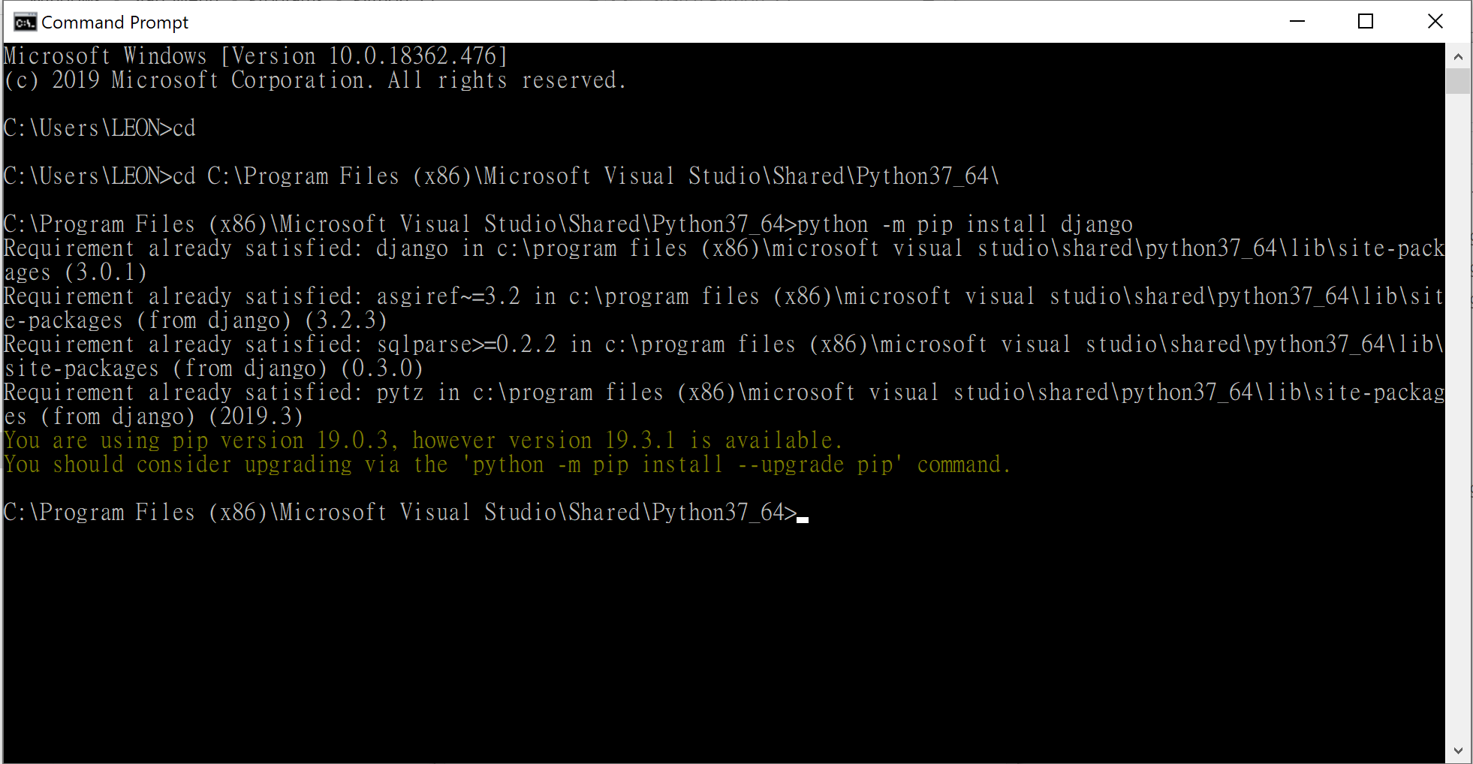
Install package
>pip install django

Slide 5
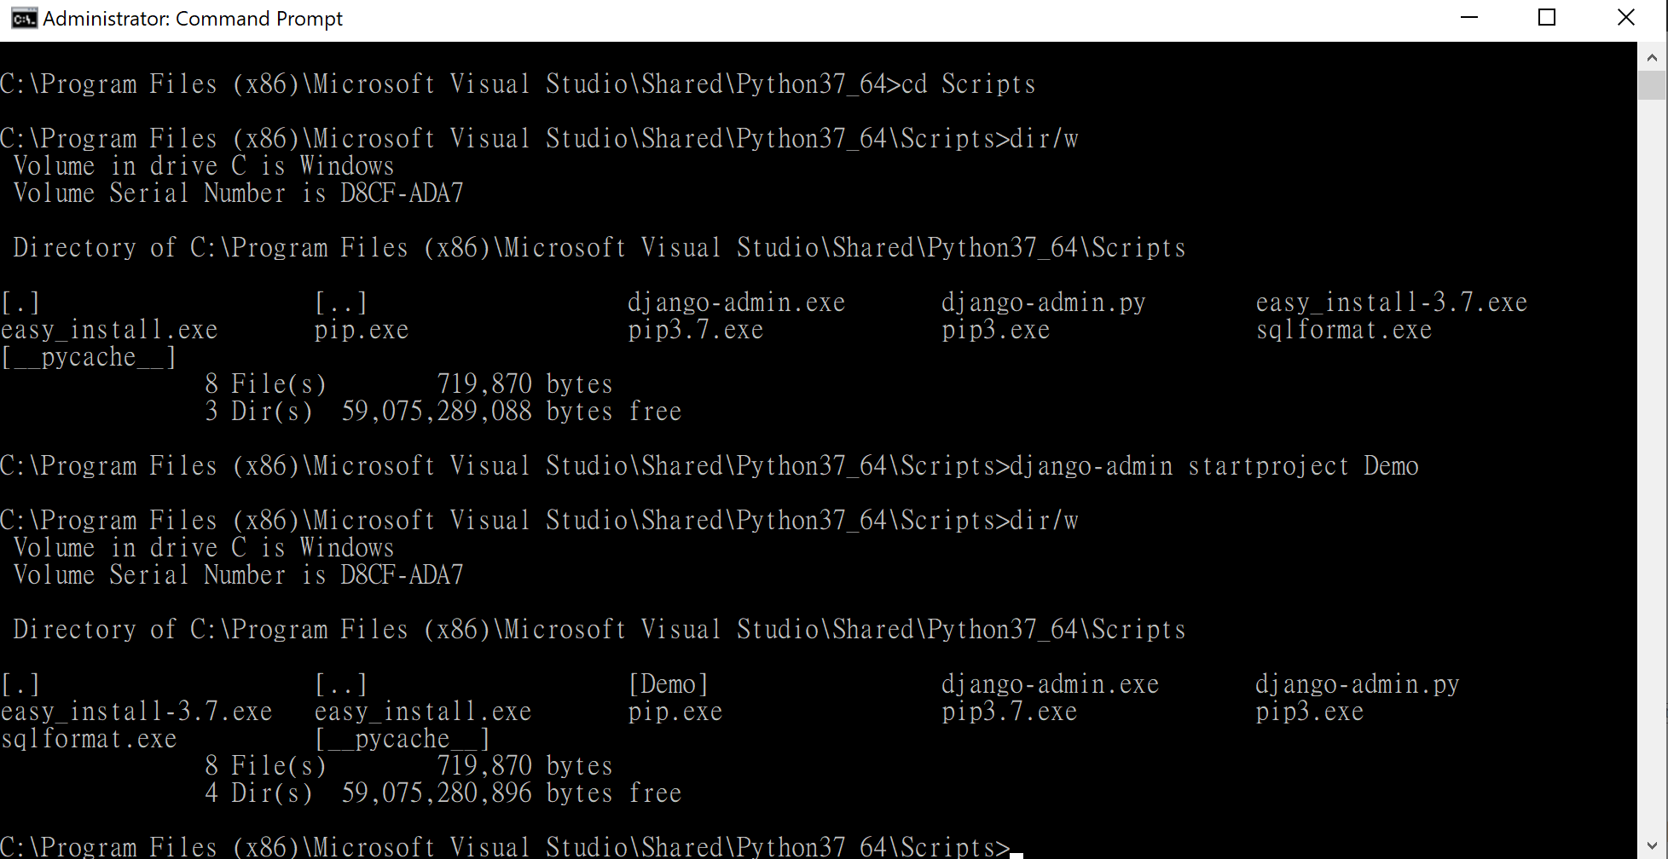
Create django project
>django-admin startproject Demo

Slide 6
Create django apps
>cd Demo
>django-admin startapp home

Slide 7
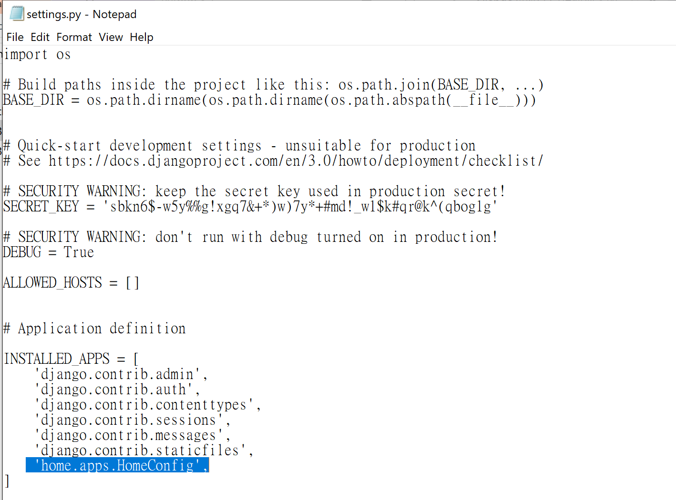
Add apps to the project
edit Demo/Demo/settings.py
add 'home.apps.HomeConfig',
to installed apps

Slide 8
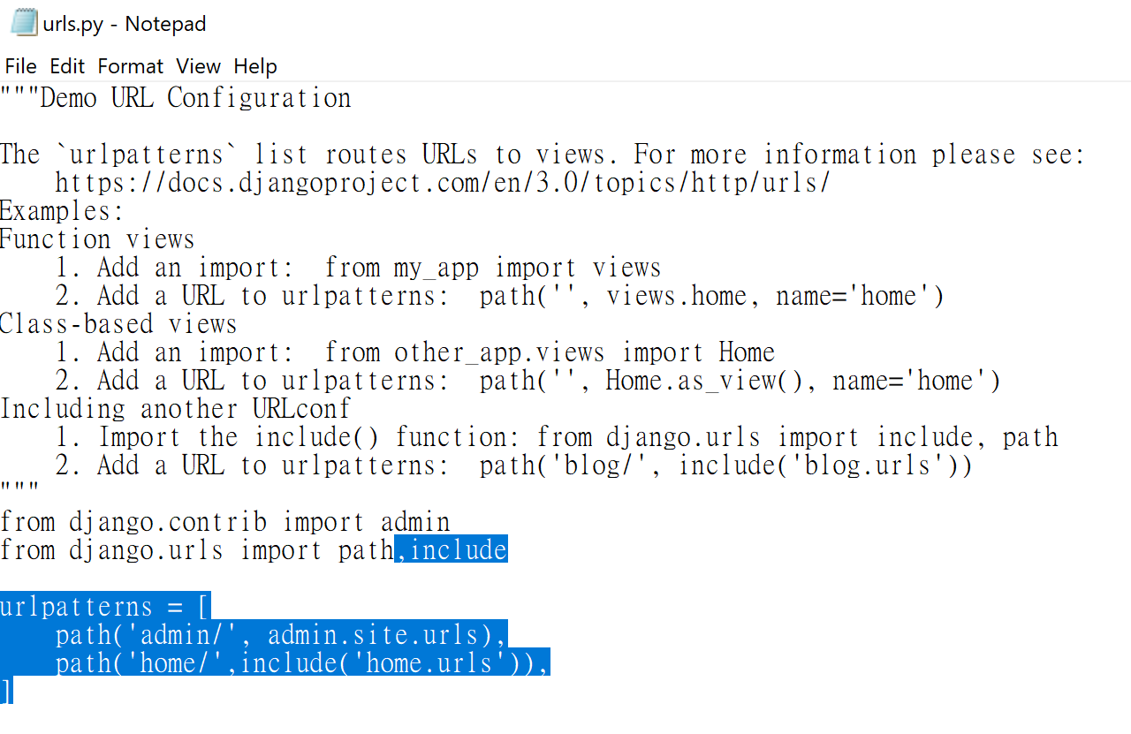
Add a new path to your site
edit Demo/urls.py
add package include
add path('home/',include('home.urls')), to urlpatterns

Slide 9
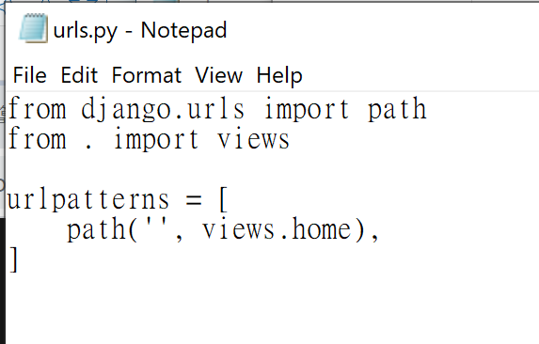
point to corresponding py function
create home/urls.py
add the below code:
from django.urls import path
from . import views
urlpatterns = [
path('', views.home),
]

Slide 10
Write the corresponding py function
edit home/views.py
# Create your views here.
from django.shortcuts import render,HttpResponse
def home(request):
return render(request, 'home/home.html')

Slide 11
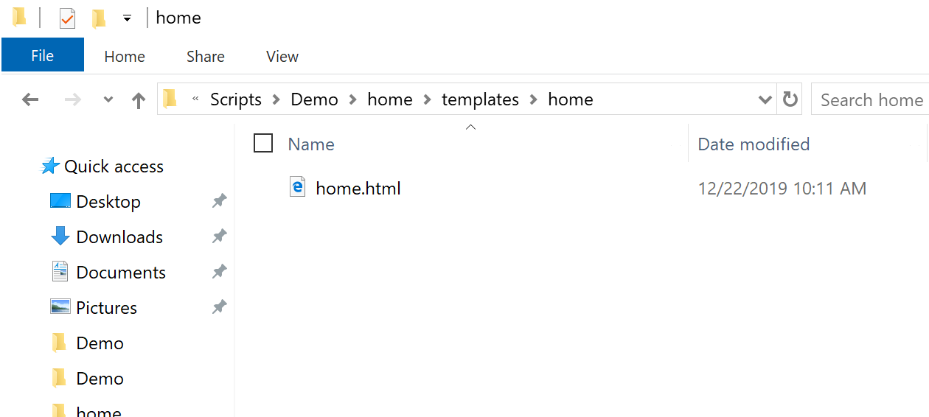
Add template web pages
under home dir
create templates/home/home.html
<!DOCTYPE html>
<html lang="en">
<head>
<meta charset="UTF-8">
<title>Title</title>
</head>
<body>
<div class='container'>
<h1>HOME</h1>
<h2>Hello World!</h2>
</div>
</body>
</html>

Slide 12
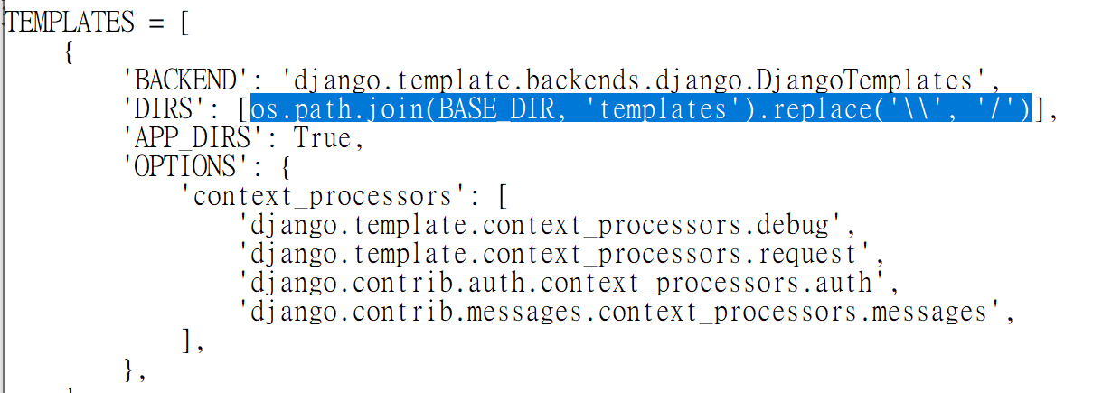
Assign templates path to django project
edit /Demo/settings.py
add
import os
os.path.join(BASE_DIR, 'templates').replace('\\', '/')

Slide 13
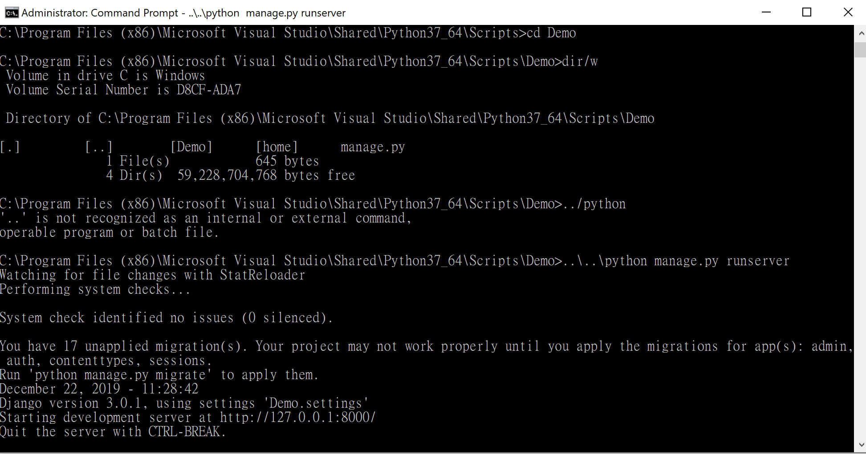
run server
>..\..\python manage.py runserver

Slide 14
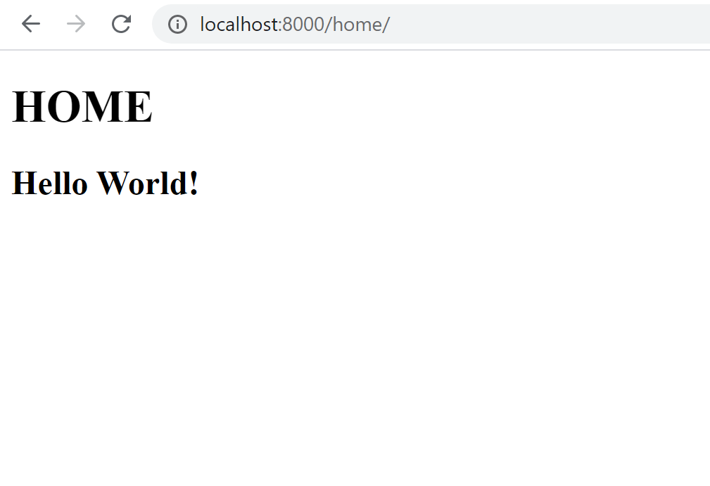
Check it out
http://localhost:8000/home/

Slide 15
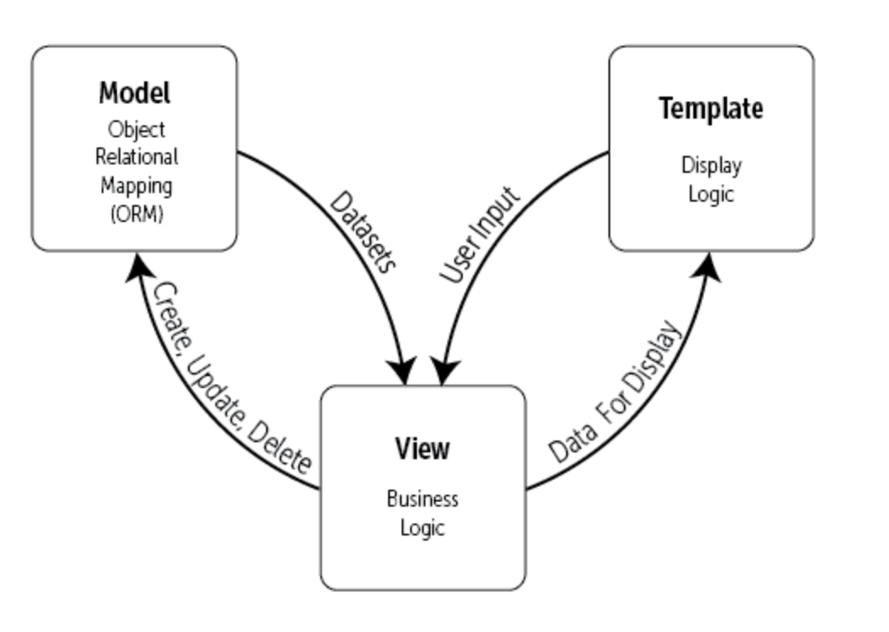
Reviews Django MTV model
Model:
Templates:
Views:

Slide 16
Go On add another python function
edit home/views.py
add another function
from bs4 import BeautifulSoup
import requests
def simple_crawl(request):
url = "https://www.cnn.com/"
res = requests.get(url)
soup = BeautifulSoup(res.text,"html.parser")
title = soup.select('title')
return render(request,'home/home.html',locals())

Slide 17
Edit home.html
edit templates/home/home.html
add
<h1>cnn web page title is {{title}}</h1>

Slide 18
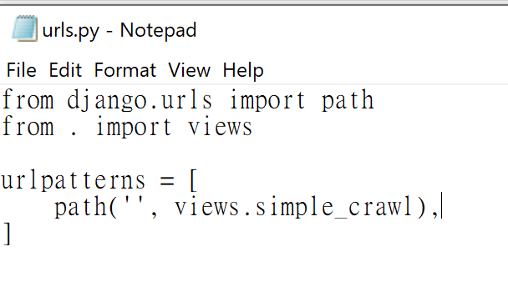
call simple_crawl when Home directory is accessed

Slide 19
Run server and check it out
>..\..\python manage.py runserver

Slide 20
Django template language
link

Slide 21
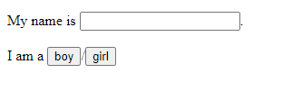
Getting info from web page
Add interface
<form action="/home/welcome/" method="GET" autocomplete="off">
My name is <input type="text" name="name" id='keyin'>.<br><br>
I am a <input type="submit" value="boy" class="button"
name="gender">/<input type="submit" value="girl" class="button" name="gender">
</form>

Slide 22
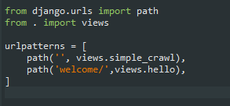
Link action to views function
/home/urls.py add
path('welcome/',views.hello),

Slide 23
Edit home/views.py
Add function hello
import datetime
def hello(request):
name=request.GET['name']
gender=request.GET['gender']
c={'g':gender}
c['who']=name
return render(request,'home/hello.html',c)

Slide 24
Add forward web page template
/templates/home/hello.html
<!doctype html>
<html>
<body class="back">
<div class="content">
<p>Gender: {{g}}</p>
<p class="response">Hello {{who}}</p>
</div>
</body>
</html>

Slide 25
test

