Slide 1
Introduction to Data Mining
Kuo-chen Li
Information Management Department, Chung-Yuan Christian University
kuochen@cycu.edu.tw

Slide 2
Data science
“Data is the new science. Big Data holds the answers.” – Pat Gelsinger, CEO, VMware
“Data really powers everything that we do.” – Jeff Weiner, CEO, LinkedIn
"Information is the oil of the 21st century, and analytics is the combustion engine” - Peter Sondergaard, Senior Vice President, Gartner
"Data are becoming the new raw material of business." - Craig Mundie , Senior Advisor to the CEO at Microsoft

Slide 3
What is “Big” data
No single standard definition…
“Big Data” is data whose scale, diversity, and complexity require new architecture, techniques, algorithms, and analytics to manage it and extract value and hidden knowledge from it…
Marko Grobelnik. (2012). Big-Data Tutorial

Slide 4
Problem solving approach
Before
give me faster computers, I can “come up” with the answer
Now
give me MORE data, I can “find” the answer

Slide 5
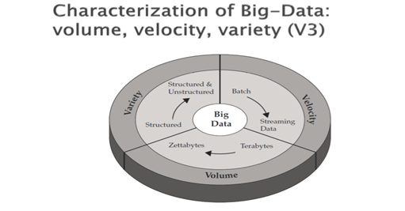
Big data characteristics
Volume
Velocity
Variety

Slide 6
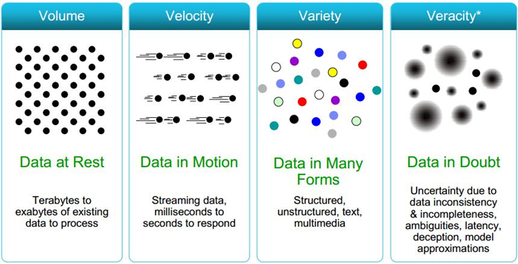
One more ---Veracity

Slide 7
Process of big data analysis
1. collection
2. storage
3. management
4. processing
5. visualization
6. privacy
7. business model

Slide 8
It’s about time to talk ..
Data Mining

Slide 9
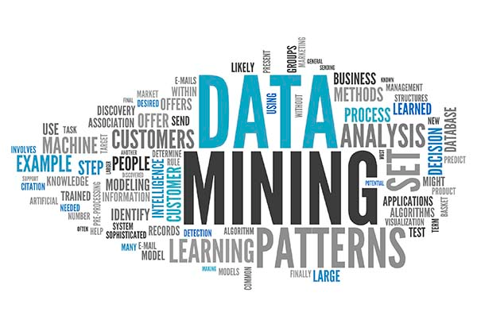
What is Data mining?

Slide 10
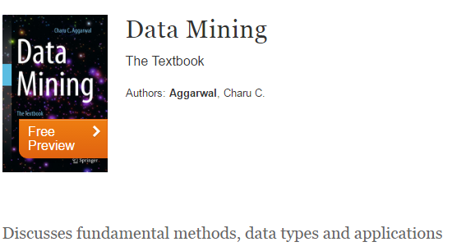
Understand Data Mining -- text book

Slide 11
Data mining techniques
Clustering
Classification/Regression
Association rules (Pattern discovery)
Text Mining
Social network analysis
Spatial analysis

Slide 12
Clustering
is the task of grouping a set of objects in such a way that objects in the same group (called a cluster) are more similar (in some sense or another) to each other than to those in other groups (clusters). wiki
K-means
hierarchical clustering
Expectation-Maximization (EM) clustering
DBSCAN
etc.

Slide 13
It’s our turn doing it

Slide 14
Get ready
Packages you need:
Matplotlib
Numpy
Scipy
Sklearn
pandas

Slide 15
Steps:
Load the data from csv file
Plot the points
Labels the points
Plot the points with label
Clustering to groups
Plot the result
Test with the new data

Slide 16
Step 1 Load the data from csv file
import pandas as pd
data=pd.read_csv("data.csv")
print(data)
X,Y
2,2
3,3
3,4
1,2
10,5
7,6
9,5
8,7

Slide 17
Step 2 Plot the points
import matplotlib.pyplot as plt
plt.scatter(data.X,data.Y,c=“red”)
plt.show()

Slide 18
Step 3 Label the points
groups=[0,0,0,0,1,1,1,1]

Slide 19
Step 4 Plot the points with label
import matplotlib.pyplot as plt
import pandas as pd
import numpy as np
colors=np.array(["red","blue"])
groups=[0,0,0,0,1,1,1,1]
plt.scatter(data.X,data.Y,c=colors[groups])
plt.show()

Slide 20
Step 5 Clustering to groups
from sklearn.cluster import KMeans
model = KMeans(n_clusters=2).fit(data)

Slide 21
Step 6 Plot the result
import matplotlib.pyplot as plt
import pandas as pd
import numpy as np
from sklearn.cluster import KMeans
plt.scatter(data.X,data.Y,c=colors[model.labels_])
plt.show()

Slide 22
Step 7 test the results
from sklearn.cluster import KMeans
test=[[3,4],[5,7]]
print(model.predict(test))

Slide 23
Serious example
import matplotlib.pyplot as plt
from sklearn import datasets
from sklearn.cluster import KMeans
import sklearn.metrics as sm
import pandas as pd
import numpy as np
# Only needed if you want to display your plots inline if using Notebook
# change inline to auto if you have Spyder installed
iris = datasets.load_iris()
print(type(iris.data))
print(iris.feature_names)
print(type(iris.target))
print(iris.target_names)
# Store the inputs as a Pandas Dataframe and set the column names
x = pd.DataFrame(iris.data)
x.columns = ['Sepal_Length','Sepal_Width','Petal_Length','Petal_Width']
y = pd.DataFrame(iris.target)
y.columns = ['Targets']
# Set the size of the plot
plt.figure(figsize=(14,7))
# Create a colormap
colormap = np.array(['red', 'lime', 'black'])
print(type(y.Targets))
# Plot Sepal
plt.subplot(1, 2, 1)
plt.scatter(x.Sepal_Length, x.Sepal_Width, c=colormap[y.Targets], s=40)
plt.title('Sepal')
plt.subplot(1, 2, 2)
plt.scatter(x.Petal_Length, x.Petal_Width, c=colormap[y.Targets], s=40)
plt.title('Petal')
plt.show()
model = KMeans(n_clusters=3)
model.fit(x)
model.labels_
# View the results
# Set the size of the plot
plt.figure(figsize=(14,7))
# Create a colormap
colormap = np.array(['red', 'lime', 'black'])
# Plot the Original Classifications
plt.subplot(1, 2, 1)
plt.scatter(x.Petal_Length, x.Petal_Width, c=colormap[y.Targets], s=40)
plt.title('Real Classification')
# Plot the Models Classifications
plt.subplot(1, 2, 2)
plt.scatter(x.Petal_Length, x.Petal_Width, c=colormap[model.labels_], s=40)
plt.title('K Mean Classification')
plt.show()

Slide 24
Other mining techniques

Slide 25
Classification
Classification is a general process related to categorization, the process in which ideas and objects are recognized, differentiated, and understood.

Slide 26
Example problem
(Adapted from Leslie Kaelbling's example in the MIT courseware)
•Imagine that I'm trying predict whether my neighbor is going to drive into work, so I can ask for a ride.
•Whether she drives into work seems to depend on the following attributes of the day:
–temperature,
–expected precipitation,
–day of the week,
–what she's wearing.

Slide 27
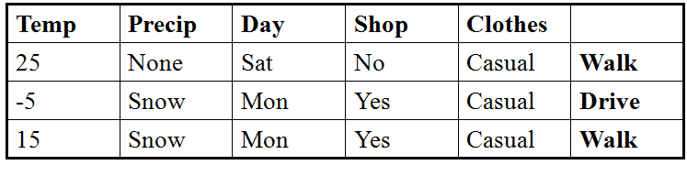
Memory
•Okay. Let's say we observe our neighbor on three days:

Slide 28
Classification
Temp | Precip | Day | Clothes
25 | None | Sat | Casual | Walk
-5 | Snow | Mon | Casual | Drive
15 | Snow | Mon | Casual | Walk
-5 | Snow | Mon | Casual | ???

Slide 29
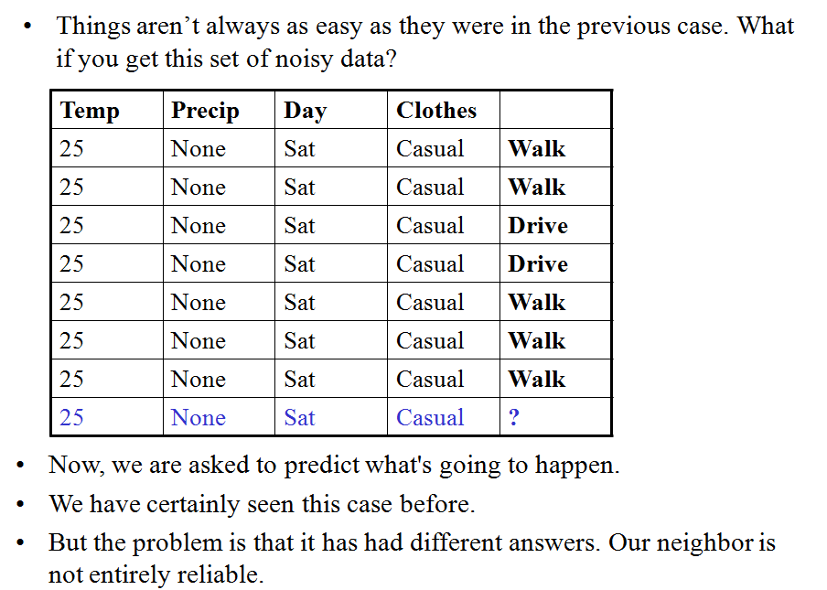
What real life is….

Slide 30
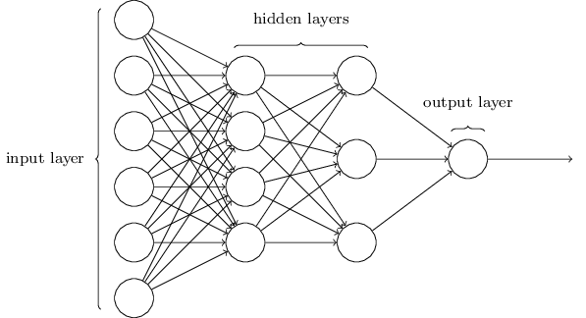
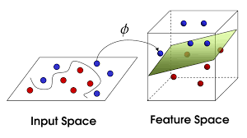
Classification techniques
Neural network
decision tree
Support Vector Machines
Etc.

Slide 31
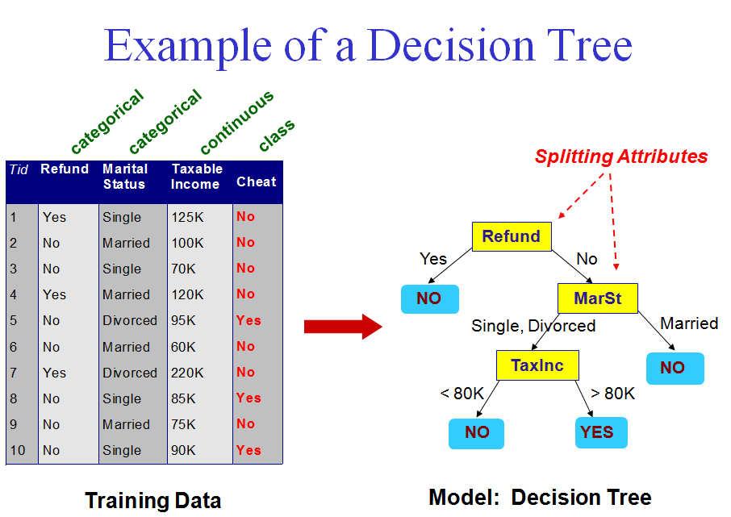

Slide 32
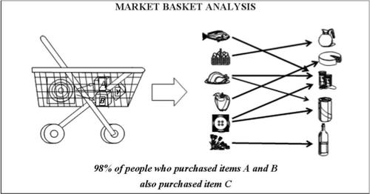
Assoication rules
Association rule learning is a method for discovering interesting relations between variables in large databases. It is intended to identify strong rules discovered in databases using some measures of interestingness

Slide 33
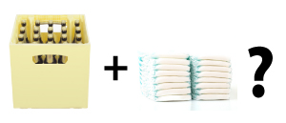
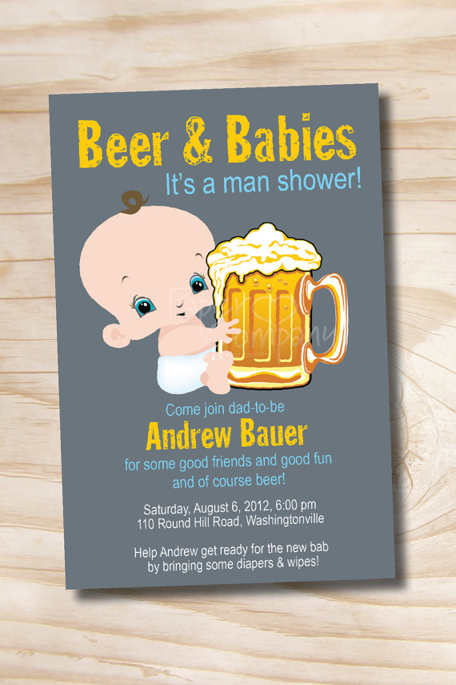
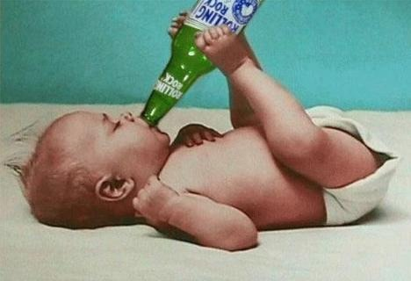
The famous “Beer & Diaper” example
There is a story that a large supermarket chain, usually Wal-Mart, did an analysis of customers' buying habits and found a statistically significant correlation between purchases of beer and purchases of nappies (diapers in the US). It was theorized that the reason for this was that fathers were stopping off at Wal-Mart to buy nappies for their babies, and since they could no longer go down to the pub as often, would buy beer as well. As a result of this finding, the supermarket chain is alleged to have the nappies next to the beer, resulting in increased sales of both.

Slide 34
Try it by ourselves

Slide 35
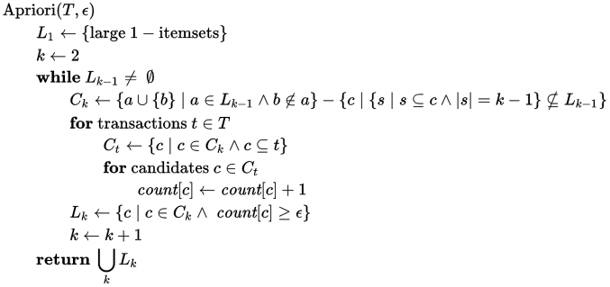
Apriori algorithm
Apriori^{[1]} is an algorithm for frequent item set mining and association rule learning over transactional databases. It proceeds by identifying the frequent individual items in the database and extending them to larger and larger item sets as long as those item sets appear sufficiently often in the database.
too hard to understand

Slide 36
Interpret the results
Support: Support is an indication of how frequently the item-set appears in the database.
Confidence: Confidence is an indication of how often the rule has been found to be true.
Lift: Lift is a measure of the performance of a targeting model (association rule) at predicting or classifying cases as having an enhanced response (with respect to the population as a whole), measured against a random choice targeting model.

Slide 37
Text Mining

Slide 38
Text Mining
“The objective of Text Mining is to exploit information contained in textual documents in various ways, including …discovery of patterns and trends in data, associations among entities, predictive rules, etc.” (Grobelnik et al., 2001)

Slide 39
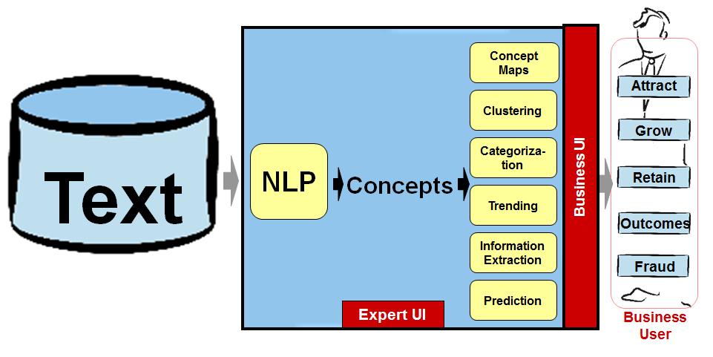
How to do it?

