Slide 1

CREDIT CARD CLIENT CHURNING PREDICTION USING MACHINE LEARNING
Cong Lyu

Slide 2

BACKGROUND
• Customer retention is crucial to a company’s profitability and growth.
• This project will leverage machine learning techniques to predict credit card customer attrition, providing banks insights for proactive retention strategies

Slide 3
OBJECTIVES
• Identify key factors influencing customer attrition.
• Develop predictive models to identify customers at a higher risk of attrition.
• Evaluate model performance and utilize model parameters to gain insight into how to prevent customer churn

Slide 4
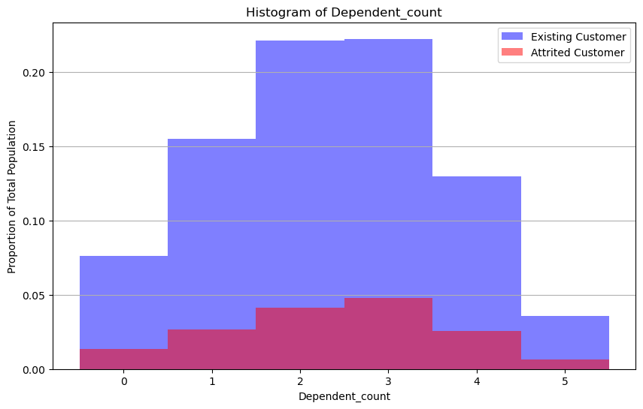
Distribution of number of dependent count

Slide 5
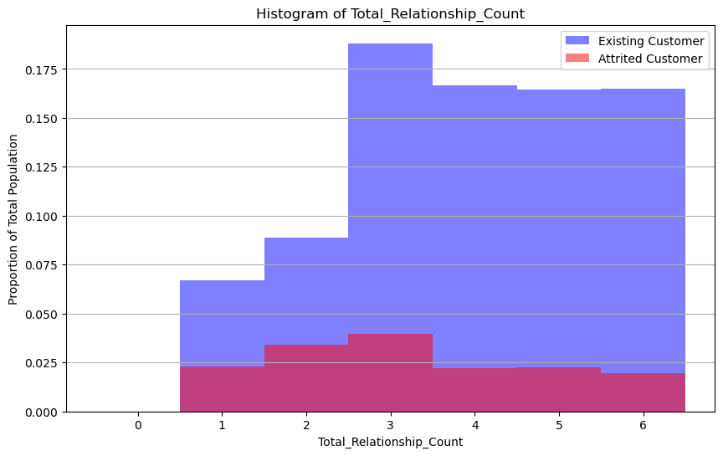
Distribution of number of product held by customer

Slide 6
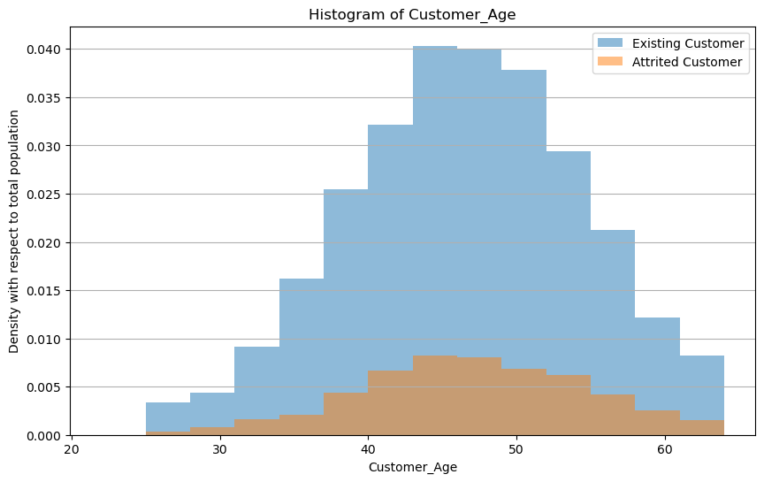
Distribution of age of customer

Slide 7
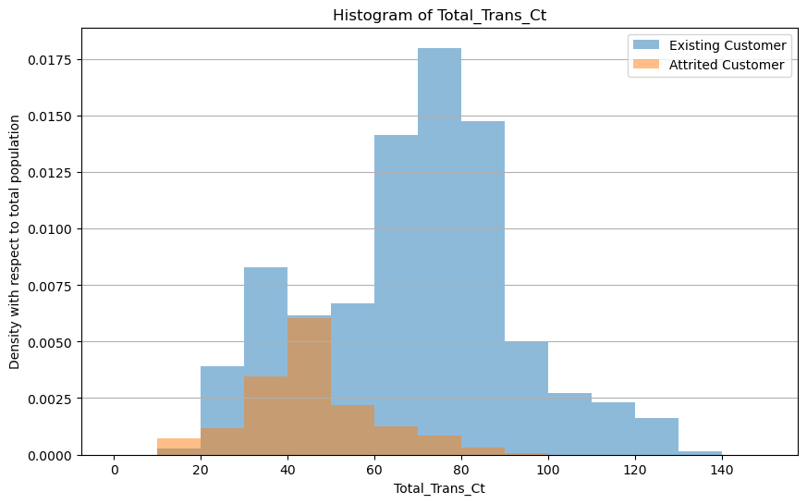
Distribution of total customer transactions

Slide 8
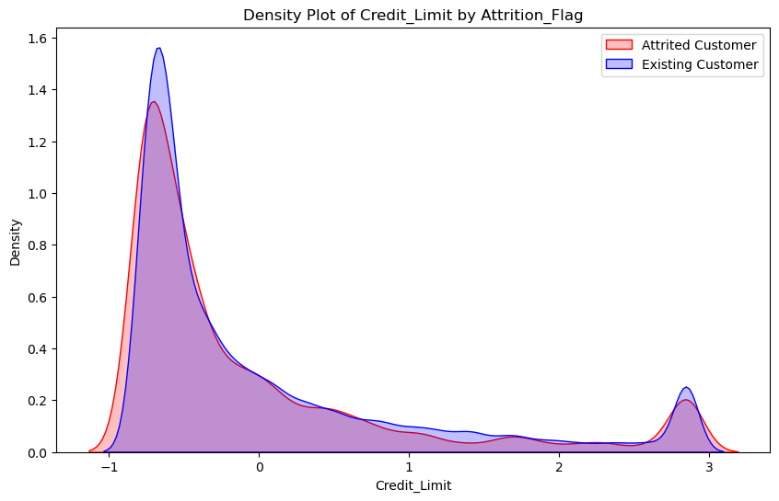
Distribution of credit limit

Slide 9
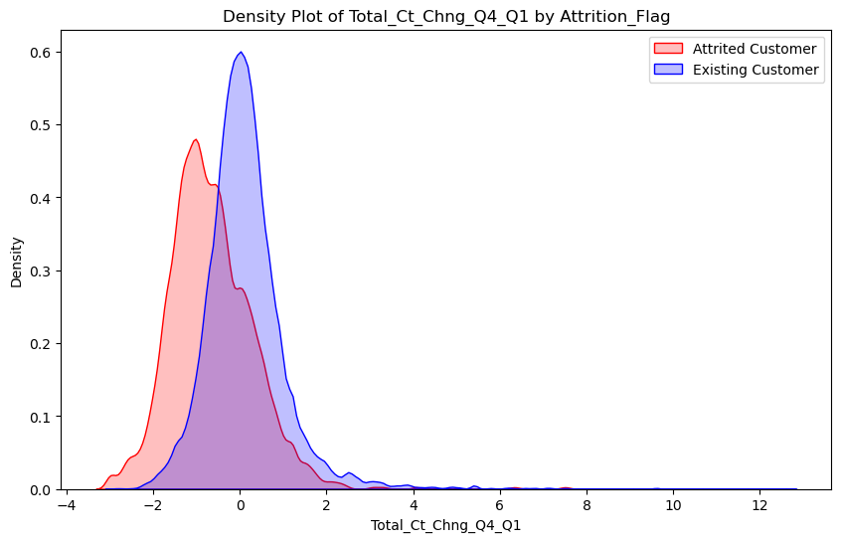
Distribution of change in transaction count (Q4 over Q1)

Slide 10
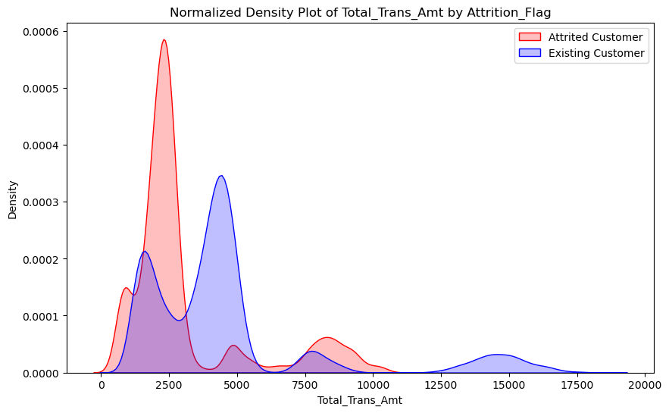
Distribution of total transaction amount

Slide 11
Preprocess the Data
Factorize Categorical Variables
Standardize Decimal Variables
Convert attrition flag to 0,1 for model training
Splitting data into 60% training, 20% validation, 20% test

Slide 12
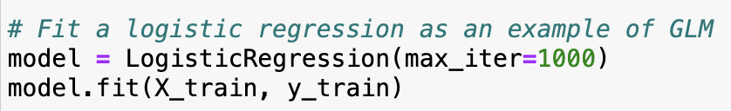
Fit a GLM Model to predict attrition¶
Use LogisticRegression provided by sklearn.linear_model to fit the data

Slide 13
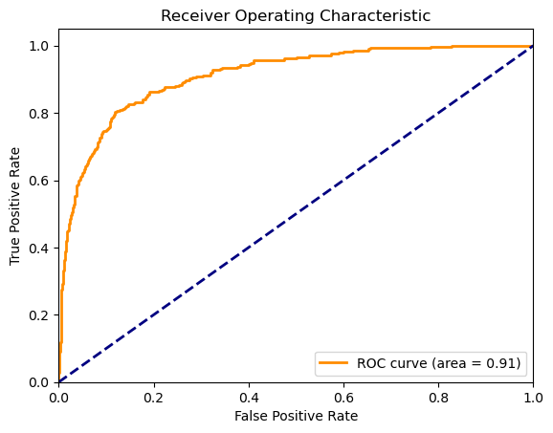
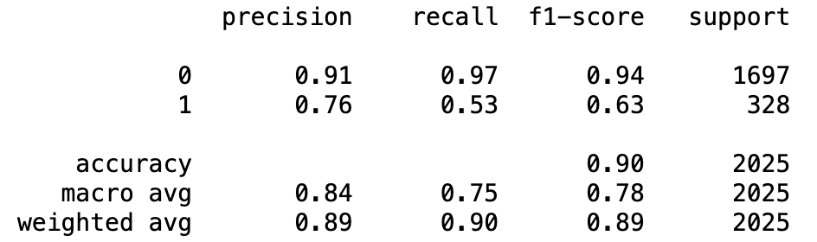
Check the model performance
Compute ROC curve and ROC area for the validation set
Use confusion matrix to test the accuracy

Slide 14
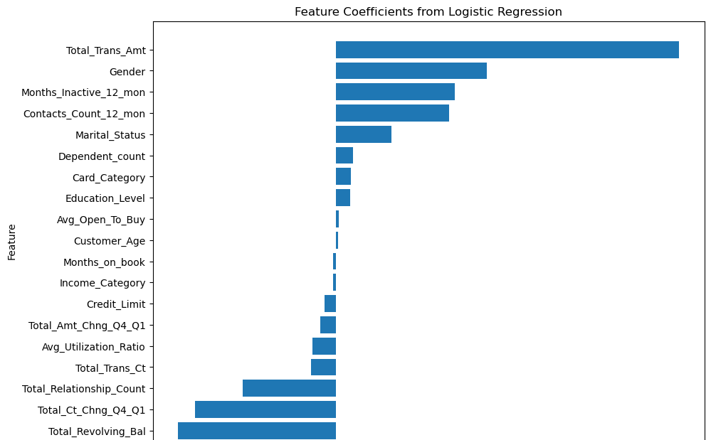
Model coefficient analysis
A positive coefficient indicates an increase in the likelihood of attrition (customer leaving), while a negative coefficient suggests a decrease in that likelihood (customer staying).

Slide 15
Top Factors Increasing Likelihood of Attrition
Total_Trans_Amt (1.566514): The total transaction amount has the strongest positive impact on customer attrition. Higher spending customers are more likely to leave.
Gender_Female (0.688676): This suggests gender has a significant impact on attrition, with Female customer being more likely to leave than Male customer.
Months_Inactive_12_mon (0.541984): Longer periods of inactivity in the last 12 months increase the likelihood of attrition.
Contacts_Count_12_mon (0.515431): A higher number of contacts with the bank over the last 12 months is associated with an increased risk of leaving.

Slide 16
Top Factors Decreasing Likelihood of Attrition¶
Total_Revolving_Bal (-0.724191): Higher revolving balances are the strongest negative predictor of attrition, suggesting customers with higher balances are less likely to leave.
Total_Ct_Chng_Q4_Q1 (-0.645265): A decrease in the number of transactions from Q4 to Q1 significantly reduces the likelihood of attrition.
Total_Relationship_Count (-0.427701): Customers with more products or accounts with the bank are less likely to leave.

Slide 17
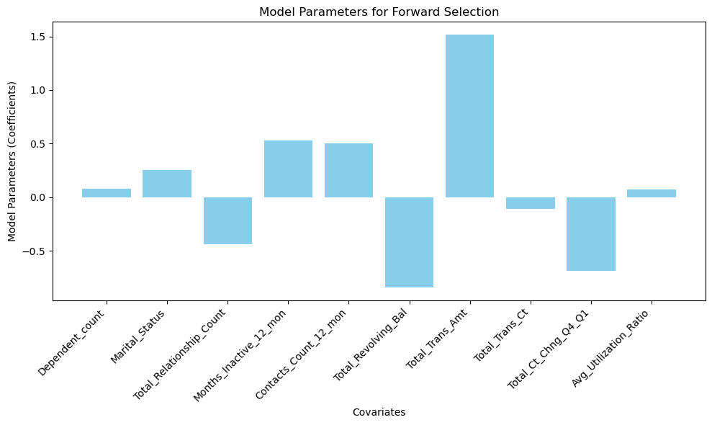


Reducing non-significant variables using forward and backward selection
Evaluate the model with forward-selected and backward-selected features on the validation set using SequentialFeatureSelector provided by mlxtend package
Examine the parameters selected by the model and compare them with the complete model

Slide 18
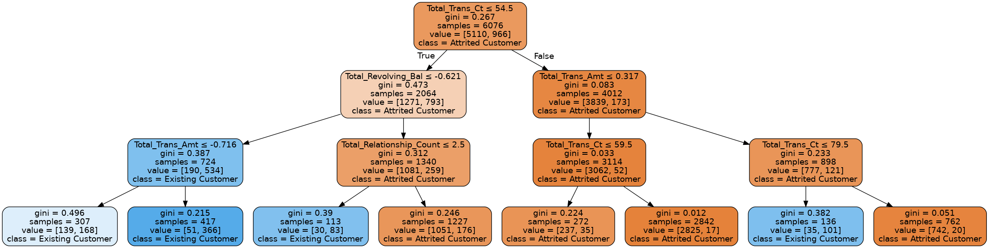
Use decision tree to predict attrition

Slide 19
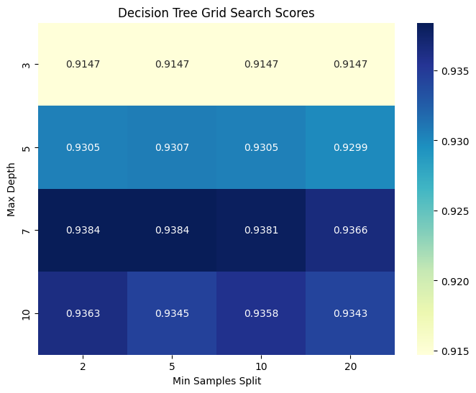
Select maximum depth and minimum sampling split using grid search

Slide 20
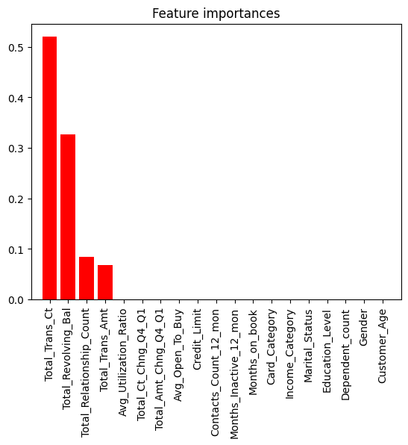
Important features from decision tree

Slide 21
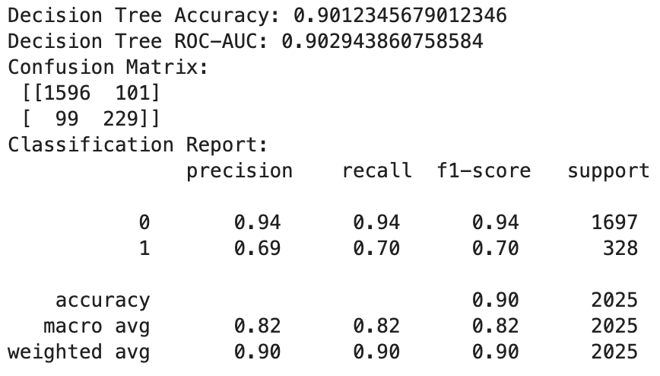
Decision tree model performance

Slide 22
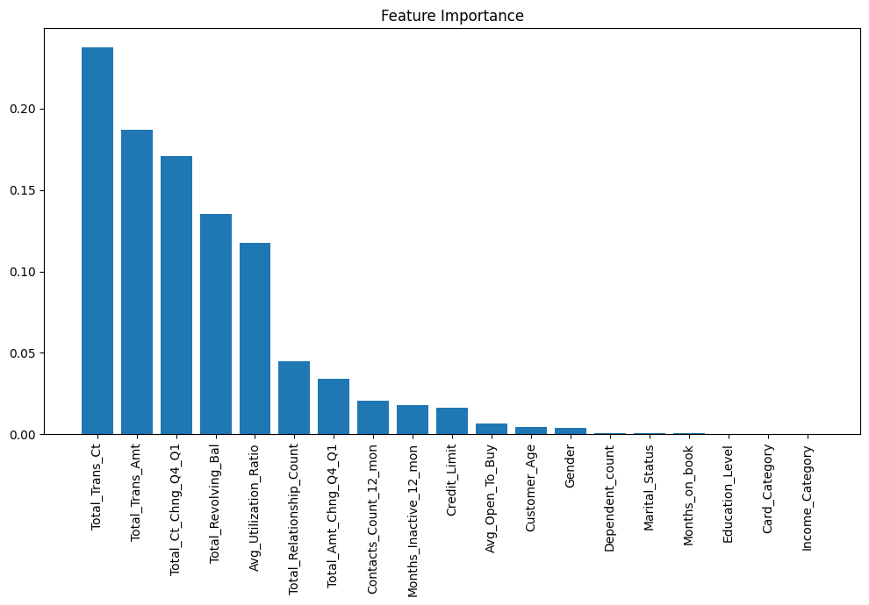
Using random forest to enhance the performance

Slide 23
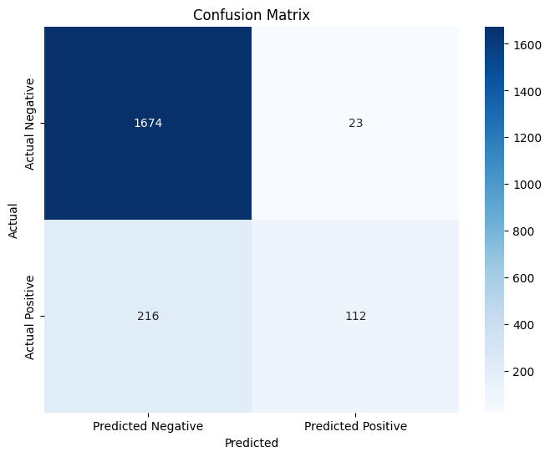
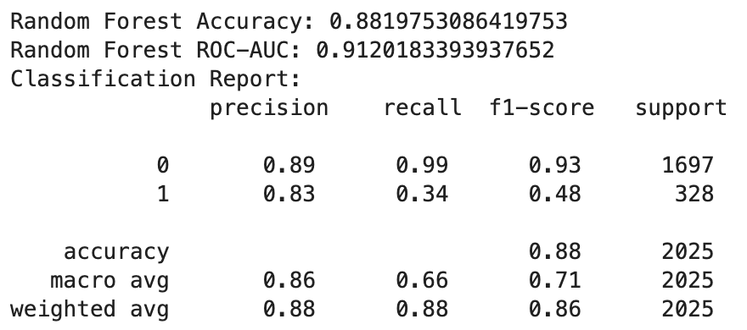
Random forest model performance Confusion matrix of Random Forest model

Slide 24
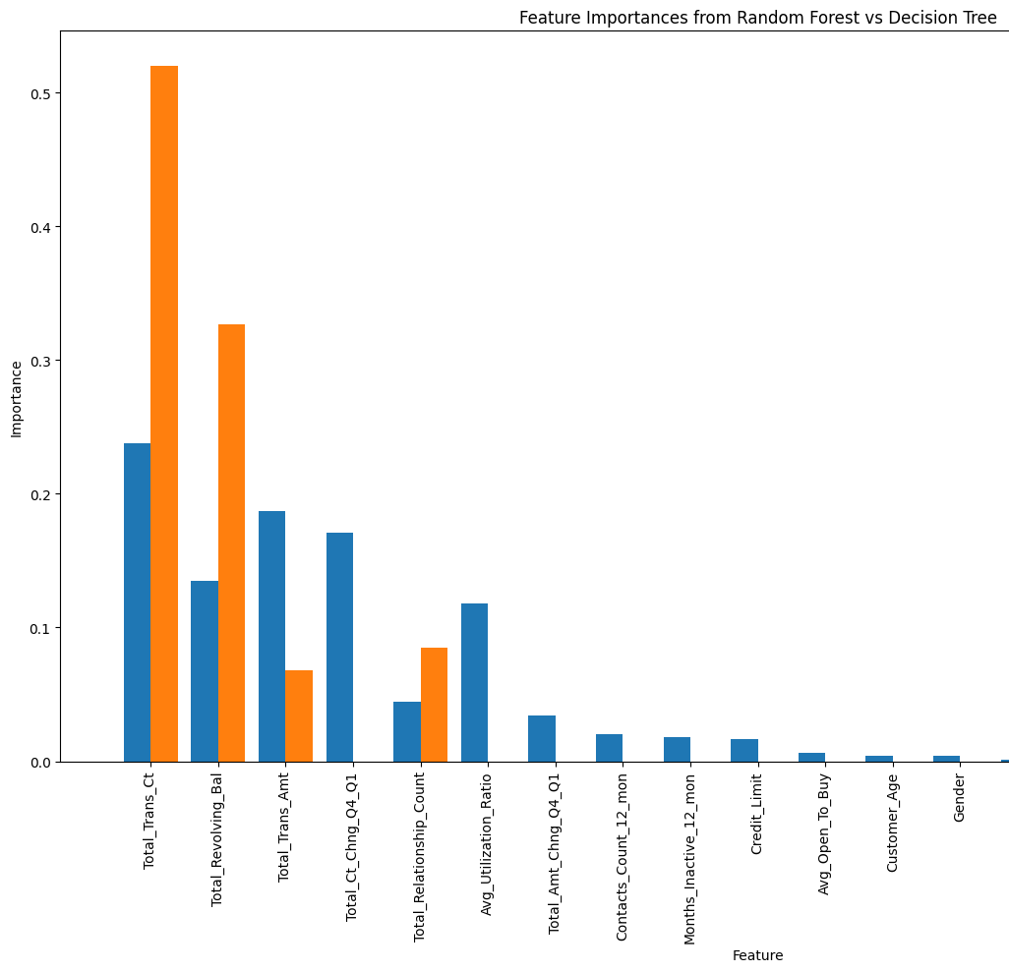
Comparison of Important Features of Random Forests and Decision Trees

Slide 25
Insights for Action¶
Focus on Engagement: Encouraging active use of accounts and reducing inactivity periods could mitigate attrition risk.
Improve Customer Service: The positive coefficient for Contacts_Count_12_mon highlights the importance of resolving customer issues effectively to prevent them from leaving.
Leverage Customer Data: Understanding the specific needs and behaviors of customers with high Total_Trans_Amt and adapting services to them could help in retention.
Enhance Loyalty Programs: Strengthening loyalty programs, especially for customers with a high Total_Relationship_Count and Total_Revolving_Bal, could enhance retention.

