Slide 1


Credit Risk Analysis Using Credit Transition Matrices
Cong Lyu
Supervisor: Yuehua (Amy) Wu
Collaboration with Michael Xu

Slide 2
1 Introduction
Credit Risk Analysis:
Essential for managing potential losses due to borrower defaults.
Critical for financial institutions, investors, and regulators.

Slide 3
Traditional Methodologies:
Credit Scoring Models: Simplified risk assessment using borrower attributes (e.g., FICO score [1] Altman, E. I. (1968).).
Structural Models: Default probability based on firm’s equity as a call option on assets (e.g., Merton model [2] Merton, R. C. (1974).).
Reduced-Form Models: Direct modeling of default events using market data [3] Duffie, D., & Singleton, K. J. (1999).

Slide 4
limitations of the traditional Methodologies:
Credit Scoring Models: These models often oversimplify the complexities of credit risk by reducing it to a single score.
Structural Models: These models require extensive data on the firm’s asset value and volatility, which may not always be available.
Reduced-Form Models: These models rely heavily on market data, which can be volatile and influenced by factors unrelated to the borrower’s creditworthiness.

Slide 5
Advantages of Credit Transition Matrices (TMs):
Historical Data Utilization: Estimates transition likelihoods based on extensive historical data.
Dynamic Credit Assessment: Captures dynamic nature of credit risk over time.
Regulatory Compliance: Aligns with IFRS9 standard for calculating expected credit loss.
Versatility: Applicable to various credit exposures (corporate bonds, sovereign debt, consumer loans).

Slide 6
Impact of Different Withdraw Rates on Probability of Default(PD)
Withdraw rates, representing the probability of a borrower exiting the rating system before default, can significantly affect the observed PD.
To analyze this impact, we incorporate three matrices to simulate the transition process:
Original TM
Moody’s 50% Withdraw reweighted TM
Withdraw removed TM

Slide 7
Transition Matrix Properties:
Diagonal Dominance: The highest ratings tend to have the largest diagonal values, indicating a higher probability of remaining in the same rating. Conversely, the lowest ratings, have smaller diagonal values but higher probabilities of transitioning to default.
Downgrade Likelihood: Customers are more likely to experience a downgrade in their rating rather than an upgrade.
Withdraws: The probabilities of withdraws are relatively consistent across different ratings, representing a random setting for withdraws.
Probability Distribution: The diagonal probabilities are the largest in the matrix, indicating the highest likelihood of remaining in the same rating. The migration probabilities decrease along the diagonal, diminishing as they extend upwards or downwards from the diagonal.
Adjacent Transitions: The three ratings adjacent to the current rating have positive values, while others remain zero, indicating that migrations are more likely to occur to ratings close to the current one.

Slide 8
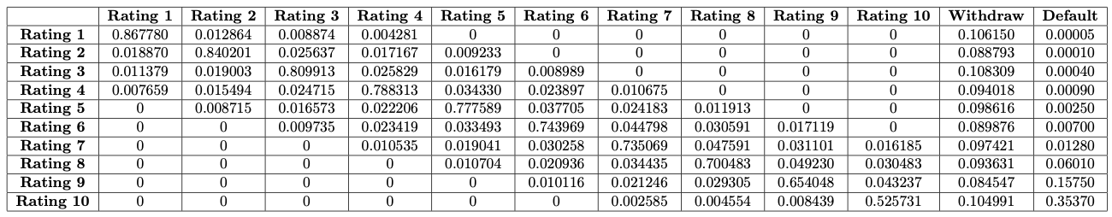
Transition Matrix Example:

Slide 9
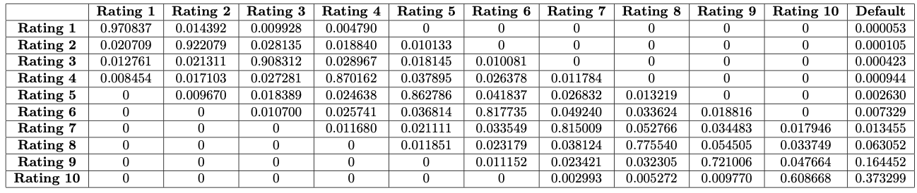
Moody’s Withdraw Adjusted TM
50% of the withdrawn entities are reassigned proportionally to their existing ratings, while the remaining 50% are distributed proportionally across all ratings plus default.

Slide 10
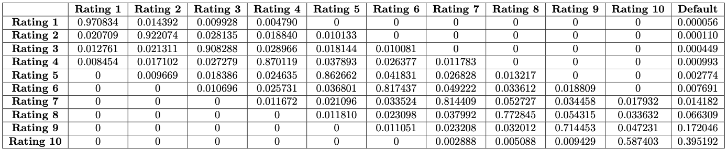
Withdraw removed TM
The probabilities associated with withdraws are proportionally redistributed to all existing ratings, including the default rating.

Slide 11
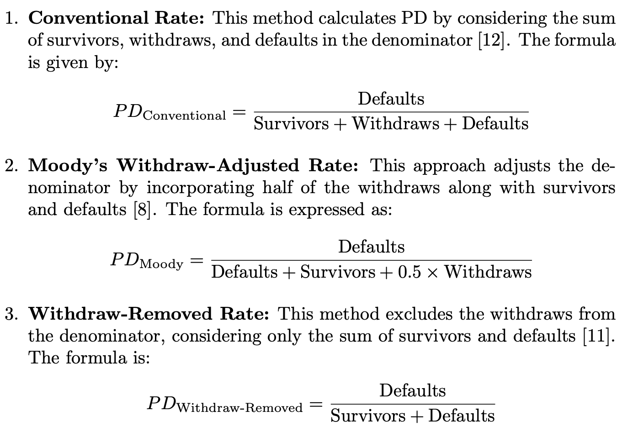
In this study, we employ three different methods to calculate the probability of default (PD), each offering a unique perspective on how withdrawals impact DR:

Slide 12
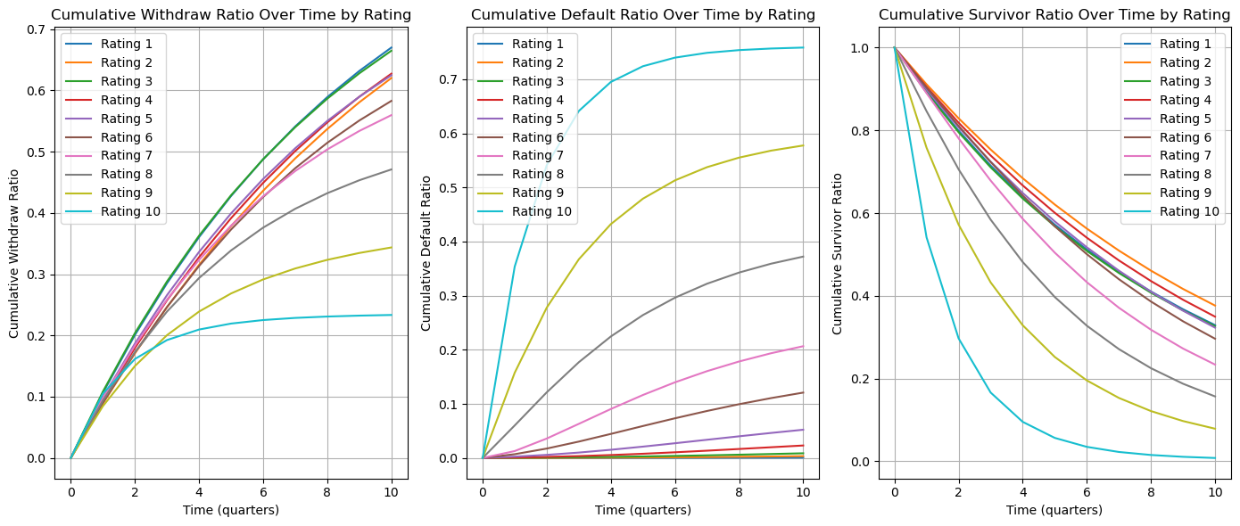
Simulation Process
Start with an identity matrix for initial obligor distribution.
For each quarter, update distribution based on transition probabilities.
Cumulative withdrawals, defaults, survivors over time.

Slide 13
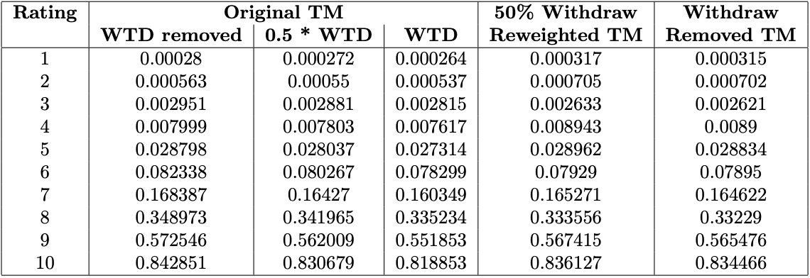
Results
Withdraw Rate: 0.01

Slide 14
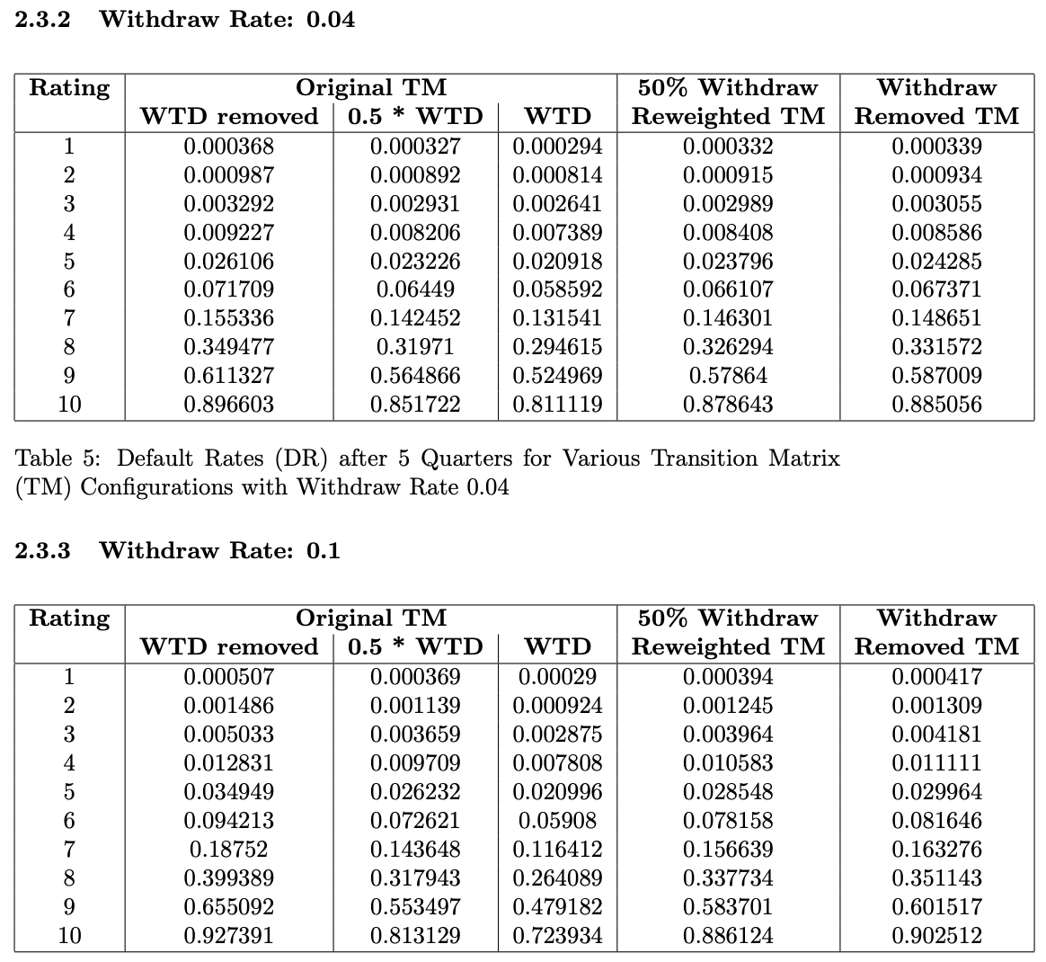
As the withdraw rate increases from 0.01 to 0.1, the difference in PD calculated in different methods increase significantly, indicating a strong sensitivity of PD to changes in withdraw probabilities.

Slide 15
The increase in PD is non-linear as we move from higher to lower ratings, indicating the higher sensitivity of lower ratings to changes in withdraw probabilities.
As established in the design of the TM, customers are more likely to experience downgrades than upgrades, reflecting the greater propensity for ratings to deteriorate over time.
The higher the withdraw rate, the greater the difference between the PDs calculated by the different methods. The PD of the original TM was the lowest, while the PD of the TM with WTD removed was the highest.

Slide 16
Simulation of Transition Process with Given Withdraw Counts
In real bank practice, the significance of the withdraw count is paramount. Often, only the withdraw counts are provided without access to the default counts or existing customer counts. Despite this limitation, it is crucial to accurately calculate the Probability of Default (PD) to determine the Expected Credit Loss (ECL) for each rating.

Slide 17
Handling Withdraws:
Withdraws are applied proportionally based on the count of each rating.
Withdraw counts are subtracted from the current distribution.
Remaining obligors (survivor and default accounts) will be used for future transitions.

Slide 18
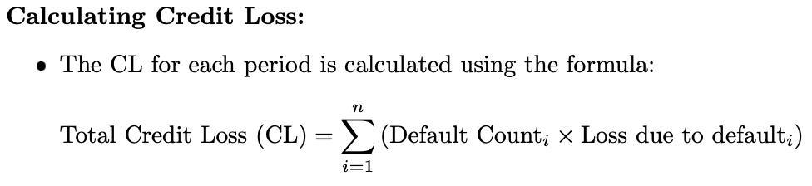
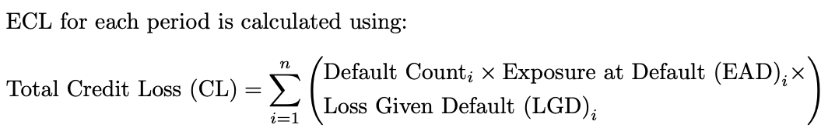
Formula for calculating credit losses

Slide 19
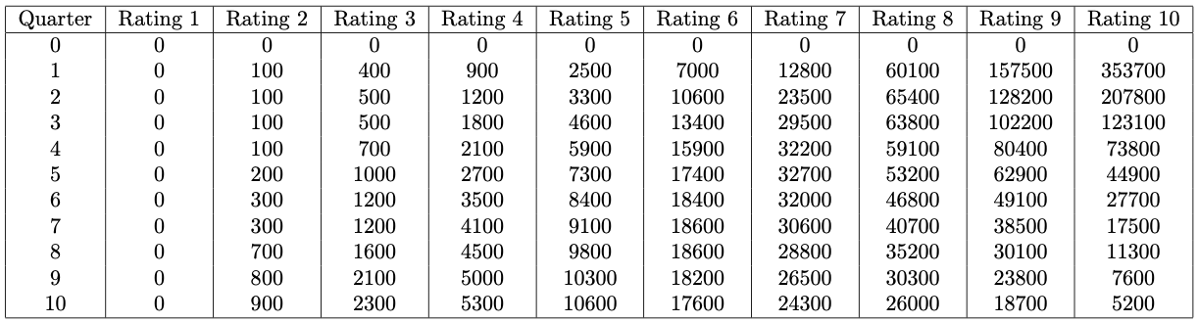
Loss Given Default (LGD) of 1 and an Exposure at Default (EAD) of 100

Slide 20
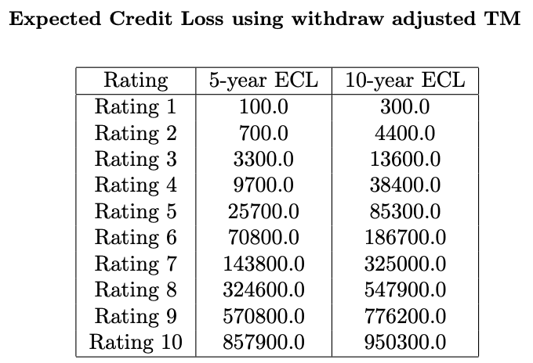
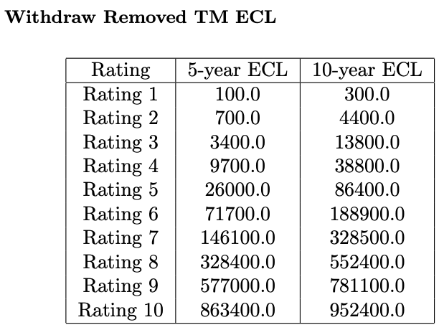
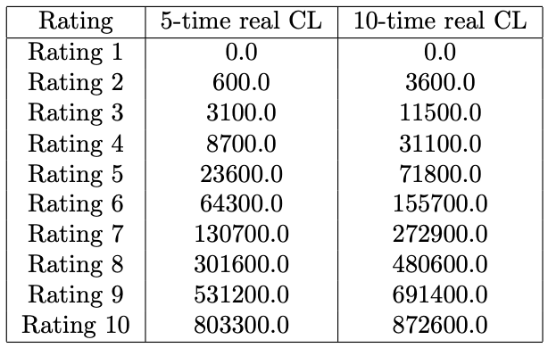

Slide 21
Simulation of the Transition Process Using Marginal Conditional PD
Simulation of the yearly transition process using marginal conditional PD, considering the performance of the previous year.
The marginal conditional PD is calculated using the default count of each year divided by the survivors of the previous year.
Assessment of the accuracy of this method in predicting yearly credit transitions.

Slide 22
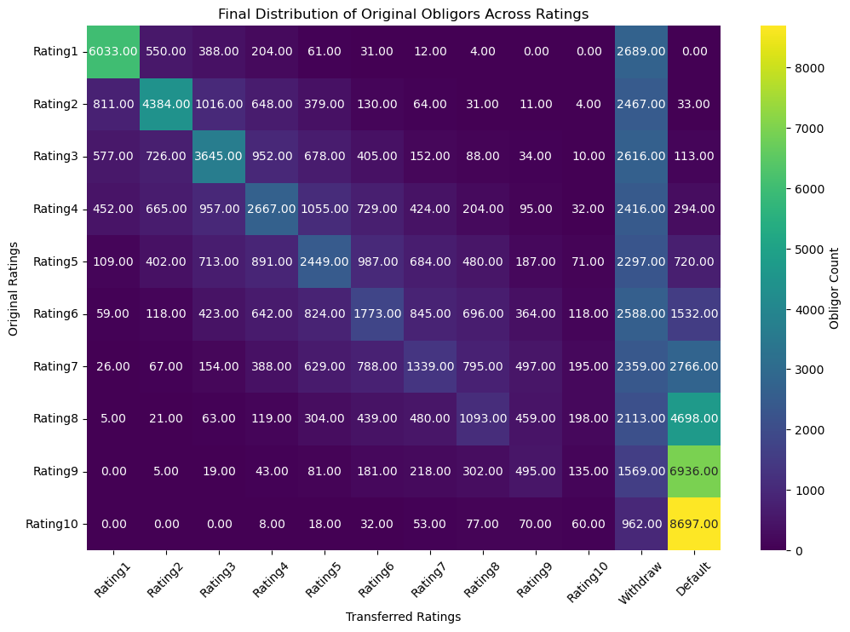

Slide 23
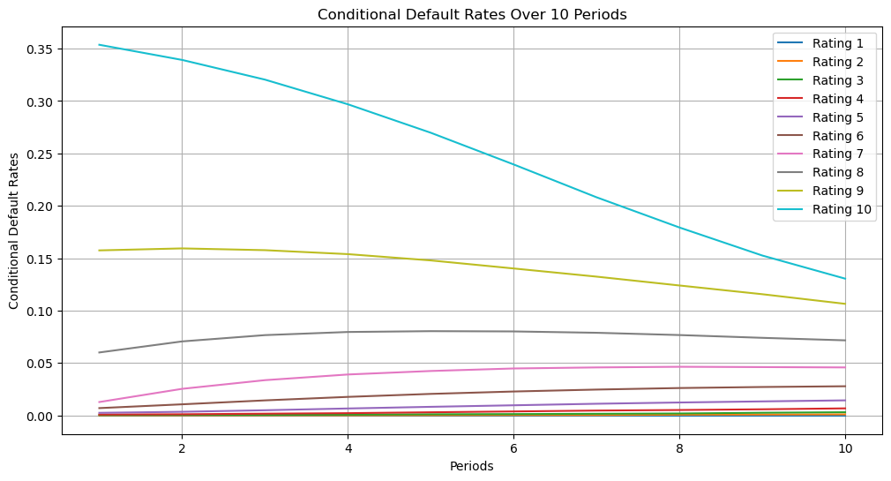

Slide 24
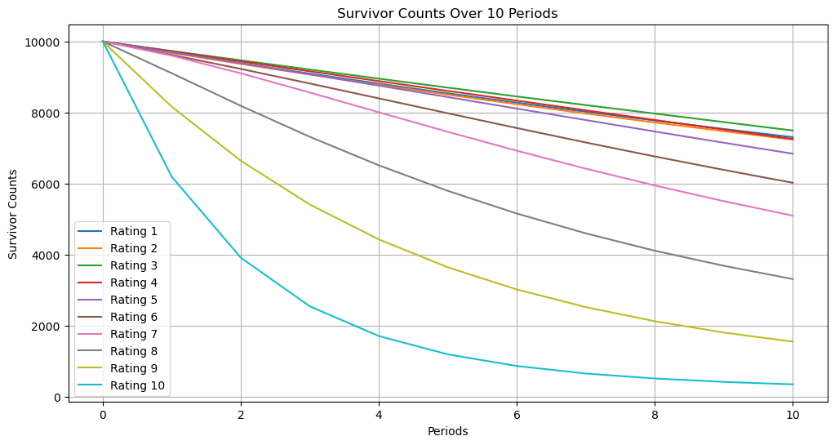

Slide 25
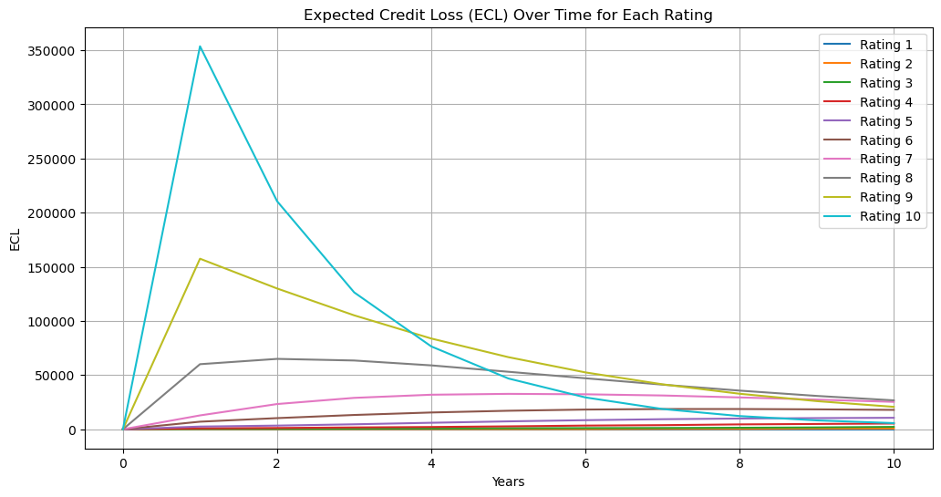

Slide 26
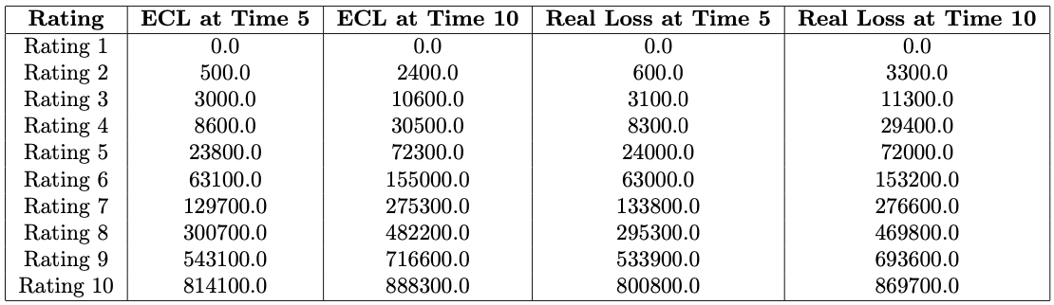

Slide 27
Simulation of Real Credit Loss and Calculation of Expected Credit Loss (ECL) Using Cumulative PD
Simulation scenarios where default counts of each year are unavailable, relying solely on withdraw counts and migration probability to calculate cumulative PD.

Slide 28
Simulation process
The simulation starts with a Transition Matrix (TM) that includes complete withdraws. The default counts are determined, and the withdraw counts are stored for each period. The withdraw adjusted counts are calculated by deducting the withdraw probability at each iteration.
For each period, the ECL is calculated using the withdraw adjusted counts. This involves deducting the withdraw counts each iteration and multiplying the PD from Transition Matrix by the withdraw adjusted counts to calculate the expected default count.

Slide 29
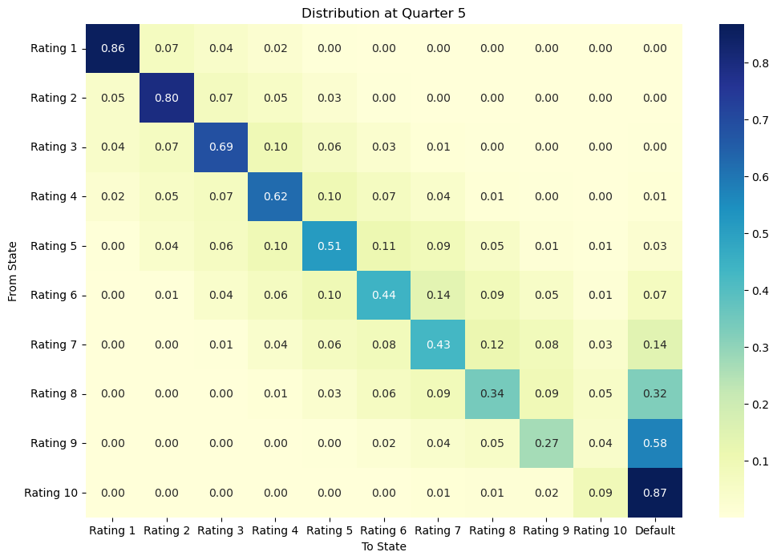
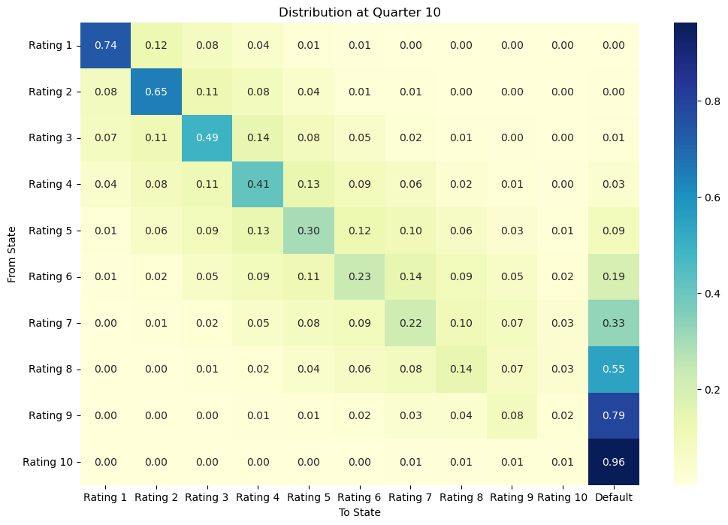
Obligors distribution at quarter 5 and 10

Slide 30
Heatmap at Quarter 5:
The majority of the obligors in higher ratings (Rating 1 to Rating 4) remain in their original ratings, indicating stability in the early quarters.
Ratings 5 and below show a noticeable transition to lower ratings and the default state, reflecting higher credit risk for lower-rated obligors.
Withdraws and defaults are relatively low at this stage, with most obligors still in the system.

Slide 31
Heatmap at Quarter 10:
By Quarter 10, there is a significant shift with higher defaults and withdraws, particularly in lower ratings (Rating 7 to Rating 10).
Higher ratings (Rating 1 to Rating 4) still retain a substantial proportion of obligors, but some transitions to lower ratings and defaults are evident.
The DR are noticeably higher, indicating increased credit risk over time.

Slide 32
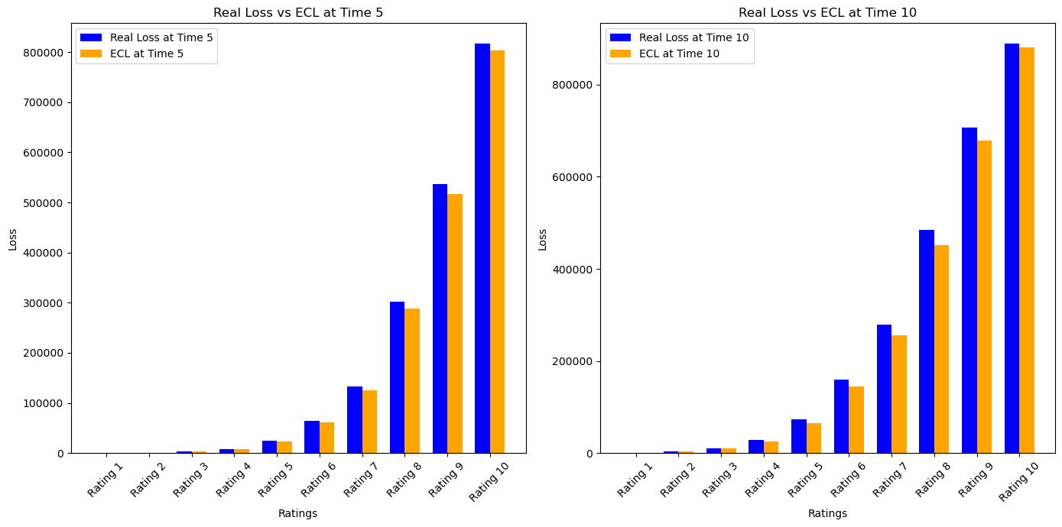
Real loss compared to Expected loss

Slide 33
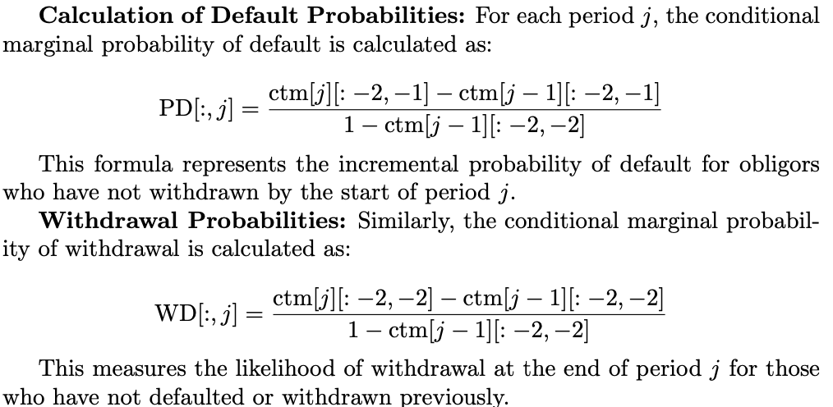
Case 1: Theoretical Accuracy in Credit Risk Modeling
This case assumes that all customers who withdraw from their obligations do so at the end of each period. Additionally, the model operates under the assumptions of a Loss Given Default (LGD) of 1 and an Exposure at Default (EAD) of 1

Slide 34
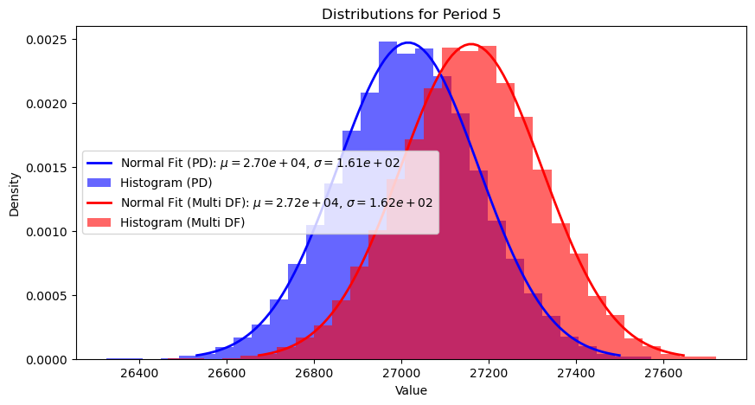
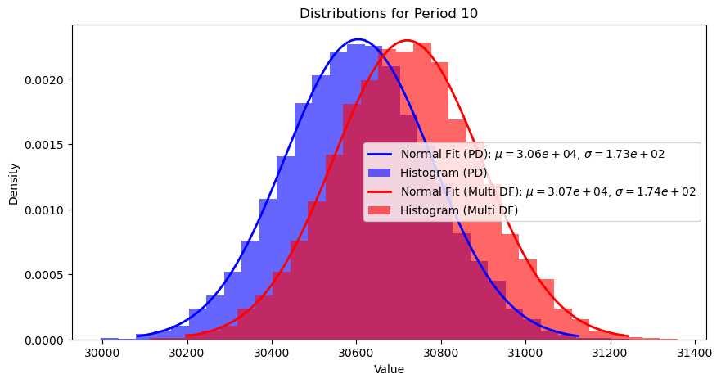
Distribution of the predicted defaults and the actual observed defaults across Period 5, and 10

Slide 35
Summary of Plots
Period 5: A slight divergence begins to appear, with the observed defaults showing a marginally higher mean compared to the predicted defaults. This indicates that the model is starting to slightly underestimate the defaults.
Period 10: The divergence becomes more noticeable, with the observed defaults exceeding the predicted defaults more significantly. This trend suggests that the model may underestimate the risk of defaults as time progresses, indicating a potential need for recalibration for longer-term predictions.

Slide 36
Case 2: Analysis of Probability of Default (PD) and Multi-Period Defaults
In Case 2, the objective is to analyze the distribution of Probability of Default (PD) sums, half-year PD sums (PD hf), and the observed multi-period defaults (Multi DF) at selected periods (1, 5, and 10). This analysis is crucial for understanding the risk profile over multiple periods and comparing the theoretical estimates against actual observed defaults.

Slide 37
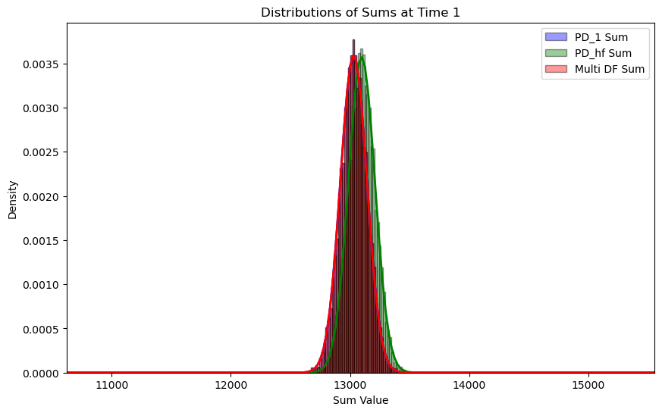
Expected Probability of Default (PD) sums, half-year PD sums (PD hf), and the observed multi-period defaults (Multi DF) at time 1

Slide 38
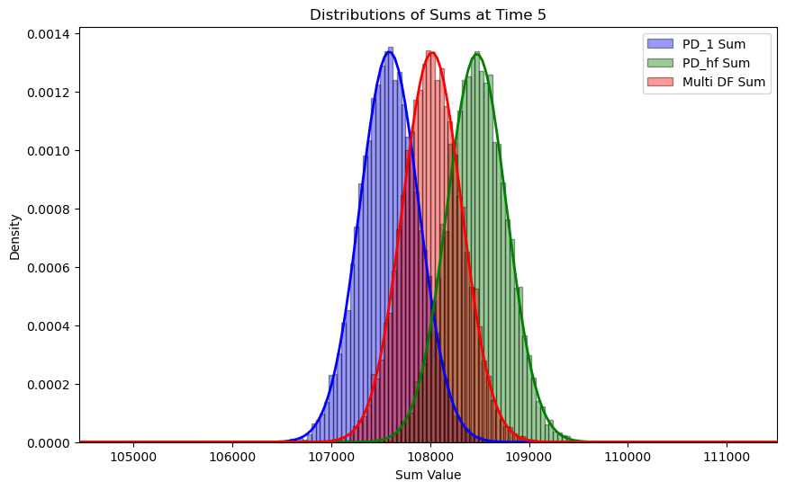

Slide 39
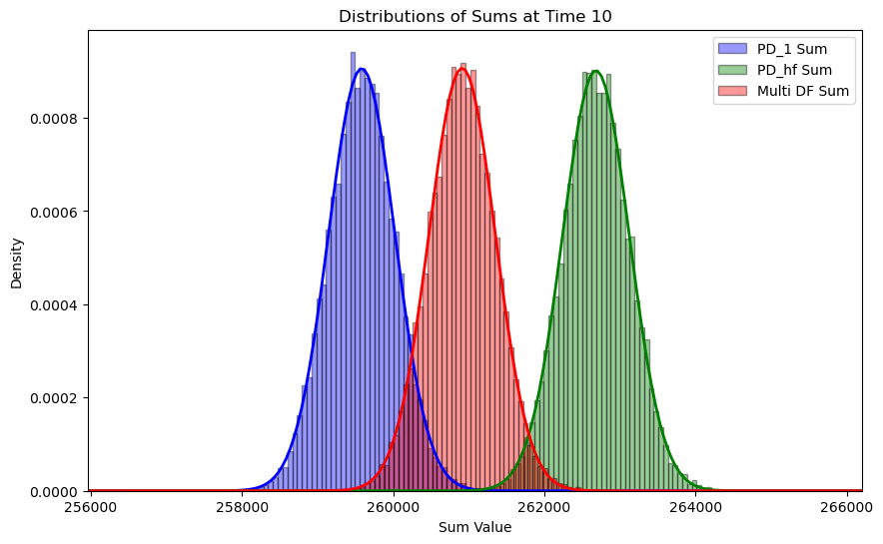

Slide 40
Case 3: Real-world Simulation
In this scenario, we simulate credit risk assuming that only the long-run average transition matrix (TM) can be used instead of the point-in-time (PIT) TM, and that withdraws (WD) only occur in the middle of each period.
The expected credit losses (ECL) are calculated using two different transition matrices: the original TM and the half-year forward (HF) TM.

Slide 41
Metrics used to test performance
Ratio 1 (sum(ecl1)/sum(loss) - 1): This ratio compares the ECLs calculated using the full-year transition matrix (original TM) to the actual observed losses.
Ratio 2 (sum(ecl1 hf)/sum(loss) - 1): This ratio compares the ECLs calculated using the half-year forward transition matrix (HF TM) to the actual observed losses. Like the first ratio, a positive value indicates over- estimation, and a negative value indicates underestimation.

Slide 42
Impact of Withdraw Rates and Time
The withdrawal rates and time periods significantly impact the calculated ratios. Here, we tested withdraw rates equal to 0.01, 0.03, and 0.05, and time periods 1, 5, and 10 to examine their effect on the expected loss versus actual loss error.

Slide 43
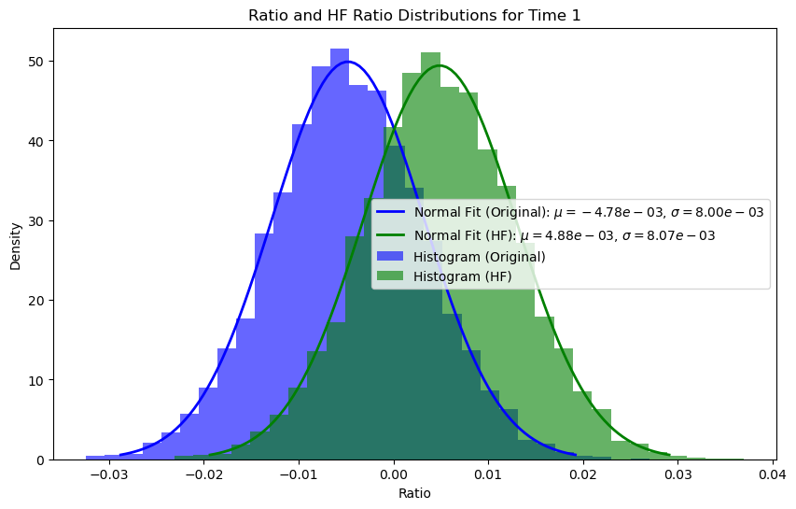
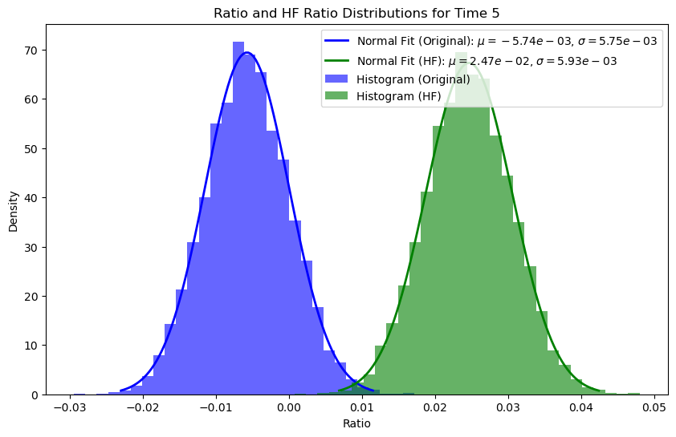
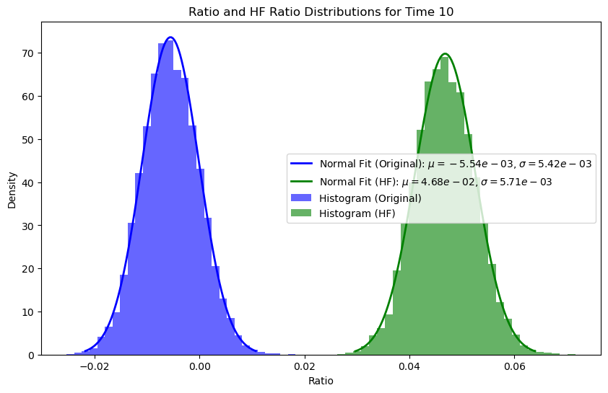
Withdraw rate = 0.01, period 1, 5, 10

Slide 44
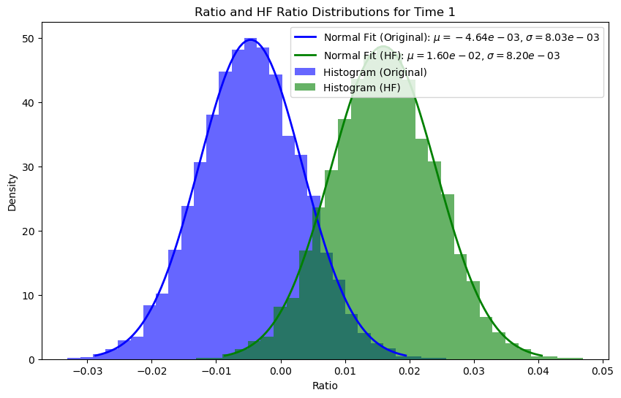
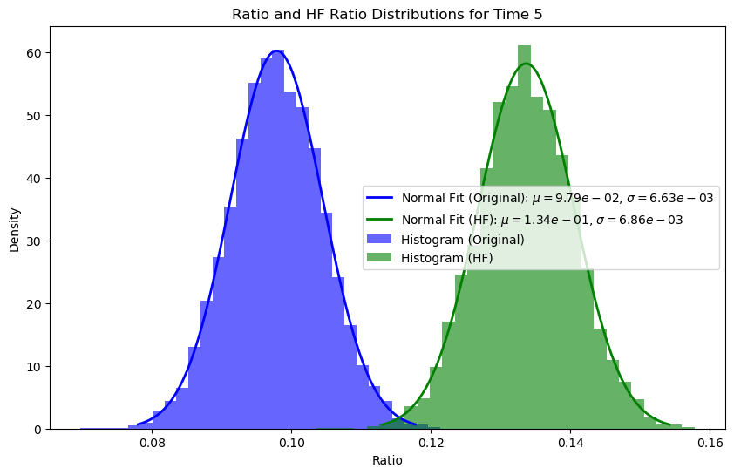
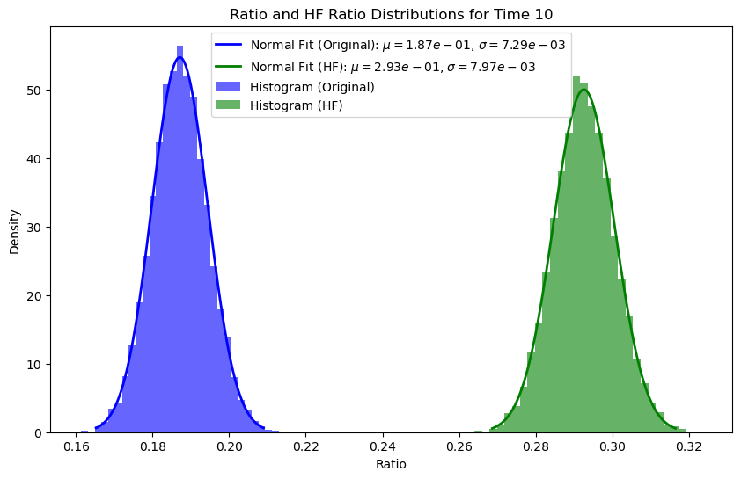
Withdraw rate = 0.03, period 1, 5, 10

Slide 45
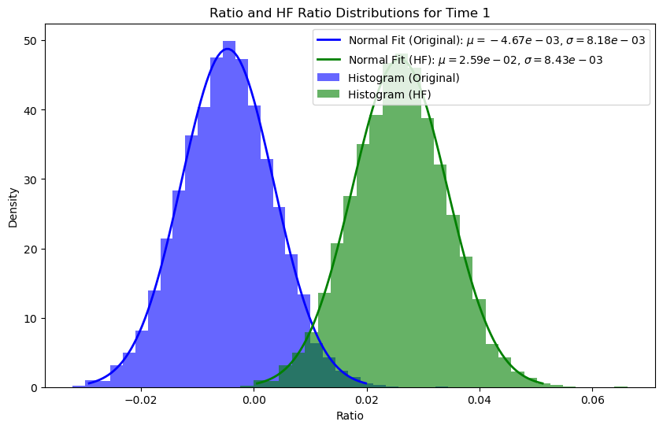
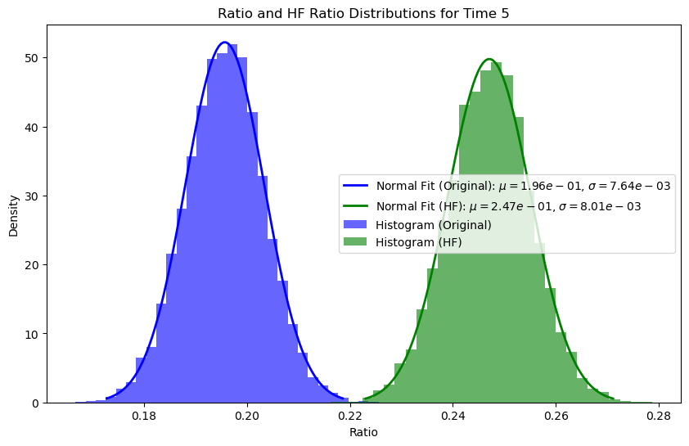
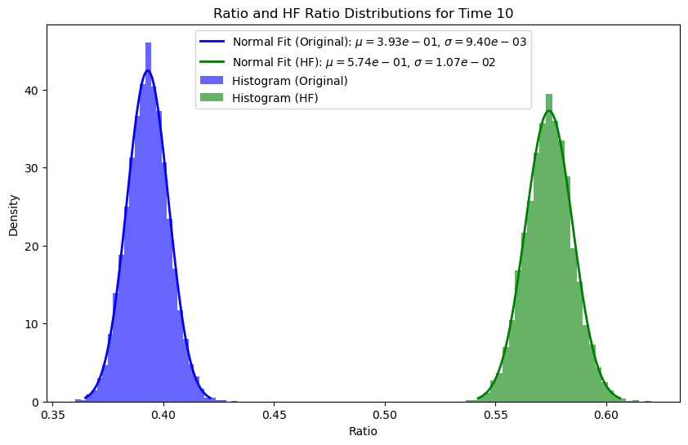
Withdraw rate = 0.05, period 1, 5, 10

Slide 46
Conclusion
Impact of Withdraw Rates: The analysis shows that the higher the withdraw rate, the higher the PD for all credit ratings in both the moody’s withdraw reweighting matrix and the withdrawal removed matrix.
Simulation of Transition Processes: The simulation of transition pro- cesses with given withdraw counts and using conditional PDs provides valuable insights into the dynamics of credit transitions.
Utilizing Cumulative PD for ECL Calculation: The introduction of cumulative PD to calculate the ECL offers a comprehensive view of credit risk over time.
Application in Real-World Scenarios: The methodologies and findings presented in this paper have significant implications for financial institutions.

Slide 47
References
[1] Altman, E. I. (1968). Financial Ratios, Discriminant Analysis and the Pre- diction of Corporate Bankruptcy. Journal of Finance, 23(4), 589-609.
[2] Merton, R. C. (1974). On the Pricing of Corporate Debt: The Risk Structure of Interest Rates. Journal of Finance, 29(2), 449-470.
[3] Duffie, D., & Singleton, K. J. (1999). Modeling Term Structures of Default- able Bonds. Review of Financial Studies, 12(4), 687-720.
[4] Thomas, L. C., Edelman, D. B., & Crook, J. N. (2002). Credit Scoring and Its Applications. Philadelphia: SIAM.
[5] Crouhy, M., Galai, D., & Mark, R. (2000). A Comparative Analysis of Cur- rent Credit Risk Models. Journal of Banking & Finance, 24(1-2), 59-117.
[6] Jarrow, R. A., & Turnbull, S. M. (1997). A Markov Model for the Term Structure of Credit Risk Spreads. Review of Financial Studies, 10(2), 481- 523.
[7] Jafry, Y., & Schuermann, T. (2004). Measurement, Estimation and Com- parison of Credit Migration Matrices. Journal of Banking & Finance, 28(11), 2603-2639.
[8] Lando, D., & Skodeberg, T. M. (2002). Analyzing Ratings Transitions and Ratings Drift with Continuous Observations. Journal of Banking & Finance, 26(2-3), 423-444.
[9] Bangia, A., Diebold, F. X., Kronimus, A., Schagen, C., & Schuermann, T. (2002). Ratings Migration and the Business Cycle, with Application to Credit Portfolio Stress Testing. Journal of Banking & Finance, 26(2-3), 445-474.
[10] Moody’s Analytics (2022). Moody’s Credit Transition Model: Methodology and User Guide. Retrieved from https://www.moodysanalytics.com
[11] Nickell, P., Perraudin, W., & Varotto, S. (2000). Stability of Rating Tran- sitions. Journal of Banking & Finance, 24(1-2), 203-227.
[12] Bluhm, Christian and Overbeck, Ludger and Wagner, Christoph. (2016). An Introduction to Credit Risk Modeling. Chapman and Hall/CRC.

Slide 48
Thank you for listening!

