Slide 1
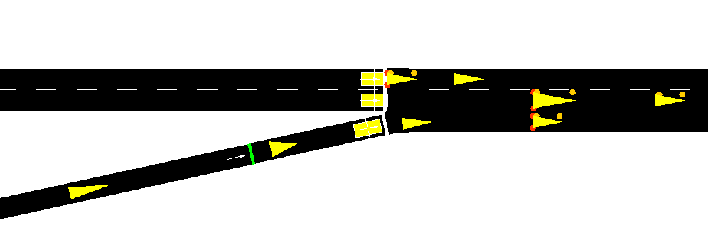

L
-1 | -1 | -1 | -1 | -1 | 54 | -1 | -1
-1 | -1 | -1 | -1 | -1 | -1 | 45 | 43
-1 | -1 | -1 | -1 | 25 | -1 | 35 | -1
-1 | -1 | 0 | 21 | -1 | -1 | -1
0.56
0.67
-1 | -1 | -1 | -1 |  |  | -1 | -1
-1 | -1 | -1 | -1 | -1 | -1
-1 | -1 | -1 | -1 |  | -1 |  | -1
-1 | -1 | 0 |  | -1 | -1 | -1
0.9
0.56
0.53
0.31
0.43
X
Mask position
Normalize Speed
0.26
0.9
X
State Representation
0.67
-1 | -1 | -1 | -1 | -1 |  | -1 | -1
-1 | -1 | -1 | -1 | -1 | -1
-1 | -1 | -1 | -1 |  | -1 |  | -1
-1 | -1 | 0 |  | -1 | -1 | -1
Y
Y
0.56
0.53
0.31
0.43
N
Stopped vehicle
0.26
0.9
N
M
M
Delayed obervation vehicle
SUMO Simulation
Position matrix
Position + Speed matrix
Moving vehicle

Slide 2
L
-1 | -1 | -1 | -1 | -1 | 54 | -1 | -1
-1 | -1 | -1 | -1 | -1 | -1 | 45 | 43
-1 | -1 | -1 | -1 | 25 | -1 | 35 | -1
-1 | -1 | 0 | 21 | -1 | -1 | -1
0.56
0.67
-1 | -1 | -1 | -1 |  |  | -1 | -1
-1 | -1 | -1 | -1 | -1 | -1
-1 | -1 | -1 | -1 |  | -1 |  | -1
-1 | -1 | 0 |  | -1 | -1 | -1
0.9
0.56
0.53
0.31
0.43
X
Mask position
Normalize Speed
0.26
0.9
X
State Representation
0.67
-1 | -1 | -1 | -1 | -1 |  | -1 | -1
-1 | -1 | -1 | -1 | -1 | -1
-1 | -1 | -1 | -1 |  | -1 |  | -1
-1 | -1 | 0 |  | -1 | -1 | -1
Y
Y
0.56
0.53
0.31
0.43
N
Stopped vehicle
0.26
0.9
N
M
M
Delayed obervation vehicle
SUMO Simulation
Position matrix
Position + Speed matrix
Moving vehicle

Slide 3
