Slide 1
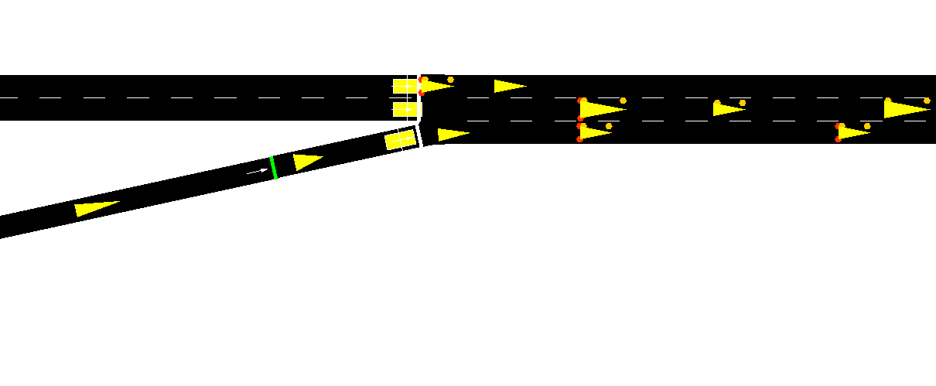

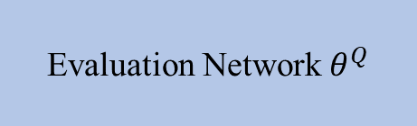
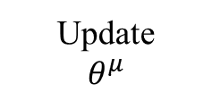
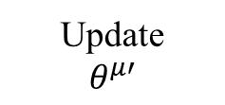
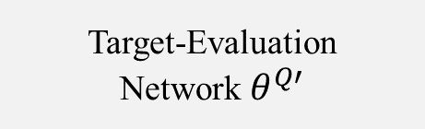
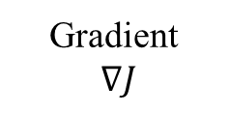
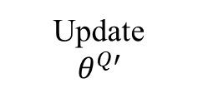
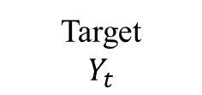



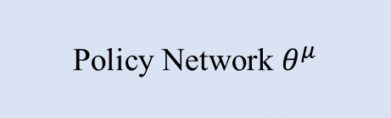
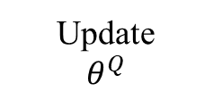
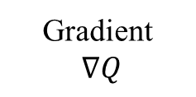

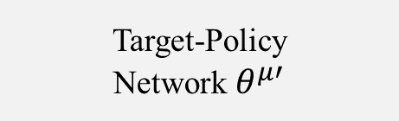

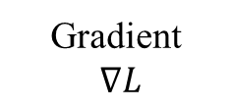
Actor Network
Critic Network
Actor Optimizer
Critic Optimizer
Update
$$θ^{μ}$$
Gradient
$∇J$
Update
$$θ^{Q}$$
Gradient
$∇L$
SUMO Env
$A_{t}=μ\left(S_{t}\right)+ 𝒩_{t}$
Policy Network $θ^{μ}$
$$A_{t}=μ(S_{t})$$
Evaluation Network $θ^{Q}$
Gradient
$∇Q$
Update
$$θ^{μ′}$$
Update
$$θ^{Q′}$$
Target
$Y_{t}$
$$S_{t}$$
Target-Policy
Network $θ^{μ′}$
Target-Evaluation
Network $θ^{Q′}$
0.56
0.67
-1 | -1 | -1 | -1 |  |  | -1 | -1
-1 | -1 | -1 | -1 | -1 | -1
-1 | -1 | -1 | -1 |  | -1 |  | -1
-1 | -1 | 0 |  | -1 | -1 | -1
0.56
0.53
0.31
0.43
0.26
0.9
$$S_{t−1}$$
Sample
Reward function
Store Transition
Replay memory ($S_{t}, A_{t}, R_{t}, S_{t+1})$

