Slide 1
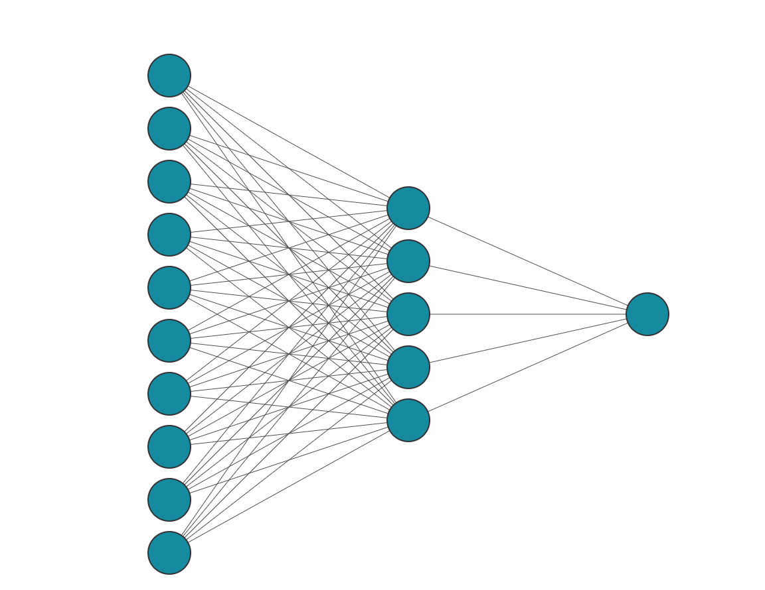



Macroeconomic variables
Firm characteristic variables
Input layer: $Z^{(0)}$
Hidden layer: $Z^{(1)}$
Output layer: $R^{abr}$

