Slide 1
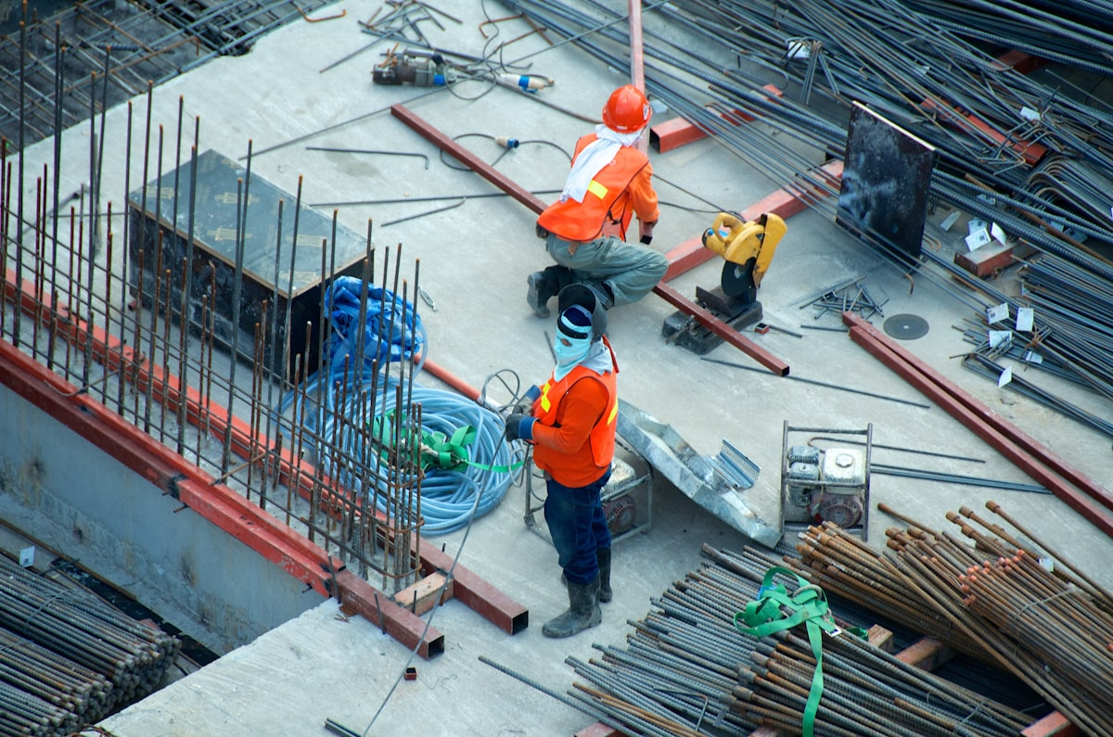

Introducing mantroOps
The first maintenance platform built for how African engineering teams actually work.
PROJECT KICKOFF · JUNE 2025
We aren't building another generic CMMS. We are building for the operational realities of African engineering teams.
mantroOps · Project Kickoff · June 2025
01
Notes:
Team, today I'm introducing mantroOps. We aren't trying to build another generic CMMS. Global tools already solve this problem on paper. The real gap is fit—those tools weren't built for the operational realities of African engineering teams. We are changing that.

Slide 2
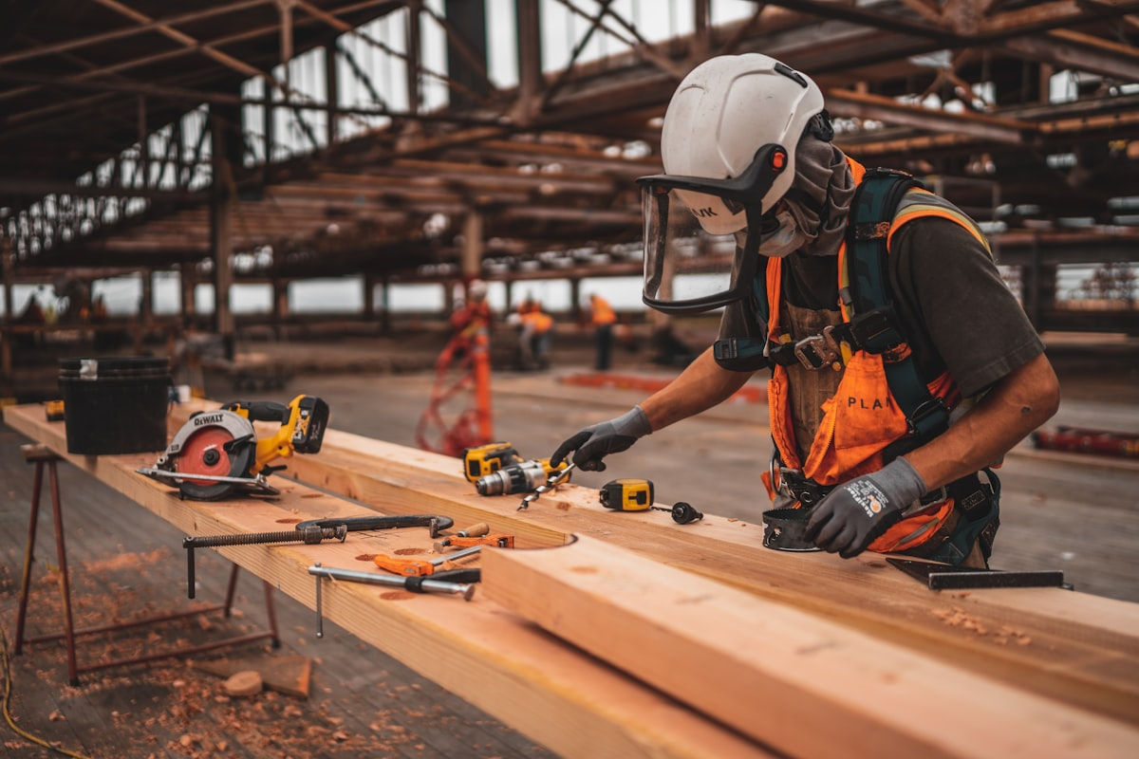
Who We Are Building For
The Opportunity & Market Gap
Target Market: Mid-size and smaller Ghanaian engineering contractors, service companies, fabricators, and builders managing expensive, critical equipment daily.
Status Quo: Large multinationals use SAP or IBM Maximo. Local firms use spreadsheets — or nothing at all.
Opportunity: Give local firms an accessible, affordable platform built for their specific engineering context.
mantroOps · Project Kickoff · June 2025
02
Notes:
Engineering firms in Ghana—across construction, mining, oil & gas, and utilities—are managing millions of dollars in equipment. Right now, if you aren't a massive multinational with an enterprise budget, you are stuck using spreadsheets. That is our market.

Slide 3

Why Global Software Fails in Ghana
The Real Problems on the Ground
Connectivity Drops
Complex Interfaces
Cloud-only tools become useless offline on remote sites like Obuasi or Takoradi.
Field technicians carry basic Android phones; complex UIs get abandoned immediately.
The WhatsApp Loop
Currency & Logistics
Approvals happen on chat — no audit trail for EPA or GNPC compliance.
USD pricing ($50–$200/user/mo) with no GHS procurement or local vendor tracking.
mantroOps · Project Kickoff · June 2025
03
Notes:
The issue isn't that software doesn't exist; it's that it doesn't get used. When a technician's internet drops in Tema, Takoradi, or Obuasi, global cloud tools break down. They revert to WhatsApp, and management loses all visibility and compliance data.

Slide 4
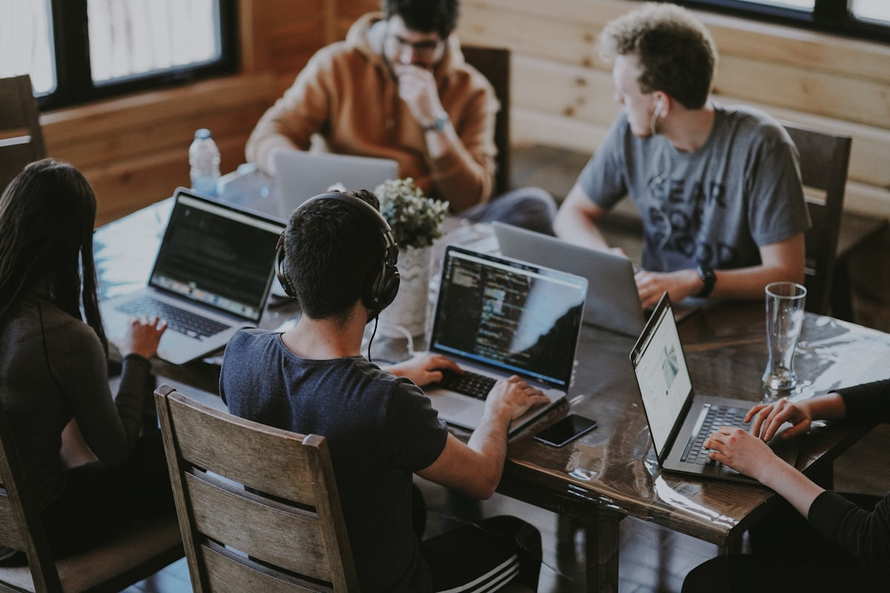
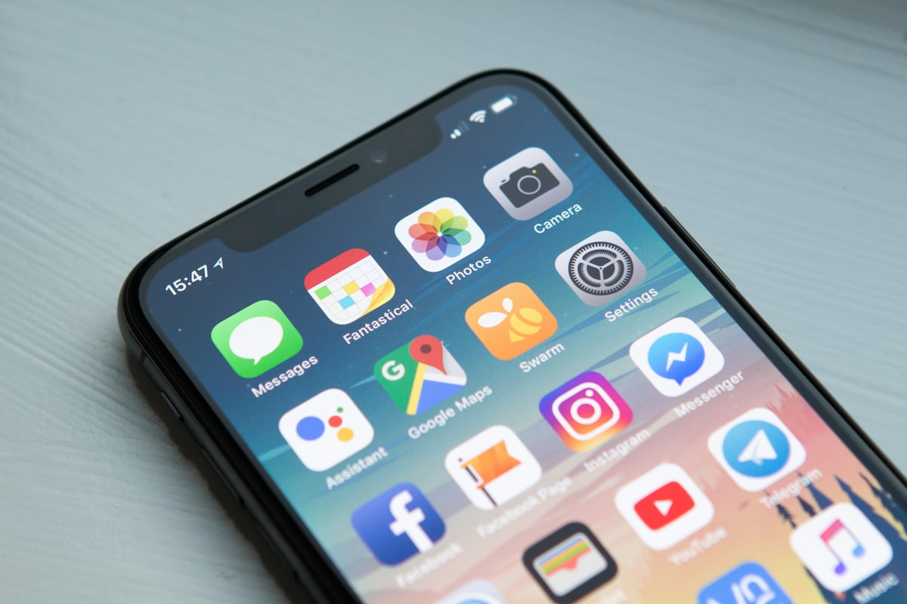
How mantroOps Solves It
One Product, Two Experiences
Adoption-Driven Design
A responsive system where the software adapts to the firm — not the other way around.
Desktop Dashboard
Field-Ready Mobile
Built for managers and supervisors — full asset setup, configuration, and compliance reporting.
Simple app for technicians — scan QR codes, receive work orders, and log jobs offline with automatic sync.
mantroOps · Project Kickoff · June 2025
04
Notes:
mantroOps bridges the gap between the office and the field. Managers get a powerful desktop dashboard for tracking and reporting, while technicians get an incredibly simple mobile experience that works seamlessly offline and syncs automatically later.

Slide 5
Where We Win
Feature Comparison Matrix
Factor | Global / Regional Tools | mantroOps
Connectivity | No / limited offline capability | Full offline-first capability
Alerts & Reminders | Email or app notifications only | Built-in WhatsApp & SMS alerts
Procurement | USD only, no local vendor tracking | GHS + local suppliers
Compliance | No local regulatory framework | One-tap EPA & GNPC reporting
Pricing & Setup | High USD subscription; months to onboard | Affordable GHS pricing; onboard in days
mantroOps · Project Kickoff · June 2025
05
Notes:
Our competitive advantage isn't just a list of features—it's pure adoption. We win because we meet teams where they already are: on WhatsApp, using local vendors in Kumasi or Takoradi, and paying in Cedis.

Slide 6
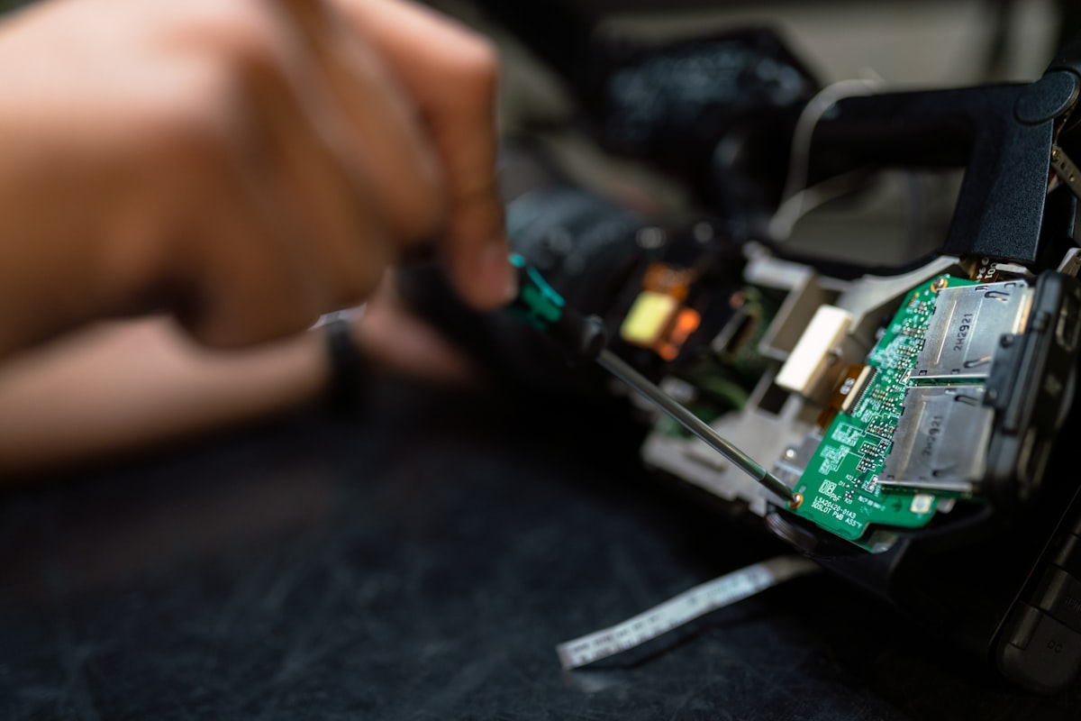
Small Team, Fast Execution
Our Lean Execution Team
Product & Tech Lead (CEO)
Sales & BD
Builds the MVP, owns product vision, and handles critical tech decisions.
Leverages local engineering connections to open doors and close pilot clients.
UI/UX Designer
Operations & Growth
Clean, intuitive interfaces that work on lower-end Android phones in the field.
Manages onboarding, client communication, and ensures smooth delivery.
mantroOps · Project Kickoff · June 2025
06
Notes:
We are a focused 4-person team built to move fast without unnecessary overhead. The tech lead builds, the designer makes it look simple enough to easily sell, sales gets us in front of the right clients, and operations makes sure nothing falls through the cracks.

Slide 7
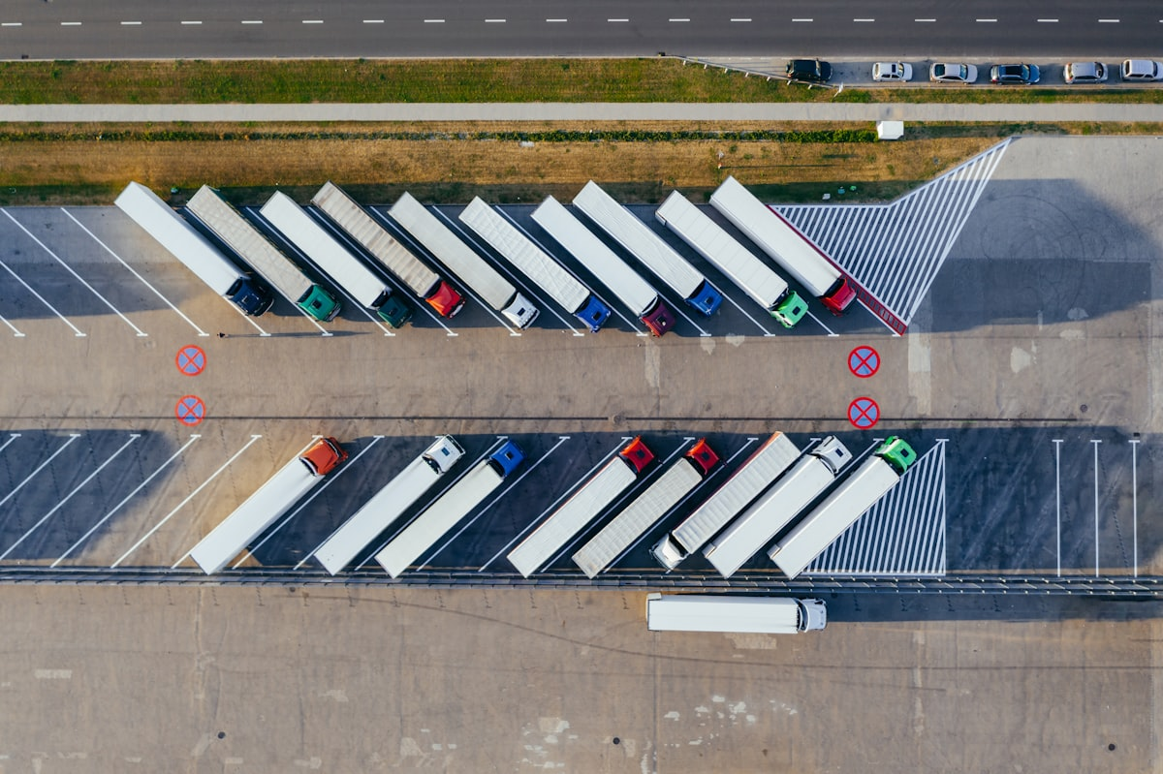
Roadmap to Our First Pilot
The First 90 Days
Days 1–30
Foundation
Build core MVP (Asset Register, Work Orders, PM Reminders). Sales initiates conversations with 5 engineering firms.
Days 31–60
Demo Ready
Polish UI, add full offline support and QR scanning. Run live demos with warm contacts.
Days 61–90
First Pilot
Onboard and deeply support our first paying or committed pilot client to document real results.
mantroOps · Project Kickoff · June 2025
07
Notes:
Our target for the next 90 days is hyper-focused: get a demoable MVP ready and land our very first pilot client. We are not building everything at once; we are focusing on traction.

Slide 8
Relationship-Driven Growth
Go-To-Market Strategy
Phase 1
Warm Outreach
Use existing industry relationships for 30-minute problem-validation chats — not cold sales pitches.
Phase 2
Pilot Program
Onboard 2–3 firms on a free or discounted 3-month pilot to document downtime reduction and cost savings.
Phase 3
Convert & Refer
Convert pilots to paying customers. Leverage Ghana Institution of Engineers for visibility.
mantroOps · Project Kickoff · June 2025
08
Notes:
The honest reality is that our first 3 clients won't come from digital marketing or a website. They will come from us picking up the phone and calling people we already know in the industry. Trust and warm introductions close deals in Ghana.

Slide 9
Design Guidelines & Visual Intent
Product Brand & Identity
Big Smile Papaya
Foggy Day Gray
#F1583B
#4F4E4F
Logos, primary buttons, key CTAs
Body text and secondary UI elements
Verdemar Seguro
White
#00A691
#FFFFFF
Synced, approved, and online states
Backgrounds, cards, generous breathing room
Crisp and premium — yet clean enough for lower-end Android phones in the field.
mantroOps · Project Kickoff · June 2025
09
Notes:
Our UI/UX needs to look crisp and feel premium, yet clean enough to operate smoothly on lower-end Android phones in the field. We'll use Papaya orange for primary interactions and Verdemar teal for clear visual feedback when data syncs or a work order is approved.

Slide 10
Immediate Actions
1
Confirm final team responsibilities and workflow.
2
Begin problem-validation calls with 5 to 10 engineering firms.
3
Kick off our first tech build sprint for the core MVP.
4
Identify and list top early pilot partners in Accra, Tema, and Takoradi.
Let's build this.
mantroOps · Project Kickoff · June 2025
10
Notes:
Let's align on our roles today so we can kick off the first engineering sprint and start talking to our core contacts to validate these specific field pain points. Let's build this.

