Slide 1
Strawberry
PRESENTATION
Congyao Duan

Slide 2
Road Map
Ý
Introduction
.Data organization
EDA
Data cleaning

Slide 3
Introduction
This dataset is about the information of three kinds of berries:
blueberries, strawberries and raspberries.
I choose to analyze the data of strawberries.
First, I use R to clean and select the raw data.I chose strawberry for
analysis. Then, I use R to analysis the data. I do some exploratory
research to get familiar with this data.

Slide 4
Data cleaning&organization
Separate the data strawberries from other berries.
Remove the columns with only one value
Separate the column of data item, domain, domain category into the column of type, production, Materials, Chemical.
Remove redundant columns and rearrange all the columns.
Deal with the value column to transform na, D,into 0 and convert character data to numeric.
Yes or no question
Score: 0 - 5

Slide 5
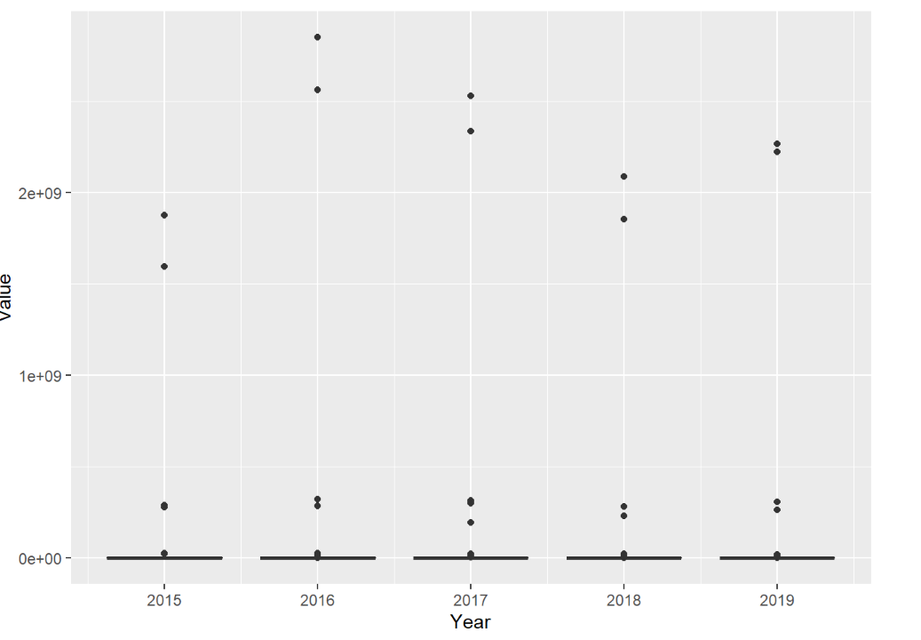
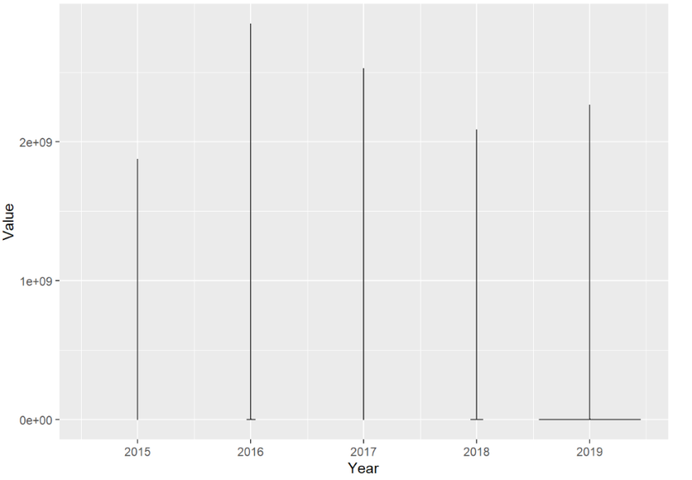
Exploratory Data Analysis(EDA)
In order to see the distruction of the data clearly,I draw boxplots and violin plots to observe first.Boxplot can not only reflect the distribution characteristics of the original data, but also compare the distribution characteristics of multiple groups of data. It can find the maximum, minimum, median and two quartiles of the data. A boxplot can also be used to find outliers and thus process outliers in data.Violin plots are used to show the distribution and probability density of multiple sets of data. This chart combines the features of box and density charts and is mainly used to show the distribution shape of the data. Similar to the box diagram, but better displayed at the density level. Here’s an example below:

Slide 6
Thank You

