Slide 1
Distortion-free, multi-shot EPI with Blip-Up and Down Acquisition (BUDA) and structured low-rank reconstruction
Contact: Congyu Liao, cyliao@stanford.edu

Slide 2
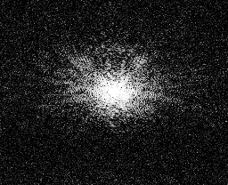
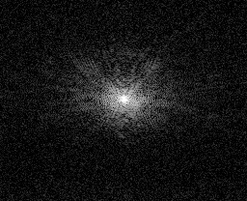
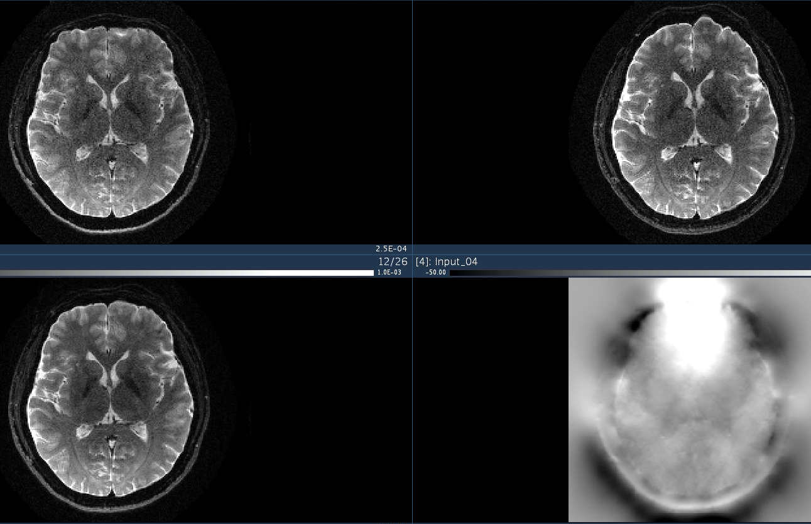
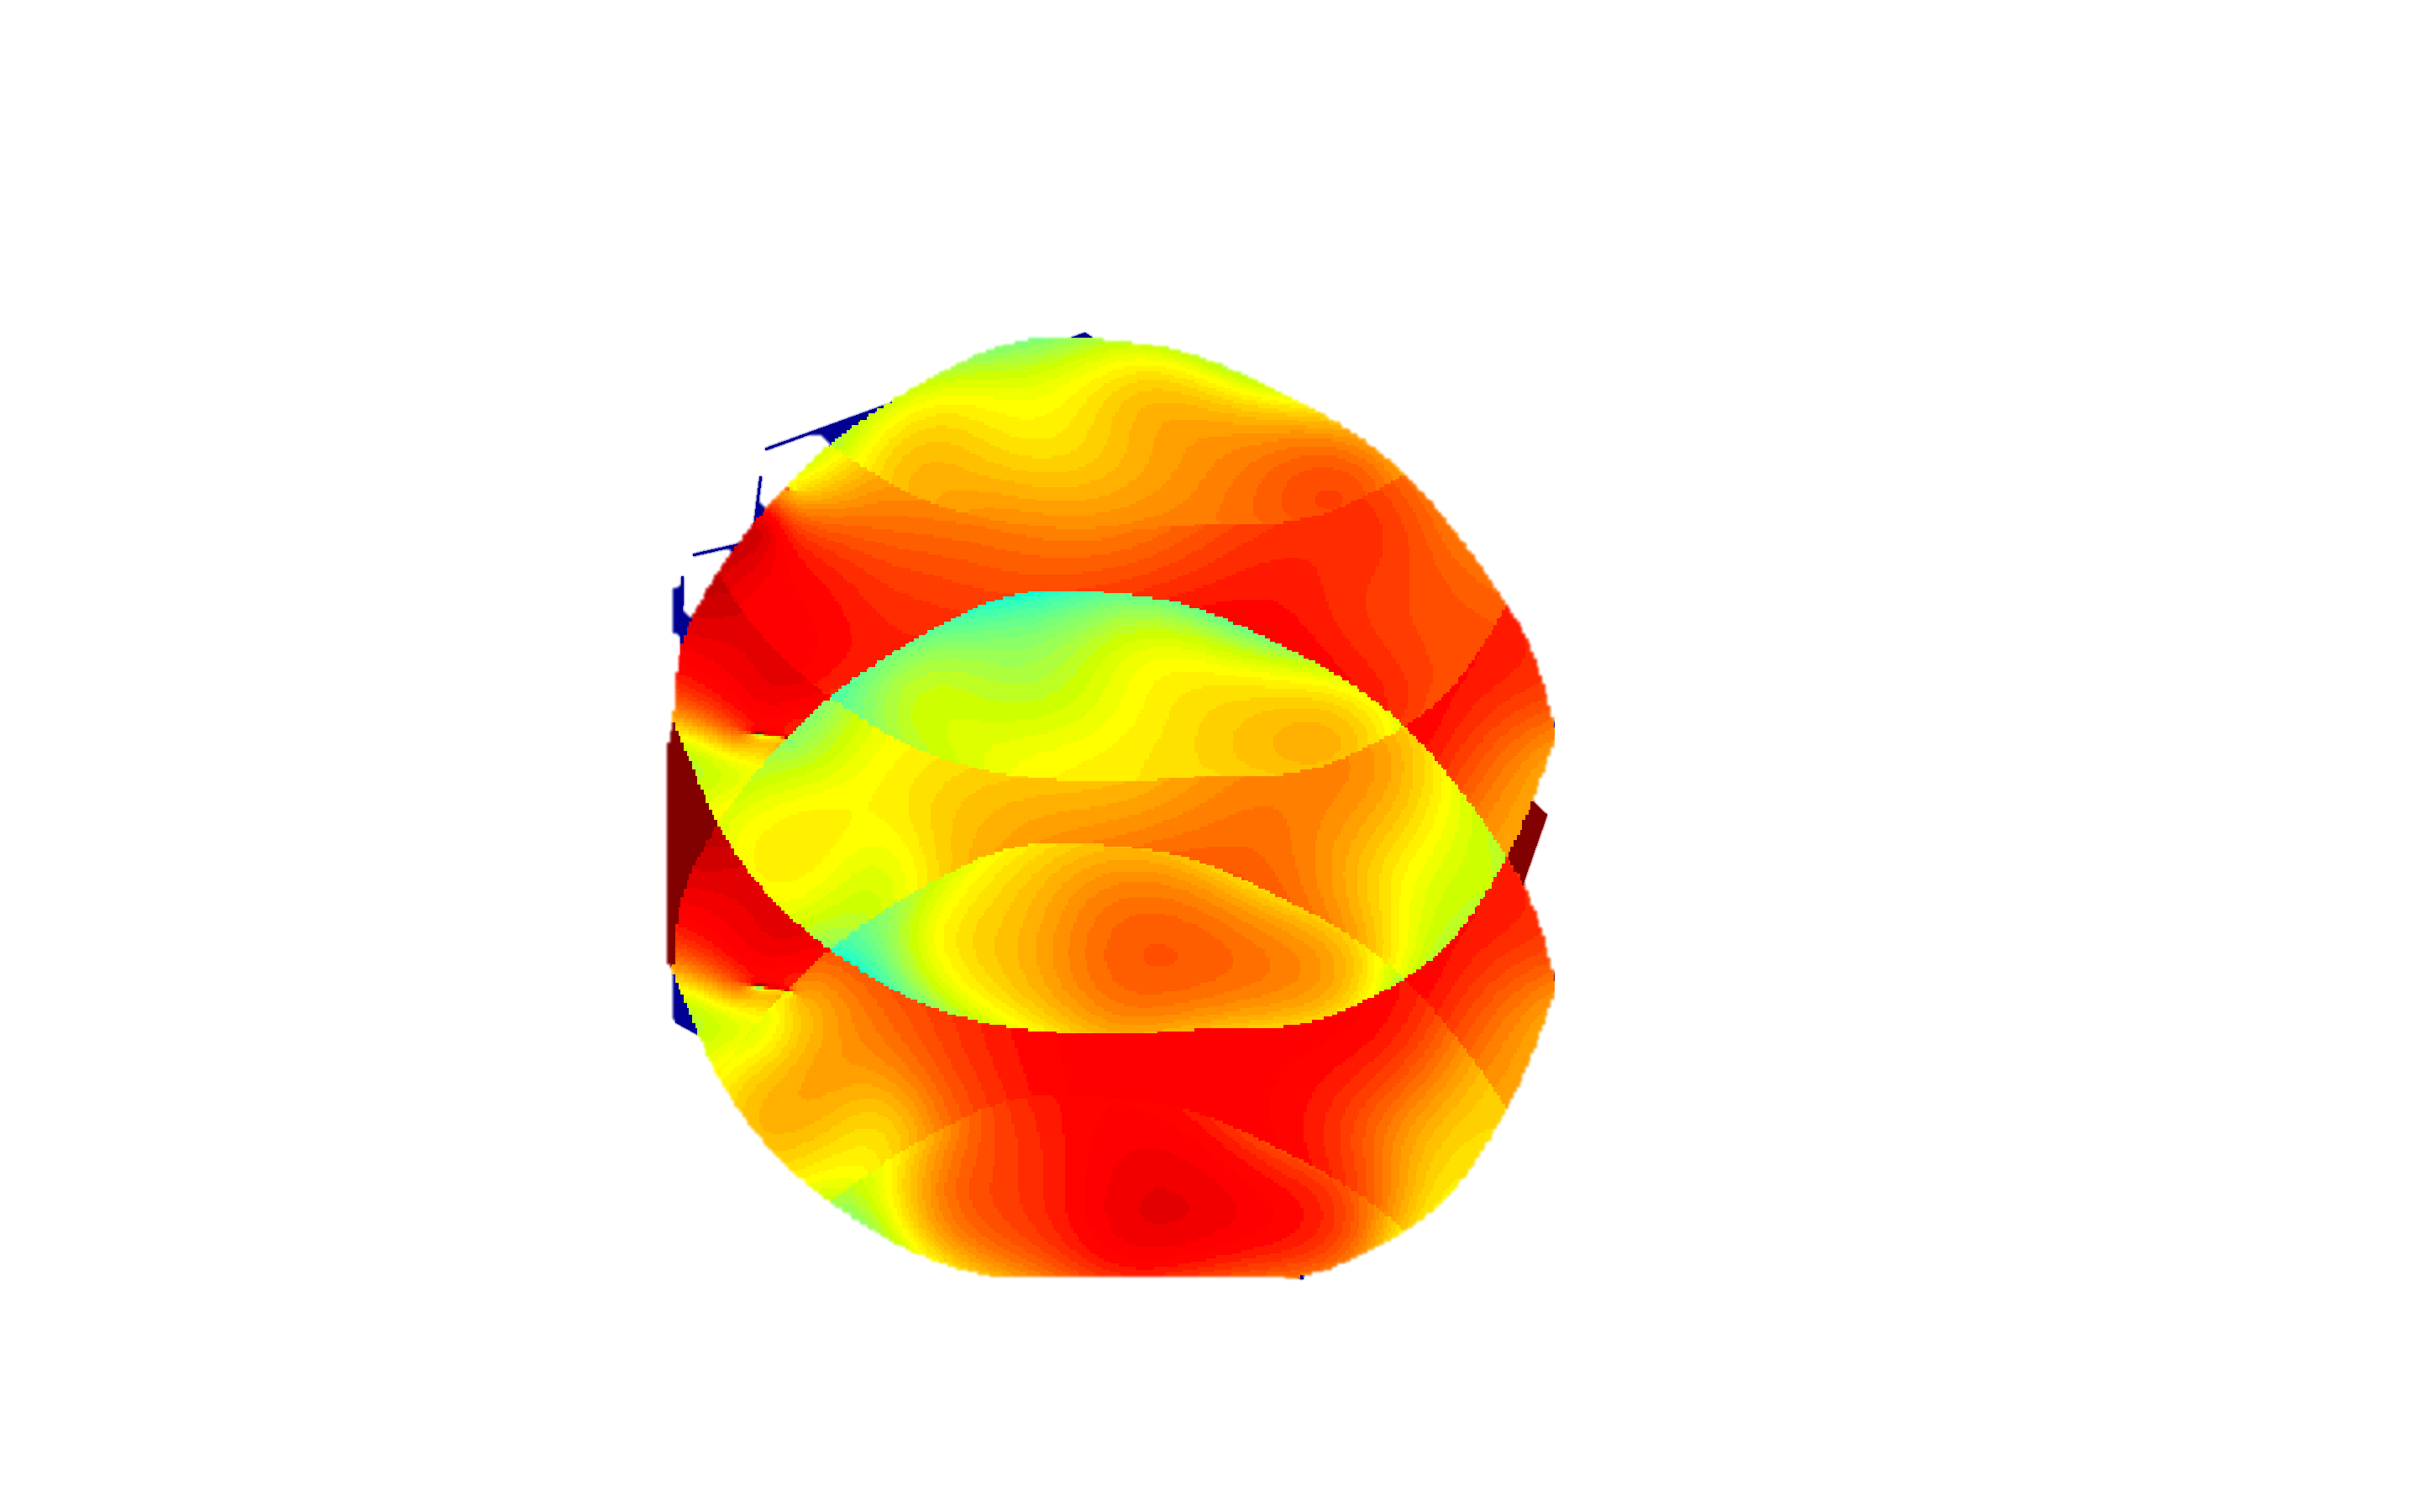
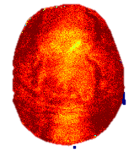
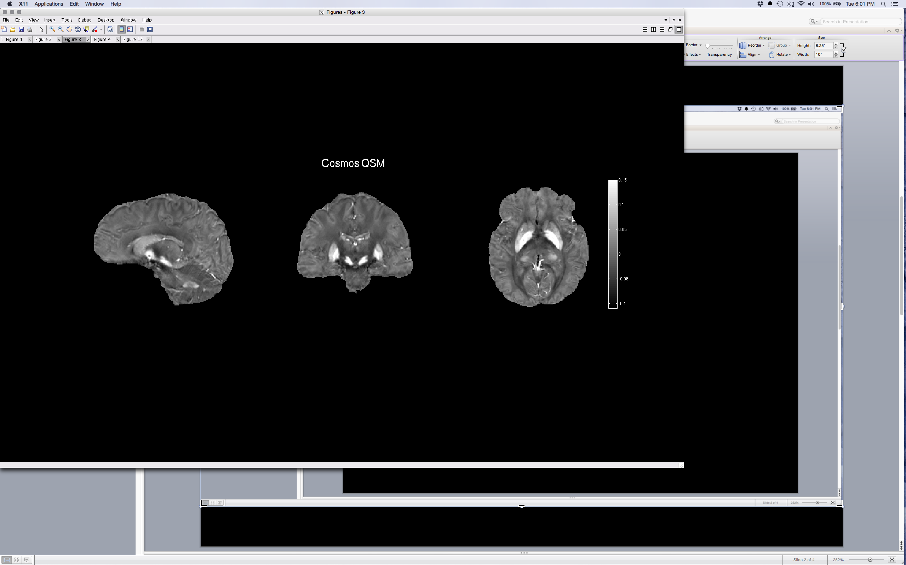
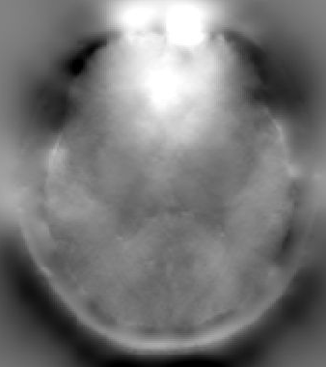
Blip-up and down acquisition/reconstruction framework
Blip-up Recon
Blip-down Recon
Distortion-free
Recon
partial Fourier
partial Fourier
G_{avg}=1.43
G_{avg}=1.13
d1: shot1
_{blip-up}
d2: shot2
_{blip-down}
FSL:TOPUP
R_{inplane}=4
2-shot R_{inplane}=4
50 Hz
Joint Reconstruction
$$\min_{x}\sum_{t}{{\left\|F_{t}E_{t}Cx_{t}−d_{t}\right\|}_{2}^{2}}+λ{\left\|\left.ℋ(x\right)\right\|}_{∗}$$
low-rank
constraint
parallel imaging with field map $E$
$$\left.ℋ(x\right)$$
-50 Hz
low-rank on Hankel matrix
Field map
(A)
Iterative
reconstruction
(B)
Notes:
Change the sampling pattern

Slide 3
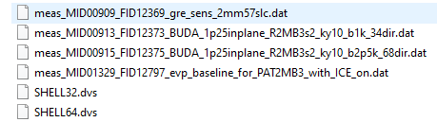
Acquired in-vivo datasets
GRE scans for coil sensitivity maps
BUDA data with b= 1000 and (32 diffusion directions +2 b=0 images)
BUDA data with b= 2500 and (64 diffusion directions +4 b=0 images)
Scan protocols
Diffusion b-tables
Download these datasets from :
And then copy these datasets to ./data/ folder

Slide 4
The scan protocol of BUDA data
FOV: 220 mm *220mm, matrix size: 176*176
In-plane resolution: 1.25 mm *1.25mm
Slice thickness: 2mm
Number of slices: 57
Number of coils: 32
TR/TE = 2800/77 ms
Effective echo-spacing = 0.37 ms
Multi-band factor: 3 with CAPI-shift FOV/2 per shot
In-plane acceleration factor :2 per shot
partial Fourier factor: 0.75
BUDA acquisition with AP shot kyshift 1 and PA shot kyshift 0
Two shells: b= 1000 with 32 diffusion directions and b=2500 with 64 diffusion directions

Slide 5
MATLAB offline reconstruction
The reconstruction scripts have been tested on MATLAB 2015b.
The reconstruction scripts have been tested on Linux OS.
The scripts require BART toolbox and FSL software
BART toolbox 0.5.00 is recommended (https://zenodo.org/record/3376744)
FSL 6.0.4 is recommended (https://fsl.fmrib.ox.ac.uk/fsl/fslwiki/FslInstallation)
Warning: your workstation should have more than 64GB RAM and 50 GB storage to reconstruct the raw data!

Slide 6
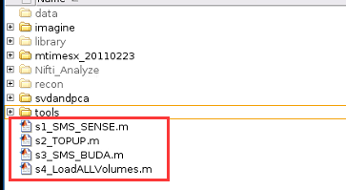
Reconstruction scripts
Step1: run S1_SMS_SENSE.m to reconstruct each shot separately
Step2: run S2_TOPUP.m to estimate the field maps between AP/PA shots
Step3: run S3_SMS_BUDA.m to jointly reconstruct distortion-free BUDA-EPI
Step4: run S4_LoadALLVolumes.m to load all volumes and combines AP/PA shots after removing background phase of each shot

Slide 7
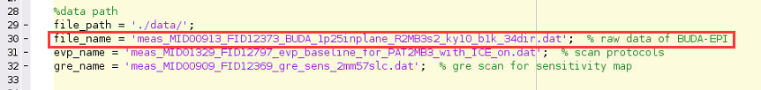
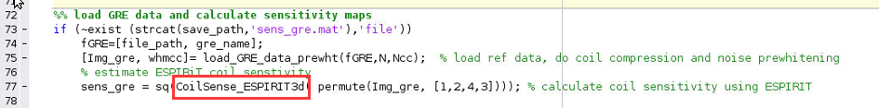
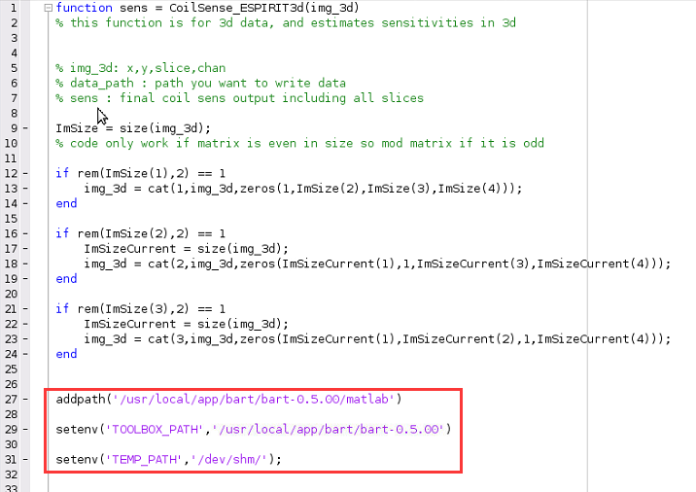
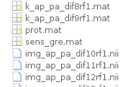
S1_SMS_SENSE.m
1. file_name
2. The “CoilSense_ESPIRIT3d” function is using BART toolbox. Make sure you installed BART successfully.
3. Open this function, make sure the environment setting
and folder path are correct
4. The script will create SMS-SENSE reconstructed AP/PA shots
and ghost-corrected undersampled k-space data

Slide 8
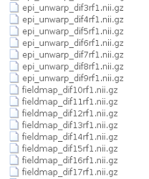
S2_TOPUP.m
Make sure the FSL functions can be called on MATLAB
This script will generate field maps as well as unwrapped EPI shots

Slide 9
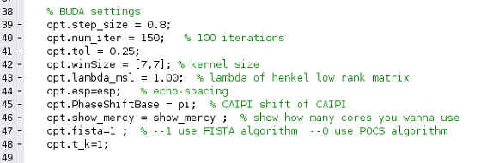
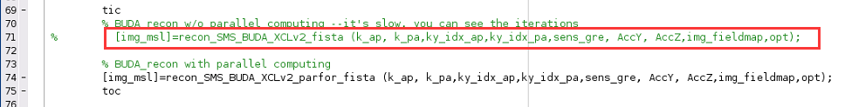
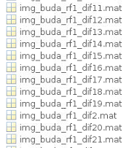
S3_SMS_BUDA.m
BUDA settings:
You can also use non-parallel computing version to debug BUDA code
This script will generate BUDA reconstructed images

Slide 10
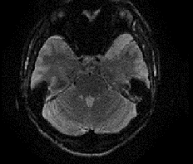
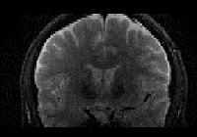
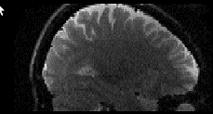
S4_LoadALLVolumes.m
load whole-brain volumes and do real-valued diffusion processing to combine BUDA shots
This script will generate final BUDA results in ./recon/ folder.

Slide 11
Reference
If possible, please include the following citations if you find our reconstruction useful:
[1] Liao C, Bilgic B, Tian Q, Stockmann JP, Cao X, Fan Q, Iyer SS, Wang F, Ngamsombat C, Lo WC, Manhard MK. Distortion‐free, high‐isotropic‐resolution diffusion MRI with gSlider BUDA‐EPI and multicoil dynamic B0 shimming. Magnetic Resonance in Medicine. 2021
[2] Liao, C., Cao, X., Cho, J., Zhang, Z., Setsompop, K. and Bilgic, B., Highly efficient MRI through multi-shot echo planar imaging. In Wavelets and Sparsity XVIII (Vol. 11138, p. 1113818). International Society for Optics and Photonics. 2019

