Slide 1
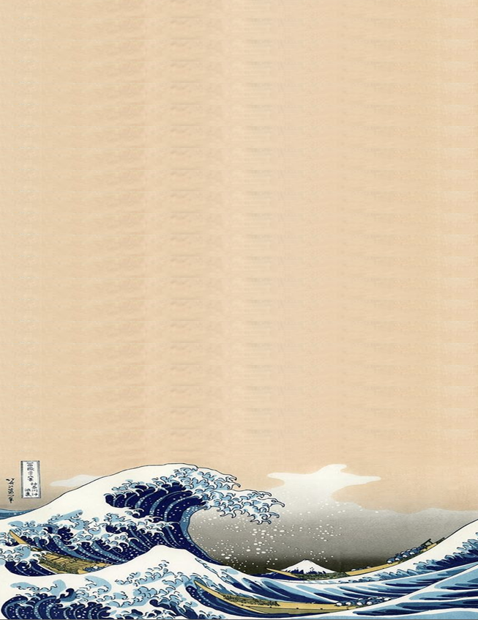


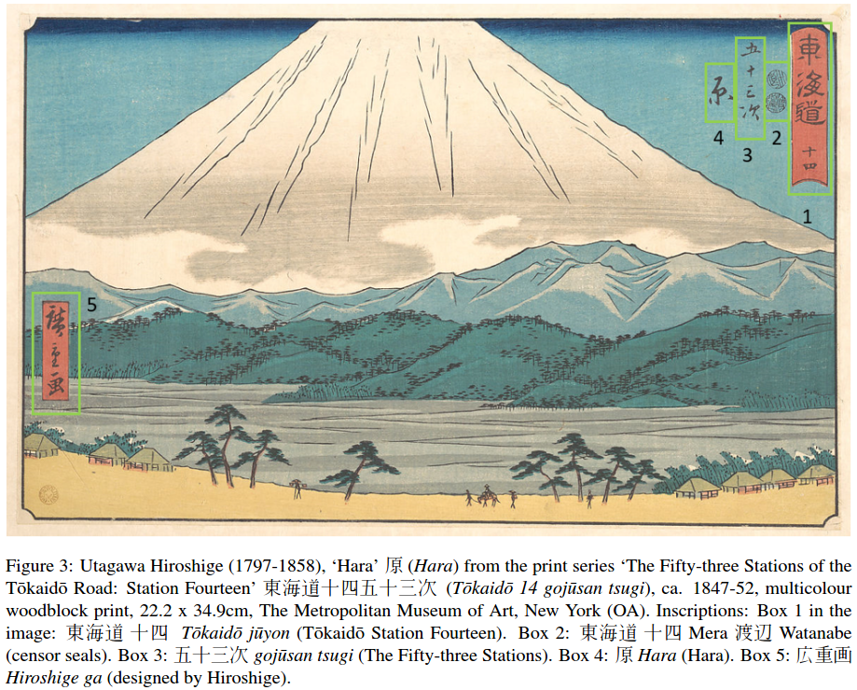
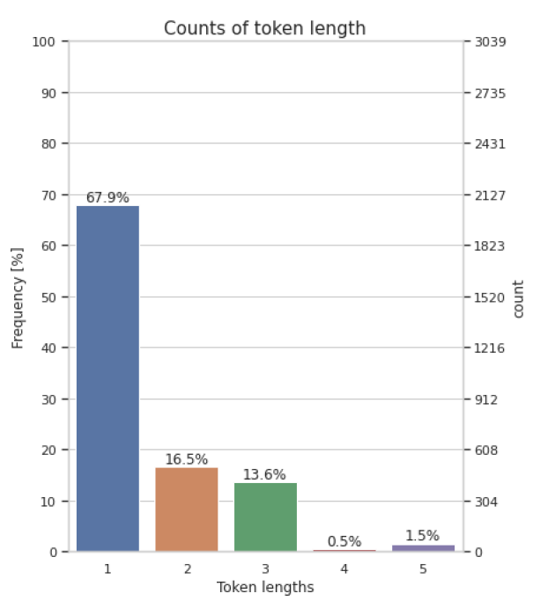
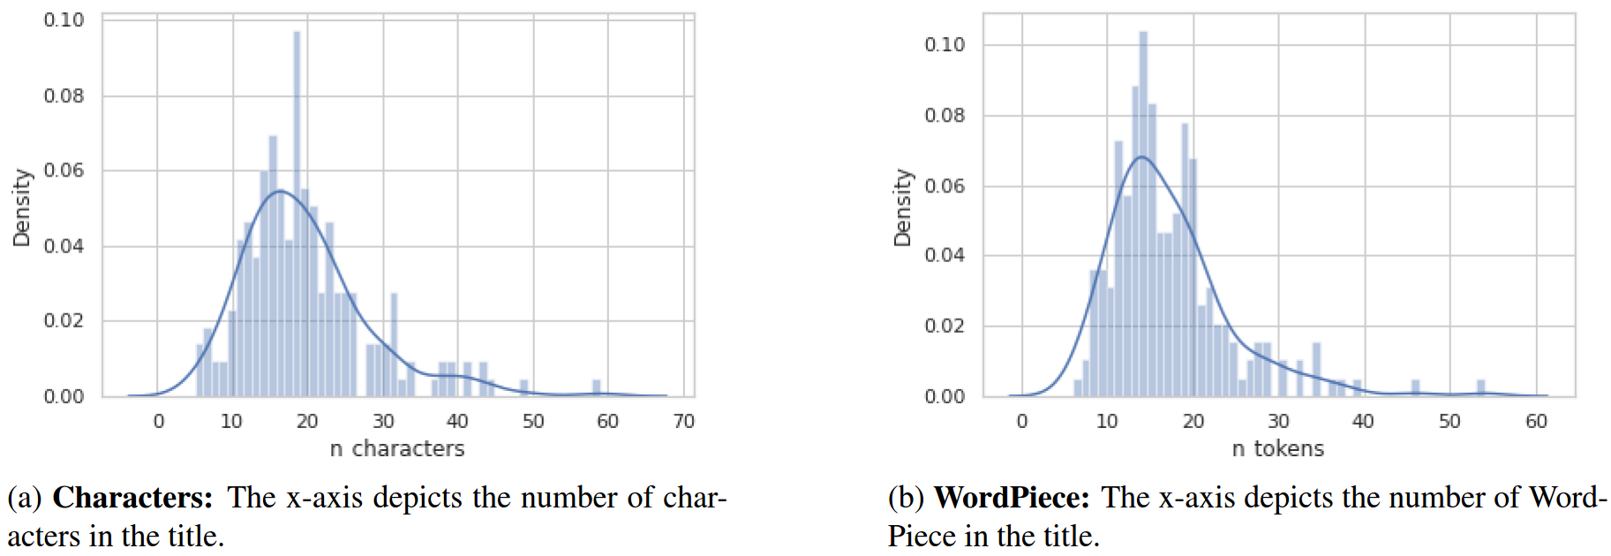
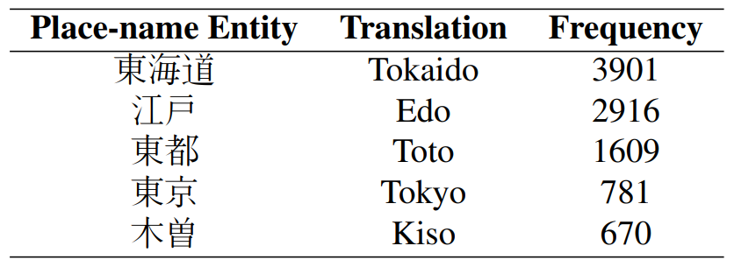
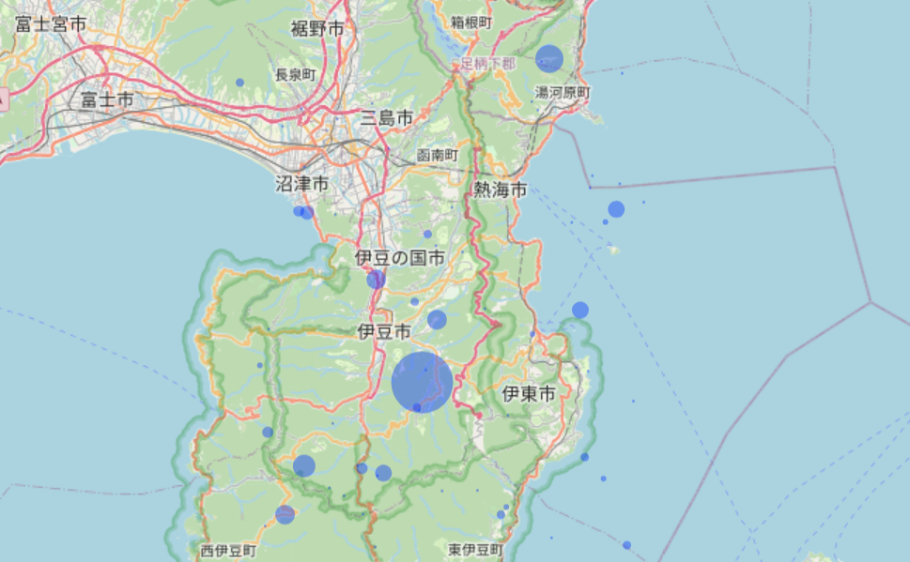
A Study of Distant Viewing of Ukiyo-e Prints
Konstantina Liagkou, John Pavlopoulos, Ewa Machotka
Introduction
This study targets multicolor landscape prints produced in Japan between the 17th and mid-19th century.
Defined as meisho-e or ‘pictures of famous places’ these images are grounded in rich poetic culture and tend to mediate depicted places and topographies.
Due to the richness and diversity of the corpus the extent and nature of this mediation is still not understood by art historians.
This study hypothesizes that NLP technology allows for a large-scale digital geospatial exploration of the studied prints, which is currently impossible.
The goal of this study is is to answer the following research questions:
What kind of places are depicted in meisho-e prints and what places are not featured in the images?
How are these places distributed across Japanese territory?
The combination of art historical ‘close reading’ with computational ‘distant viewing’, or microanalysis of images, is expected to generate a new epistemology of landscape prints.
Dataset
Inscriptions on prints are in ‘cartouches’ or are positioned directly in compositional space of the image.
Each inscription includes one or more place-names.
For example, the inscriptions on Fig. place-name: Tokaido Road.
The annotator define 東海道 as GPE.
Access by Art Research Centre (ARC) at Ritsumeikan University
20,408 digitized Japanese early modern ukiyo-e prints
Our dataset comprises inscriptions of 200 prints
One main annotator, marked 469 tags in the dataset
104 tags were of type LOC and 365 of type GPE
 | Avg | Min | Max
tags per title | 2.33 | 1 | 11
characters per GPE tag | 2.62 | 1 | 8
characters per LOC tag | 2.93 | 2 | 5
cartouches per title | 2.50 | 1 | 11
character tokens per title | 19.68 | 5 | 59
WordPiece tokens per title | 17.17 | 6 | 54
length per token | 1.52 | 1 | 5
Methodology
NER to identify place-names (LOC & GPE) in inscriptions on ukiyo-e
The inscriptions on 100 prints were annotated by an art historian
Used these to fine-tune pre-trained spaCy and BERT models
Annotated another set of 100 prints for evaluation
Precision, Recall and F1 scores for evaluation metrics
The inscriptions of 20 randomly selected prints were annotated by a second annotator, an expert in Japanese history and language
Computed Cohen kappa for inter-annotator agreement
Table: Ukiyo-e prints statistics that count of a number of dimensions
Results
Inter-annotator Agreement (ΙΑΑ)
Micro-averaged Cohen’s kappa
42.97% for LOC
78.63% for GPE
LOC + GPE → PLACE leads to 78.80% IAA
Experiments
SpaCy and BERT perform equally well in F1 for LOC
BERT significantly better in GPE
SpaCy scores high in Precision but lacks in Recall
BERT balanced between Precision and Recall, with 74% F1
Error analysis
Named entities correctly identified
Misclassification between GPE and LOC, maybe because LOC IAA is low
Fine-tuning BERT with PLACE labels F1-score increases to 78%
 | Precision | Recall | F1-score
 | SPACY BERT | SPACY BERT | SPACY BERT
GPE | 0.84 0.73 | 0.44 0.74 | 0.41 0.74
LOC | 0.59 0.59 | 0.50 0.50 | 0.54 0.54
Table: Evaluation of SpaCy and Bert NER with Precision, Recall and F1-score at the named entity level, on 100 instances. In bold is the best F1-scores.
Discussion
Conclusion
Discussion
We used the BERT model in order to tag all the place-name entities mentioned within image content-related inscriptions printed on 20,408 prints. The place-names are pinned on a map. The size of each
pin reflects the frequency of a given place-name.
Tokaido was the most frequent place-name.
• BERT NER model, fine-tuned on our dataset, can provide a means for ‘distant viewing’. However, the model makes mistakes (e.g. places that belong outside Japan).
• Only a single place-name tag, PLACE, was used in BERT NER model.
• The dataset comprises only 200 instances, but more annotations can lead to more accurate models.
Presented a dataset (is released for public use) of
ukiyo-e landscape prints, with place-names included in the print inscriptions annotated by an art historian.
Japanese BERT-based NER model can achieve a promising performance.
Use-case of how can a distant viewing of a visual dataset be undertaken for facilitating research in art history.
Expand our dataset with more inscriptions, as well as with entity types.
Undertake a spatiotemporal study of ukiyo-e landscape prints and investigate the benefits of NLP-fuelled ‘distant viewing’ by integrating the dimension of time in our analysis.
Table: The five most frequent place-names recognised by BERT within the the 20,408 titles studied.
Limitations
Future Work
Notes:
Introductions
Hello everyone. I want to introduce us to our paper, ‘a study of distant viewing of ukiyo-e prints’. The authors of this paper was Konstantina liagkou, John Pavlopoulos and Ewa machotka
First let me explain the rationale for this research project. Japanese early modern woodblock prints, so-called ukiyo-e or ‘pictures of the floating world’ produced between the seventeenth and mid-nineteenth century, are one of the most widely recognizable visual images today.The question is however how to do it considering that corpora are extremely rich and diversified. Traditional analytical methods based on close reading or interpretation of individual images are not effective for this task. Therefore, we have decided to explore a possibility to complement close reading with macroanalysis of large dataset of prints with help of computational tools to group the images on the basis of their visual features (content-based and formal characteristics) and develop a new classification of prints that we today perceive as ‘landscapes’. This is of course a very complex task and today we are presenting the results of the first phase of the study.The goal of this study is is to answer the following research questions:What kind of places are depicted in meisho-e prints and what places are not featured in the images?How are these places distributed across Japanese territory?
Dataset
To conduct ‘distance viewing’ of images we of course needed data. Fortunately, the access to the data for this work was facilitated by the database hosted at the Art Research Centre at Ritsumeikan University, one of the leading Digital Humanities hubs in Japan and a collaborative partner of this project. The centre’s digital databases of Japanese printed culture hosts approx. 700,000 (678,429) prints kept at 28 institutions in Japan and abroad. Our study investigated approx. 20,000 (20,408) digitized prints featuring natural environments, issued around 1800-1850s.
From the 20,000 digitized prints which arose from our search based on the keyword ‘meisho’ (famous place) and ‘meisho-e’ (image of a famous place), we randomly selected 200 samples to annotate and use them to train and test machine learning algorithms regarding extracting place-name entities. An art historian, an expert in Japanese early modern history annotated two sets of images (100 images each) identified through random sampling.
click: The annotation process was guided by two major principles. First, all places that were possible to be pinned on a map (e.g. names of cities, temples, shrines, bridges) were annotated as GPE and we detect 365 GPE tag. Second, places that were less-easily pinned on a map (e.g. roads, mountain ranges) were annotated as LOC with 104 tags
click: Here, there are some statistics for ukiyo-e prints that count the average ,minimum and maximum of tags and tokens. For instance, around 17 tokens appear in each title, after using WordPiece tokinizer. The image content-related inscriptions have 19.68 Sino-Japanese kanji characters on average, with minimum 5 and maximum 59.
click: Then to have a more complete picture around the data, we did deeply exploratory analysis in the tokens and the characters. As, seen in barplot, the tokens had length from 5 characters to 1 characters, which were the most. The length of the titles, counting in word pieces, follows the normal distribution without a lot of outliers as can be seen in distribution plot with the mean is 17 tokens as we said before.
click:The image content related inscriptions on prints are often featured in square red boxes called ‘cartouches’ or are positioned directly in the compositional space of the image (without the box). Each inscription includes one or more place-names. The titles that annotated are depicted in the prints and include place-names. To show what we mean, the inscriptions on Fig. 3 include two place-names: Tokaido Road and Hara village.
Methodology
We use a Name Entity Recognizer to identify the place-names in inscriptions on ukiyo-e. To develop a model, we need a annotated dataset, so our main art historian, Ewa, create LOC and GPE tags for the place-name entities for 200 inscriptions. Then, we fine tune pretrain spacy and bert models with the half data, and evaluate them with the other half. As we have an entity classification model , we select to use the most widely metrics, precision, recall and f1-score. Last but not least, a second annotator annotated the inscriptions of 20 randomly prints of the already annotated sample to perform inter-annotator agreement.
Results
click: As we can see here, to annotate the scriptions with GPE and LOC tags was very difficult for the japanese expert, let alone for a machine learning model that can learn only the annotation for an expert.
click: As the GPE had both more tags appear and higher inter annotator agreement, it is obvious that can have better results than LOC. Furthermore, the bert model had significantly better in GPE than spacy, as balanced between Precision and Recall, with 74% F1-score. Lastly, the misclassification between GPE and LOC logically due to the fact that LOC was low in inter-annotator agreement. Thus, we Fine-tune the BERT with PLACE labels and F1-score increases to 78%.
Conclusion
Disc: We used the best-performing fine-tuned BERT model in order to tag all the place-name entities mentioned within image content-related inscriptions printed on 20,408 prints. The place-names are pinned on a map. The size of each pin reflects the frequency of a given place-name. Moreover, we represent the five most frequent place-name that regognised by Bert with the Tokaido take the first place with around 4.000 appearance.
Lim:
- The BERT NER model, fine-tuned on our dataset, can provide a means for `distant viewing', as shown in map. However, the model does make mistakes and noise is expected to be included in this view (e.g., places that belong outside Japan).
-Only a single place-name tag, PLACE, was used by our NER model, because GPE and LOC were merged into a single entity type. However, a bigger dataset could allow an analysis using a much more fine-grained resolution.
-Our released dataset comprises only 200 instances, but more annotations can lead to more accurate models. We plan to extend this dataset with more instances and place-name types.
click:To sum up, taking everything into consideration, This work presented a dataset of ukiyo-e landscape prints, with place-names included in the print inscriptions annotated by an art historian. Our dataset is released for public use. We showed that a Japanese BERT-based NER model, can achieve a promising performance. We provide an use-case of how can a distant viewing of a visual dataset be undertaken, as a step towards facilitating research in art history.
click:We expand our dataset with more inscriptions, as well as with entity types. Also, by integrating the dimension of time in our analysis, we will attempt to undertake a spatiotemporal study of ukiyo-e landscape prints and investigate the benefits of NLP-fuelled ‘distant viewing’.

