Slide 1


“One Rule Based System to rule them all”
Konstantina Liagkou
Emmanouil Papadatos

Slide 2
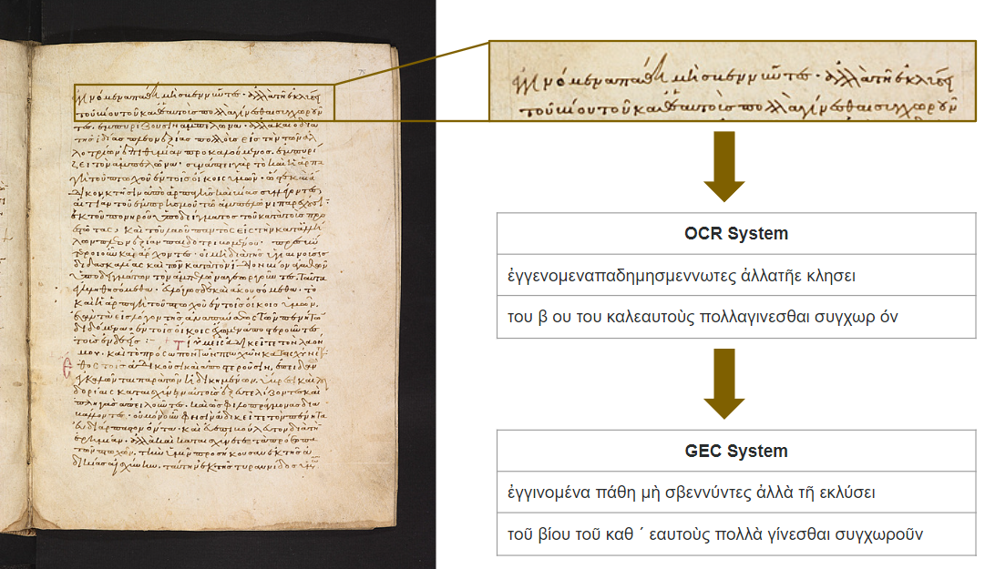
1
Introduction - Problem Set
Digital Image of Byzantine & Greek manuscripts
Extract text from image with an HTR System
Correct the text through a GEC System

Slide 3
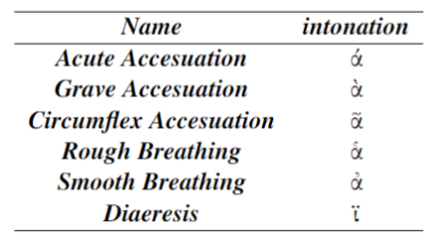
2
Exploratory Data Analysis - HTR outputs
01
- struggled to recognize the space in the correct position ("ἀλλατῆε κλησει"→"ἀλλὰ τῆ εκλύσει")
- some characters were converted to space ("β ου"→"βίου")
space
02
- many different intonations in ancient Greek language
("εμπυριζου"→"ἐμπυρίζουσι")
word stress
03
- struggled to identify visually similar characters
("δ" -> "ό")
visually similar characters
04
- misunderstood words were joint together
("ἐγγενομεναπαδημησμεννωτες"→"ἐγγινομένα πάθη μὴ σβεννύντε")
joint words

Slide 4
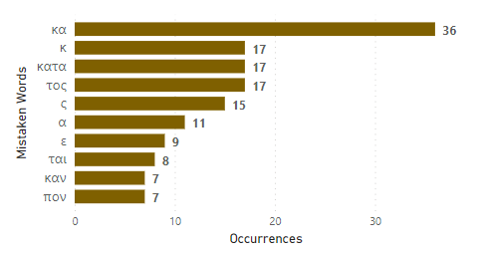
3
Exploratory Data Analysis - HTR outputs
05
different misleading representation of frequent words
- most common mistakes made by the HTR system with "κα" being the most frequent misrepresentation of "και" with over 36 occurrences.
06
split sentences
- words could be split at the end of
each line and continue to the next
[id3] "τῶν ἀλλ"
[id4] "οτρίων"
→ " τῶν ἀλλοτρίων" (complete sentence)

Slide 5
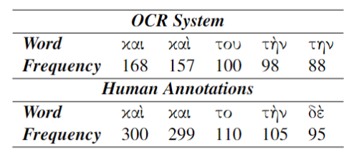
4
Exploratory Data Analysis - Annotated output
01
inconsistent / removed word stress
- word stress was missing from many sentences HTR output: "μος, καὶ τοπρο ποτω απτω χω ηκατίςχων ερ",
annotated transcript: "μου και το προσωπον των πτωχων καταισχυνετε"
- different word stress of the same word
καὶ, καί, και
02
wrongly corrected words
- HTR output: "της ἐδίας πλσον ἐξιας πολλους ἐις τὴν τῶν ἀλ"
annotated transcript: "τῆς ἡδεῖας πλεονεξίας πολλοὺς εἰς τὴν τῶν ἀλλ"

Slide 6

5
Method - Rule Based Model
Input Sentence:
"παιξτεεχηρευ καιπαιξτε καινούργιος γυναικας δικαι ονπεριτους ἀπλὡς ή πῶς φοῦ ἐ δίαι ἐεστιν τνῶ τηνκαρδιαν ειντοις"
"παιξτε εχηρευ καιπαιξτε καινούργιος γυναικας δικαι ονπεριτους ἀπλὡς ή πῶς φοῦ ἐ δίαι ἐεστιν τνῶ τηνκαρδιαν ειντοις"
Corrected as we go:

Slide 7
5
Method - Rule Based Model
Subset of
word
1
Subset of word
if subset of token, in corpus,
split the token
"παιξτεεχηρευ καιπαιξτε καινούργιος γυναικας δικαι ονπεριτους ἀπλὡς ή πῶς φοῦ ἐ δίαι ἐεστιν τνῶ τηνκαρδιαν ειντοις"
"παιξτε εχηρευ καιπαιξτε καινούργιος γυναικας δικαι ονπεριτους ἀπλὡς ή πῶς φοῦ ἐ δίαι ἐεστιν τνῶ τηνκαρδιαν ειντοις"

Slide 8
5
Method - Rule Based Model
Subset of
word
1
Combinations
of words
2
Combinations of words
The rule joined all possible combinations of words from corpora, and if the word was found in the test set, it was split.
"παιξτεεχηρευ καιπαιξτε καινούργιος γυναικας δικαι ονπεριτους ἀπλὡς ή πῶς φοῦ ἐ δίαι ἐεστιν τνῶ τηνκαρδιαν ειντοις"
"παιξτε εχηρευ και παιξτε καινούργιος γυναικας δικαι ονπεριτους ἀπλὡς ή πῶς φοῦ ἐ δίαι ἐεστιν τνῶ τηνκαρδιαν ειντοις"

Slide 9
5
Method - Rule Based Model
Edit distance
(1 & 2)
3
Subset of
word
1
Combinations
of words
2
ED = 2
Edit distance (ED)
-The rule checked if the token with edit distance equal to one character was in corpora
-The same rule was separately applied for words with more than 8 characters, like "γυναικας", but with edit distance equal to two characters
"παιξτεεχηρευ καιπαιξτε καινούργιος γυναεκασ δικαι ονπεριτους ἀπλὡς ή πῶς φοῦ ἐ δίαι ἐεστιν τνῶ τηνκαρδιαν ειντοις"
"παιξτε εχηρευ και παιξτε καινούργιος γυναικας δικαι ονπεριτους ἀπλὡς ή πῶς φοῦ ἐ δίαι ἐεστιν τνῶ τηνκαρδιαν ειντοις"

Slide 10
5
Method - Rule Based Model
Edit distance
(1 & 2)
3
Subset of
word
1
Combinations
of words
Bigrams of
words
2
4
Bigrams of words
-White spaces in the wrong positions
-The system took bigrams and merged them
-Then it would split the words into known words found in the corpora and create a new correct bigram
"παιξτεεχηρευ καιπαιξτε καινούργιος γυναικας δικαι ονπεριτους ἀπλὡς ή πῶς φοῦ ἐ δίαι ἐεστιν τνῶ τηνκαρδιαν ειντοις"
"παιξτε εχηρευ και παιξτε καινούργιος γυναικας δικαιον περιτους ἀπλὡς ή πῶς φοῦ ἐ δίαι ἐεστιν τνῶ τηνκαρδιαν ειντοις"

Slide 11
5
Method - Rule Based Model
Edit distance
(1 & 2)
Single character tokens
3
5
Subset of
word
1
Combinations
of words
Bigrams of
words
2
4
Single character tokens
-First rule, check whether the token is an article
-Second rule, if the token is not an article, it is merged with the end of the token to the left and the token on the right on its’ start. If any of those combinations matched with a word in the corpora, it would be replaced
"παιξτεεχηρευ καιπαιξτε καινούργιος γυναικας δικαι ονπεριτους ἀπλὡς ή πῶς φοῦδ ς δίαι ἐεστιν τνῶ τηνκαρδιαν ειντοις"
"παιξτε εχηρευ και παιξτε καινούργιος γυναικας δικαιον περιτους ἀπλὡς ή πῶς φοῦδ δίαι ἐεστιν τνῶ τηνκαρδιαν ειντοις"

Slide 12
5
Method - Rule Based Model
Edit distance
(1 & 2)
Single character tokens
3
5
Subset of
word
1
Combinations
of words
Bigrams of
words
Duplicate characters
2
4
6
Duplicate characters
Duplicate characters found in tokens were replaced with single ones, unless the token was found in the corpora
"παιξτεεχηρευ καιπαιξτε καινούργιος γυναικας δικαι ονπεριτους ἀπλὡς ή πῶς φοῦ ἐ δίαι ἐεστιν τνῶ τηνκαρδιαν ειντοις"
"παιξτε εχηρευ και παιξτε καινούργιος γυναικας δικαιον περιτους ἀπλὡς ή πῶς φοῦ δίαι ἐστιν τνῶ τηνκαρδιαν ειντοις"

Slide 13
5
Method - Rule Based Model
Edit distance
(1 & 2)
Single character tokens
Misspelled
pronouns
3
5
7
Subset of
word
1
Combinations
of words
Bigrams of
words
Duplicate characters
2
4
6
Misspelled pronouns
-Pronouns are difficult to correct, because too many words contain them with edit distance of two characters
-If the system recognized a misspelled pronoun, it would replace it with the correct version
"παιξτεεχηρευ καιπαιξτε καινούργιος γυναικας δικαι ονπεριτους ἀπλὡς ή πῶς φοῦ ἐ δίαι ἐεστιν τνῶ τηνκαρδιαν ειντοις"
"παιξτε εχηρευ και παιξτε καινούργιος γυναικας δικαιον περιτους ἀπλὡς ή πῶς φοῦ δίαι ἐστιν τῶν τηνκαρδιαν ειντοις"

Slide 14
5
Method - Rule Based Model
Edit distance
(1 & 2)
Single character tokens
Misspelled
pronouns
3
5
7
Subset of
word
1
Combinations
of words
Bigrams of
words
Duplicate characters
Joint
pronouns
2
4
6
8
Joint pronouns
If a pronoun was located at the beginning of a token, it would be split into two new tokens, with a white-space in between.
"παιξτεεχηρευ καιπαιξτε καινούργιος γυναικας δικαι ονπεριτους ἀπλὡς ή πῶς φοῦ ἐ δίαι ἐεστιν τνῶ τηνκαρδιαν ειντοις"
"παιξτε εχηρευ και παιξτε καινούργιος γυναικας δικαιον περιτους ἀπλὡς ή πῶς φοῦ δίαι ἐστιν τῶν την καρδιαν ειντοις"

Slide 15
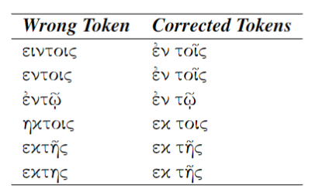
5
Method - Rule Based Model
Edit distance
(1 & 2)
Single character tokens
Misspelled
pronouns
3
5
7
The End of RBS
Subset of
word
9
1
Main
prepositions
Combinations
of words
Bigrams of
words
Duplicate characters
Joint
pronouns
2
4
6
8
Main prepositions
"παιξτεεχηρευ καιπαιξτε καινούργιος γυναικας δικαι ονπεριτους ἀπλὡς ή πῶς φοῦ ἐ δίαι ἐεστιν τνῶ τηνκαρδιαν ειντοις"
"παιξτε εχηρευ και παιξτε καινούργιος γυναικας δικαιον περιτους ἀπλὡς ή πῶς φοῦ δίαι ἐστιν τῶν την καρδιαν ἐν τοῖς"

Slide 16
6
Experimental Results - Rule Based Model
Character Error Reduction Rate (CERR)
 | Rule Based Model | 1st place | 2nd place | 3rd place
 | CERR
real | 0.439 | 2.525 | 1.034 | 0.567
synthetic | 0.096 | -7.719 | -7.784 | -0.629
real & synthetic | 0.278 | -2.264 | 0.049 | 0.247
 | WERR
real | 1.822 | 14.967 | 4.629 | 3.398
synthetic | 1.292 | -23.140 | -31.859 | -3.112
real & synthetic | 1.575 | -2.846 | -0.101 | 1.836
- based on the concept of Levenshtein distance
- count the minimum number of character-level operations required to transform the ground truth text into the HTR output.
Word Error Reduction Rate (WERR)
- more applicable if it involves the transcription of paragraphs and sentences of words with meaning
- the number of word substitutions, deletions, or insertions needed to transform one sentence into another.
Notes:
more applicable if it involves the transcription of paragraphs and sentences of words with meaning (e.g., pages of books, newspapers). [word level]

Slide 17
7
Experimental Results - Rule Based Model
Without Intonations
Models | Rule Based Model with intonation | Rule Based Model without intonation | 1st place
 | CERR
real | 0.439 | 4.632 | 2.525
synthetic | 0.096 | -7.826 | -7.719
real & synthetic | 0.278 | 5.947 | -2.264
new RBM overcome all the exist models.
- real without intonations
original RBM better results on synthetic.
- synthetic include intonations

Slide 18
8
Error Analysis - Rule Based Model
Different structure
- different structure altogether is out of the model’s capabilities to correct
Example:
"καξεύδὡςτα ξήμής"→ "κἀξηῦρες ὥστ ἀζημίους"
RBM: "και ξεύδὡς τα φήμής"
Increase size of corpus
- provide over 100 books of text in ancient Greek and Byzantine scraped from online sources.
The biggest collection:
title: Σύνοψις Ιστοριών
author: I.Skylitzis
total books: 5
words: 153,709
Corpora of limited size
- limits its correcting capabilities
Example:
"διδειγματα" → "διδαγματα"
Limitations
Improvements
- provide a lexicon of over 42,107 ancient Greek words independent of the collection of books
Small words
- small words that were very similar
Example:
HTR: "μολλειν"→ "μελλειν"
RBM: "μολεῖν" (an infinitive of "βλώσκω")
↓
Extract corpus for RBM
or
MLP mask models
Notes:
-RBS struggled with small words that were very similar.
-provide over 100 books of text in ancient Greek and Byzantine scraped from various online sources. Unfortunately, due to time constraints, we could not utilize them, and thus we provide them for future work.

Slide 19
9
Conclusion
Future Work
Additional resources provided to further improve the model
Pros & Cons
Does not require training and annotations
Dependent on corpora size
Proposed Solution
Developed a
Ruled Based Model
Experimental Results
RBM performed well on synthetic & real/synthetic data, underperformed on real data
RBM without intonation outperforms all other
proposed models
VS
Task
Correction of HTR output,
Byzantine & Greek manuscripts

Slide 20
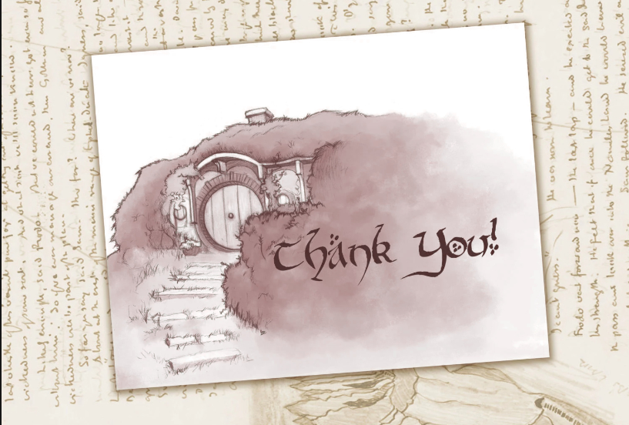

Slide 21
CONTENT
01
Introduction
Problem Set
Exploratory Data Analysis
HTR output & Annotated output
02
03
Method
Rule Based Model
Experimental Results
Rule Based Model
04
05
Error Analysis
Rule Based Model
Conclusion
Discussion & Future work
06

