Slide 1
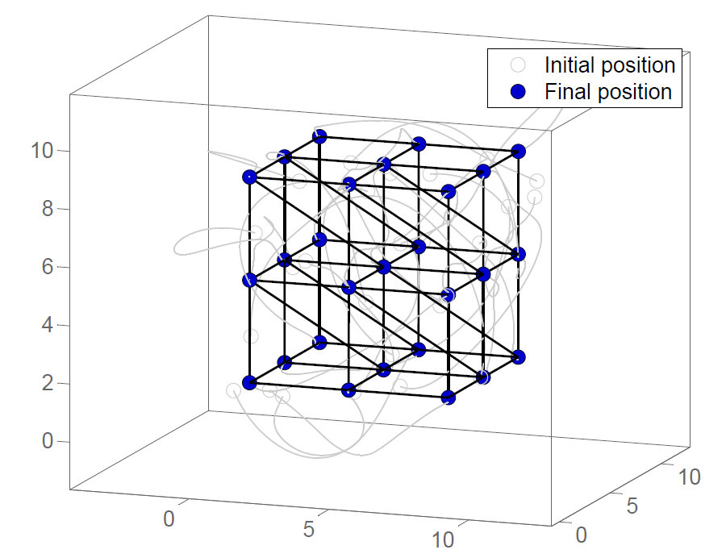
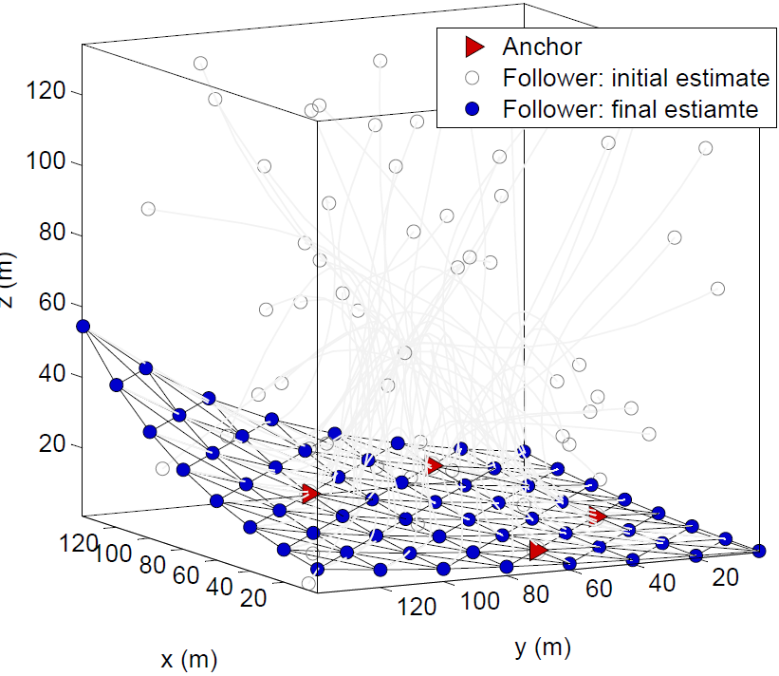
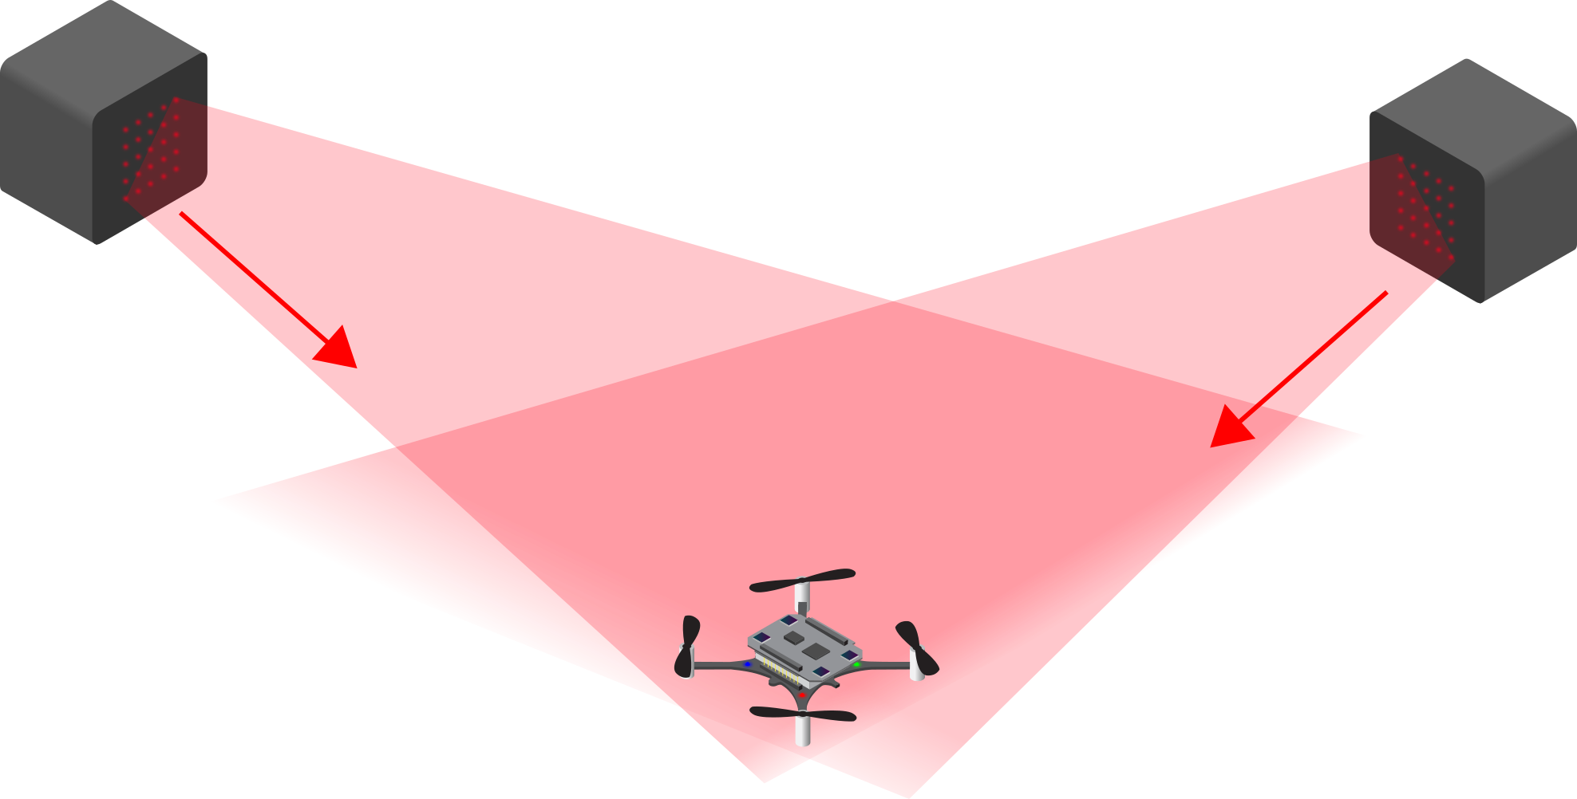
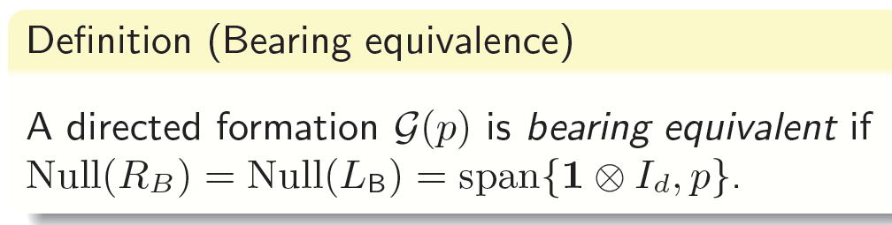
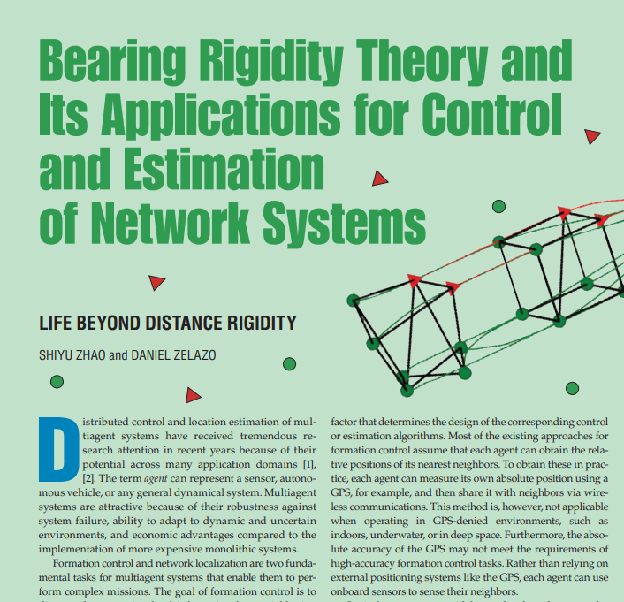
Characterizing bearing equivalence in directed graphs
Zhiyong Sun, Shiyu Zhao, Daniel Zelazo
Vision-based measurement: multi-robot coordination with bearing information
Bearing-based formation and network localization
Bearing equivalence in directed graphs
New formula for bearing Laplacian matrix;
Graphical characterizations of bearing equivalence (acyclic and cyclic digraphs);
Spectrum analysis of digraph bearing Laplacians;
Bearing-based formation control with stability guarantees.

