Slide 1


EC Vertical – Revenue Acceleration Blueprint
Data | Channel | AI | Governance
Pranav Kumar, Program Manager (Proposed)

Slide 2




Building a Predictable Revenue Engine
Funnel Governance & Leakage Control
Churn Reduction Through ROI Visibility
Channel-Based Cost Optimization
AI-Driven Pipeline Management
Objective: Revenue Stability + Margin Improvement

Slide 3






Revenue Architecture: Uncovering the Opportunity
Lead
Key Opportunity Areas
12,000 leads generated
Lead-to-conversion inefficiency
Low activation ratio
Limited segmentation by turnover
High direct acquisition cost
Weak predictive visibility
Contact
3,200 contacts made
Qualified
700 qualified opportunities
Conversion
180 conversions achieved
Retention
Sustaining customer relationships
Upsell
Expanding customer value
This horizontal flow illustrates the progression of customers through our revenue stages. Significant drops indicate leakage points, representing lost opportunities between each stage. Focusing on these areas is crucial for improving efficiency and maximizing revenue.
Core Insight: Revenue exists. Governance is fragmented.

Slide 4
Revenue Governance Framework: Weekly Tracking Dashboard
75%
INR.125
92%
8%
Activation %
ARPU
Renewal Ratio
Churn %
INR.50K
30s
Revenue per Manager
SLA Response Time
Impact: Revenue predictability + performance accountability

Slide 5
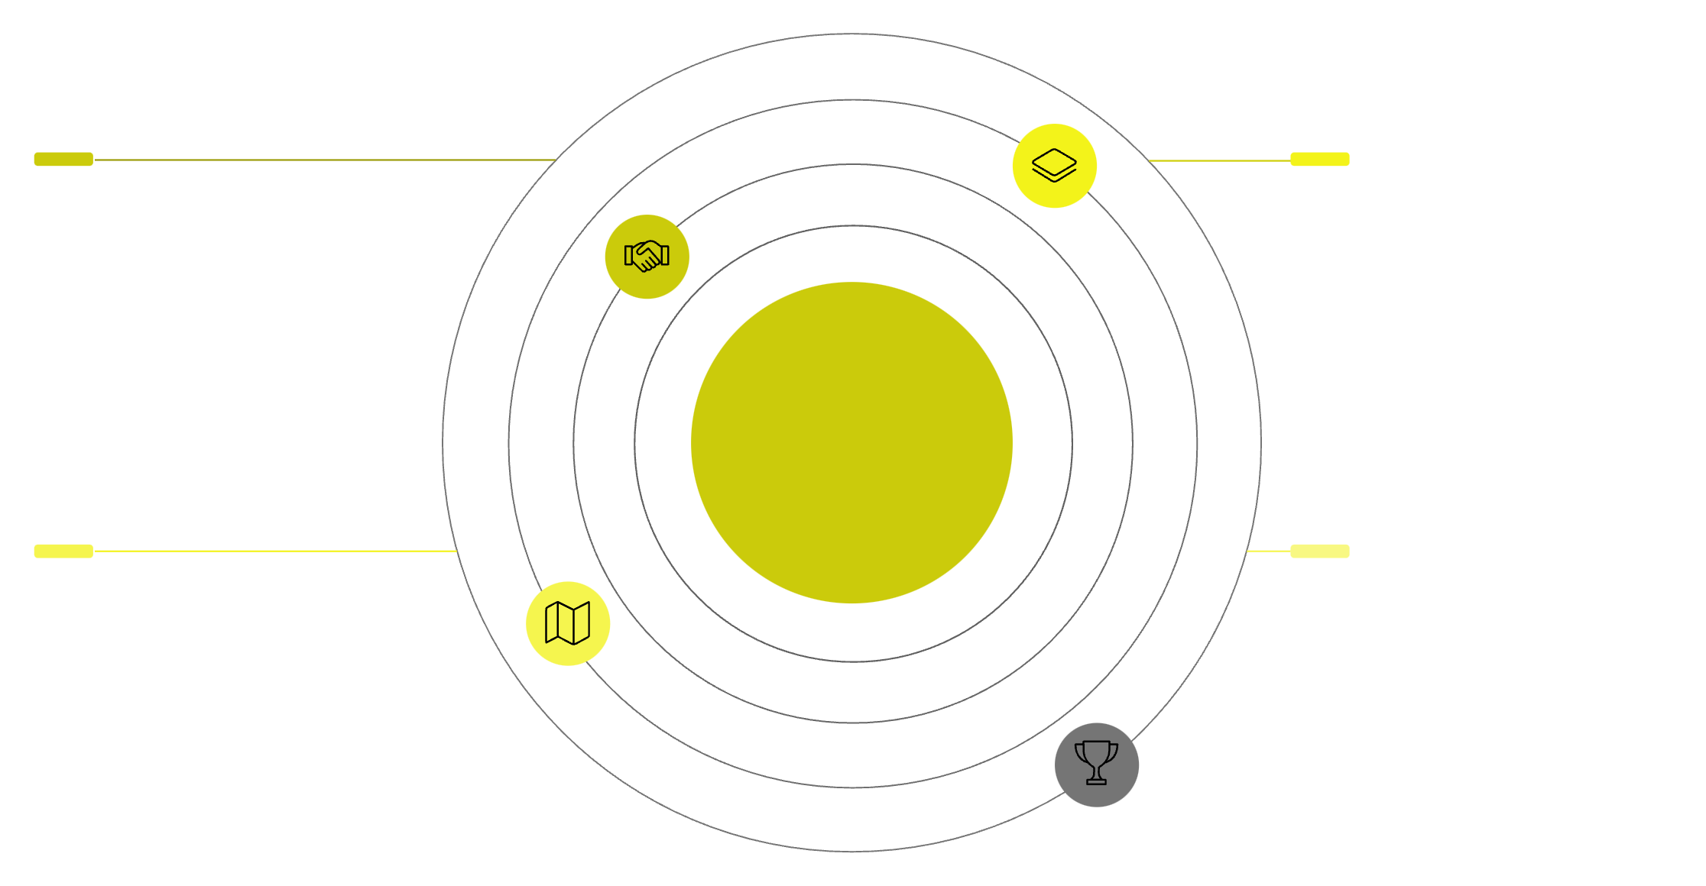




Channel Expansion Model: Cost Reduction Engine
Channel Partners
Cluster Leads
Authorized distributors and resellers
Local coordinators for market clusters
TradeIndia EC Vertical
Regional Network
Performance Incentive Layer
Area-level sales and support teams
Rewards driving sales efficiency
This diagram illustrates our strategic approach to channel expansion, positioning the core business as a central hub for a network of interconnected partners. This model is designed for scalability and cost efficiency, ensuring seamless integration and leveraging partner strengths to drive growth.
Key components:
Structured Channel Partner Module
Cluster-based partner expansion
Commission-led performance framework
Reduced direct acquisition dependency
Impact: Lower CAC + Faster market penetration

Slide 6


Segmentation & Team Structuring: Optimized for Conversion
Team Alignment:
1
Senior Managers → Premium portfolio
Hunters → Growth accounts
Scaled Ops → Volume segment
2
3
1
Premium Accounts
2
Growth Accounts
3
Volume Accounts
Right Portfolio + Right Capability = Higher Conversion

Slide 7
AI-Driven Enablement & 90-Day Execution Plan
AI Framework
90-Day Execution Timeline
Lead Prioritization Scoring
30 Days
Diagnostic + Funnel Mapping + Dashboard Baseline
Churn Prediction Model
60 Days
Channel Pilot + SLA Rollout + Portfolio Restructuring
Productivity Analytics
90 Days
Revenue Forecasting Dashboard
AI Rollout + Forecast System + Governance Institutionalization
Impact: Controlled scale-up

Slide 8
Expected Business Impact & Closing
Projected Outcomes:
+8–15% Revenue Uplift
3–5% Churn Reduction
10% Productivity Improvement
Lower Acquisition Cost
Predictable Revenue Model
Building a Scalable & Intelligent EC Revenue Engine
Thank You
Looking Forward to Working Together
Pranav Kumar
9990974701
connect_pranav@outlook.com

