Slide 1
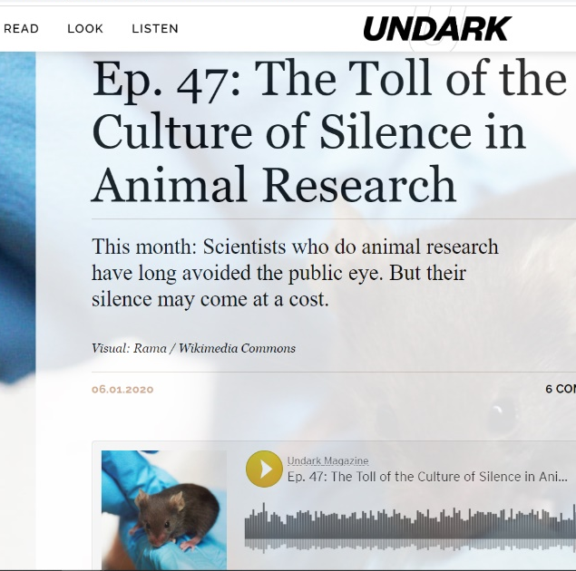
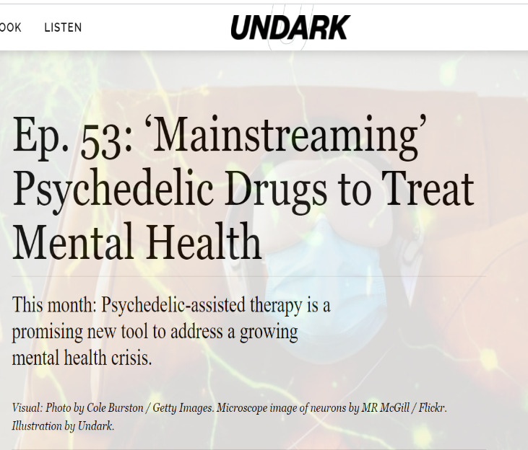
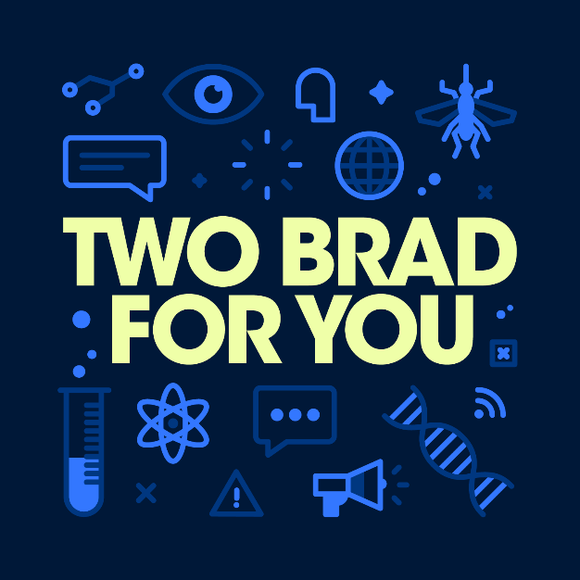
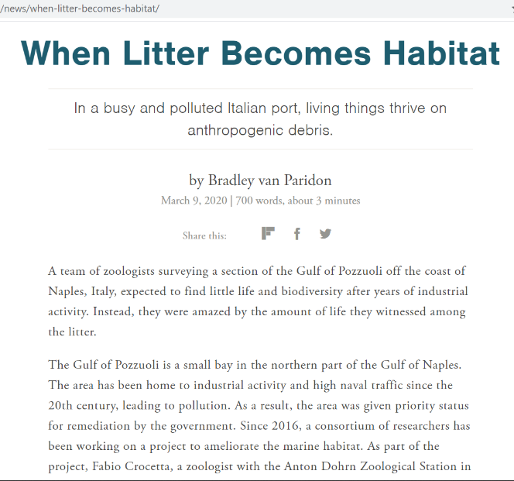
Scientist turned science communicator/journalist

Slide 2
Audience IS Essential
Without an audience your effort is wasted
Try to think about and identify your audience
Who are they?
What are their motivations?
What do they already know?
What do you want them to know?
This will define your tone, your goal and your medium

Slide 3
Nobody Cares About Your Stupid Science
Generalized modern audience is:
Smart but lacking specific knowledge
Easily distracted
Constantly consuming media
Your job to make them care
Bring them in and tell a great story

Slide 4
Storytelling / Narratives
Humans are wired for story
Shared narratives define and unite groups
Transmit information
Knowledge Deficit Model vs Narrative Policy Framework
Jones & Crow. Nature, 2017. https://doi.org/10.1057/s41599-017-0047-7
Notes:
Humans are wired for story and this is how we make sense of the world. This is because stories are logical, there is cause and effect, there are consequences to actions and we can see it play out in front of us. They are also emotional. People connect with emotion and it makes the information poignant and relevant.

Slide 5
Knowledge Deficit Model
As it sounds, aims to supply the audience with knowledge they don’t have
Uses repetition of facts and tends to mirror the values of science itself
Relies on the belief that an audience just doesn’t understand or have the information needed to be persuaded / informed
Jones & Crow. Nature, 2017. https://doi.org/10.1057/s41599-017-0047-7

Slide 6
Narrative Policy Framework
Acknowledges that people make decisions using more than facts.
Emotions, relationships, worldview play a major role
Encourages communicators to identify as storytellers and connect with audiences on human level, on terms that matter to them.
Jones & Crow. Nature, 2017. https://doi.org/10.1057/s41599-017-0047-7

Slide 7
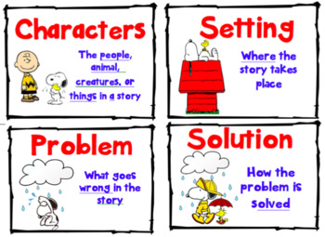
Storytelling / Narratives
Science generally tells two types of story
About Research
About Scientists
Story elements
Setting
Characters
Plot
Conflict/Resolution, Scenes, Events

Slide 8
Setting
The space in which the story takes place and within which your characters operate
Physical setting i.e., the lab, field work
Ideas, facts and characteristics that are related to the story
Elements of the setting can be rigid or flexible

Slide 9
Characters
People or objects in the story that are doing things, or not doing things, within in the story and that influence the outcome
Can be people, places, or things
Can be you or your audience
Characters also provide the emotional punch of many stories
Villains, Victims and Heroes

Slide 10
Plot
The things that happen to the characters
Will position the characters in your settings over time and space
Establishes relationships between character
Determines which elements of the setting are necessary, active or dormant.
Punctuated with evidence

Slide 11
Moral
What’s the point. What do we learn.
In our science narratives this would be the “why is this important” or “why is this interesting.”
The resolution or a call to action
Jones & Crow. Nature, 2017.

Slide 12
Structure of narrative in the folk-tale
Hero met → problem introduced → “quest” required →
first test (fail) → “gift” → transformation →
test again → triumph → problem resolved!
Adapted from: Padian, K. Integrative and Comparative Biology 2018. https://doi.org/10.1093/icb/icy038

Slide 13
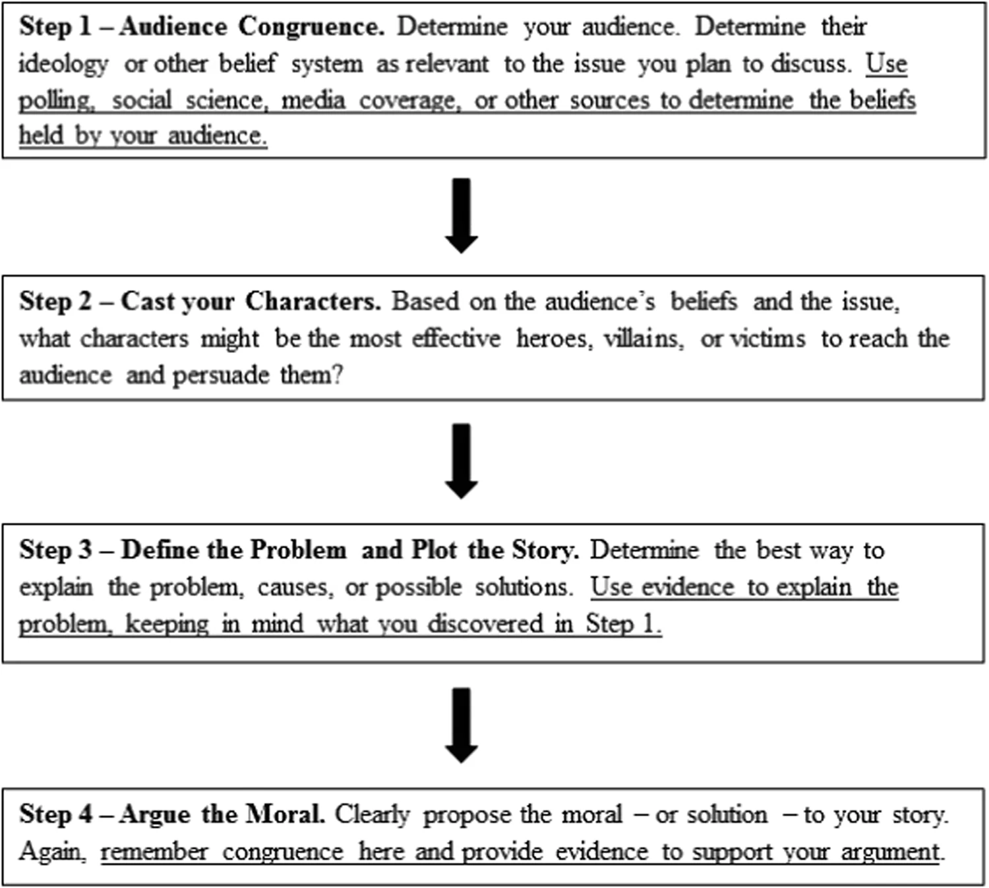
Jones & Crow. Nature, 2017.

Slide 14
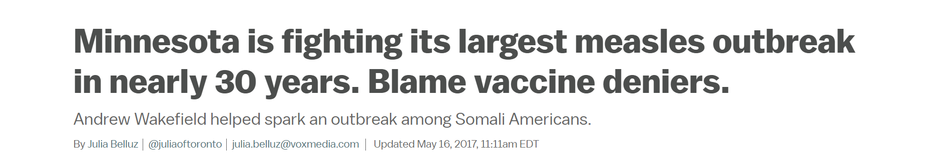
Example In Practice
Step 1: Audience
General public
Step 2: Cast your characters:
Wakefield
Somali children
Public health officials
Step 3: Define the problem and the plot
Serious outbreak of measles among Somali immigrant population in Minnesota
Wakefield and anti-vaxxers have been spreading misinformation among this group
Some argue this is has led to decease in vaccination rates
Step 4: Argue the moral
Policy needs to change or education needs to improve

Slide 15
Qualities of a Good Story
Interesting, relevant, clear and understandable to the audience
New and/or novel
Entertaining
(True)
Meets the medium’s non-negotiable demands about length, form, style, etc.

Slide 16
Story Does Not Need
Completeness
Thoroughness
Strict accuracy
Audience, what do they know, what do they need to know
Discussions of measurement uncertainty, confidence levels, etc.
Acknowledgment of alternative theories or explanations
Acknowledgment of collaborators, competitors, previous work, etc.

Slide 17
Things To Think About
Congruence with your audience
Find themes, language, symbols, the audience recognizes
METAPHORS and EXAMPLES
JARGON!!!!
Audiences can’t read minds
the Curse of Knowledge
Level of detail
Signposting
Notes:
Often better to explain complicated things in voice over and use interview clips that show emotion, enhance points, or punctuate the script
Prepare/Pre-interview
Open ended questions, leave space (can edit it out later)

Slide 18
Practice Exercise
Audience
Who is the audience and why would they tune in?
Do they want to be entertained? (Hint: Yes, they do)
Do they want information about the topic? What kind?
What might they already know? Is there “common knowledge” we can build off?
Purpose
Why am I doing this?
What is the topic?
What do we want to say about this topic?
Do we want to persuade the audience to a viewpoint?
Do we want to make them care about a topic they are unaware of? How can we do that?
Do we want to inform them about an issue/topic?
Do we want to excite them increase their curiosity about a topic?

Slide 19
Write An Intro To Your Story
After thinking about these questions and answering as many as possible, can you now introduce your story in a paragraph? Now try to do it in 3 sentences?
The intro should let the audience know what the story is about and what they can expect to learn when listening, oh and it should make them want to listen.
Now can you shorten this to a title and one sentence?

Slide 20
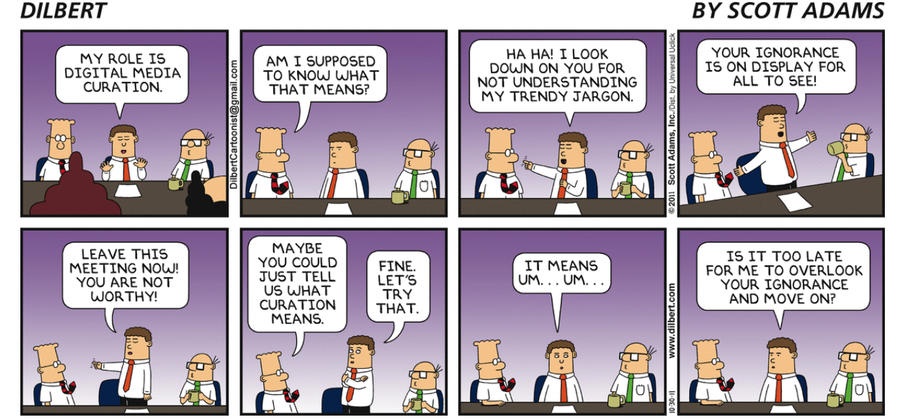
Common Mistakes
The Curse of Knowledge and JARGON

Slide 21
Curse of Knowledge
The inability to understand that not everyone knows what you know.
Robs the audience of clarity and nuance
Best to assume to little than to much
Audience is smart but lacks specific knowledge
Don’t be afraid to spell it out (abbreviations and ideas)
For example, as in, such as

Slide 22
Curse of Knowledge
Jargon, not just a time saver
As we learn we place things into categories or chunks to remember them (abstract chunks)
Example. Transcription and translation
Functional fixedness (functional labels)
Fixate on what something does rather than what it is.

Slide 23
Example
Participants were tested under conditions of good to excellent acoustic isolation.
We tested the students in a quiet room.
Example from The Sense of Style. Pinker, S. 2014

Slide 24
Example
There is a significant positive correlation between measures of food intake and body mass index.
The more you eat, the fatter you get.
Example from The Sense of Style. Pinker, S. 2014

Slide 25
Curse of Knowledge
Importantly, this also leads to a lack of colorful detail
Tell us, who did what, why and where.
Salamander offspring were sampled.
We trapped and counted the tiny newborn tadpoles from a shallow mountain pond.

Slide 26
Making the Impersonal Personal
Scientists love to erase themselves from the story
Write an intro to an article for a public audience
Connect yourself or a character to the science the article will be about
Introduce topic by talking about yourself/character
Can be deep, humorous, anecdotal, activist
Doesn’t have to be personal therapy, but it has to be personal

Slide 27
Practice On Your Own
Take the time to explain your work outside of the lab
Friends, roommates, family, other departments
Begin with, “here’s how I got interested in what I do and why its important” not “here is what I do”
Be the hero of this narrative, what is your quest?
Work on an elevator pitch
Consider doing a no-text presentation
Use pictures, figures, symbols
Title that states the problem
Consider writing for a general audience
Blog, newsletter, opinion piece, web content for your institution
Kevin Padian, Narrative and “Anti-narrative” in Science: How Scientists Tell Stories, and Don’t, Integrative and Comparative Biology. 2018.

Slide 28
Stay In Touch
Email: bvanp213@gmail.com
Twitter/Instagram: @bvanparidon or @TwoBradForYou (available on Spotify, ITunes, etc.)
Website:
bradley.vanparidon.com
twobradforyou.wordpress.com

Slide 29
References
Steven Pinker’s The Sense of Style
Steven Pinker on Why Your Professional Writing Sucks (And What to Do) https://fs.blog/2016/03/stephen-pinker-tells-us-why-our-professional-writing-sucks-and-what-to-do/
The Role of Narrative in Science by Victoria Corless https://www.advancedsciencenews.com/the-role-of-narrative-in-science/
D. Jones, M., Anderson Crow, D. How can we use the ‘science of stories’ to produce persuasive scientific stories?. Palgrave Commun 3, 53 (2017). https://doi.org/10.1057/s41599-017-0047-7
Kevin Padian, Narrative and “Anti-narrative” in Science: How Scientists Tell Stories, and Don’t, Integrative and Comparative Biology, Volume 58, Issue 6, December 2018, Pages 1224–1234, https://doi.org/10.1093/icb/icy038
The COVID-19 ‘infodemic’— Debunking works, if it’s done right. https://www.thestar.com/opinion/contributors/2020/06/19/the-covid-19-infodemic-debunking-works-if-its-done-right.html
van der Linden, S.L., Clarke, C.E. & Maibach, E.W. Highlighting consensus among medical scientists increases public support for vaccines: evidence from a randomized experiment. BMC Public Health 15, 1207 (2015). https://doi.org/10.1186/s12889-015-2541-4
Going viral: how to boost the spread of coronavirus science on social media https://www.nature.com/articles/d41586-020-01356-y
Schmid, P., Betsch, C. Effective strategies for rebutting science denialism in public discussions. Nat Hum Behav 3, 931–939 (2019). https://doi.org/10.1038/s41562-019-0632-4

