Slide 1
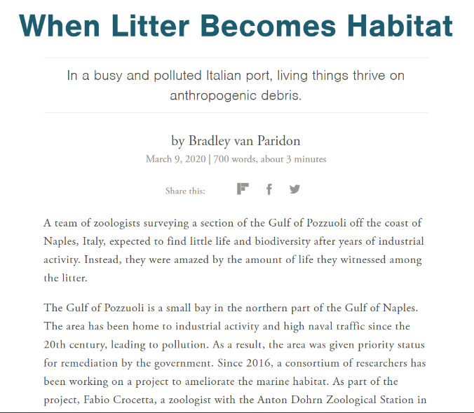
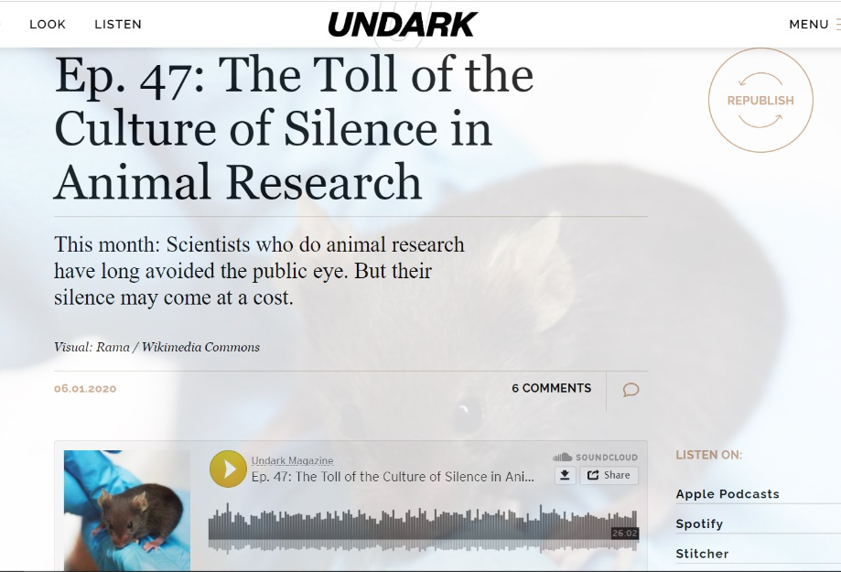
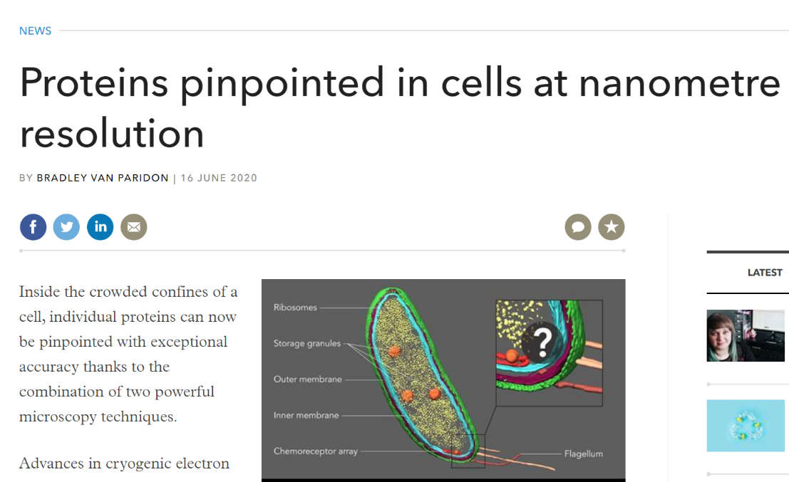

Scientist turned science communicator/journalist

Slide 2
Writing Online and Podcasting
Regardless the medium, sci comm is about storytelling
Blogging/Online Writing/Podcasting are great ways to tell your stories

Slide 3
Audience IS Essential
Without an audience your effort is wasted
Try to think about and identify your audience
Who are they?
What media do they already consume?
Do some research? (https://www.omnicoreagency.com/youtube-statistics/)
This will define your tone, your goal and your medium

Slide 4
Nobody Cares About Your Stupid Science
Generalized modern audience is:
Smart but lacking specific knowledge
Easily distracted
Constantly consuming media
Your job to make them care
Bring them in and tell a great story

Slide 5
Storytelling
Story elements
Setting, Characters, Conflict
Point of View
Yours, the characters, the audience
Media is beholden to a good story
If you don’t provide one they need to invent one
Online mediums are a great way to tell YOUR story

Slide 6
Things To Think About
JARGON!!!!
Audiences can’t read minds
Level of detail
Signposting
Scenes
Help advance the narrative and organize the flow of the story
Are all your scenes necessary
Personality
Notes:
Often better to explain complicated things in voice over and use interview clips that show emotion, enhance points, or punctuate the script
Prepare/Pre-interview
Open ended questions, leave space (can edit it out later)

Slide 7
Examples of Science Storytelling
First you and then me
Examples I showed were from the writer Ed Yong
https://edyong.me/
https://twitter.com/edyong209
Five Thirty Eight (https://fivethirtyeight.com/)
Podcast-19 https://fivethirtyeight.com/tag/podcast-19/

Slide 8
Getting Started
No need to start from scratch
The Xylom, Science Blog, PLoS Blogs, The Conversation, Medium, Social Media
Matchmaker.fm
If you are starting fresh
Medium, Wordpress, Social Media, SEO

Slide 9
Making A Podcast
Equipment:
Microphone (cellphone, headset, USB or Studio Mic)
Recording / Editing Software (Audacity / GarageBand)
Internet Connection (for posting)
Music/Sound Effects
freesound.org
GarageBand
Soundcloud

Slide 10
Recording
GET GOOD AUDIO!!!
Always monitor your audio when possible
Be aware of surroundings
Street noise, wind, etc.
Capture your setting with sound and words
Emotive language, avoid literal descriptions try emotive descriptions
Don’t be afraid to get close
Ask your subject to repeat themselves
Don’t be afraid to get creative
Record in a closet, under a table or blanket

Slide 11
Editing
Record and Edit in WAV when possible and then export to MP3 or other formats
Think about transitions
How does each clip flow into each other and what is the best order to tell your story
Technical Aspects
EQ, Limiters and Compression

Slide 12
Posting
Tons of hosting websites both free and paid
Mixcloud (free)
Libsyn / Podbean/ Spreaker / Buzzsprout / Transitor and many more.
Subscription based, covers everything, gets you on popular platforms like iTunes, Spotify, Stitcher
Do It Yourself (requires hosting and RSS feed)

Slide 13
Recap
No matter what medium you decided to work with
Think about your audience, what they like, what they might want and/or know and what you want to tell them/or want them to know
It’s all about telling a good story, with interesting characters and an entertaining narrative

Slide 14
Recommended Resources
Books
Steven Pinker The Sense of Style
The Science Writers' Handbook: Everything You Need to Know to Pitch, Publish, and Prosper in the Digital Age
Websites
www.podcastinsights.com
theopenotebook.com
Youtube!!

Slide 15
Lets Make A Podcast!!
The group interested in podcasting can work with me to develop a podcast from start to finish. This includes:
Coming up with a topic/story and how best to present it
Map out an episode or series of mini-episodes
Draft a script
Learn the basics of recording and editing
Post the final product to the Connect website

Slide 16
The Creative Process
This is awesome
This is tricky
This is shit
I am shit
This might just be ok
This is awesome
- Marcus Romer

Slide 17
Stay In Touch
Email: bvanp213@gmail.com
Twitter/Instagram: @bvanparidon or @TwoBradForYou (available on Spotify, ITunes, etc.)
Website:
bradley.vanparidon.wordpress.com
twobradforyou.wordpress.com

