Slide 1
Competitive problem tag generation and similarity analysis
Group name: Classifiers
Mentor: Kanay Gupta
Team Members:
Chittaranjan Rath (2018201007)
Prakash Nath Jha (2018201013)
Nitish Srivastava (2018201012)
Suraj Garg (2018202003)

Slide 2
Project goal
Attempt to guess programming problem tags for a problem
Performing Multi-label Classification for coding problems from different paradigm :
a) On Basis of problem Statement
b) On Basis of problem Solution

Slide 3
Work Flow
Data Collection
Data Pre Processing
Exploratory Data Analysis
Implementation :
Linear Support Vector Classification and visualization(s)
Long Short Term Memory and visualization(s)
Comparison of Approaches
Conclusion

Slide 4


Data Collection
Considered various sources for data collection like UVA , A2OJ , CodeChef , Codeforces , SPOJ.
As per a perfect structural description of code we have finalised below sources for data collection.
Codeforces and CodeChef.

Slide 5
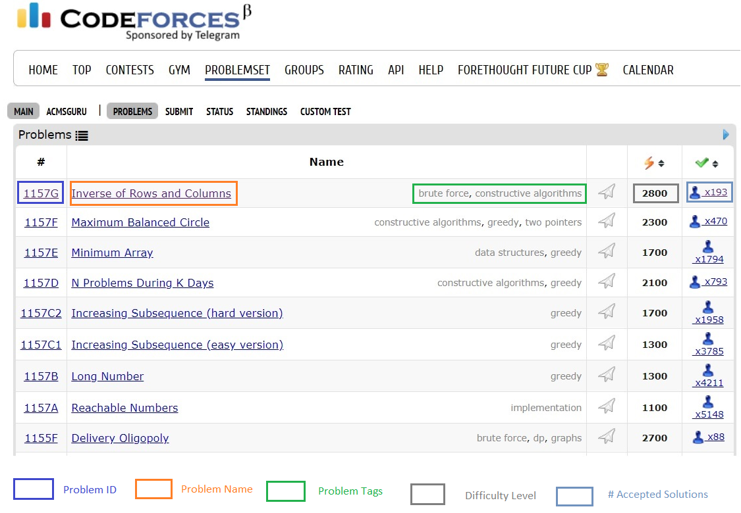
Codeforces

Slide 6
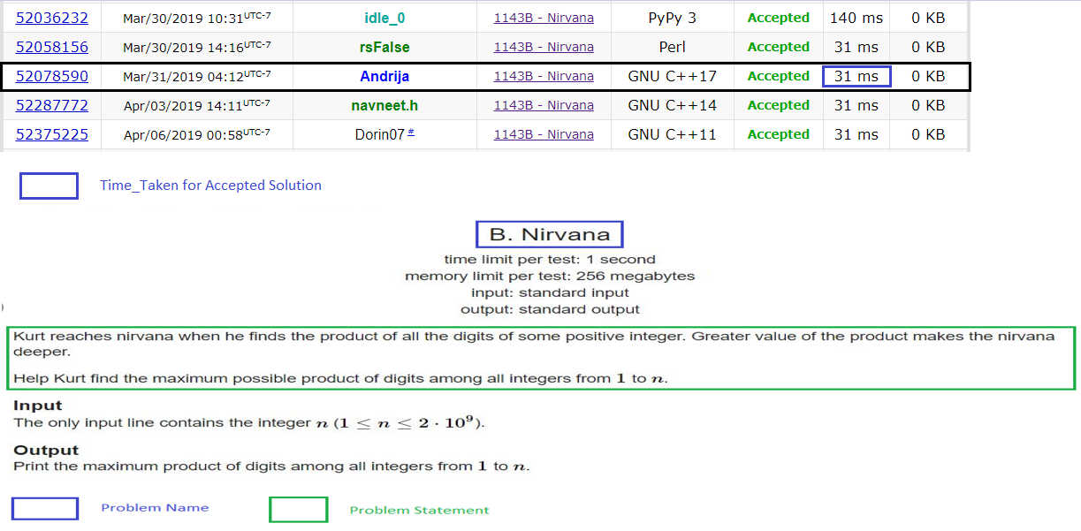
Codeforces Contd…
Sample problem description :
http://codeforces.com/problemset/problem/1143/B

Slide 7
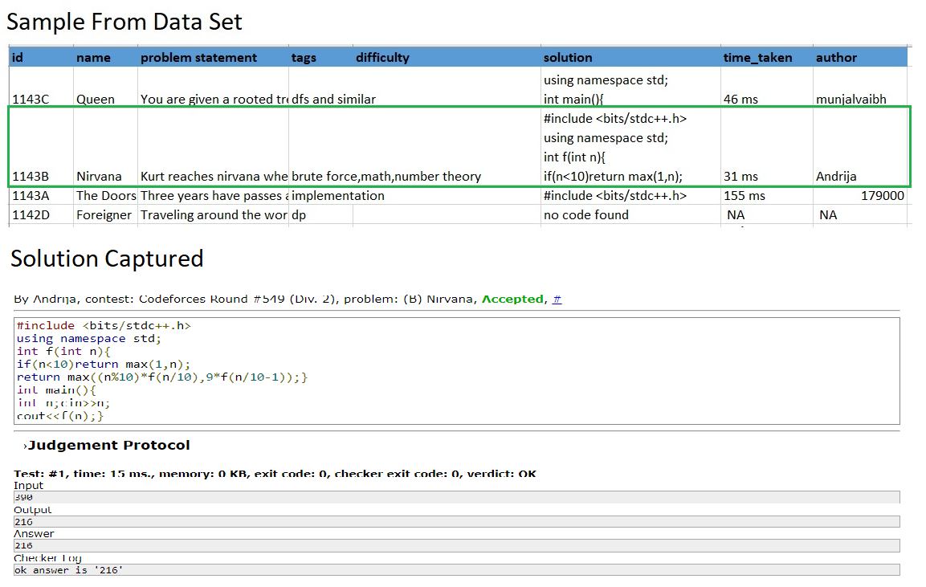
Codeforces Contd…

Slide 8
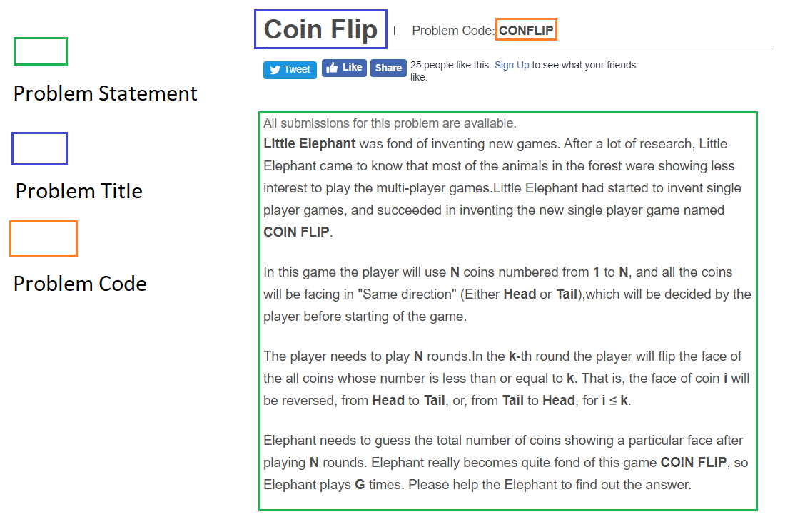
CODECHEF
Sample problem description :
https://www.codechef.com/problems/CONFLIP

Slide 9
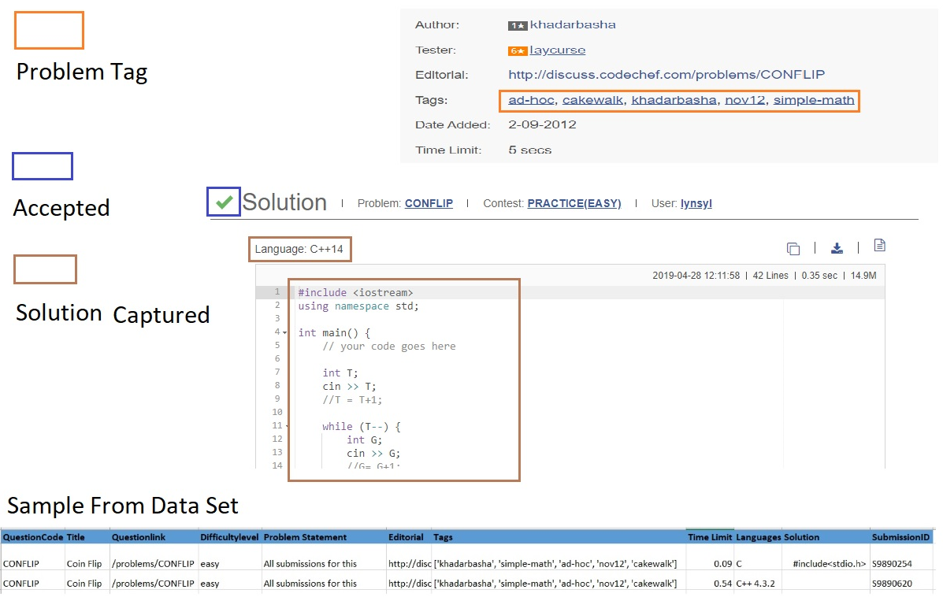
CODECHEF CONTD..

Slide 10
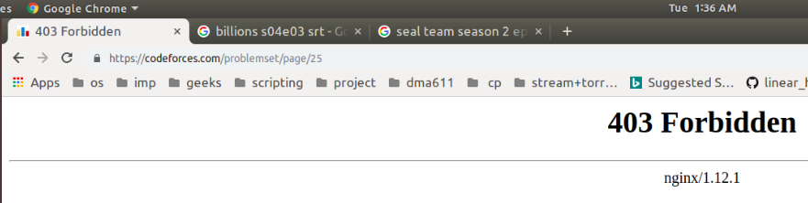
Data COLLECTION CONTD…
Issues faced During Data Collection :
At Multiple places we were not able to both problem statement along with their solution.
like at UVA , A2OJ etc.
While web Scrapping Codeforces was blocking requests randomly at many instances.
Unstructured solutions of problem ( like we have solution from tester but not for setter )

Slide 11
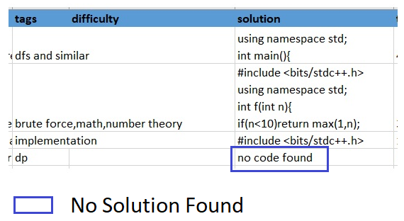
Data PRE-PROCESSING
Pre-processing on CodeForces Data Set :
“no code found” has been used an indicator for problems having no solution. For these type of problem prediction is only based on problem statement.

Slide 12
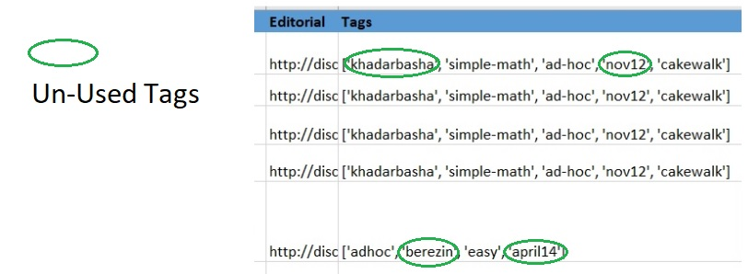
Data PRE-PROCESSING CONTD…
Pre-processing on CodeChef Data Set :
CodeChef provides various tags , but we processed only relevant tags. Sample of un-used tags are shown below.

Slide 13
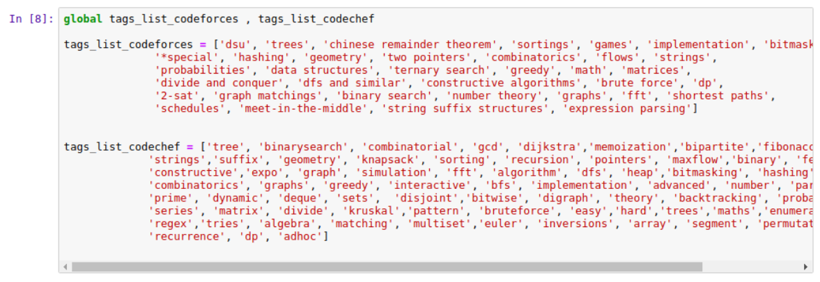
Data PRE-PROCESSING CONTD…
Creation of predefined tags for datasets.
Based on collected data , these are our defined tags for respective dataset.

Slide 14
Data PRE-PROCESSING CONTD…
Following are the steps performed for cleaning up of data set :
Removing Stop Words
Removing Special Characters
Applying Stemming ( as per English Dictionary )
The above approaches are not applied on solution.
Post Cleaning up of dataset :
Word to Vector embedding by CountVectorizer
TF-IDF
are applied for making data ready for training.
Processing of Output Label :
Multilabel Binarizer is used for output label.

Slide 15
Data PRE-PROCESSING CONTD…
Comparison of pre and post clean up on problem Statements
All submissions for this problem are available. Let A be a set of the first N positive integers :A={1,2,3,4.........N} Let B be the set containing all the subsets of A. Professor Eric is a mathematician who defined two kind of relations R1 and R2 on set B. The relations are defined as follows: R1={ (x,y) : x and y belong to B and x is not a subset of y and y is not a subset of x and the intersection of x and y is equal to empty set } R2={ (x,y) : x and y belong to B and x is not a subset of y and y is not a subset of x and the intersection of x and y is not equal to empty set } Now given the number N,Professor Eric wants to know how many relations of kind R1 and R2 exists.Help him. NOTE : (x,y) is the same as (y,x) ,i.e the pairs are unordered. Input format: The first line contains the number of test cases T.Each of the test case is denoted by a single integer N. Output format: Output T lines, one for each test case,containing two integers denoting the number of relations of kind R1 and R2 respectively, modulo 100000007. Example Sample Input: 3 1 2 3 Sample Output: 0 0 1 0 6 3 Constraints: 1 <= T <= 1000 1 <= N <= 10^18 Explanation: Let A={1,2} Then B={Phi,{1},{2},{1,2}} Phi=Empty Set So R1=Either {({1},{2})} or {({2},{1})} and R2=No relation exists So,there is 1 relation of kind R1 and 0 relation of kind R2.
problem avail let set first n posit integ n let b set contain subset professor eric mathematician defin kind relat r r set b relat defin follow r x x belong b x subset subset x intersect x equal empti set r x x belong b x subset subset x intersect x equal empti set number n professor eric want know mani relat kind r r exist help note x x e pair unord input format first line contain number test case test case denot singl integ n output format output line test case contain integ denot number relat kind r r respect modulo exampl sampl input sampl output constraint n explan let b phi phi empti set r either r relat exist relat kind r relat kind r

Slide 16
Data PRE-PROCESSING CONTD…
Comparison of pre and post clean up on solution
#include <cstdio> #include <vector> #define pb push_back #define rep(i, n) for (int i = 0; i < n; i++)
using namespace std; typedef long long ll; typedef vector<bool> vb; const ll L = 100000007, inv2 = 50000004;
int main(){
ll pow2[128], pow3[128]; // pow2[i]=2^(2^i), pow3[i]=3^(2^i)
pow2[0] = 2, pow3[0] = 3; rep(i, 126) {
pow2[i + 1] = (pow2[i] * pow2[i]) % L;pow3[i + 1] = (pow3[i] * pow3[i]) % L;
}
int t; scanf("%d", &t);
while (t--){
ll n;
scanf("%lld", &n);
vb bits = toBinary(n - 1);
ll t1 = 1, t2 = 3; // t1=2^(n-1), t2=3^n
rep(i, bits.size()){ if (bits[i]){
t1 = (t1 * pow2[i]) % L;
t2 = (t2 * pow3[i]) % L; } }
ll r1, r2;
r1 = (((t2 + 1) * inv2) % L - (2 * t1) % L + L) % L; r2 = ((t1 * (2 * t1 + 3)) % L - ((3 * t2 + 1) * inv2) % L + L) % L;
printf("%lld %lld\n", r1, r2); } return 0; }
includ cstdio includ vector defin pb push back defin rep n int n use namespac std typedef long long typedef vector bool vb const l inv vb tobinari vb re re pb return re int main pow pow pow pow pow pow rep pow pow pow l pow pow pow l int scanf n scanf lld n vb bit tobinari n n n rep bit size bit pow l pow l r r r inv l l l l r l inv l l l printf lld lld n r r return

Slide 17
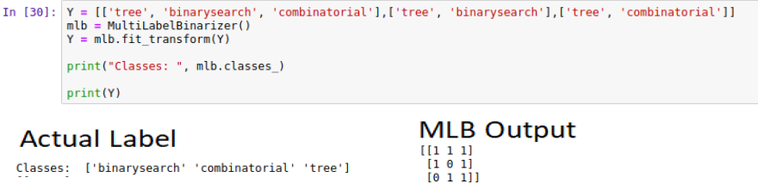
Data PRE-PROCESSING CONTD…
Mutilabel Binarizer ( a toy example )

Slide 18
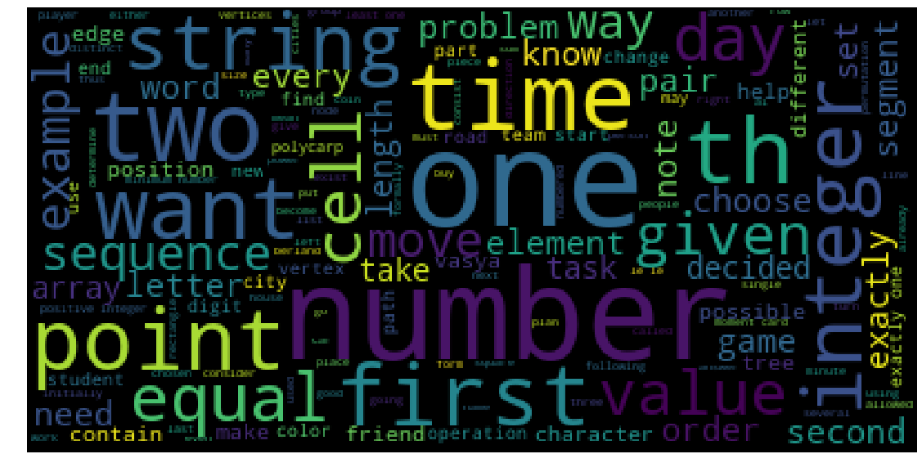
Exploratory data analysis
Word Cloud for problem statement

Slide 19
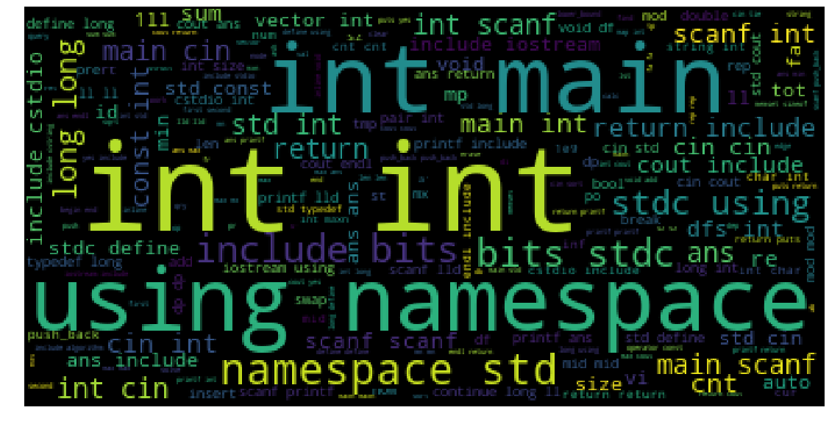
Exploratory data analysis CONTD…
Word Cloud for solutions

Slide 20
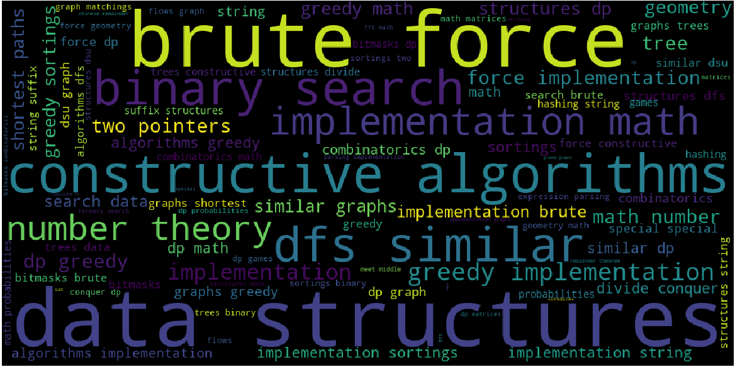
Exploratory data analysis CONTD…
Word Cloud for CodeForces Tags

Slide 21
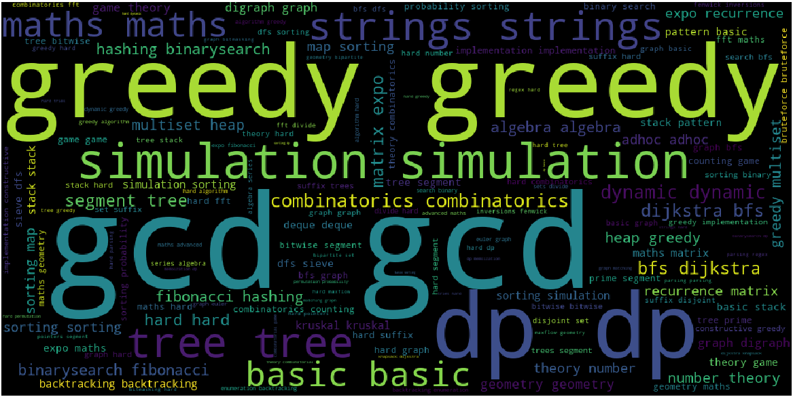
Exploratory data analysis CONTD…
Word Cloud for CodeChef Tags

Slide 22
Exploratory data analysis CONTD…
Class Imbalance Problem :
Scenario where the number of observations belonging to one class is
significantly lower than those belonging to the other classes.
implementation tags are most dominant
fft tags are very rare
Resolution:
Over-Sampling.
Under-Sampling.

Slide 23
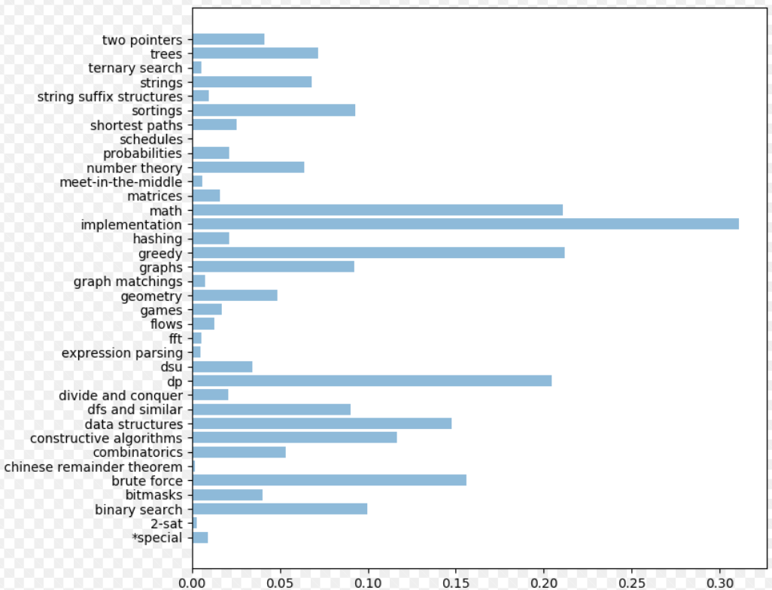
Exploratory data analysis CONTD…
Data Presentation for CodeForces Solution ( Before Class Imbalance ) :
Tags v/s Percentage

Slide 24
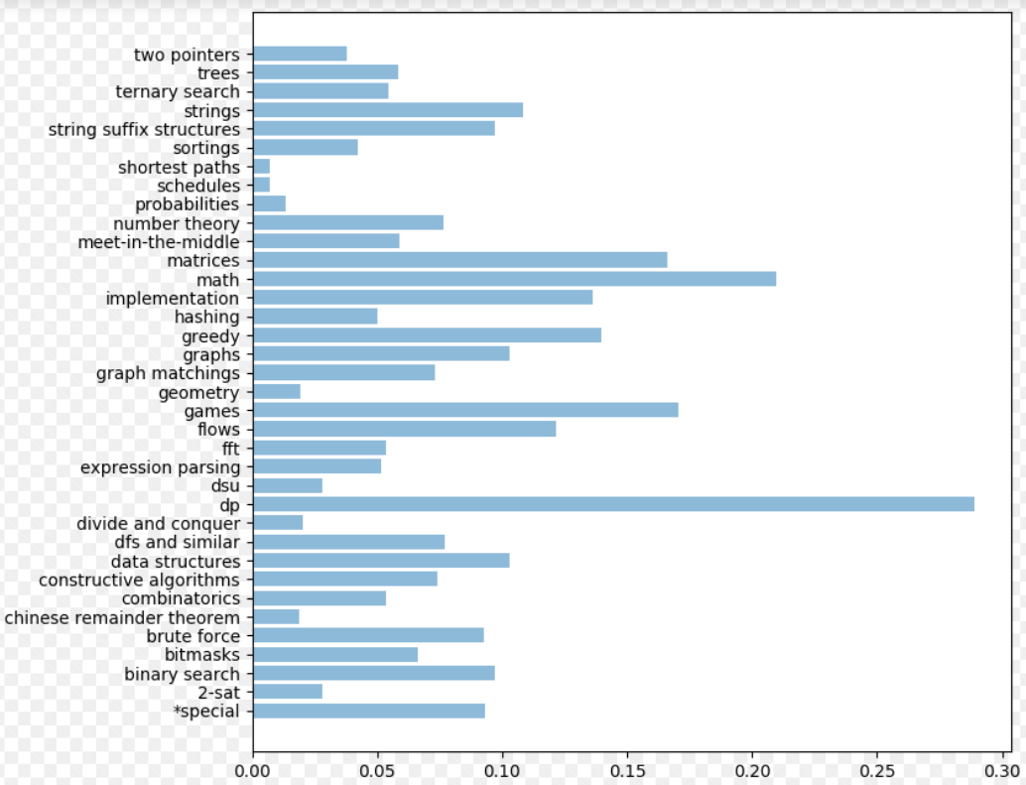
Exploratory data analysis CONTD…
Data Presentation for CodeForces Solution ( After Class Imbalance ) :

Slide 25
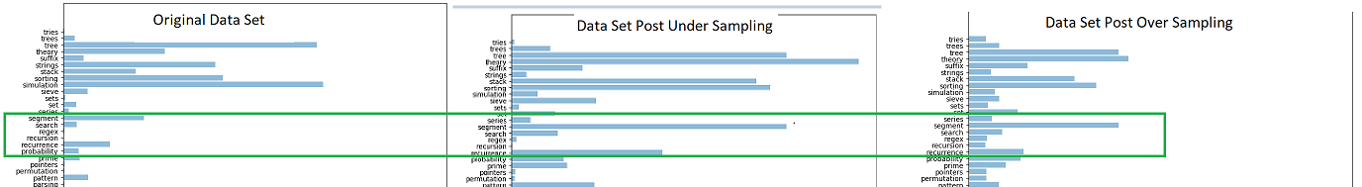
Exploratory data analysis CONTD…
Data Presentation for CodeChef Solution ( Handling Class Imbalance ) :

Slide 26
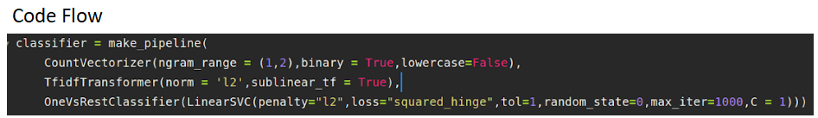
Implementation THROUGH LINEAR SVC
Start
Remove Stop Words
Remove Special Characters
Apply Stemming
Handling Class Imbalance
End
Apply Linear SVC for Training
TF-IDF
Count Vectorizer

Slide 27
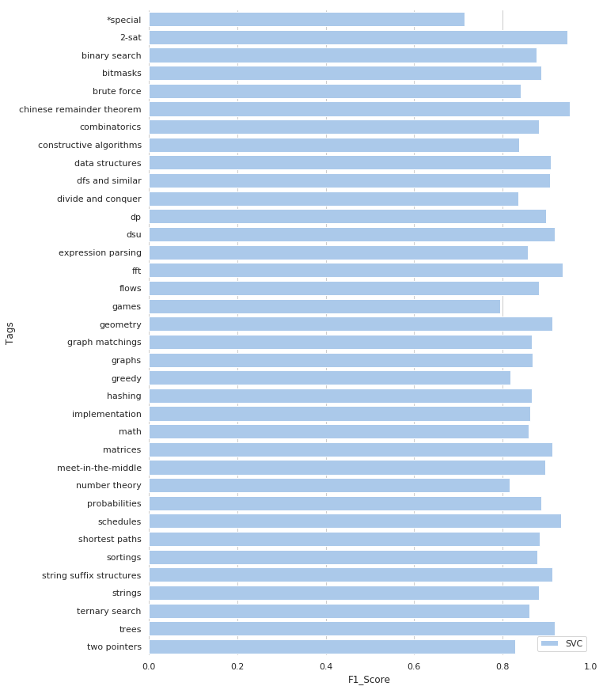
Implementation THROUGH LINEAR SVC CONTD…

Slide 28
Implementation THROUGH LSTM
Start
Remove Stop Words
Remove Special Characters
Apply Stemming
Handling Class Imbalance
LSTM Layer
Embedding Layer
Sequences
Tokenizer
LSTM Dense Layer
End

Slide 29
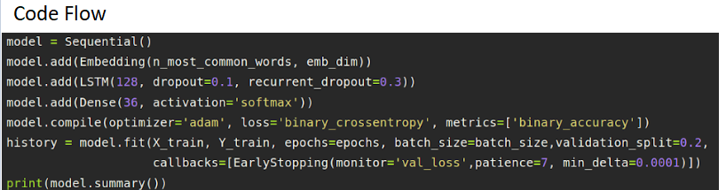
Implementation THROUGH LSTM

Slide 30
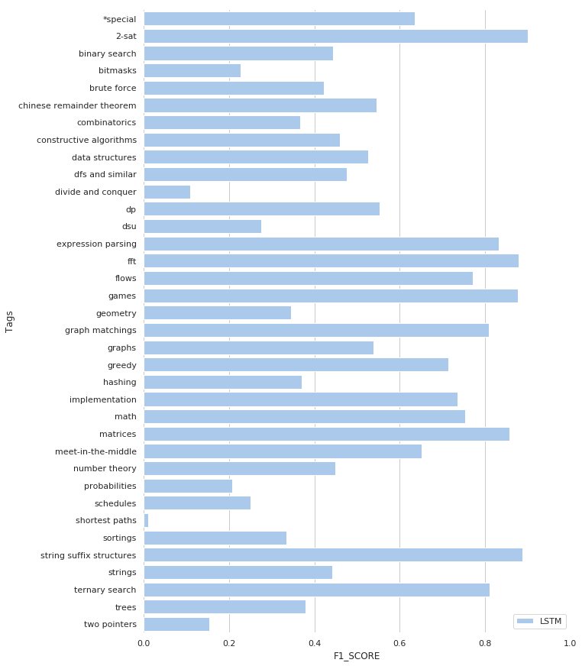
Implementation THROUGH LSTM CONTD…

Slide 31
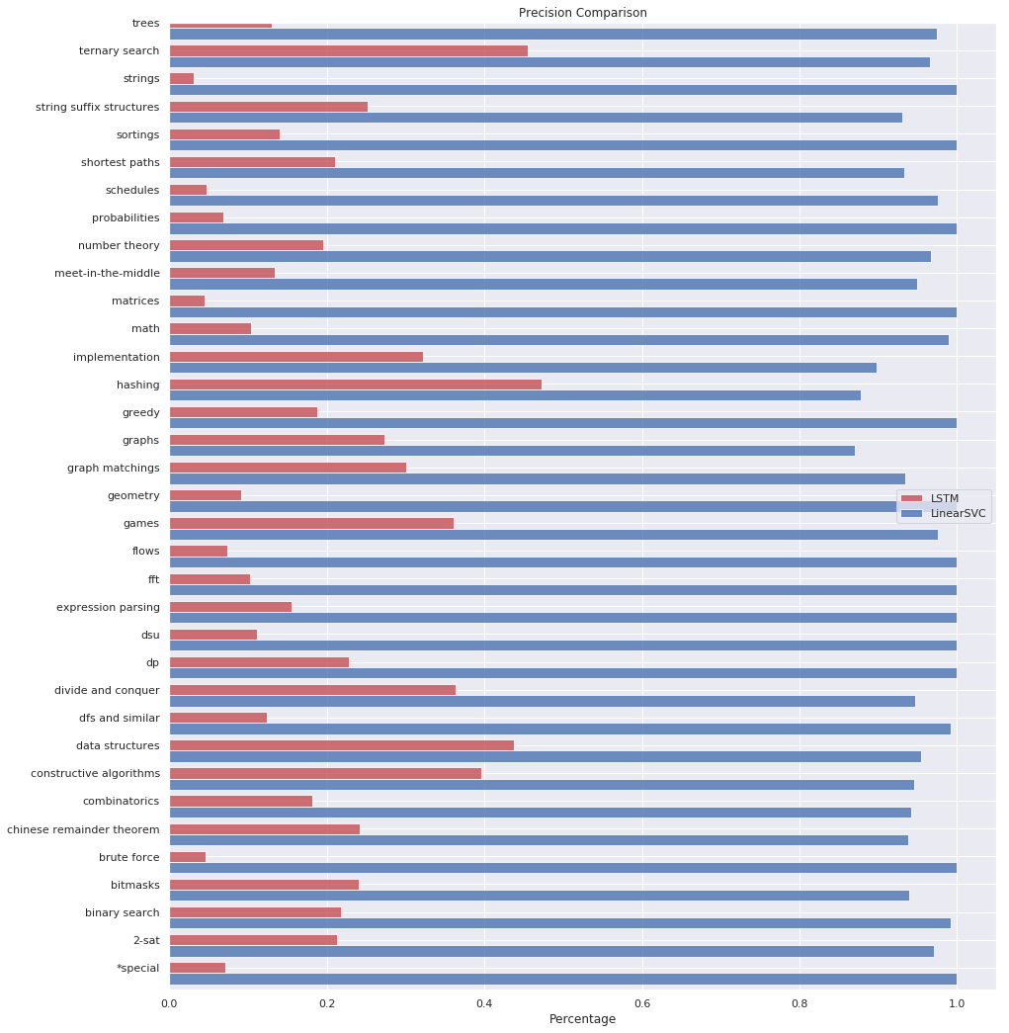
COMPARISON OF APPROACHES

Slide 32
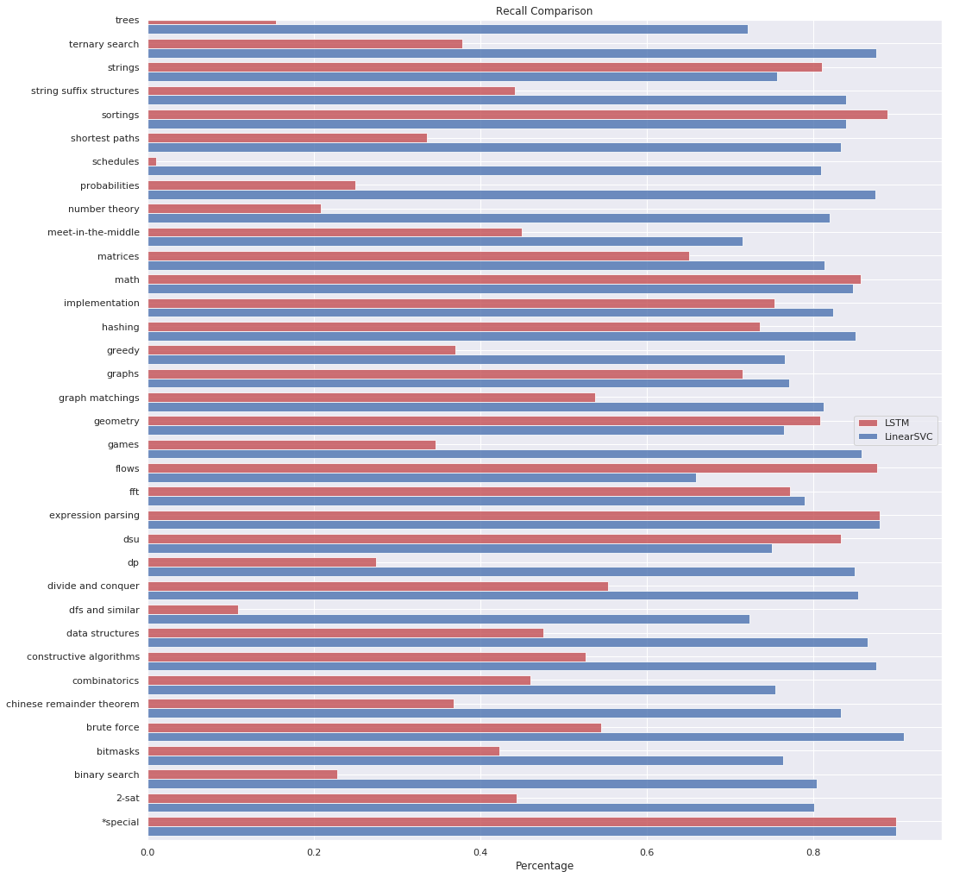
COMPARISON OF APPROACHES CONTD…

Slide 33
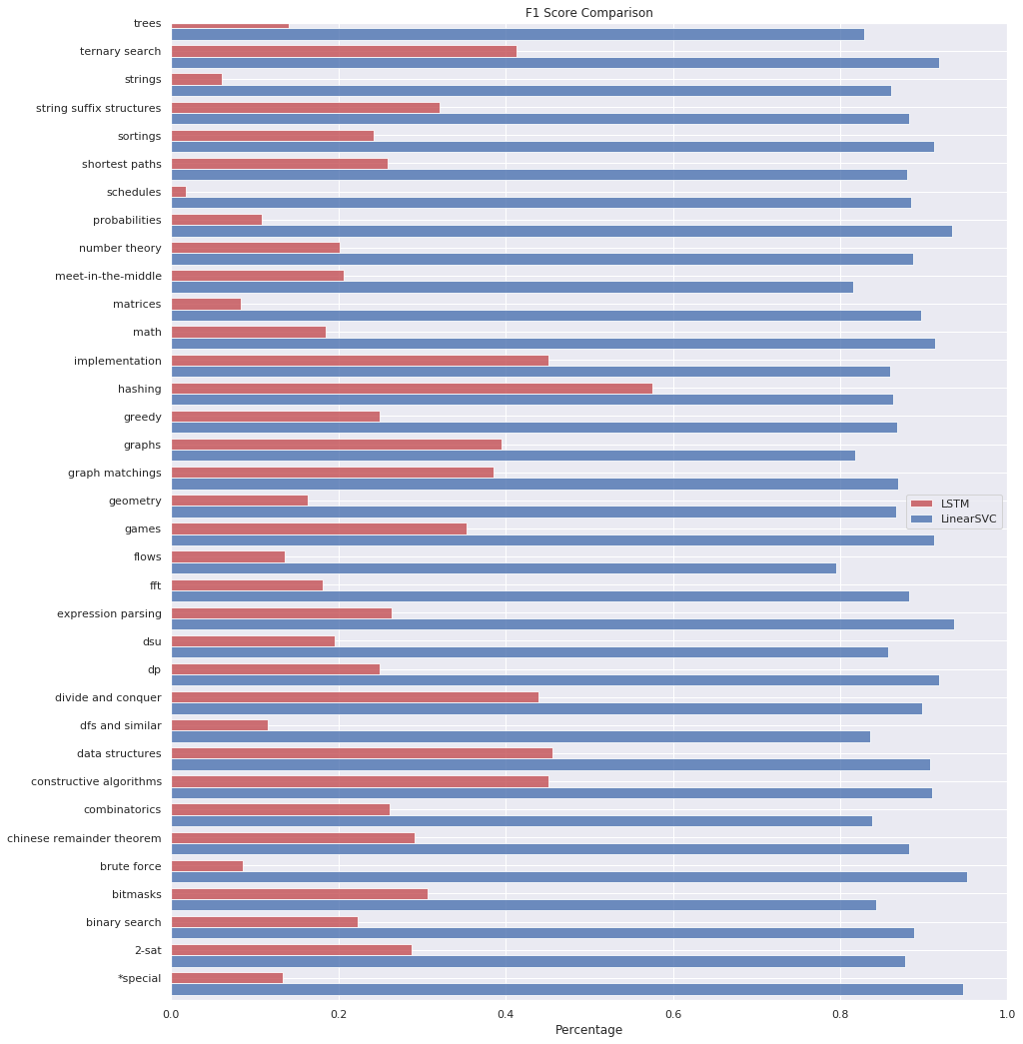
COMPARISON OF APPROACHES CONTD…

Slide 34
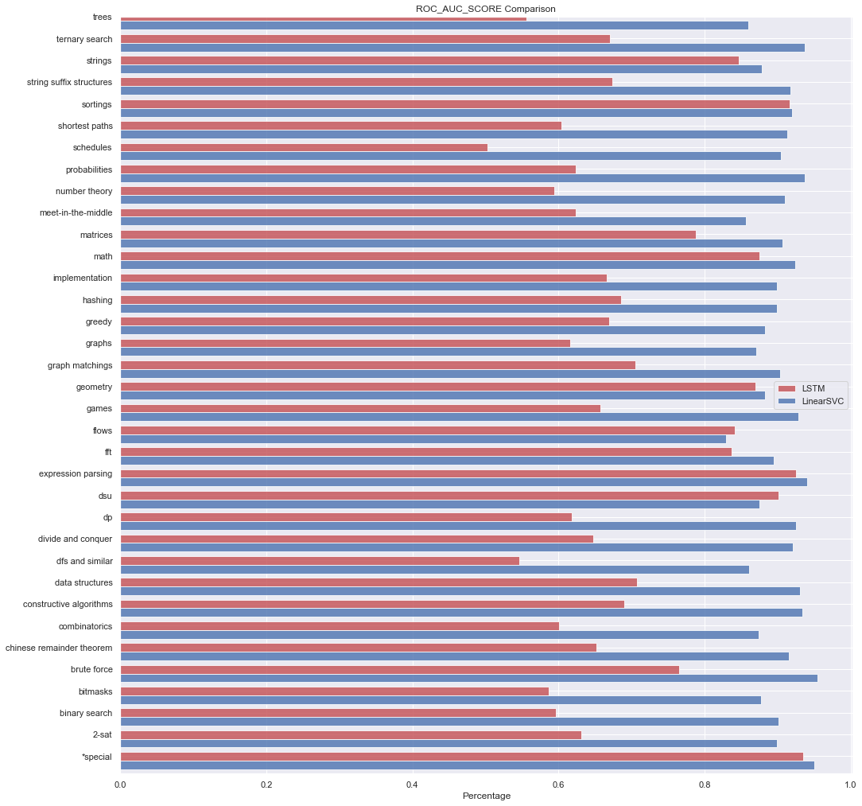
COMPARISON OF APPROACHES CONTD…

Slide 35
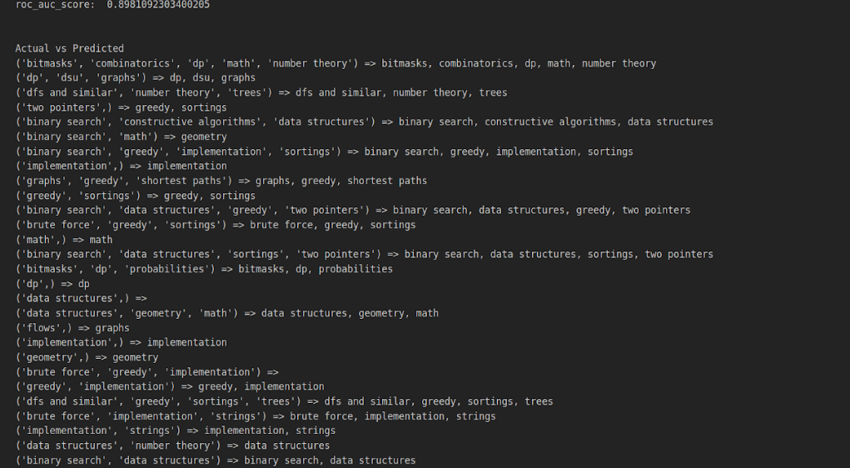
COMPARISON OF APPROACHES CONTD…

Slide 36
OBSERVATIONS ON DataSET
CodeChef :
Skewed data resulting to underperformance of model.
Same type of tag is repeated in multiple data samples.
Data is sparse w.r.t to tags :
# rare tags is more
Some tags are very frequent
76 unique tags with 122K data samples.
CodeForces:
Better Distribution of tags w.r.t CodeChef dataset.
36 unique tags with 40K data samples.

Slide 37
OBSERVATIONS BASED ON Criteria
Based on Problem Statement :
Based on approaches applied , model is underperforming because it’s quiet difficult to manually interpret problem statement.
Most content of problem statement is not directly related to problem in hand.
As inferenced from word cloud there are only less things observed.
Based on Solution :
Multiple Solution has been considered for each problem.
Linear SVC performs well on Solution without using any word embedding.
LSTM underperformed because English language based word embedding is used.

Slide 38
CONCLUSIONS
LSTM is under-performing as to Linear SVC because of loosing programming language semantics.
Post Handling class Imbalance , we observed better performance.
Considering multiple solution for particular problem aids to better performance.

Slide 39
Thank you

