Slide 1
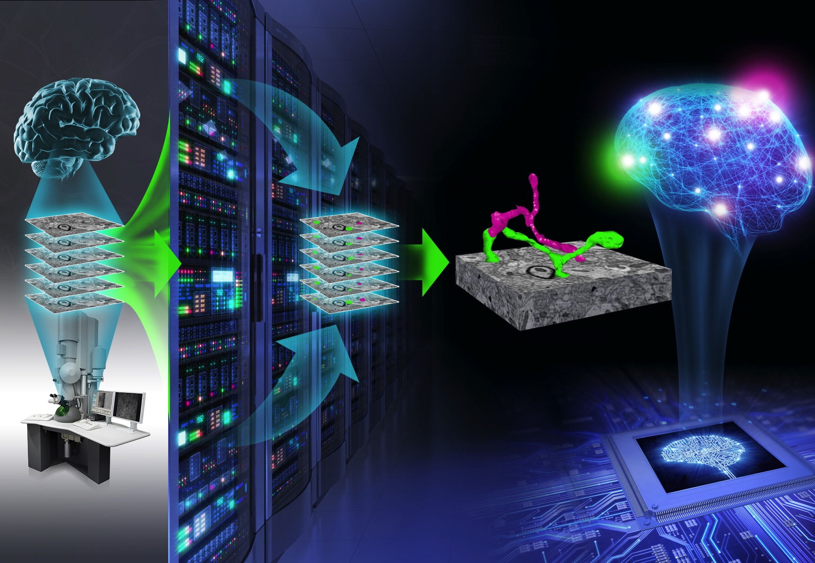
Introduction to Connectomics Intersession Class
Will Gray Roncal
Greg Kiar
January 2016

Slide 2
Mapping the Brain! a.k.a. the coolest job ever

Slide 3
Class Overview
Journal Club + Team Project (3 people)
Philosophy is to treat you like graduate students and give you real problems
But grade you like undergraduates!
To do well in this class:
Participate
Complete all assignments (journal paper presentation, team project)
Read papers
S/U, so focus on learning, not grading!
Recommendation: Work hard (research success is highly correlated to time spent).
15 hours/week out of class recommended.

Slide 4
“Rules”
Don’t miss class unless you have to – hard to make up
Bring a laptop
Research integrity is crucial – I don’t know is fine. Making things up is bad.
Opportunities for papers/posters exist, but will require either 1) additional work beyond scope of this class
We will acknowledge you wherever possible!
If you don’t know something and want to, let us know and we can point you in the right direction
This class is a pilot, which means we need your feedback
We try out new ideas here
You can continue to learn through other neurodata classes Fall/Spring

Slide 5
Syllabus Review
Honor code – team work encouraged, unless otherwise specified. But credit where due.
Cell: 443-338-8536. Text and other modern technology.
Suggestions welcome
If it takes you way longer to do something than you think it should, let us know
This is different from a regular course what you do here contributes to state-of-the-art research
Student led, but with lots of support
We will discover the answers together

Slide 6
By Tuesday
Fill out project survey (no later than 5pm today)
Sign up for a paper to present
Presenting this week = less boring + (small) prize
Use git issues for questions/paper discussion
Download MATLAB (JHU has a license), and CAJAL API (www.openconnecto.me/CAJAL) and pip install ndio

Slide 7
What is Connectomics?
con-nec-to-mics: a branch of biotechnology concerned with applying the techniques of computer-assisted image acquisition and analysis to the structural mapping of sets of neural circuits or to the complete nervous system of selected organisms using high-speed methods, with organizing the results in databases, and with applications of the data (as in neurobology, psychiatry, or fundamental neuroscience)
Merriam-Webster Unabridged Dictionary, 2019 (according to Dr. Jeff Lichtman)

Slide 8
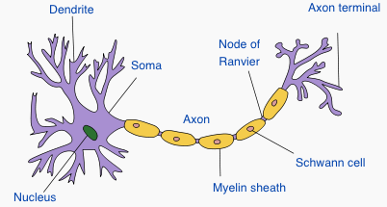
Neuroscience Primer
http://en.wikipedia.org/wiki/Neuron

Slide 9
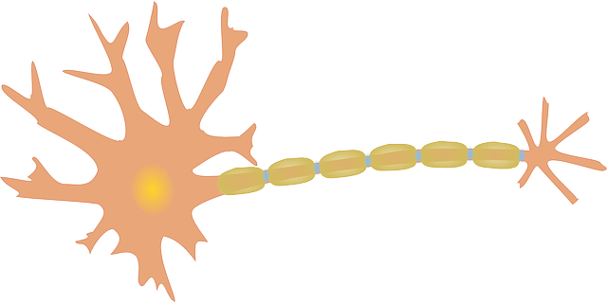
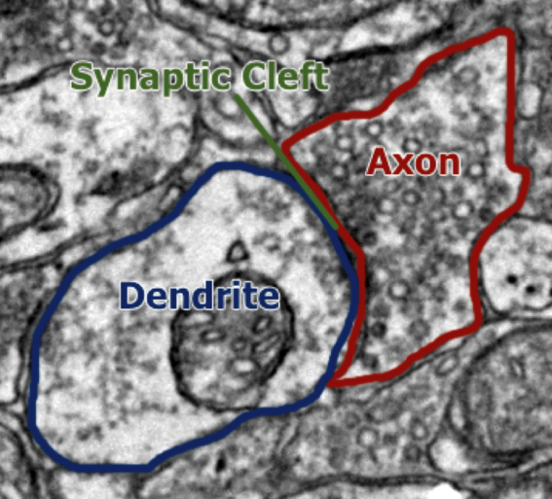
Brain Graph

Slide 10
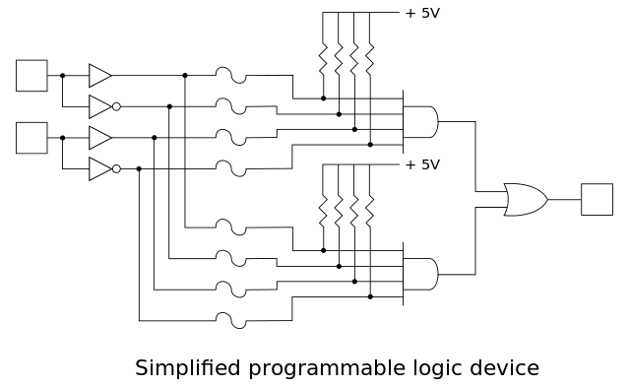
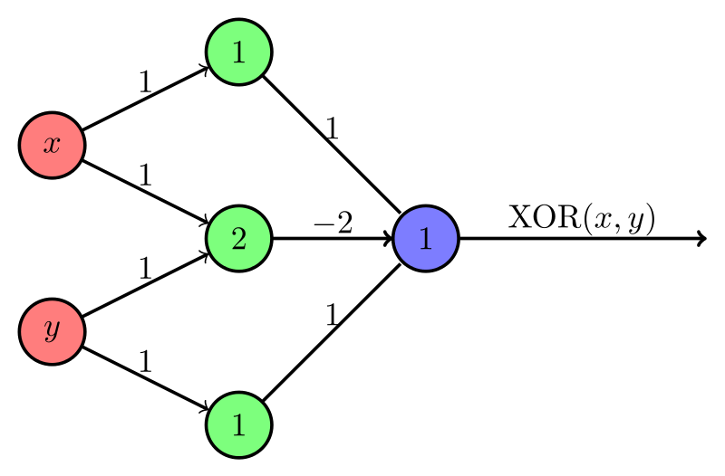
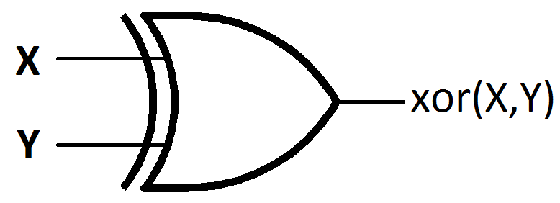

Slide 11
Class Scope
Primarily high resolution connectomics (nanometer scale), but also some MR connectomics and other modalities
Focus on structural connectomics, vs. functional
Aimed toward (eventually) validating Mountcastle’s cortical column conjecture

Slide 12
OCAR

Slide 13
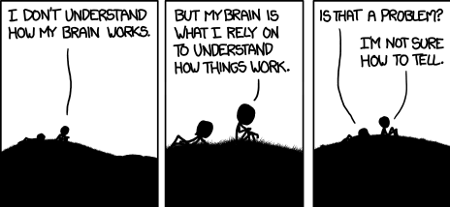
Class Projects

Slide 14
Tools
Github
https://help.github.com/
High level links
http://classic.scottr.org/presentations/git-in-5-minutes/
https://help.github.com/articles/good-resources-for-learning-git-and-github/
http://rogerdudler.github.io/git-guide/
https://guides.github.com/
Cheat Sheets
https://training.github.com/kit/downloads/github-git-cheat-sheet.pdf
http://rogerdudler.github.io/git-guide/files/git_cheat_sheet.pdf
Latex (overleaf.com)
API (python/matlab)

Slide 15
Project Descriptions
** Exploitable biological priors [Neuroscience, Computer Vision]
** Validating an EM connectome [Neuroscience, Computer Vision]
Vesicle Detection [Computer Vision]
** Mitochondria Detection [Computer Vision]
** Validating an MR Connectome [Neuroscience, Engineering]
** Web viewer for EM Annotations, 3D printing (might split into two projects) [Visualization]
** Web viewer for graph data [Computer Science, Applied Math]
** Exploiting brain graphs – mining structure to learn new insights (might split this into two projects) [Graph Theory]
Statistical query replication using the API [Programming, Math]
Survey of cortical columns – are they real? [Neuroscience]
** Neurally inspired algorithms in theory and practice [Neuroscience, Computer Vision]
** of high interest to your instructors. ☺

Slide 16
Project Signup
live sign up process!
Neuroscience-Math-Computer Science

