Slide 1
Statistical connectivity provides a sufficient foundation for specific functional connectivity in neocortical neural microcircuits
Paper by: Sean L. Hill, Yun Wang, et al.
Presentation by: Greg Levine

Slide 2
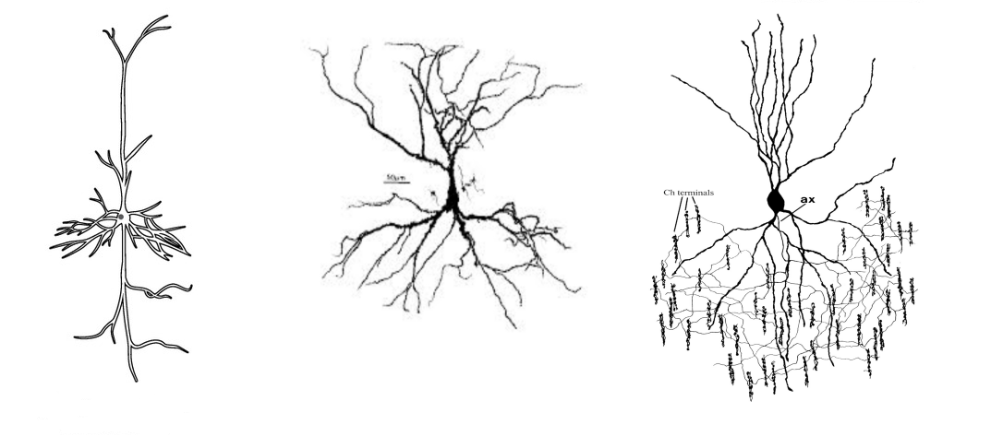
Opportunity
One of the key questions neuroscientists have identified for understanding how the brain works is the issue of whether axon formation during development is guided toward specific dendritic arbors or is random

Slide 3
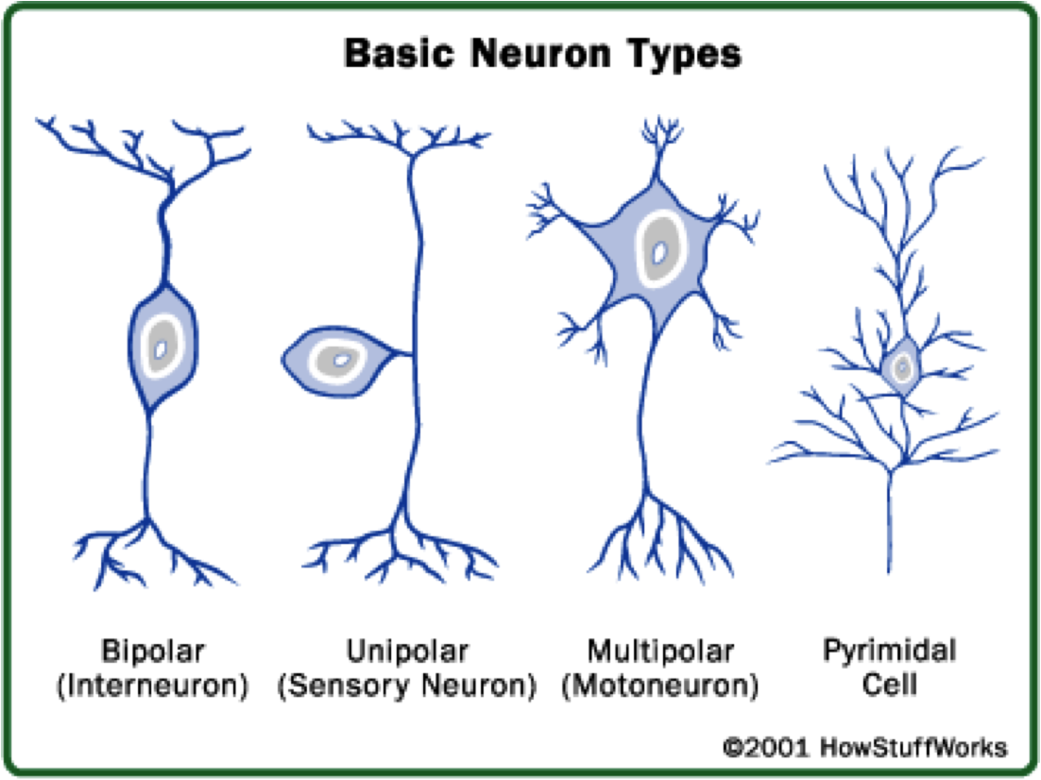
Dendritic Arbors
Dendritic arbors are the region in which a neurons dendrites are, and come in several different shapes, which we use to classify them

Slide 4
Opportunity
We observe that certain types of neurons tend to have a certain percentage of connections to certain places on other types of neurons dendrites
The question the paper addresses is to what degree these percentages are in line with random neuron growth vs specifically targeted growth toward these locations
Those who believe they are guided tend to support the theory of chemo- specific signaling
Others believe that the axons just grow mostly randomly and connect with whatever dendritic arbors they happen to encounter

Slide 5
Challenge
The challenge taken on by Hill was to determine which of these two competing theories best explains the observed percentages of connections between each type of cell
To do this, Hill decided to first observe an actual sample of brain and see what the statistics actually are
Then he decided to find a way to control for chemical signaling so that connections formed could only be the result of random chance
If the same or similar connection probabilities were observed in both the real and constructed cases, this would suggest that chemo-specific signaling does not play as much of a role as statistical connectivity

Slide 6
Action: Functional Synaptic Connectome
Hill first studies an actual connectome, specifically in rat somatosensory cortex
The neurons were reconstructed into a 3D model, and Hill and his team collected statistics such as:
TTL5 Neurons have about 20-25% of synapses on third order dendrites of other TTL5 Neurons
Next, he devised a method to see how closely these statistics matched up with the expected incidental connections made by neurons that were not guided by chemo-specific signals

Slide 7
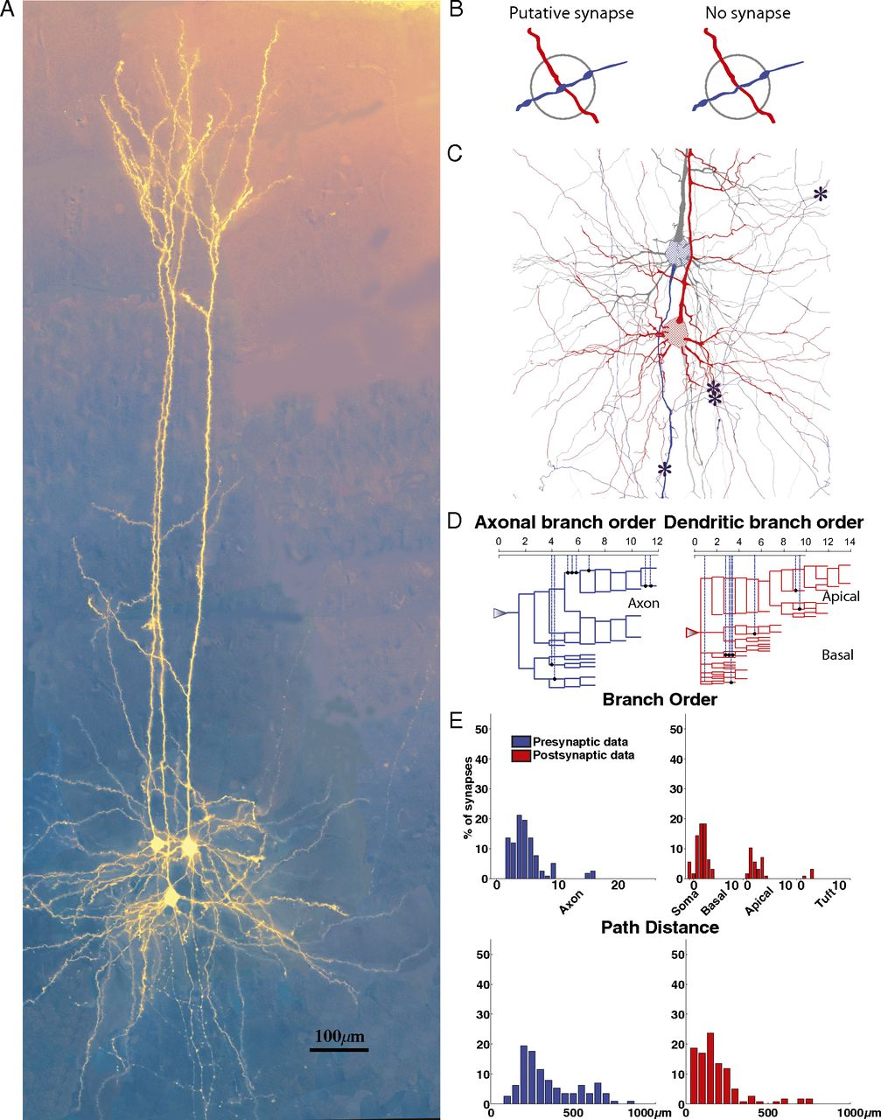

Slide 8
Action: Statistical Structural Connectome
To eliminate any possible chemo-specific mechanism that could have guided axon growth, Hill and his team collected 3D models of 298 different neurons from different rats, though they made sure all were the same species and age, and all samples were from the same region of the brain
Then they placed and oriented them randomly, with the same density and percentage of each type of neuron

Slide 9
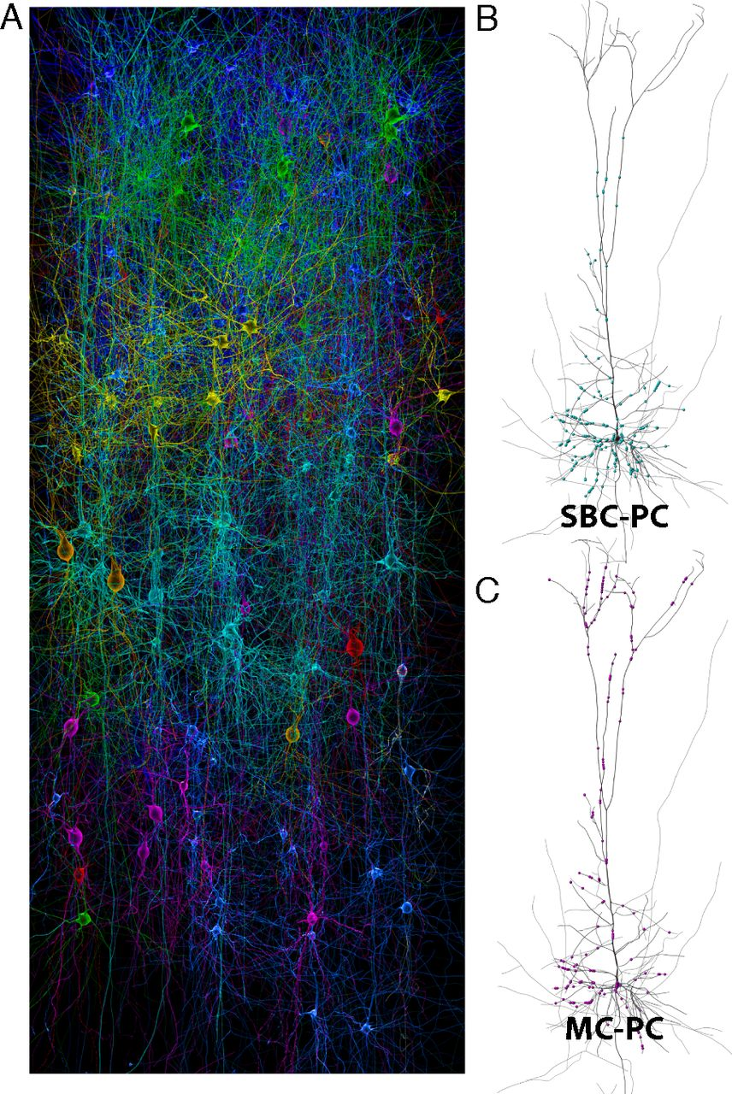

Slide 10
Action: Statistical Structural Connectome
Using a collision detection algorithm on a supercomputer, they found all intersection between axons and dendritic arbors
This was done 10 times for randomly generated layouts of neurons
From this they calculated the percentage of pairwise connections between each types of cell, and compared these to the results from the actual brain that was studied

Slide 11
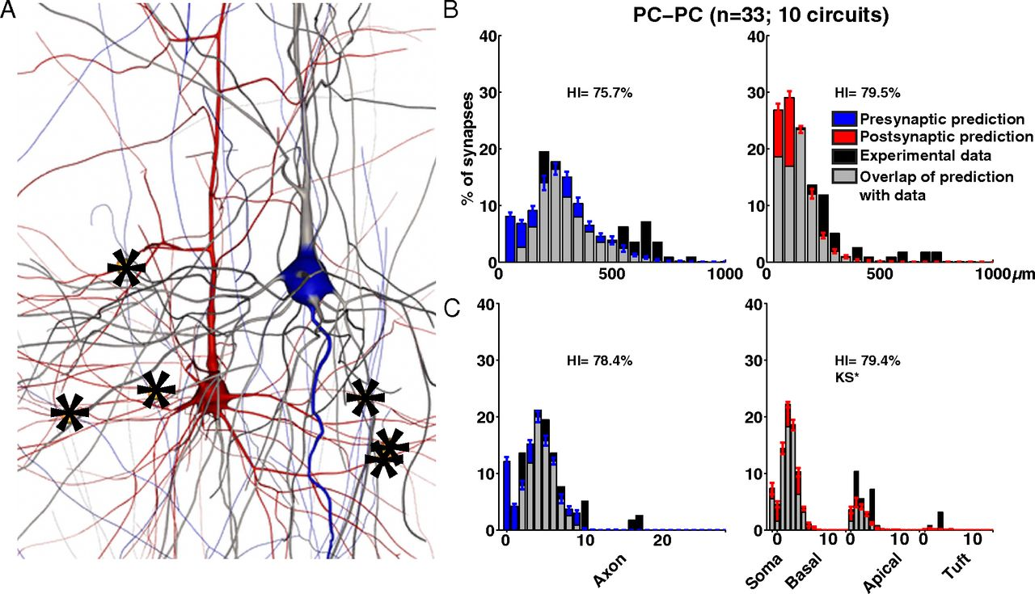

Slide 12
Results
Averaging over all types of connections, it was found that 74±2.7% of all connections in the actual connectome were predicted by the statistical model connectome, suggesting that the main driving factor in the formation of axon connection to dendritic arbors is incidental overlap, not chemo-specific mechanisms
The statistical connectome does not predict all types of connections well
Only Chandelier axons can form connections on the initial axon segment, this is not predicted by the statistical connectome
So while there are likely some chemo-specific mechanisms that determine the connections between axons and dendrites, statistical connectivity can account for much of the specific synaptic patterning between neurons

Slide 13
Future
This study has huge implications in the debate between statistical and chemospecific mechanisms in the formation of the connectome
Although the study does not exclude chemospecific mechanisms as a possible factor, it indicates that a large majority of connections are explained by simple chance, meaning they are mostly in line with what we would expect from randomly placed neurons.
Hill believes that if there are chemospecific mechanisms, then they only serve to make small adjustments to the positioning and overlap of axons and dendritic arbors

