Slide 1
Ultrastructural Analysis of Hippocampal Neuropil from the Connectomics Perspective
Yuriy Mishchenko, Tao Hu, Josef Spacek, John Mendenhall, Kristen M. Harris, Dmitri B. Chklovskii
Presented by Thomas Keady

Slide 2
Goals
“Reconstructing neuronal circuits on the level of synapses is a central problem in neuroscience”

Slide 3
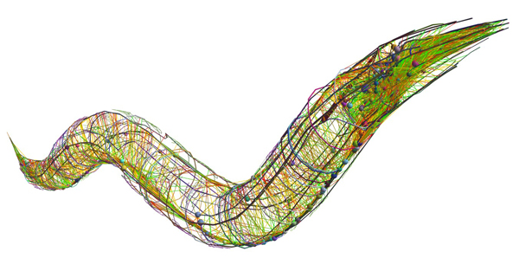
Goals
“Reconstructing neuronal circuits on the level of synapses is a central problem in neuroscience”
It has been done before – C. Elegans

Slide 4
Goals
“Reconstructing neuronal circuits on the level of synapses is a central problem in neuroscience”
It has been done before – C. Elegans
Can it be automated?

Slide 5
Goals
“automating ssTEM seems promising”

Slide 6
Goals
“automating ssTEM seems promising ( Jurrus et al., 2008, Anderson et al., 2009 and Mishchenko, 2009)”

Slide 7
Goals
“automating ssTEM seems promising ( Jurrus et al., 2008, Anderson et al., 2009 and Mishchenko, 2009)”

Slide 8
Goals
“automating ssTEM seems promising ( Jurrus et al., 2008, Anderson et al., 2009 and Mishchenko, 2009)”

Slide 9
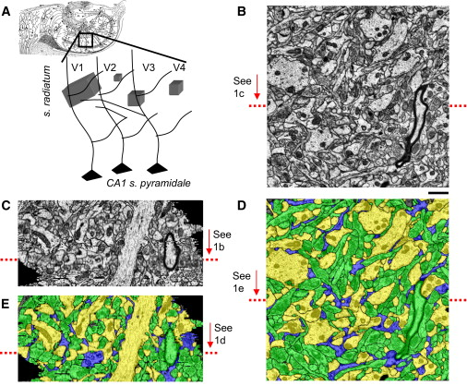
Approach
Use existing segmentation algorithms
RECONSTRUCT + proofreading

Slide 10
Approach
See if segmentation is any good for synapse prediction
Relies on statistics and probability
“Peter’s rule”

Slide 11
Peter’s Rule
“the number of synapses formed along a dendrite is proportional to the number of axons passing within reach of the spines emanating from the dendrite”
# of synapses = possible synapses * k
Where k is the connectivity constant
(0 < k < 1)

Slide 12
Peter’s Rule
Has been proven wrong before:
“different classes of pre-synaptic neurons possess different connectivity fractions onto a given postsynaptic neuron class and different post-synaptic neuron classes have different connectivity fractions with a given presynaptic neuron class.”

Slide 13
Peter’s Rule
Had been proven wrong before:
“different classes of pre-synaptic neurons possess different connectivity fractions onto a given postsynaptic neuron class and different post-synaptic neuron classes have different connectivity fractions with a given presynaptic neuron class.”
But what about between the same type of neurons?

Slide 14
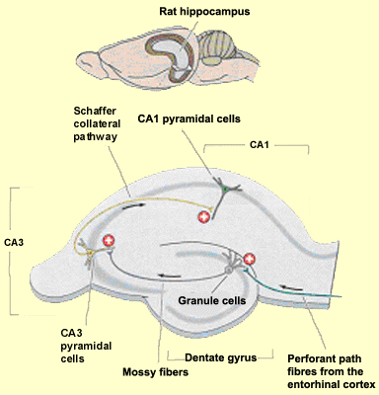
Data
“four volumes of neuropil from the middle of stratum radiatum in hippocampal area CA1”

Slide 15
V1: radial oblique dendrite
V2: Dendritic spine
V3: Apical dendrite
V4: Random

Slide 16
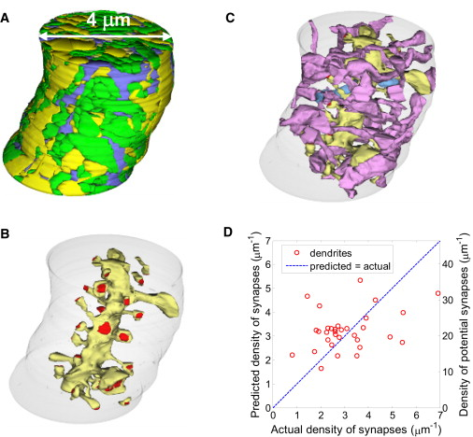
Testing Peter’s Rule for density
Axons
Dendrites
Glia
Synaptic Axons
The Dendrite
The Dendrites
Synapses

Slide 17
Testing Peter’s Rule for density
“Plot of the actual density of synapses for dendrites in V1 and V3 versus the density of synapses predicted by multiplying the mean maximum-reach connectivity fraction by the local density of potential synapses”

Slide 18
Testing Peter’s Rule for density
“Plot of the actual density of synapses for dendrites in V1 and V3 versus the density of synapses predicted by multiplying the mean maximum-reach connectivity fraction by the local density of potential synapses”
r² ≈ 0.12

Slide 19
Testing Peter’s Rule
Connectivity fraction varies with dendrite distance
“the connectivity fraction was a smooth function peaking at a distance around 0.4 um from the dendritic shaft”

Slide 20
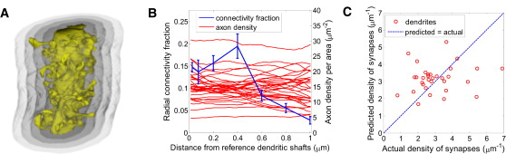
Testing Peter’s Rule
Connectivity fraction varies with dendrite distance
“the connectivity fraction was a smooth function peaking at a distance around 0.4 um from the dendritic shaft”

Slide 21
Still a poor predictor
“even with the distance-dependent connectivity fraction, Peters' rule poorly predicted the actual synaptic densities”

Slide 22
Still a poor predictor
“even with the distance-dependent connectivity fraction, Peters' rule poorly predicted the actual synaptic densities”
r² ≈ 0.02

Slide 23
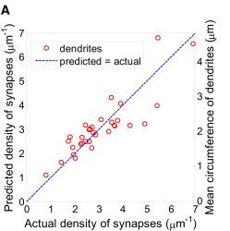
Better Predictors
Dendritic caliber: circumference of dendrite (no spine)

Slide 24
Better Predictors
Dendritic caliber: circumference of dendrite (no spine)
r² = 0.75

Slide 25
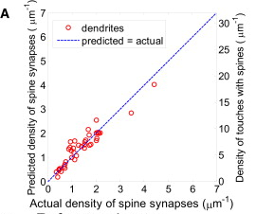
Axo-dendritic touches
“proximity between an axon and a dendritic spine with no other intervening objects”
Density of touches is a good predictor of density of synapses

Slide 26
Axo-dendritic touches
“proximity between an axon and a dendritic spine with no other intervening objects”
Density of touches is a good predictor of density of synapses
r² ≈ 0.88

Slide 27
Individual Synapses?
Can these probabilities be used to predict the existence of individual synapses?

Slide 28
Individual Synapses?
Can these probabilities be used to predict the existence of individual synapses?
“As the fraction of touches that correspond to synapses was much less than one (∼0.2), additional information is needed to determine which touches correspond to synapses”

Slide 29
Best predictor: relative size
“We found that 80% of the touches whose area is greatest among those sharing the same bouton and those sharing the same spine are synaptic.”

Slide 30
Best predictor: relative size
“We found that 80% of the touches whose area is greatest among those sharing the same bouton and those sharing the same spine are synaptic.”
“At the same time, this method detects only 46% of all spine synapses.”

Slide 31
Best predictor: relative size
“We found that 80% of the touches whose area is greatest among those sharing the same bouton and those sharing the same spine are synaptic.”
“At the same time, this method detects only 46% of all spine synapses.”
High precision, low recall

Slide 32
In Conclusion
“In conclusion, we have shown that ssTEM can be automated, in principle, but will require major advances in data acquisition and analysis to be a viable approach for reconstructing complete vertebrate circuits at the resolution of synapses.”

Slide 33
In Conclusion
“the average time required to proofread and correct the automatically segmented objects in V1 and V3 was about 10–20 min per μm3. Relative to manual tracing, we estimate a tenfold savings in time.”

Slide 34
In Conclusion
“the average time required to proofread and correct the automatically segmented objects in V1 and V3 was about 10–20 min per μm3. Relative to manual tracing, we estimate a tenfold savings in time.”
These correlations apply to neuropil – in this section of the hippocampus – in rats
“it is not clear how they would generalize beyond s. radiatum of the hippocampal area CA1”

Slide 35
http://www.sciencedirect.com/science/article/pii/S0896627310006240

