Slide 1
House Price Prediction: Advanced Regression Techniques
December 2, 2021
Darryl Connelly II
Yawavi Koudjonou
Marius Clark
KC Oh
Notes:
Vi
Introduce the project and the group members

Slide 2

Housing Price Prediction of Melbourne, Australia using Machine Learning
This dataset contains house sale prices for Melbourne, Australia. It includes homes sold between September 2017 and September 2019.
The project would help contractors or buyers to price new houses and estimate trends and demands.
Notes:
Vi
Initial dataset contained over 30,000 rows and 21 columns of data before cleaning
Dataset included address, rooms, bathrooms and car spaces among others
Purpose of our project is to predict housing prices with the least amount of error
Trained and tested our models using supervised learning models because the data was labeled
We used 7 different models to test and train our data

Slide 3
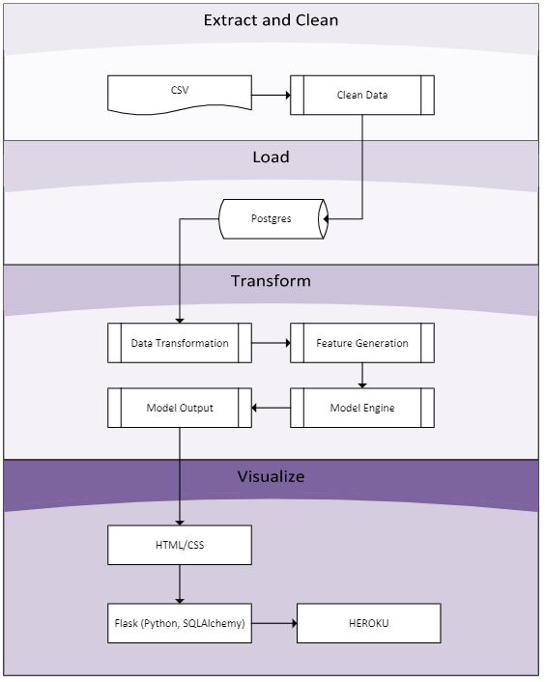
Project Flowchart
Notes:
Vi
Briefly explain the project flowchart

Slide 4



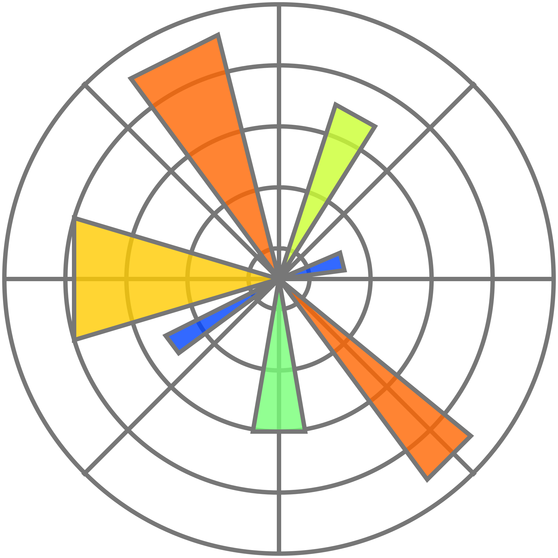






Technologies
Jupyter Notebook
Python/Pandas/Numpy
Seaborn
Matplotlib
SciPy
PostgreSQL/ SQLAlchemy
Scikit-learn
Flask
HTML/CSS
Heroku
Notes:
Vi
Briefly explain the different technologies used for the project and how we used them

Slide 5
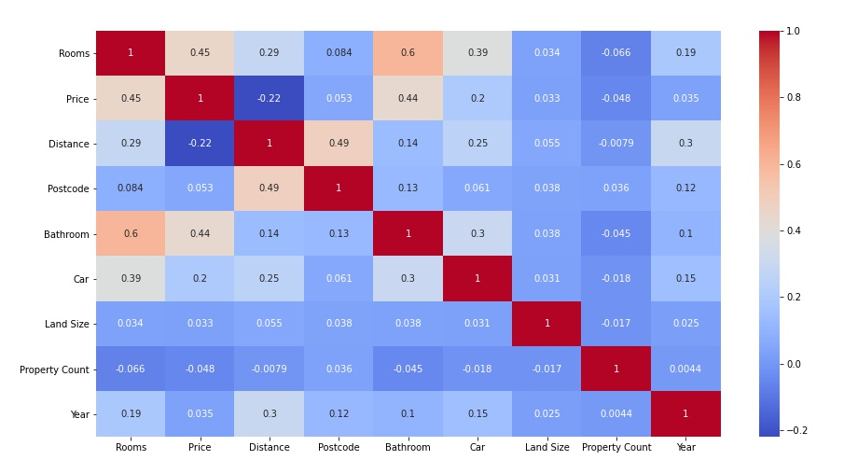
Heatmap
Heatmap used for features correlation
Notes:
Vi
There were outliers in our data exploration so we filter those outliers in important features that have a high correlation to sales price.

Slide 6
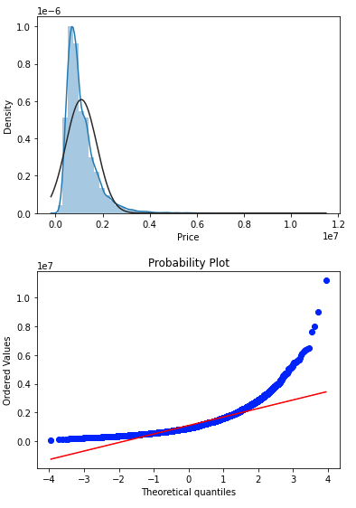
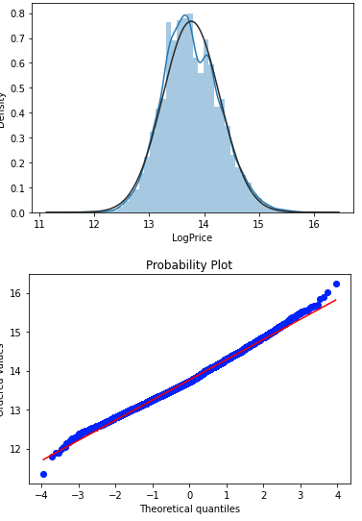
Normality Check
Histogram and probability plot before normalizing
Histogram and probability plot after normalizing
Notes:
Vi
We noticed that most variables have a strong linear relationship with price which is our target feature.
The price was in violation of normality because it was right skewed.
We transformed it by taking the log for the sake of model feeding.

Slide 7
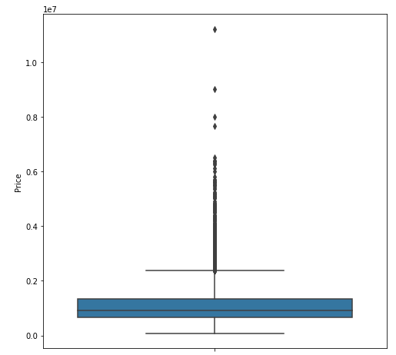
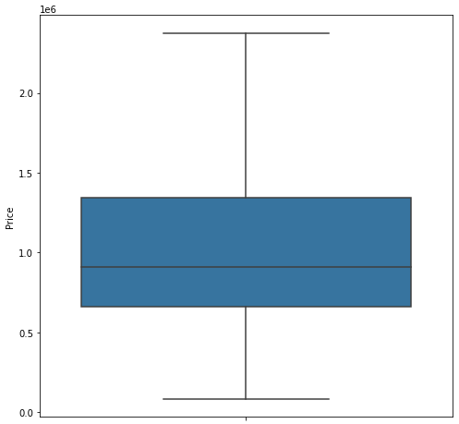
Data Visualizations
Outliers
Price boxplot with outliers
Price boxplot without outliers
Notes:
KC
We previously cleaned our dataset to not include any missing values.
We pulled outliers from price, rooms and bathrooms and dealt with them.

Slide 8
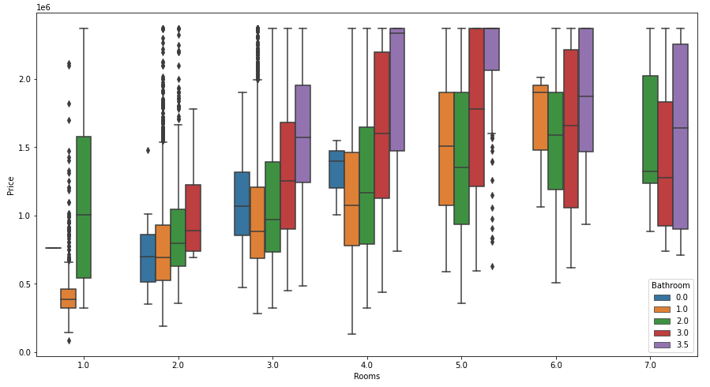
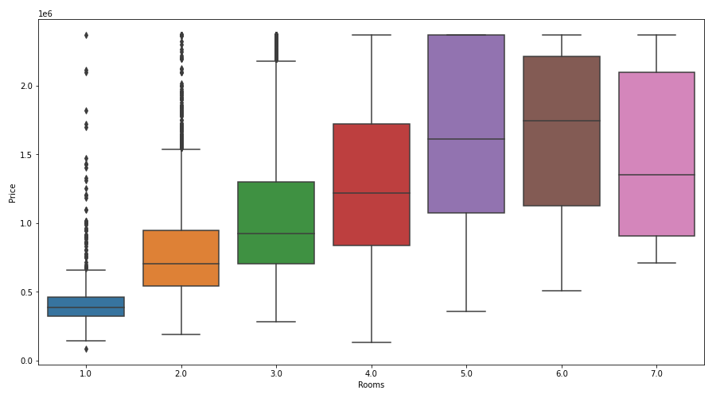
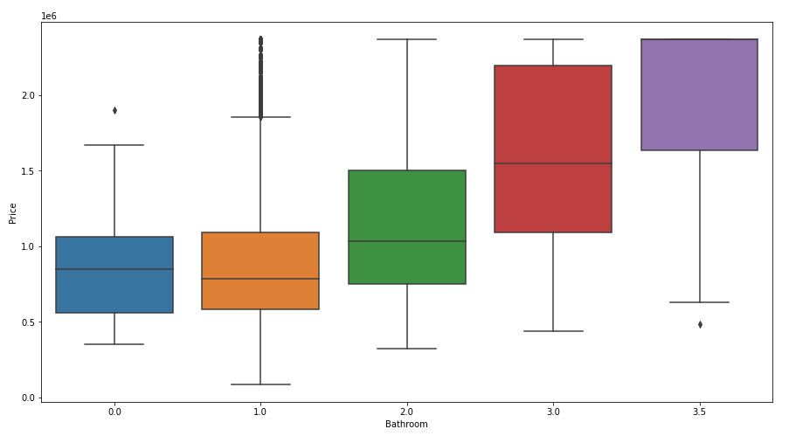
Data Visualizations
Relationships
Notes:
KC
We looked at the relationships between price, rooms and bathrooms.
We wanted to know how the rooms and bathrooms changed the housing price.
From here, we can tell that the more rooms and bathrooms in a house, the higher the price to a degree.

Slide 9
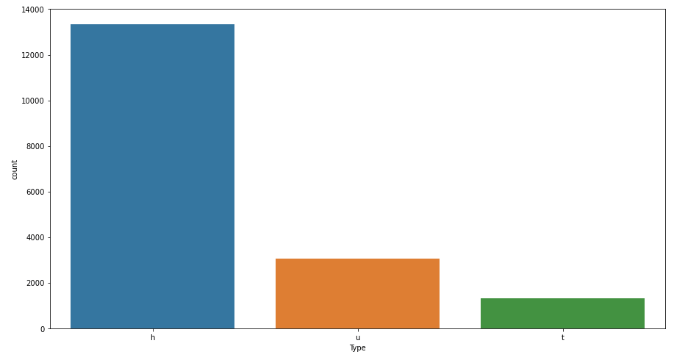
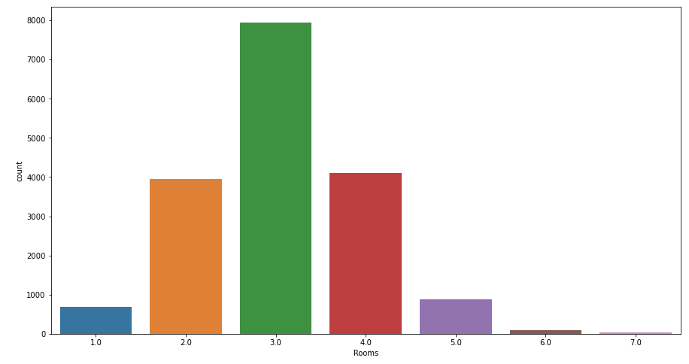
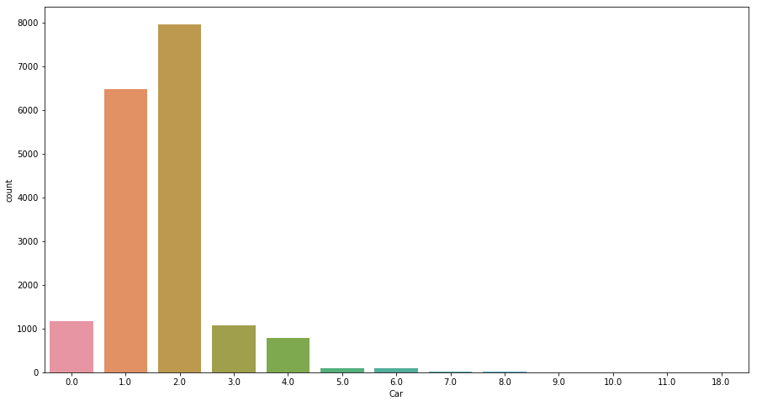
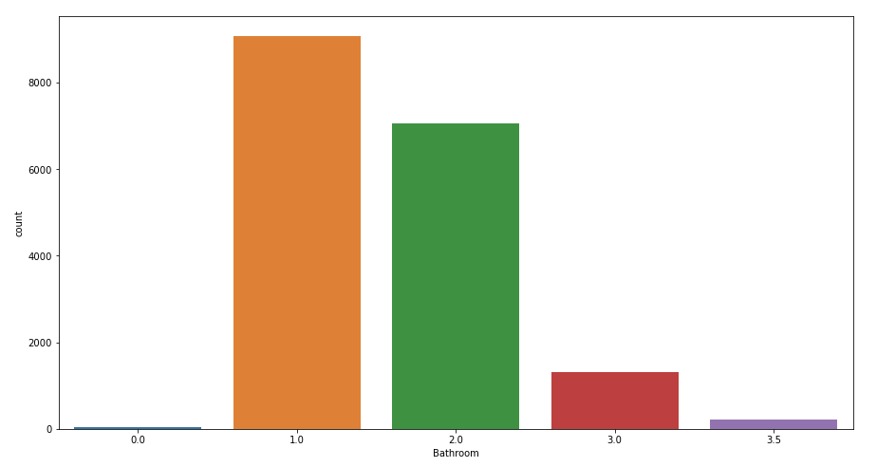
Data Visualizations
Countplots
Notes:
KC
We also wanted to see how the numbers stacked against each other to see if that had any effect with pricing.
From here, we can determine the setup for most of the houses sold.
Most houses sold seem to be houses with three bedrooms, one bathroom and two car spaces

Slide 10
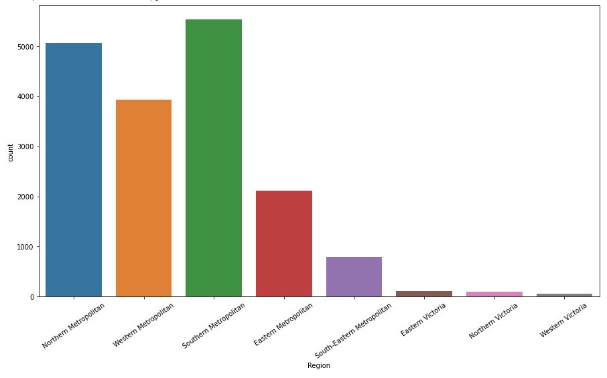
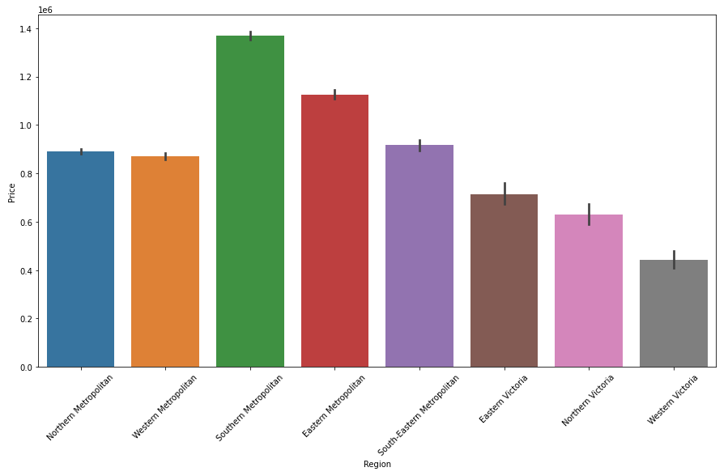
Data Visualizations
Region
Notes:
KC
We wanted to take into account where most of the houses are located to see how that helps predict a price as well.
We see that most houses are sold in the Southern Metropolitan area.
We also see the most expensive housing prices are in the Southern Metropolitan area.

Slide 11
Model Analysis
Linear Regression Model
Random Forests Model
Decision Tree Model
Randomized Search CV Model
Support Vector Regressor
Lasso Model
Ridge Model
Notes:
Darryl
Once we got a picture of our data, we trained and tested seven different machine learning models for accuracy.
We used these specific models because they are all work with labeled data.
We label encoded the housing type and region with numerical data to be ran through the model.
After converting the categorical data into numerical data and separating our target feature, we tested and trained our models.

Slide 12
Models Tested
 | train score | test score
Linear Regression | 0.476343 | 0.461641
Random Forest | 0.297033 | 0.055643
Decision Tree | 0.893777 | 0.712371
Randomized Search CV model | -128442183255.74026 | -126698883394.39828
Support Vector Regressor | -0.072771 | -0.073329
Lasso Model | 0.4763433 | 0.4616413
Ridge Model | -0.297450 | -0.300917
Notes:
Darryl
From the models tested, we were able to definitely conclude which model works best for our dataset and the predictions we are wanting.

Slide 13
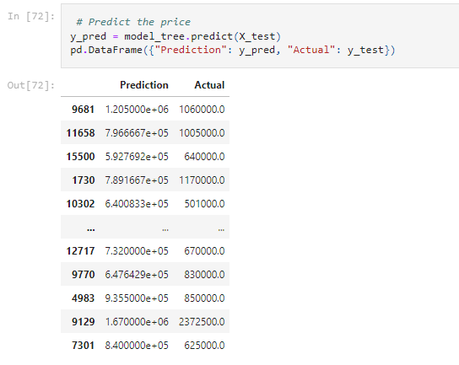
Decision Tree Model
 | train score | test score
Decision Tree | 0.893777 | 0.712371
Notes:
Darryl
With both the highest testing and training score, we decided to use the Decision Tree model for our housing price predictions.
From the model, we are expecting 71% accuracy in testing, according to the features used, to form our prediction.

Slide 14
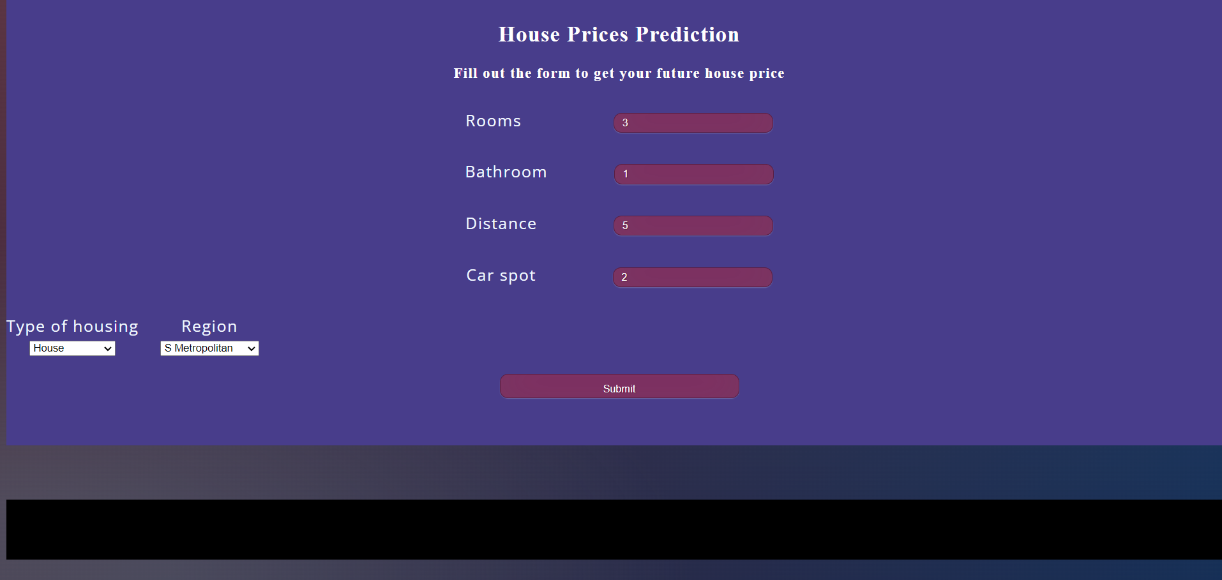
Website and Heroku Deployment
Website
Notes:
MC
Present the website and display it’s functionality.
Discuss how you deployed the application to Heroku and any challenges you faced.

Slide 15
Going Forward
Visualize data to show housing price trends on a map through an application such as Tableau.
​Scrape more recent data and see if the trends and predictions hold true.
Update the look and feel of the website to make it more user friendly and visually appealing.
Redefine the parameters of our models to try and fix possible overfitting
Notes:
MC
Discuss two to three things that you would like to do to improve upon the project in the future.
Ask for any questions from the class.

Slide 16

That’s all. Thank you!
Notes:
MC
End the presentation.

