Slide 1


Finding the Best Plan for You
With Our Program!
By Conner, Sean, Muskan, Niki, Ajoonepreet, and Jeay
Notes:
Introduce (Jaey)

Slide 2

Why Choose CellTech?
Choosing us is THE best decision of your life.
Recognized team
Most efficient program
Vivid cell plan description details
User friendly agents
Providing plans in accordance with your needs and at the cheapest prices
Catering to your requirements/needs
Notes:
Wing It! (We all have to say one point each) → on the spot whose 1st and whose last.

Slide 3



What does our tool do?
“CellTech offers excellent technology that meets our criterias” - Rogers
Our program tracks the client’s calling, texting, and monthly patterns, etc.
Our program then finds your client a new and optimal plan fit to their lifestyle.
Client’s Phone Patterns
CellTech
Optimal Plan for the Client
Notes:
Wing It & read off the slide!

Slide 4
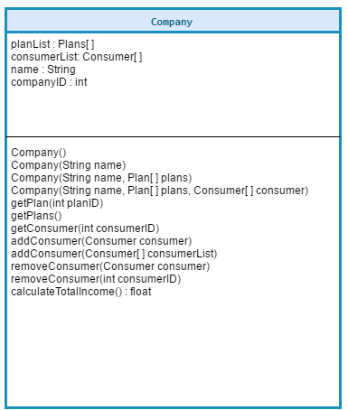
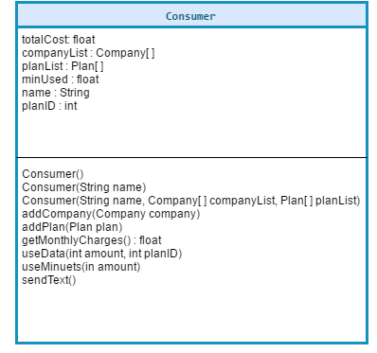
How does it work?
We track the amount of minutes you use in calling, how much data you use, as well as if you make long distance calls. Then our program analyses and finds the optimal plan.
We created UMLs to help visualise and structure our program.
Notes:
Overloading + Properties & Methods (talk about different functions+attributes) + Objects & Classes (Overview)

Slide 5
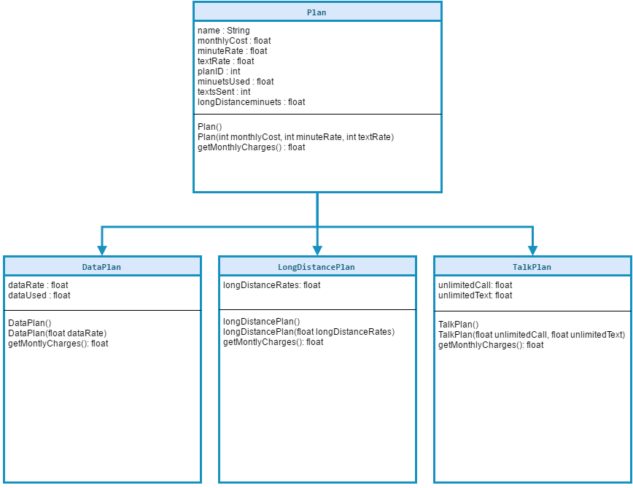
How does it work?
Part 2
The child classes (DataPlan, LongDistancePlan, and TalkPlan) override the attributes that were given to them by the plan parent class.
Notes:
Overriding + Inheritance

Slide 6
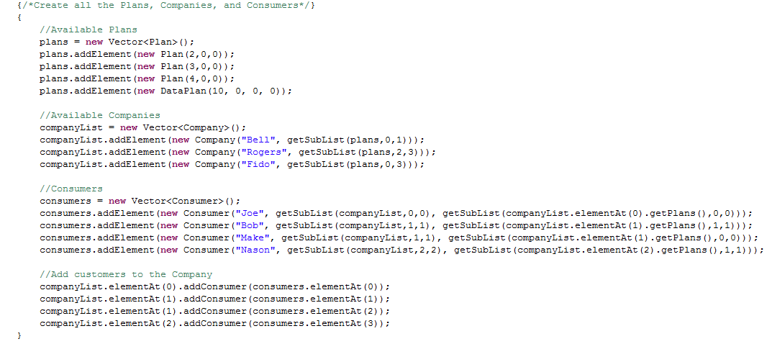
Sample Code
Code Sample
Notes:
Polymorphism

Slide 7


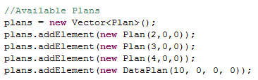
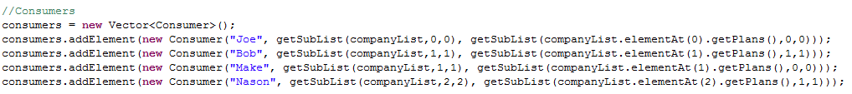
Adds each consumer to the respective companies.
Creates 3 companies and initialize each company with a name and a list of plans.
Creates a list of various plan objects
Creates each consumer and initialize each company with a name, the list of companies it is using, and the plans that it is using from that company
Notes:
Main Program → explain.

Slide 8
Use Cell Tech
Finding the Best Plan for You
With Our Program!
By Conner, Sean, Muskan, Niki, Ajoonepreet, and Jeay
Notes:
Conclude presentation (Niki)

