Slide 1
Seeing Movement Smaller Than the Wave
Phase-based sub-wavelength displacement sensing in time-lapse GPR
Conner · MSc Thesis Defense
Supervisors: [names] · [institution] · [date]
~30s
1 / 18
Notes:
Good morning. Over the next twenty minutes I want to convince you of one thing:
a ground-penetrating radar can measure a movement that is far smaller than the
wave it uses to look. About thirty times smaller. And the reason it can is that
we have been reading the wrong half of the signal.

Slide 2
Two Surveys, One Question
DRAW
DRAW
Cartoon: MONDAY — ground cross-section, fracture, fluid front
(no source file — build this one by hand)
Cartoon: FRIDAY — identical, front advanced a few mm
(no source file — build this one by hand)
?
Monday → Friday
What moved? How far?
~55s
2 / 18
Notes:
Here is the problem that motivates everything. You survey a site. You come back
later and survey it again. Something in between has moved — a fracture has
filled with water, a slope has crept, a wetting front has advanced. You want to
know what moved and by how much.
That is a TIME-LAPSE question, and I will come back to it properly in a few
minutes. But to answer it, we first have to be honest about a much older
limitation — one that applies even to a single, static survey. So let me PARK
time-lapse for now and start there.
[Coaching] Say "park it" out loud. It signals the structure and buys patience
through slides 3 and 4.

Slide 3
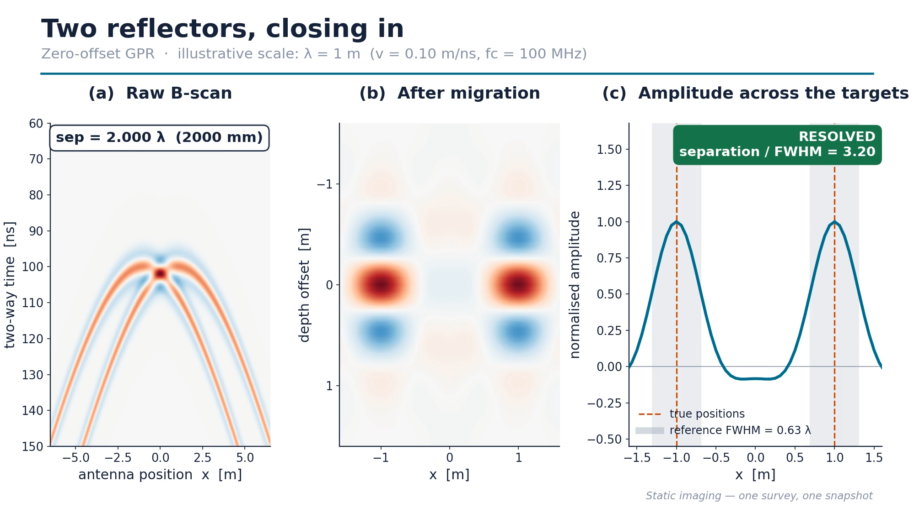
Resolution Is Set by the Wavelength
One survey. One snapshot. The classical limit.
ANIMATION
ANIMATION 1 — two scatterers converging (let it run to ~½λ, pause here)
assets/animations/anim1_imaging_floor.mp4
1.5 GHz in ice → λ ≈ 113 mm
Two reflectors closer than ~λ/2 merge
~50s
3 / 18
Notes:
GPR builds its image from a short electromagnetic pulse. Everything about how
finely it can see is set by the length of that pulse. In my setup — 1.5 GHz in
ice — one wavelength is about eleven centimetres.
[The animation runs at λ = 1 m for readability. Say so: "I've scaled the
wavelength to one metre here so the numbers are easy to read — the physics is
scale-invariant."]
Two reflectors closer than roughly half a wavelength stop being two reflectors.
Laterally that limit comes from the Fresnel zone; vertically from the pulse
bandwidth. Same physics as the Rayleigh criterion in optics.
And crucially: MIGRATION DOES NOT FIX THIS. Migration moves recorded energy back
to where it belongs — it focuses — but you still read the result off as an
AMPLITUDE picture, and that is still bound by the same floor.

Slide 4
Where the Image Gives Up
Three migration algorithms, all hitting the same wall
FIGURE
Rayleigh ratio
1 λ
1.77
Measured PSF collapse: 1λ → ½λ → ¼λ → ⅛λ, three methods
../TimeLapse_LaTeX/Thesis/17_August/fig_res_psf_crop.png
½ λ
0.89
¼ λ
0.44
⅛ λ
0.22
Kirchhoff. Below 1 = merged.
Two static scatterers, closing in
Below ~½λ: one lobe
~60s
4 / 18
Notes:
This is that limit measured rather than asserted. Two stationary scatterers, gap
swept from one wavelength down to an eighth, migrated three different ways —
Kirchhoff, Gazdag phase-shift, and time-reversal back-propagation.
Read it top to bottom. At one wavelength, all three give two clean peaks. At a
half, Kirchhoff has already lost it — ratio 0.89, below the Rayleigh threshold
of one. By a quarter wavelength everything is a single lobe. There is genuinely
no information left in the amplitude.
Back-propagation is the best of the three — it holds on to about a quarter
wavelength — but the point is not which algorithm wins. They ALL hit a wall, and
the wall is at roughly half a wavelength. Call this the IMAGING RESOLUTION FLOOR.
[Coaching] Physically point at the ½λ Kirchhoff panel. That single panel is the
whole argument.

Slide 5
Imaging Is Not Monitoring
The distinction the rest of this talk depends on
IMAGING
MONITORING
Question
Question
Where is it?
How far did it move?
Data
Data
One survey
Two surveys
Axis
Axis
Space
Time
Limit
Limit
Rayleigh, ~λ/2
?
← the subject of this thesis
Same radar. Same wavelength. Different question — so, possibly, a different limit.
~60s
5 / 18
Notes:
★ THE PIVOT SLIDE. Slow down. If they remember one slide, make it this one.
Now I want to draw a distinction that the rest of the talk depends on, so let me
be very explicit about it.
Everything so far has been IMAGING RESOLUTION. One survey, one snapshot, and the
question is: where is this thing and can I separate it from its neighbour? That
is a question about SPACE, and the answer is the half-wavelength floor we just
measured.
What I actually care about is a different question. Two surveys, and the
question is: how far did this thing move between them? That is a question about
CHANGE OVER TIME. Call it MONITORING RESOLUTION.
These are not the same quantity, and there is no law that says they must have
the same limit. That is the opening this thesis walks through.
[Build order: left panel → divider → right panel header → the "?" ]

Slide 6
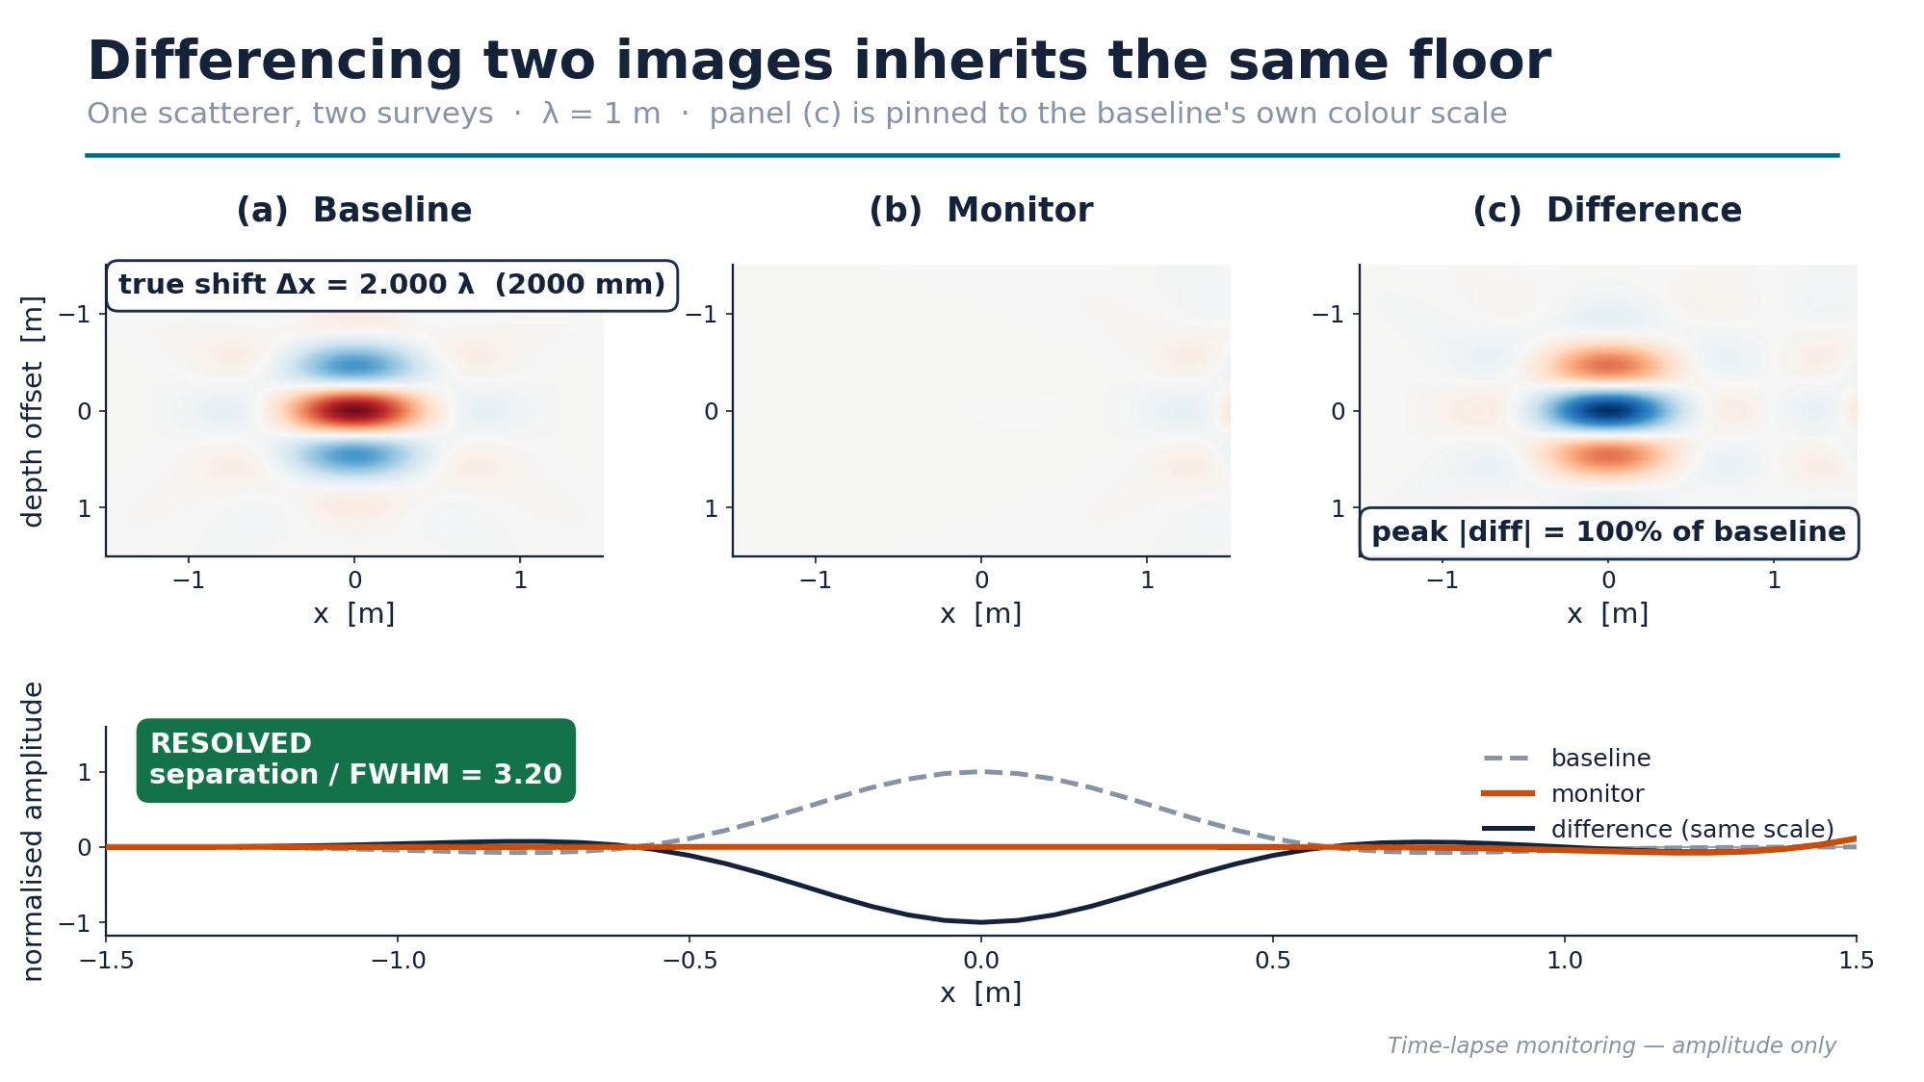
Subtracting Two Images Doesn't Help
Now it IS time-lapse — and it inherits the same floor
ANIMATION
ANIMATION 2 — baseline / monitor / difference, fixed colour scale
assets/animations/anim2_monitoring_floor.mp4
Difference the two images
Still stuck at ~½λ
~35s
6 / 18
Notes:
The obvious thing to try: migrate both surveys, subtract, look at what is left.
That works — as long as the movement is big.
But the difference image inherits the same floor. Below about a quarter
wavelength the baseline and monitor lobes overlap so completely that their
difference carries no usable position information.
[Point out the FIXED colour scale — this is the honest bit. Auto-scaling a
difference image always shows SOMETHING, which is exactly how people fool
themselves. Pinned to the baseline's own peak, the difference visibly dies.]
So amplitude differencing does not buy a new limit. It re-imports the old one.
We need to stop looking at amplitude.

Slide 7
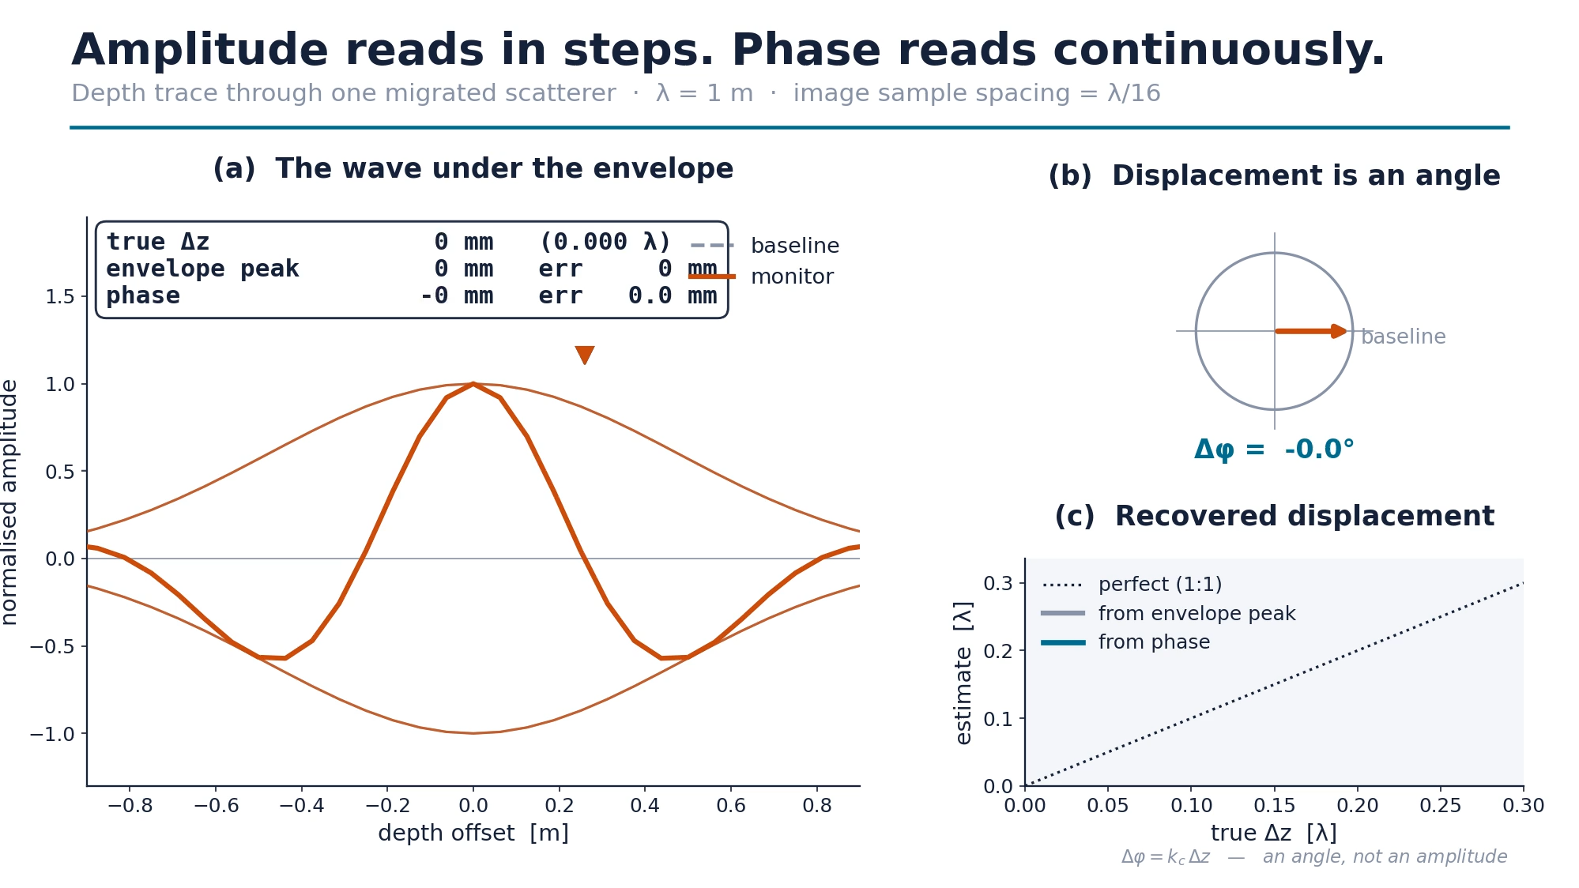
Amplitude Reads in Steps. Phase Reads Continuously.
The key insight — one scatterer, one trace
ANIMATION
ANIMATION 3 — trace + phasor + staircase-vs-straight-line
assets/animations/anim3_envelope_vs_phase.mp4
Envelope: quantised, broad
Phase: continuous, exact
~60s
7 / 18
Notes:
Here is the physical insight the whole method rests on.
A migrated point scatterer is an ENVELOPE — a broad amplitude lobe, roughly a
wavelength wide — with a wave oscillating underneath it. To read a position off
the envelope you have to locate the peak of that broad lobe on a discrete grid.
Watch panel (c): the grey curve is a STAIRCASE. Below one sample spacing it
reports zero movement.
Now the phase of the wave underneath. It advances continuously and linearly with
position. No threshold, no floor, no minimum detectable shift. Panel (b) makes
it concrete: the displacement is literally an angle.
The information was always there. Amplitude imaging quantises it away.
[Coaching] Best moment in the talk. Let the animation run once in silence before
narrating the second half.
[If challenged: "doesn't the envelope shift too?" — Yes, exactly, and that is
why I am careful to say READS IN STEPS rather than DOESN'T MOVE. The envelope
translates; what fails is separating two of them (slides 4 and 6) and reading a
sub-sample position off a discretised amplitude image.]

Slide 8
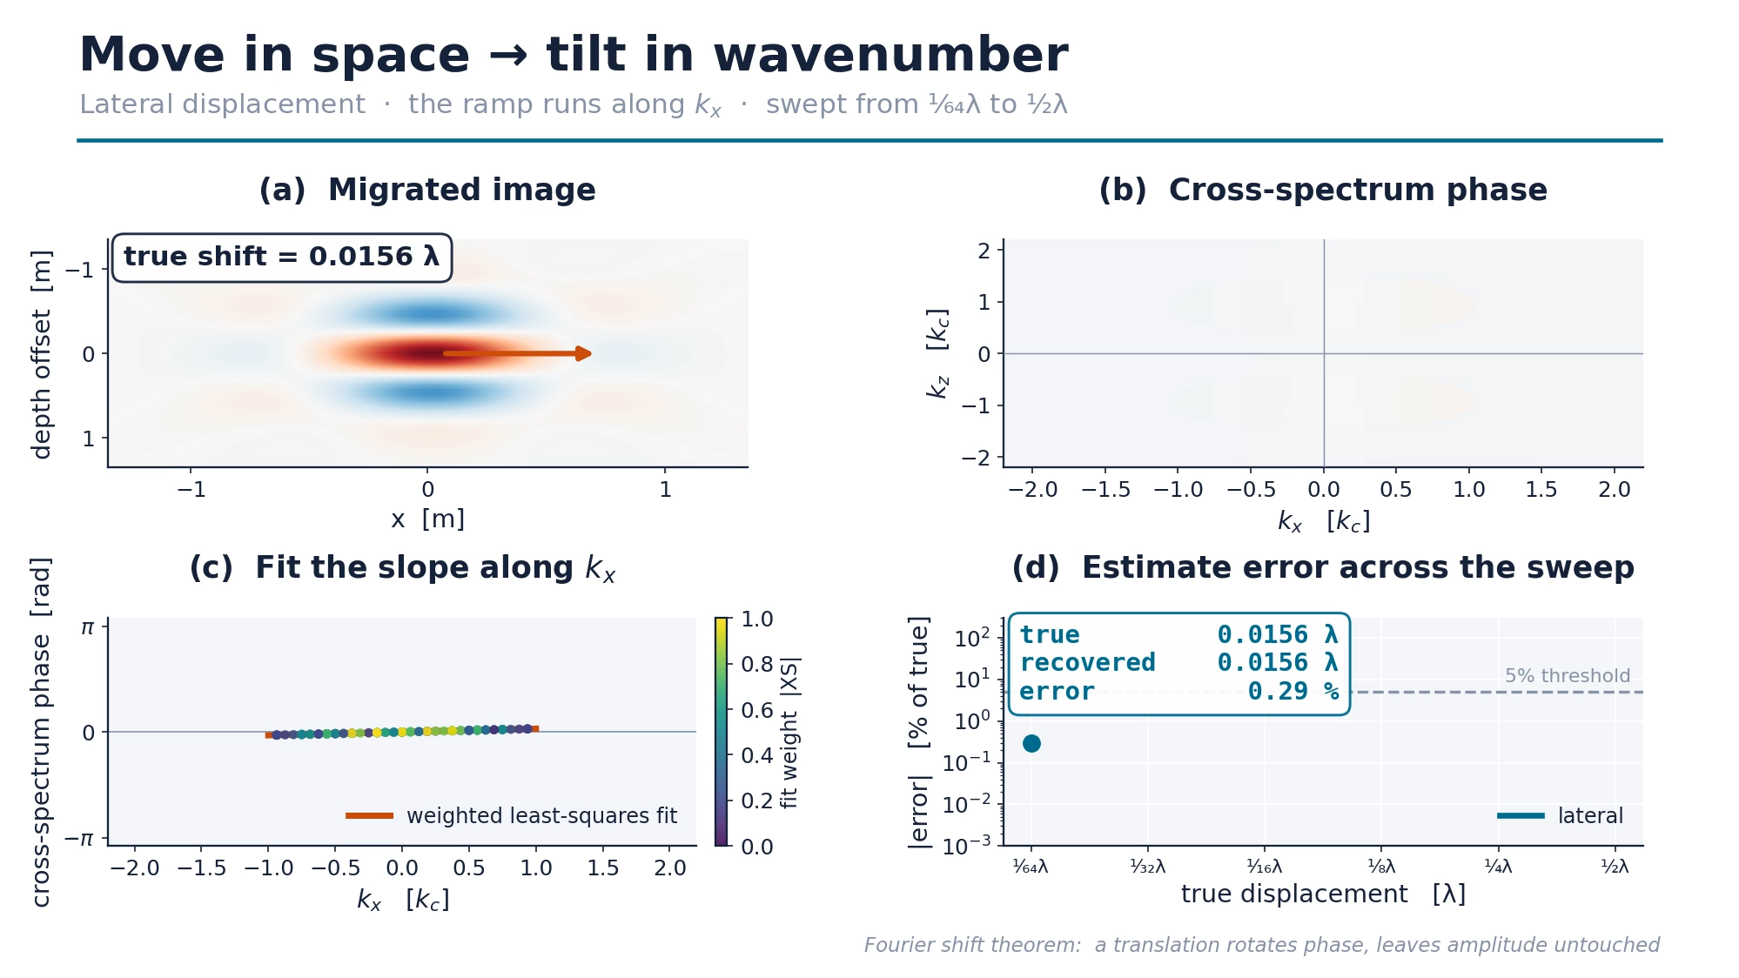
A Shift in Space Is a Tilt in Wavenumber
Fourier shift theorem: translation rotates phase, leaves amplitude untouched
ANIMATION
ANIMATION 4a — image sliding | cross-spectrum phase tilting | live fit
assets/animations/anim4_kdomain_lateral.mp4
Move in space
Tilt in wavenumber
~50s
8 / 18
Notes:
To turn that insight into a number, I move into the two-dimensional Fourier
domain — wavenumber space.
The Fourier shift theorem says something very convenient: translating an image
in space does not change its amplitude spectrum AT ALL. It only rotates the
phase, by an amount proportional to the wavenumber.
So on the left, the scatterer slides. On the right, watch the phase go from flat
— no shift — to a smooth ramp. The steeper that ramp, the bigger the shift. The
slope IS the displacement.
That is the conversion I need: from a displacement I cannot see, to a slope I
can measure.

Slide 9
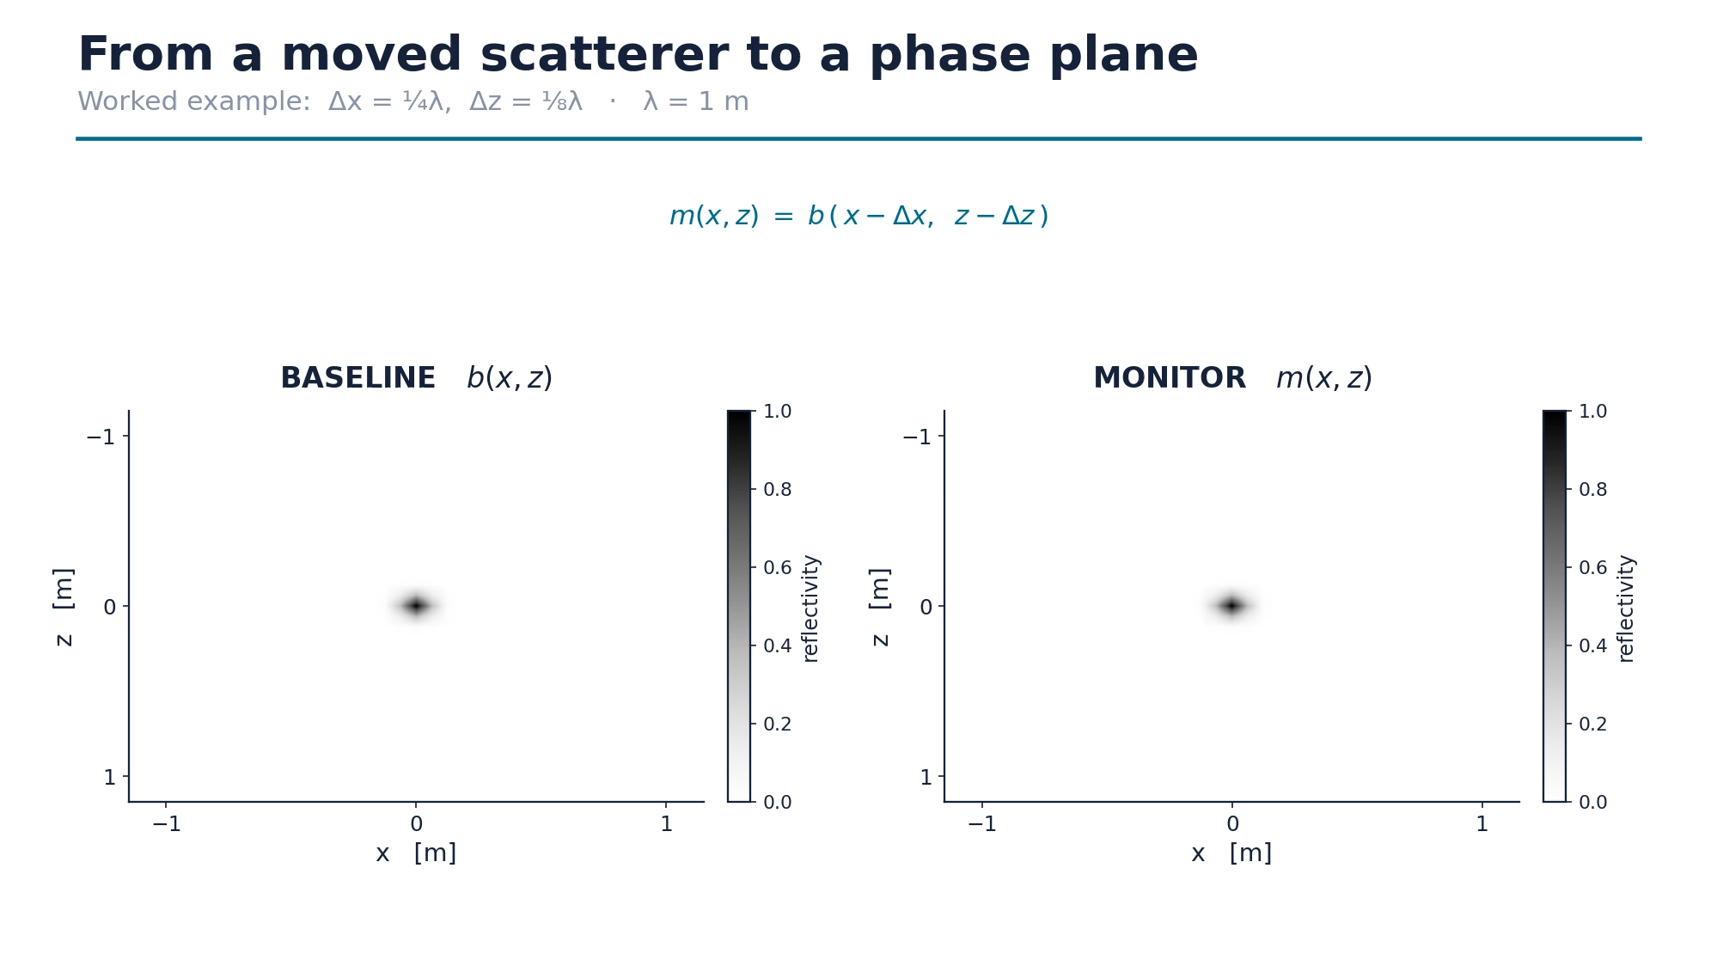
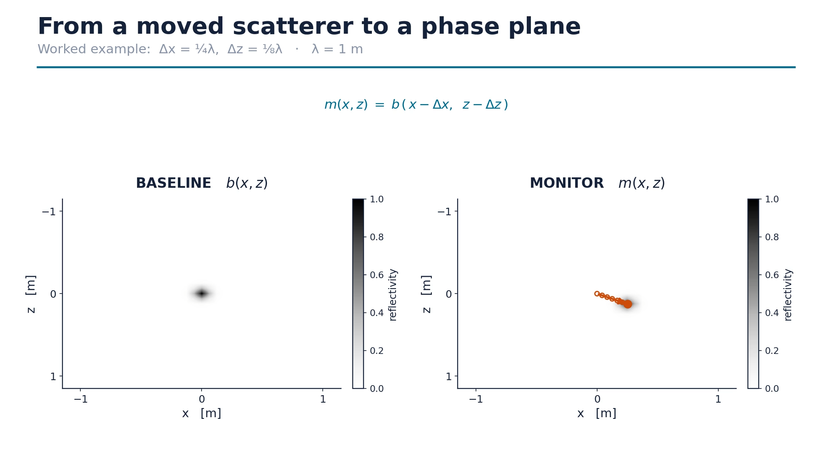
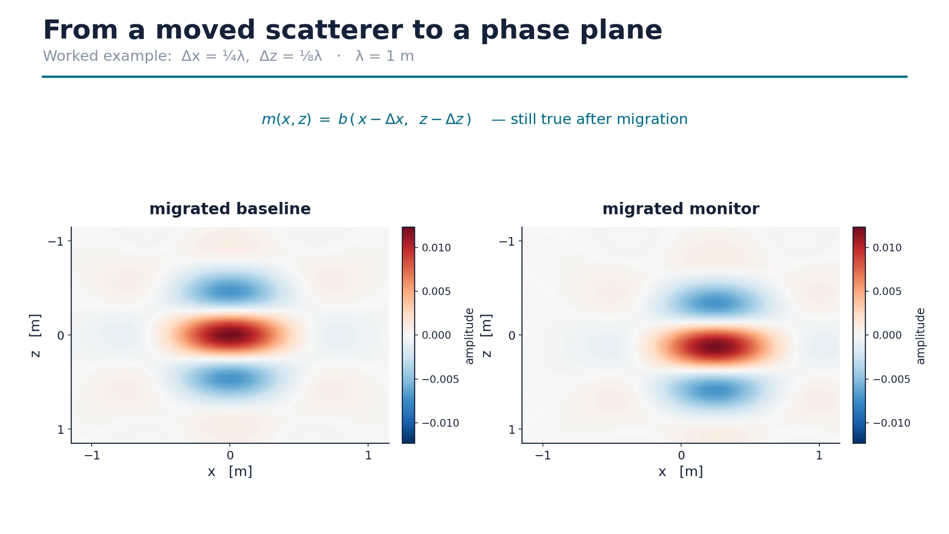
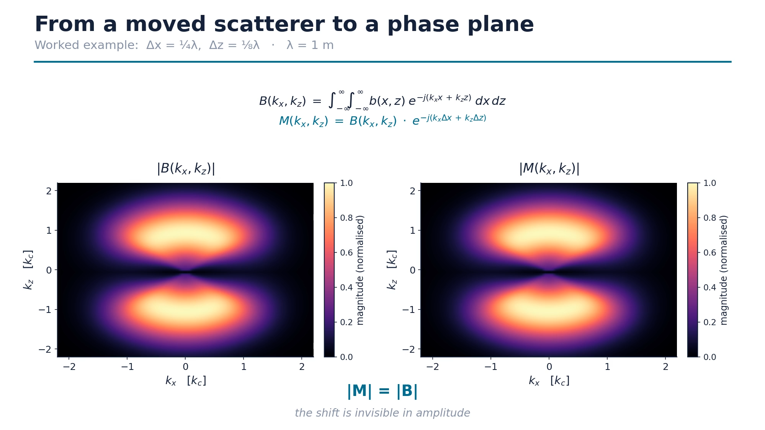
One Multiplication Cleans It Up
The cross-spectrum: everything the two images share cancels
1
m(x,z) = b(x−Δx, z−Δz)
assets/animations/anim5_act1_model.mp4
scatterer moves
2
(same relation, after migration)
assets/animations/anim5_act2_migrated.mp4
→ migrated
3
B(k) = ∫∫ b e^(−j k·r) dr M = B · e^(−j k·Δ)
assets/animations/anim5_act3_spectrum.mp4
→ wavenumber |M| = |B|
4
XS = B · M* = |B|² e^(+j k·Δ) ∠XS = Φ = kₓΔx + k_zΔz
assets/animations/anim5_act4_cross.mp4
→ |XS| and ∠XS
Build order: reveal the formula → click → the clip morphs the panels into the next domain.
Φ(k_z , k_x) = k_z · Δz + k_x · Δx
~95s
9 / 18
Notes:
THE DERIVATION SLIDE. Four formula/clip pairs; you control every step.
Two panels stay in the same place the whole way through — left is always the
baseline, right is always the monitor. Only what they REPRESENT changes. Say
that at the start; it is what stops the domain change from being disorienting.
[1] The complication first: the two surveys differ by a translation, and that
is all. m(x,z) = b(x−Δx, z−Δz). Click: the right-hand scatterer walks to its
monitor position.
[2] Click: both panels become their migrated versions. The sharp point becomes
a broad lobe — that lobe is the resolution floor from earlier. But the relation
still holds exactly, because migration is linear and I use the same operator on
both surveys.
[3] Now into the two-dimensional Fourier domain. The shift theorem says a
translation does not touch the amplitude spectrum at all; it only multiplies by
a phase ramp. Click: both panels become their spectra — and they are
IDENTICAL. Pause here. That is the point: a displacement is completely
invisible in the amplitude spectrum. Everything we need is hiding in the phase.
[4] So form the cross-spectrum: baseline times the complex conjugate of the
monitor. Click. The magnitude term is real and positive, so taking the phase
kills it completely, and what survives is a flat plane through the origin. Its
slope along k_z is the vertical displacement; its slope along k_x is the
lateral one.
That's it — that's the method. Everything after this is measurement.
[Coaching] Say "that's the method" out loud. It signals the conceptual work is
done and the audience can relax.
[If the projector will not play video: the four *_final.png stills in
assets/animations/ are the end state of each act. Step through those instead.]

Slide 10
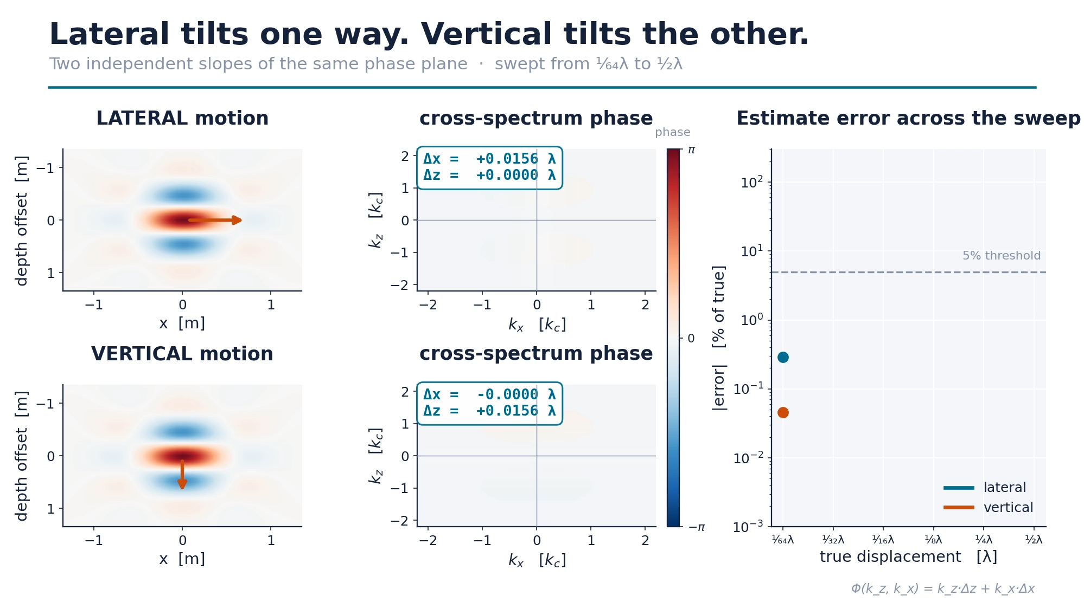
Lateral Tilts One Way. Vertical Tilts the Other.
Two independent slopes of the same plane
ANIMATION
ANIMATION 4b — 2×2: lateral vs vertical, image and k-domain
assets/animations/anim4_kdomain_both.mp4
Lateral → slope in k_x
Vertical → slope in k_z
Diagonal → both, recovered separately
~55s
10 / 18
Notes:
The two directions do not interfere. Purely lateral motion tilts the plane along
k_x and leaves k_z flat. Purely vertical does the reverse. A diagonal movement
tilts both, and the fit recovers each component independently — I tested that on
a 2:1 diagonal path and got the ratio back correctly.
One asymmetry worth flagging, because it surprised me. In the SPATIAL domain
these two directions behave completely differently — a migrated image separates
lateral spatial frequencies across its width, like a prism, but it does not do
the same in depth. In the FOURIER domain that asymmetry disappears: both are
just slopes of the same plane.
That is the practical argument for doing this in wavenumber space rather than
reading phase gradients off the image directly.

Slide 11
Fit the Plane, Weight by Energy
Thousands of noisy observations of one plane
FIGURE
Four-panel conceptual workflow: baseline → monitor → phase → fit
../TimeLapse_Figures/Resolution_Study/General/RES_018_Phase-Plane_Method__Conceptual_Workflow.png
Weighted least squares
equation 2 of 2
Bright bins count more
u = (AᵀW²A)⁻¹ AᵀW² Φ
Two slopes → Δx, Δz
~65s
11 / 18
Notes:
EQUATION 2 OF 2. Do not derive it. Point at it and move on.
A real image gives me thousands of frequency bins, each an independent noisy
observation of that plane, so this is an over-determined least-squares problem.
Two things make it robust. First, a band-pass mask that keeps the fit inside the
coherent part of the wavelet spectrum, so the total phase rotation never wraps
past ±π. Second — and this matters more — I weight every bin by the
cross-spectrum energy. A bin at the antenna's peak power is far more trustworthy
than one at the edge of the band, and unweighted least squares treats them
identically. In the fit panel you can see it working: bright high-weight points
sit tight on the line, dim ones scatter.
On this clean example the recovered shift is ten millimetres against a true ten
millimetres.

Slide 12
Phase Takes Over Exactly Where Amplitude Quits
Four movement types · three migration methods · clean data
FIGURE
Detectability map — top: Rayleigh ratio | bottom: phase error %
../TimeLapse_Figures/Hypothesis_1/General/H1_037_Hypothesis_1_--_Detectability_Map_Amplitude_vs_Phase.png
Top: amplitude dies below ½λ
3–4 orders of magnitude,
in the regime amplitude cannot reach
Bottom: phase accurate to ¹⁄₃₂λ
~75s
12 / 18
Notes:
★ THE MONEY SLIDE. Do not rush. Pause for two full seconds after the first line.
This is the central result, and I want to give you a moment to read it.
[STOP TALKING. Two seconds.]
Four movement types across the columns — lateral, vertical, diagonal, and a
graded fluid front. Three migration methods in colour. Read right to left:
displacement gets SMALLER as you move left.
Top row is amplitude — the Rayleigh ratio. Above the dotted line is resolvable.
Every curve crosses below it around a half to a quarter wavelength.
Bottom row is the phase method, percentage error on a log scale. Notice WHERE it
drops: at or BEFORE the point where amplitude fails. In the lateral case Gazdag
sits at a few thousandths of a percent error — a few hundredths of a millimetre
— at a displacement of four millimetres, one thirty-second of a wavelength.
The two rows are mirror images of each other, and that is the whole claim: phase
becomes reliable precisely where amplitude stops being. Not by a little. By
three to four orders of magnitude.

Slide 13
It Works on a Fluid Front Too
A harder target than a metal cylinder — deliberately
FIGURE
FIGURE
Graded wetting zone: 7 permittivity steps, water → air
../TimeLapse_Figures/Hypothesis_1/General/H1_028_FluidFlow_--_Model_Set_Up_baseline_graded_zone_true_scale.png
MAE summary — grey out all groups except FluidFlow
../TimeLapse_Figures/Hypothesis_1/General/H1_039_Hypothesis_1_--_MAE_Summary_Across_Movement_Types.png
≈ 1 mm error on a 113 mm target
Amplitude fails even earlier than for a hard reflector
Phase: still ~1 mm
~50s
13 / 18
Notes:
[CUT THIS SLIDE FIRST if you are running long — slide 12 already shows the
FluidFlow column.]
One fair objection to everything so far is that a perfect metal cylinder is a
very generous target. So I repeated the whole sweep with something closer to
what I actually care about: a graded wetting front — seven permittivity steps
from water down to air, standing in for fluid advancing through a fracture.
This target is HARDER. Its point-spread function is intrinsically broader, so
amplitude differencing fails even sooner — Gazdag's ratio is already below one
at two full wavelengths.
The phase fit does not care. About a millimetre of error, on a target whose own
smear is a hundred and thirteen millimetres wide. So the result is not an
artefact of the idealised point-scatterer geometry.

Slide 14
What Migration Does to Nothing at All
Laplace noise, fitted to the real field dataset
FIGURE
Pure noise in → Kirchhoff (coherent!) vs Gazdag (speckle)
../TimeLapse_Figures/Hypothesis_2/Noisy/Kirchhoff/H2_003_Migrating_Pure_Noise_no_scatterers_no_signal_--_Kirchhoff_vs.png
Circle one bright cluster in the Kirchhoff panel and label it: “looks like a target — isn’t one.”
Input: pure noise, no target
Kirchhoff manufactures structure
Gazdag stays speckle
~65s
14 / 18
Notes:
Real data is not clean, so I repeated all four experiments under noise — and not
arbitrary noise: a Laplace distribution fitted to the amplitude statistics of
the real field dataset, heavier-tailed than a Gaussian because field noise is
dominated by clutter spikes rather than thermal noise.
Before testing signal-plus-noise, I ran a sanity check I would recommend to
anyone doing this: migrate noise ALONE. No scatterer, no signal.
Kirchhoff turns it into that. Coherent, streaky, focused-looking structure —
manufactured from nothing. And that is structural, not bad luck: delay-and-sum
stacks many traces along travel-time curves, and stacking imposes coherence on
incoherent input BY CONSTRUCTION. Gazdag, which downward-continues in the
frequency domain, leaves it as speckle.
This matters because my pipeline crops its fitting window around the brightest
region. If the brightest region is a noise artefact, the fit is meaningless.

Slide 15
Accuracy and Safety Pick Different Winners
Mean absolute error, sub-½λ regime, all four movement types
ACCURACY (MAE)
FALSE-POSITIVE RISK
Kirchhoff
4.5 mm
Invents coherent targets
Back-prop (sign-bit)
11.1 mm
Stays incoherent
Gazdag
20.3 mm
Stays incoherent
Most accurate ≠ safest
Kirchhoff: accurate, but cross-check it
Sign-bit back-prop: the conservative choice
~75s
15 / 18
Notes:
So which migration should you use? I framed this originally as "which is most
noise-robust", and the honest answer is that this was the WRONG QUESTION,
because the two sensible definitions of robust give opposite answers.
On raw accuracy, Kirchhoff wins clearly — 4.5 mm mean absolute error across all
four movement types, about 2.5× better than back-propagation and 4.5× better
than Gazdag.
On false-positive risk, Kirchhoff is the ONLY method that fails. It is the one
that manufactures coherent structure from noise.
Back-propagation trades a factor of two in accuracy for that safety — but only
once you make it noise-robust, which took one specific change: injecting the
SIGN of the time-reversed wavefield rather than its amplitude. Focusing is
driven by zero-crossings, so the sign carries all the information that matters,
and it clamps every noise spike to the same ±1 as the real signal.
Gazdag loses on both counts.
My recommendation is conditional: Kirchhoff when you need accuracy and can
cross-check; sign-bit back-propagation when a false detection is the expensive
outcome.
[Caveat if pushed: this is one noise level — 10% of each B-scan's own signal
standard deviation. A sweep across levels is future work.]

Slide 16
A Borehole, and 38 Surveys
Push–pull tracer test in fractured rock · 6 June 2016
FIGURE
PUSH
→
CHASE
→
WAIT
→
PULL
1 → 3
3 → 8
8 → 20
20 → 38
Borehole domain: water-filled channel, injection at 78.7 m
../TimeLapse_Figures/FieldData_Study/Compilations/FD_borehole_domain_schematic.png
injecting
still injecting
pumping stops
extracting
up
up
settle
back
No ground truth. Target geometry unknown, true displacement unknown, region of influence painted by hand in napari.
38 borehole profiles, fractured rock
Injection at 78.7 m — same band as the tracked reflector
~55s
16 / 18
Notes:
Finally, real data. A single-hole borehole GPR dataset from a controlled
push-pull tracer test in fractured rock — 38 profiles down the same borehole,
from the Shakas campaign.
Four stages, each with a physical expectation. Push: fluid actively injected, at
78.7 metres depth. Chase: continued injection at a lower rate. Wait: pumping
stops. Pull: fluid extracted.
The critical difference from everything before this is that here I have NO
GROUND TRUTH. I do not know the target geometry, I do not know the true
displacement, and there is no pre-labelled region to fit. I picked the region of
influence by hand, in napari, painting directly on the cross-spectrum — and I
will come back to how much that choice matters.

Slide 17
Two Independent Pipelines, One Trajectory
Cumulative displacement along the borehole
FIGURE
Push stage
−1.66 m Gazdag
−2.06 m back-prop
Stage-anchored displacement: Gazdag (solid) vs back-prop (dashed)
../TimeLapse_LaTeX/Thesis/17_August/fig_fielddata_stages.png
Agreement
same sign,
every stage
No shared processing downstream of the raw B-scans.
Up while injecting
Back down when pumping stops
Two methods, no shared processing
~80s
17 / 18
Notes:
Cumulative displacement along the borehole, Gazdag solid, back-propagation
dashed.
The front moves UPWARD while fluid is pumped in, through Push and Chase. Pumping
stops, and it settles back down through Wait and Pull. Exactly the physically
expected pattern, given injection at 78.7 metres — inside the same depth band as
the reflector I am tracking.
But the part I would actually defend is the AGREEMENT between the two lines.
Gazdag and back-propagation share NO processing steps downstream of the raw
B-scans — different migration physics, different gain corrections, different
artefact suppression. They agree on the sign of the displacement in every single
stage. Two independent pipelines converging on the same trajectory is much
stronger evidence that this is a real physical signal than either estimate alone.
I want to be precise about what this does and does not show. It shows the
pipeline GENERALISES — it survives real, noisy, geometry-unknown data and returns
something stable and physically sensible. It is not a sub-wavelength validation,
because I have no independent ground truth to validate against.
═══════════════════════════════════════════════════════════════════
★ REHEARSE THIS ANSWER VERBATIM — most likely technical challenge:
Q: "Your field wavelength is ~1 m and your Push displacement is 1.66 m —
shouldn't the phase have wrapped?"
A: The hand-picked k-space ROI is a narrow band around the spectral peak, which
keeps the total phase rotation inside ±π across that band. The ±λ/2
unambiguous range quoted in the synthetic study reflects the much wider
passband used there (|k| < 1.4 k_c). The genuinely sub-wavelength stage here
is Pull, at 0.14 m against a ~1 m wavelength.
═══════════════════════════════════════════════════════════════════

Slide 18
What This Buys, and What It Costs
✔ CLAIM
⚠ CAVEAT
→ NEXT
Sub-wavelength movement,
read from phase.
Down to ¹⁄₃₂ λ,
to a few tenths of a mm —
where amplitude has
already collapsed.
Holds for a fluid front,
not just a point scatterer.
Migration choice under noise
is a trade-off, not solved.
One noise level tested.
ROI picked by hand is the
weakest link: RANSAC shifts
a k-space pick ≤ 6%,
a B-scan pick up to 59%.
Velocity change would mimic
a vertical shift. Untested.
Multiple simultaneous movers
— each imprints its own ramp,
so a global fit blends them.
Needs a localised variant.
Noise-level sweep to find the
accuracy / safety crossover.
All 38 field profiles, not 5.
Step-by-step, not 4 stages.
Thank you.
~100s
18 / 18
Notes:
To close.
THE CLAIM. Time-lapse GPR can recover a movement about thirty times smaller than
its own wavelength, by reading the phase of the migrated image instead of its
amplitude. Down to one thirty-second of a wavelength, to a few tenths of a
millimetre, exactly in the regime where the amplitude difference image has
already collapsed — and that holds for a fluid front as well as a point
scatterer.
THE CAVEATS. Three, honestly. One: under noise the choice of migration is a real
trade-off, not a solved problem, and I tested a single noise level. Two:
choosing the region of influence by hand is the weakest link in the field
pipeline — refitting with RANSAC changes a hand-picked k-space estimate by at
most six percent, but an amplitude-gated one by up to fifty-nine. Three: a
genuine change in medium velocity between surveys would masquerade as a vertical
shift, and I have not tested that.
WHAT'S NEXT. The most interesting one is multiple simultaneously-moving
scatterers — in the wavenumber domain each imprints its own tilted ramp, and a
global fit returns a meaningless blend, so that needs a localised variant.
Beyond that: a noise-level sweep to find where the accuracy and safety criteria
cross over, and running the corrected back-propagation over all thirty-eight
field profiles instead of five.
Thank you. I'm happy to take questions.

Slide 19
Backup
Do not present. Jump here from Q&A.

Slide 20
Phase-Plane Fit, Full Diagnostic
“Show me an actual fit.”
FIGURE
Backup asset
../TimeLapse_Figures/Hypothesis_1/Gazdag/H1_038_Phase-Plane_Workflow_--_Gazdag_Lateral_132_λ.png
B1

Slide 21
Does the Weighting Actually Help?
OLS vs WLS, hardest noisy case
FIGURE
Backup asset
../TimeLapse_Figures/Hypothesis_2/General/H2_008_Chapter_54_--_OLS_vs_WLS_Phase-Plane_Fitting_on_Noisy_Data.png
B2

Slide 22
Why Laplace?
Field noise distribution + Gaussian comparison
FIGURE
Backup asset
../TimeLapse_Figures/Hypothesis_2/General/H2_002_Noise_distribution_at_7_Constant_Velocity_pre-gain_with_Lapl.png
B3

Slide 23
How Much Does the ROI Matter?
WLS vs RANSAC, all pairs and methods
FIGURE
Backup asset
../TimeLapse_Figures/FieldData_Study/Compilations/FD_ransac_vs_wls_displacement_summary.png
B4

Slide 24
Does Slide 12 Survive Noise?
Noisy detectability map
FIGURE
Backup asset
../TimeLapse_Figures/Hypothesis_2/General/H2_029_Hypothesis_2_--_Detectability_Map_Noisy.png
B5

Slide 25
Clean vs Noisy, Every Pair
Dumbbell plot, log axis
FIGURE
Backup asset
../TimeLapse_Figures/Hypothesis_2/General/H2_030_Hypothesis_2_--_Clean_vs_Noisy_MAE_Dumbbell_Plot.png
B6

Slide 26
What Does the Raw Field Data Look Like?
5 profiles × 4 representations
FIGURE
Backup asset
../TimeLapse_Figures/FieldData_Study/Compilations/FD_profile_migration_grid.png
B7

Slide 27
What Is Sign-Bit Time Reversal?
Peak-normalised vs sign-bit excitation
FIGURE
Backup asset
../TimeLapse_Figures/Hypothesis_2/Back-Propagation/H2_007_Sign-Bit_Time-Reversed_Excitation_--_B-scans_and_Spectra_Lat.png
B8

Slide 28
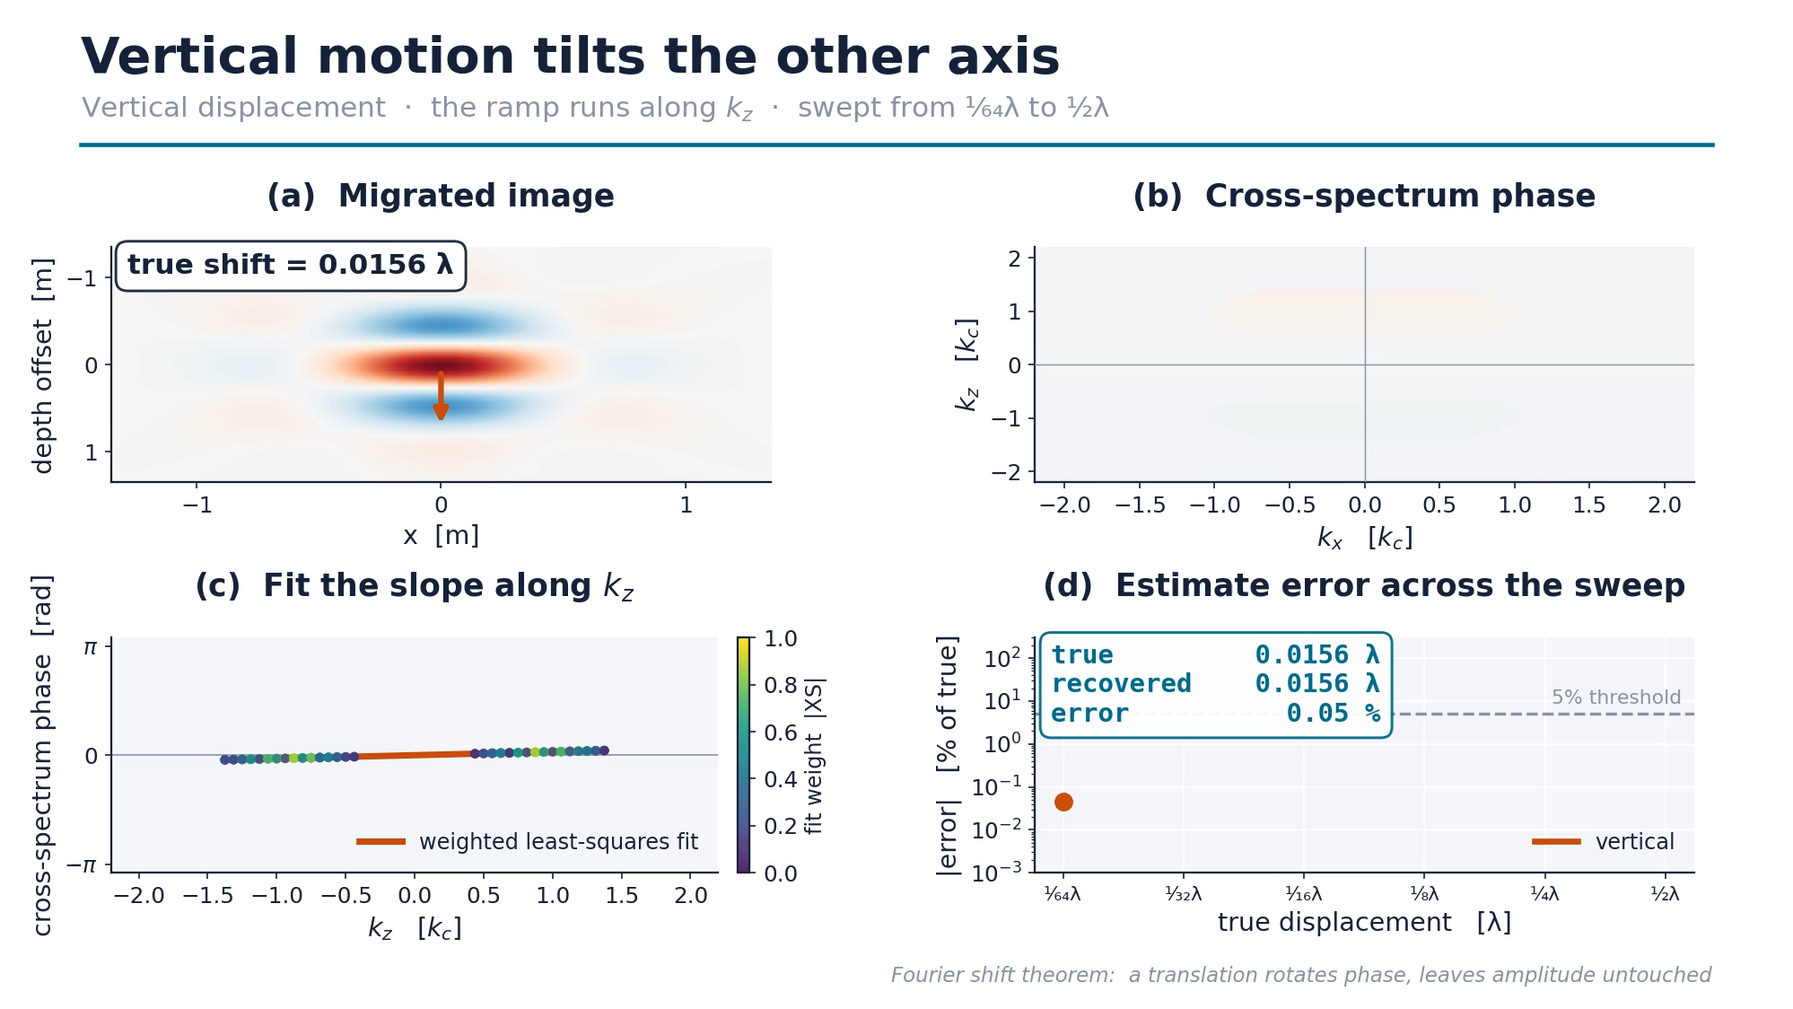
Vertical Motion in the k-Domain
Animation 4, vertical mode
ANIMATION
Backup asset
assets/animations/anim4_kdomain_vertical.mp4
B9

