Slide 1
Admission Handler
A Distributed Systems Project
Group 18: Jan Haas, Simon Hauser , Sam Kenworthy

Slide 2
Idea
Provide population control for public venues in times of pandemic
Dynamically scalable depending on guest numbers and arrival rate
Robust and fault tolerant

Slide 3
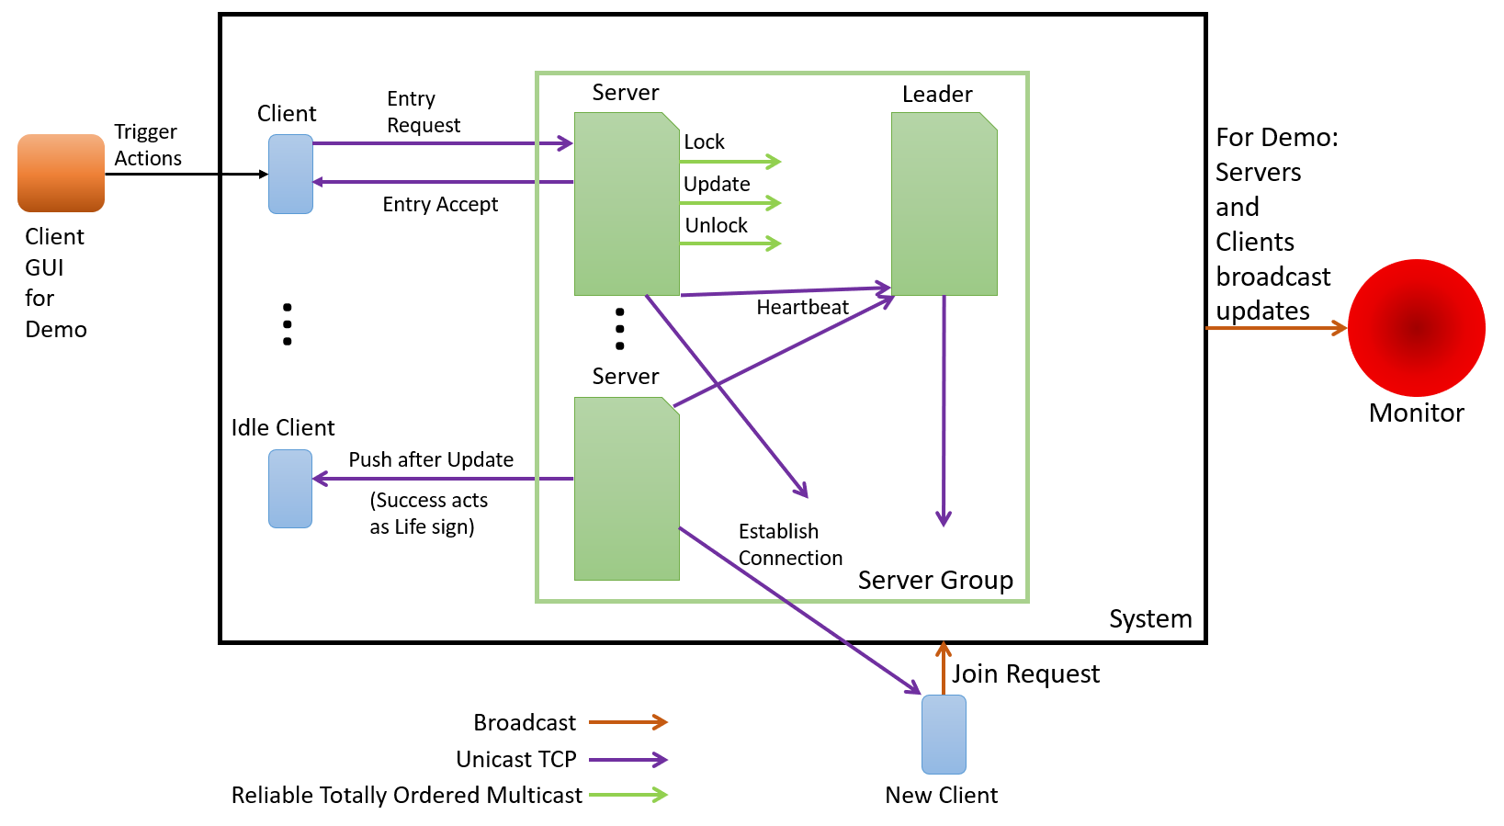
Architecture

Slide 4
Implementation
Written in Python
Asynchronous, message-based communication via
UDP (Broadcasts and Demo Messages)
TCP (Client-Server Communication, Heartbeats)
Reliable, Totally-ordered Multicast (Server Communication)
Fault Tolerant via Byzantine Algorithm if Servers desynchronize

Slide 5
Demo Time

