Slide 1
DATA SIMULATION SETTINGS FOR MIDASim

Slide 2
MIDASim
Parametric mode
Adjusted variables include
Effect size
Number of Causal/DA taxa
Sample size
Compositionality

Slide 3
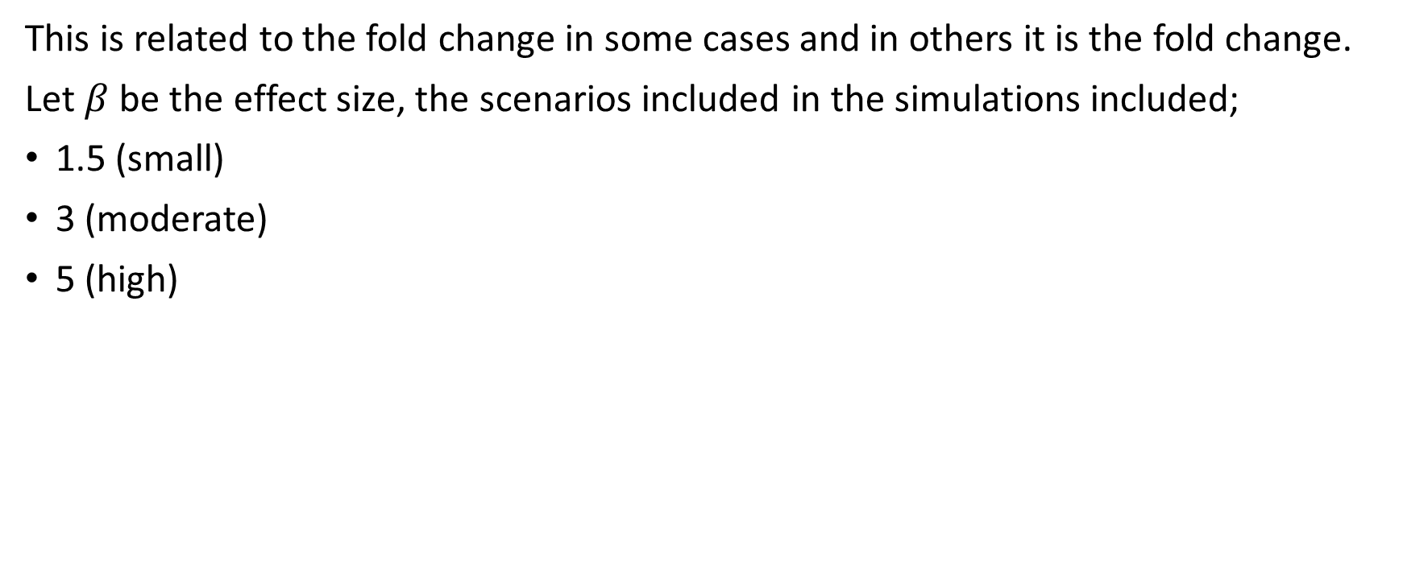
Effect size
This is related to the fold change in some cases and in others it is the fold change.
Let $β$ be the effect size, the scenarios included in the simulations included;
1.5 (small)
3 (moderate)
5 (high)

Slide 4
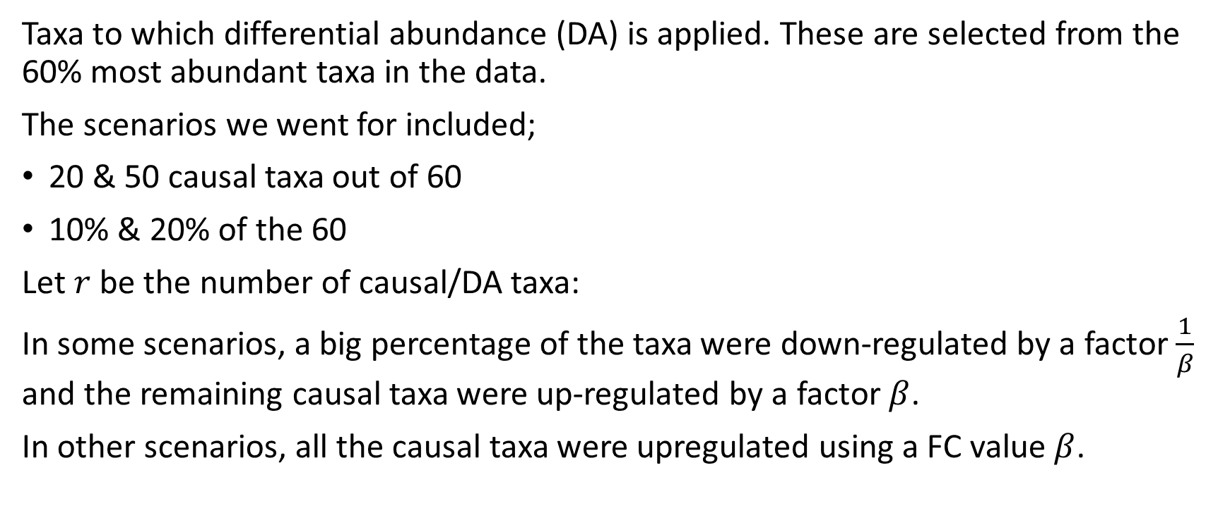
Number of causal taxa
Taxa to which differential abundance (DA) is applied. These are selected from the 60% most abundant taxa in the data.
The scenarios we went for included;
20 & 50 causal taxa out of 60
10% & 20% of the 60
Let $r$ be the number of causal/DA taxa:
In some scenarios, a big percentage of the taxa were down-regulated by a factor $\frac{1}{β}$ and the remaining causal taxa were up-regulated by a factor $β$.
In other scenarios, all the causal taxa were upregulated using a FC value $β$.

Slide 5

Sample size
We simulated data with small and large sample sizes.
Let $n$ refer to the total sample size in both groups, the scenarios generated were:
50 samples (25 per group)
200 samples (100 per group)

Slide 6
Compositionality
As we know microbiome data is very compositional, so we explored different scenarios including;
No compositionality
Moderate/small compositionality
High compositionality

Slide 7

Sparseness
To explore different levels of sparseness, we simulated data from 2 datasets with variation in sparseness
Disetswap at timepoint 2, which is not very sparse $≈0.2$
IBD data, which is highly sparse data $≈0.85$

Slide 8
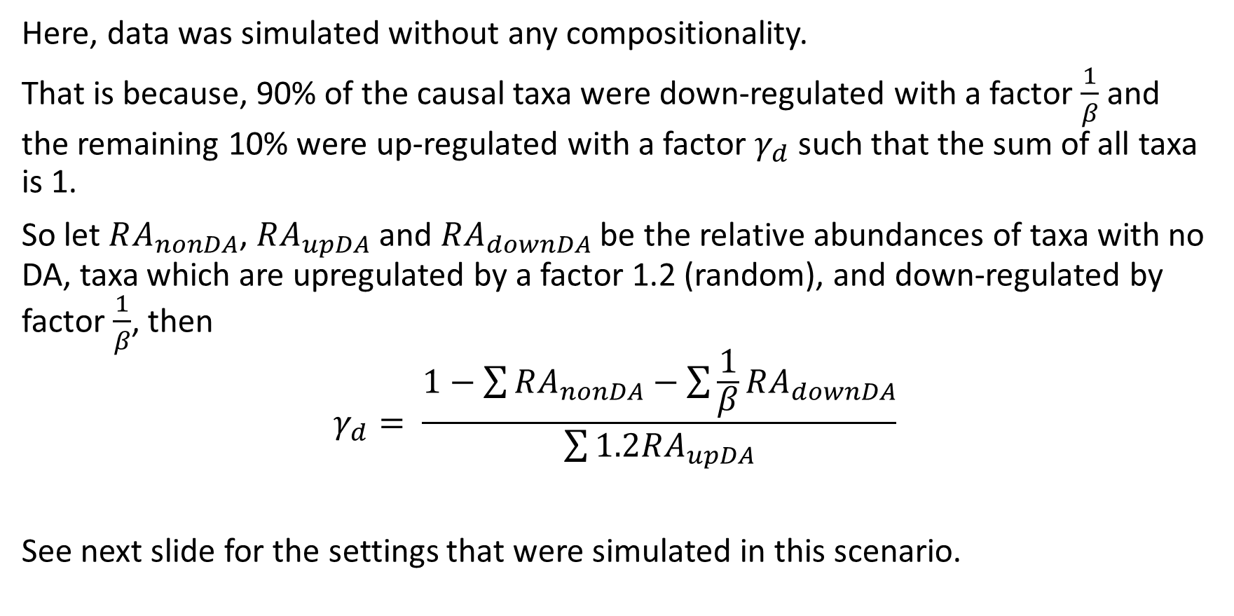
No compositionality
Here, data was simulated without any compositionality.
That is because, 90% of the causal taxa were down-regulated with a factor $\frac{1}{β}$ and the remaining 10% were up-regulated with a factor $γ_{d}$ such that the sum of all taxa is 1.
So let $RA_{nonDA}$, $RA_{upDA}$ and $RA_{downDA}$ be the relative abundances of taxa with no DA, taxa which are upregulated by a factor 1.2 (random), and down-regulated by factor $\frac{1}{β}$, then
$$γ_{d}= \frac{1−\sum{RA_{nonDA}}−\sum{\frac{1}{β}RA_{downDA}}}{\sum{1.2RA_{upDA}}}$$
See next slide for the settings that were simulated in this scenario.

Slide 9
















No compositionality
Dietswap/IBD source data
130/614 taxa
Small effect
Large effect
$$β=1.5$$
$$β=5$$
Median effect
$$r=20$$
$$r=50$$
$$β=3$$
$$r=20$$
$$r=50$$
$$n=50$$
$$n=200$$
$$n=50$$
$$n=200$$
$$r=20$$
$$r=50$$
$$n=50$$
$$n=200$$
$$n=50$$
$$n=200$$
$$n=50$$
$$n=200$$
$$n=50$$
$$n=200$$

Slide 10

Compositionality
To introduce compositionality, we down-regulate 70% of the causal taxa with a factor $\frac{1}{β}$ and up-regulate the remaining 30% by $β$.
Also 10% and 20% of the taxa were simulated to be differentially abundant.
See last slide for the settings that were simulated in this scenario.

Slide 11






Compositionality
Dietswap/IBD source data
130/614 taxa
Small effect
Large effect
$$β=1.5$$
$$β=5$$
Median effect
$$r=13/61$$
$$r=26/123$$
$$β=3$$
$$r=13/61$$
$$r=26/123$$
$$n=50$$
$$n=200$$
$$n=50$$
$$n=200$$
$$r=13/61$$
$r=26$/123
$$n=50$$
$$n=200$$
$$n=50$$
$$n=200$$
$$n=50$$
$$n=200$$
$$n=50$$
$$n=200$$

