Slide 1
Recurrent Neural Networks (RNN) – Long-Short Term Memory Networks LSTM

Slide 2
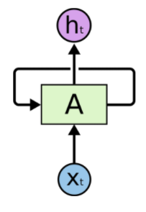
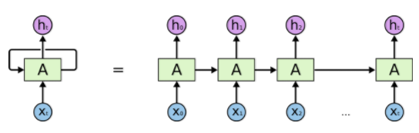
RNN – Have loops
Back propagation and the vanishing gradient problem
Notes:
the gradient tends to get smaller as we move backward through the hidden layers. This means that neurons in the earlier layers learn much more slowly than neurons in later layers. And while we've seen this in just a single network, there are fundamental reasons why this happens in many neural networks. The phenomenon is known as the vanishing gradient problem

Slide 3
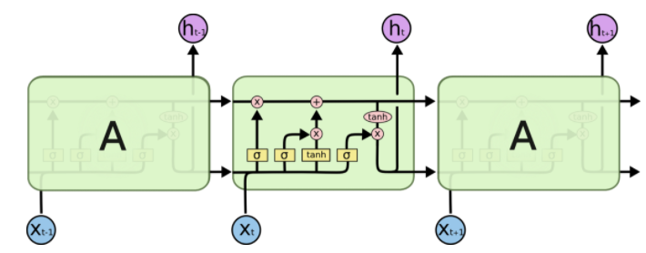
LSTM
Notes:
The LSTM does have the ability to remove or add information to the cell state, carefully regulated by structures called gates.
Gates are a way to optionally let information through. They are composed out of a sigmoid neural net layer and a pointwise multiplication operation.

Slide 4
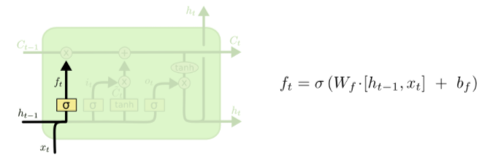
Forget gate

Slide 5
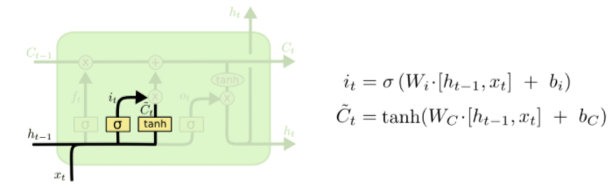
Input gate layer

Slide 6
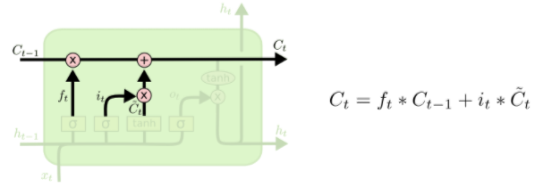
Cell state value

Slide 7
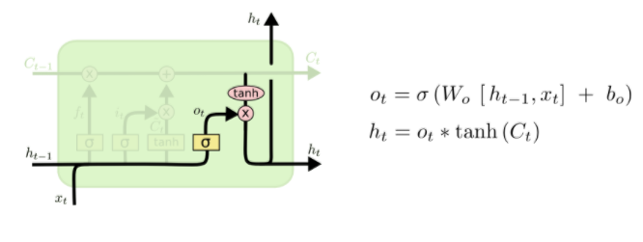
Cell output

