Slide 1

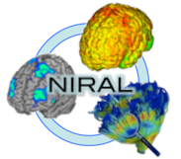
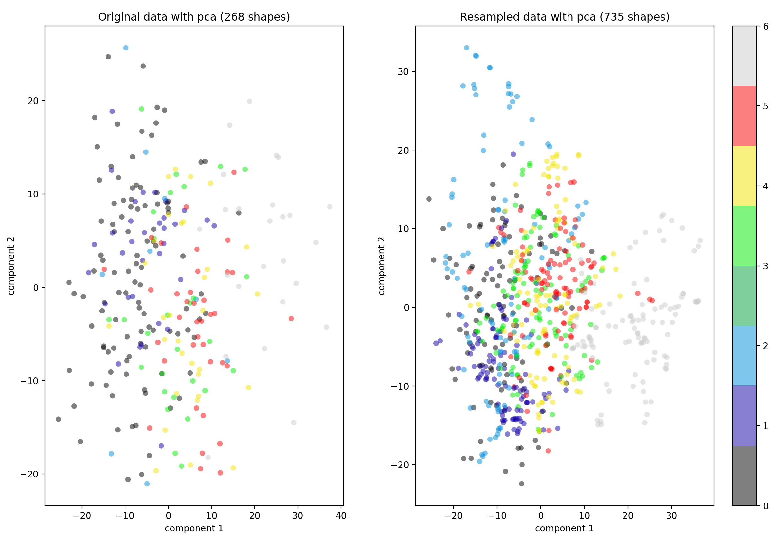
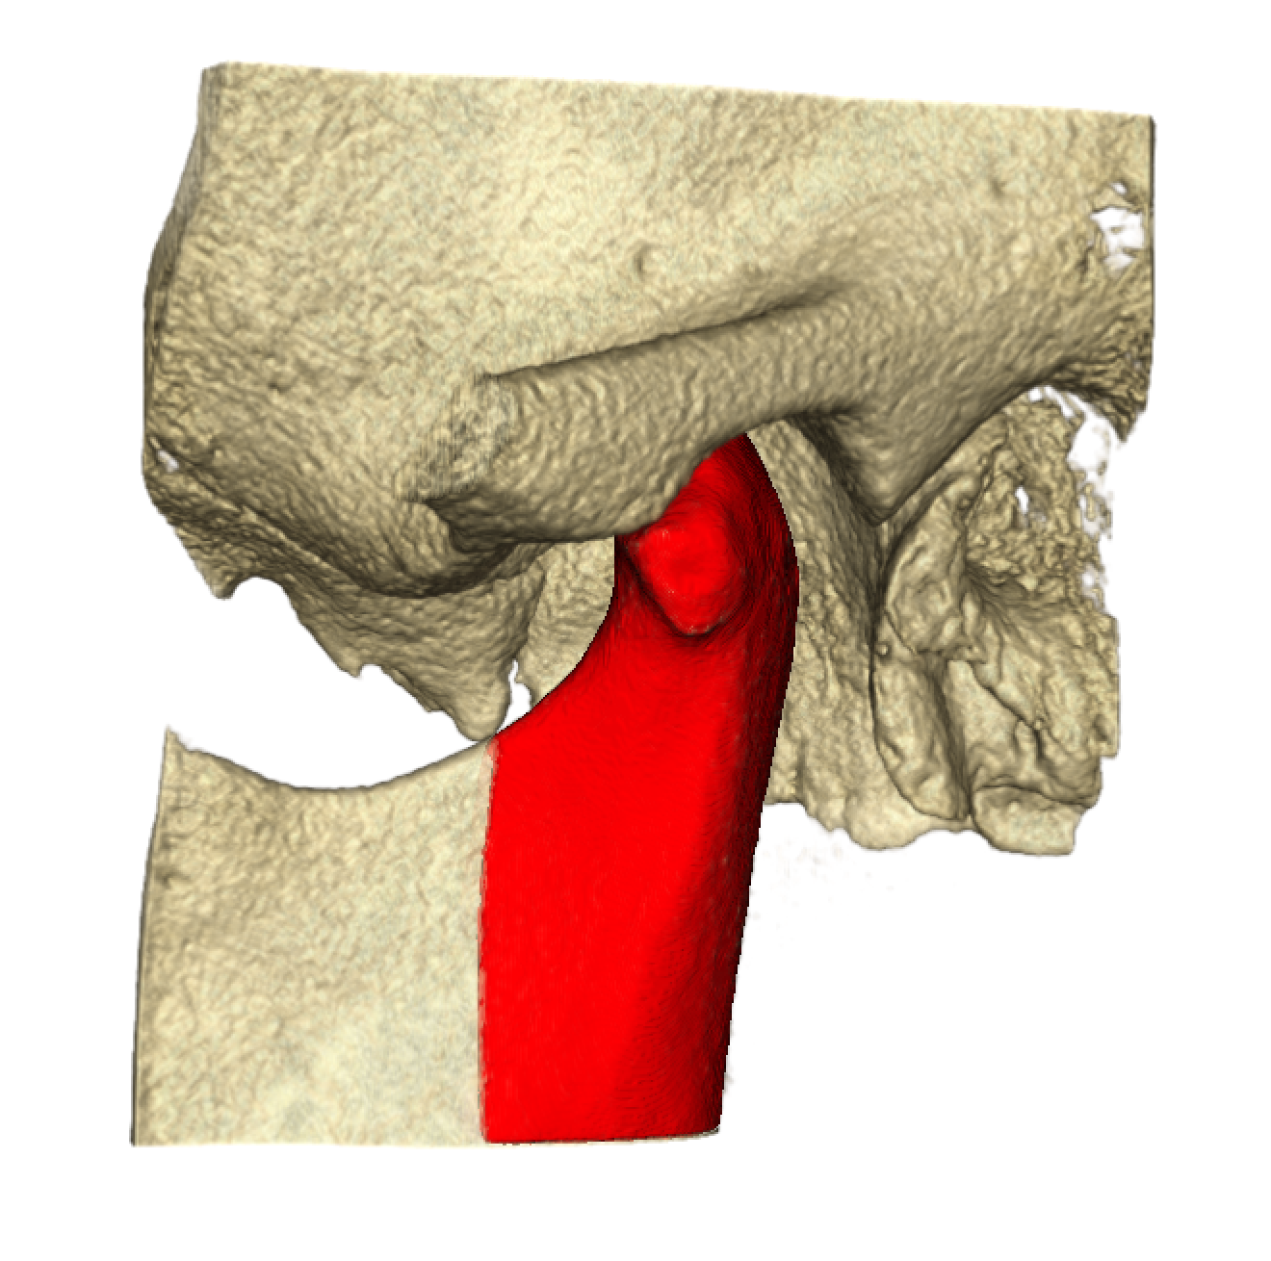
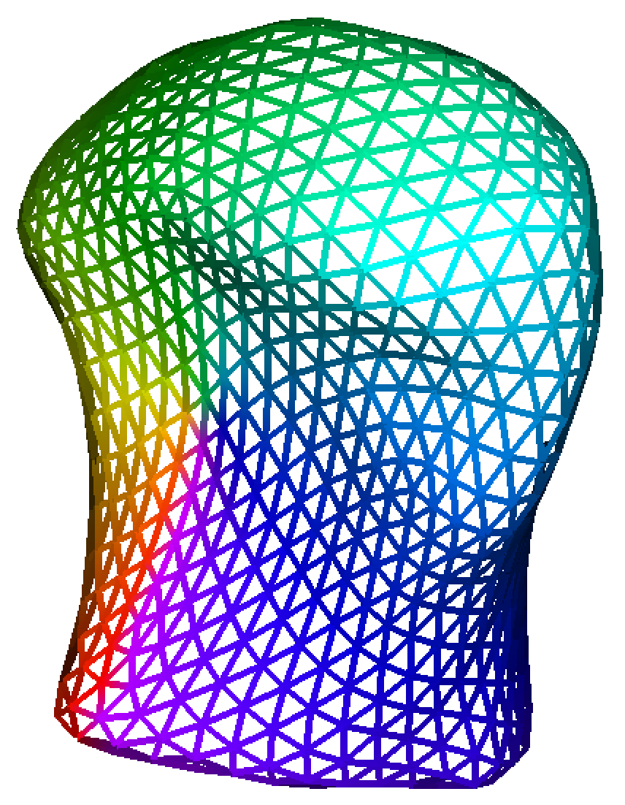
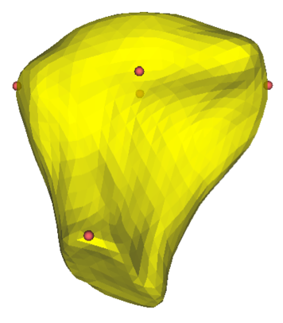
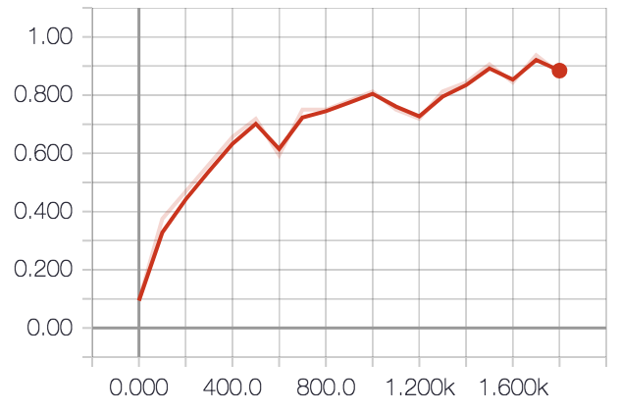
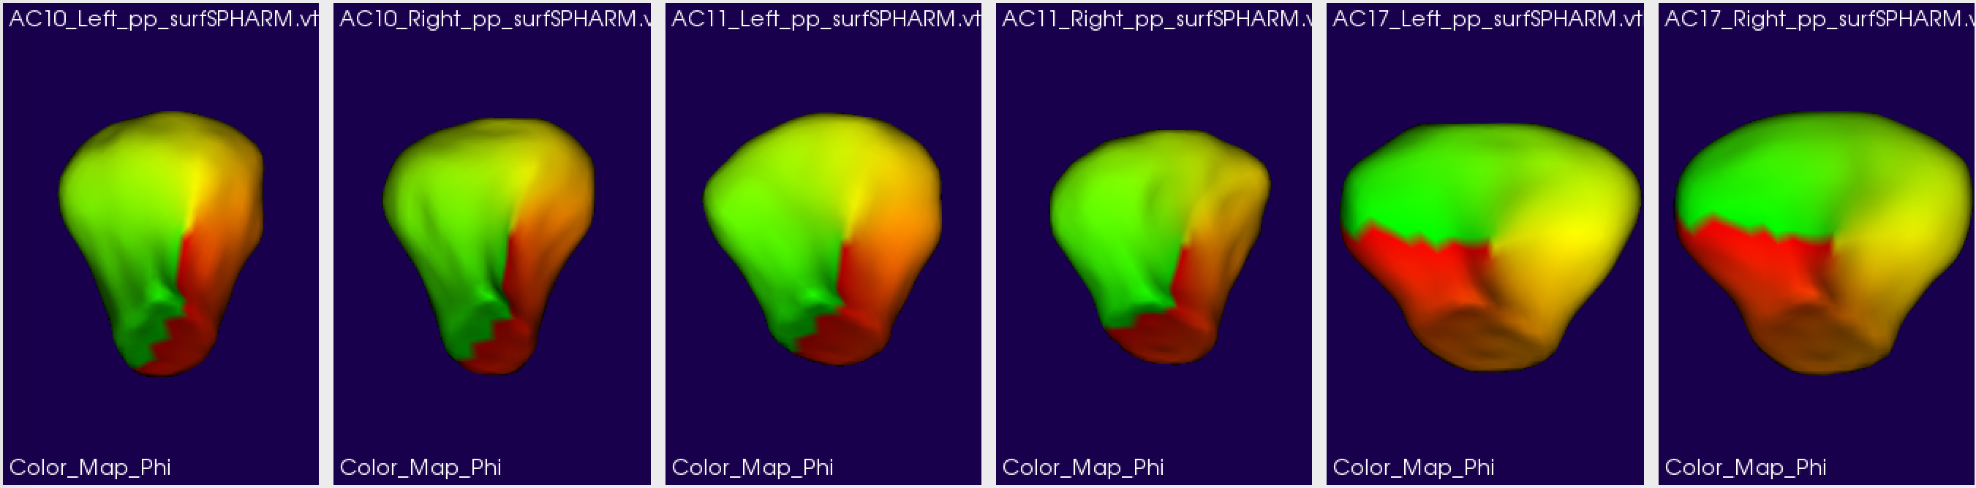
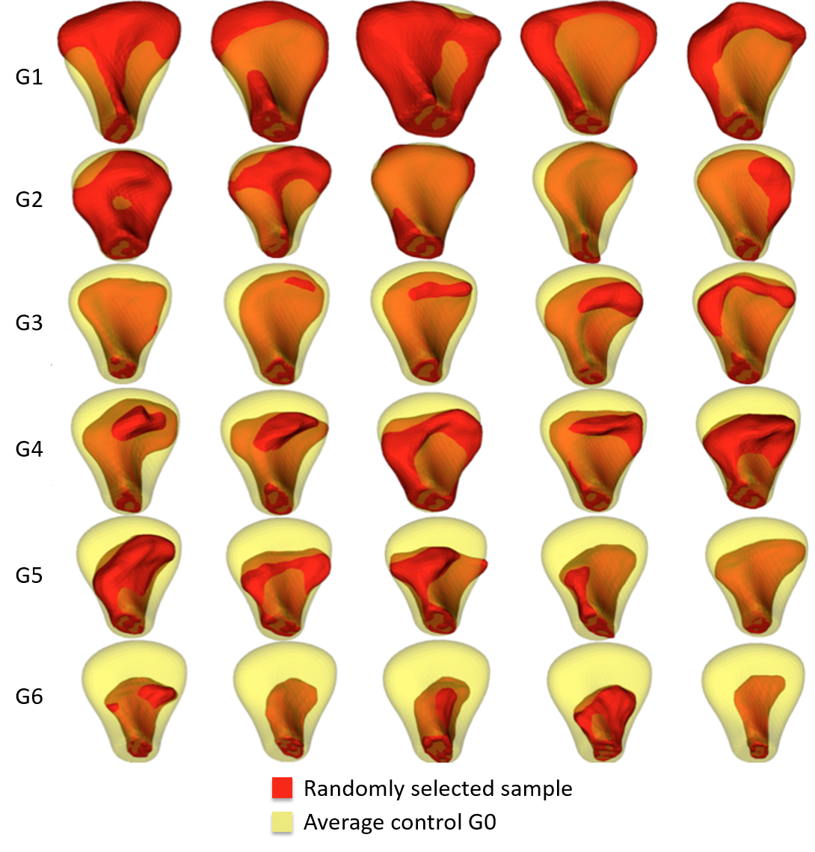
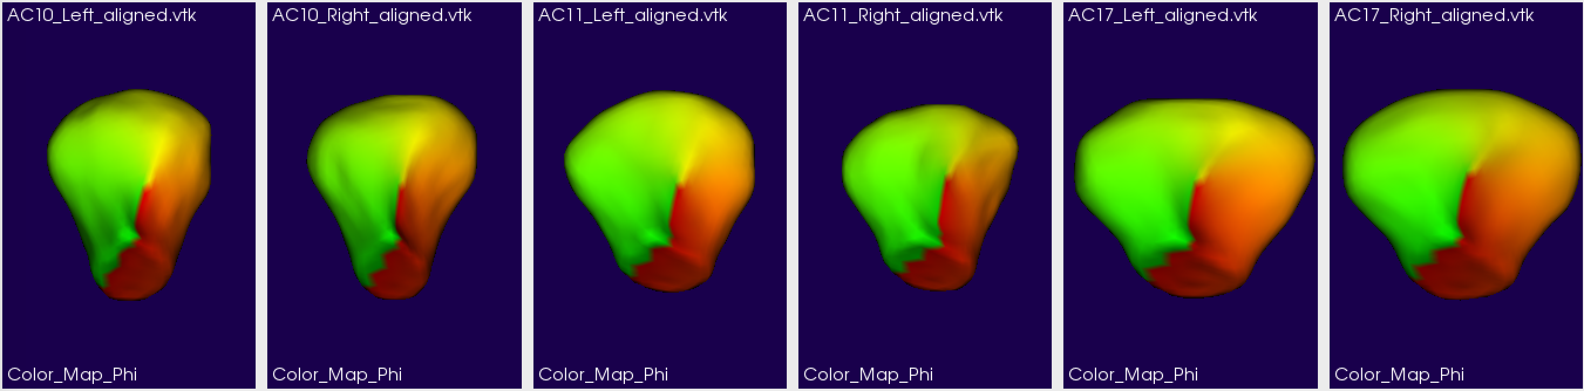
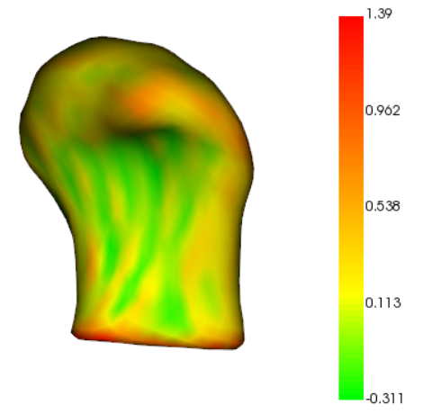
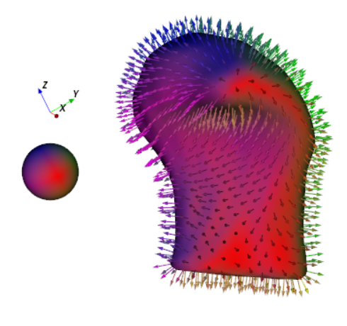
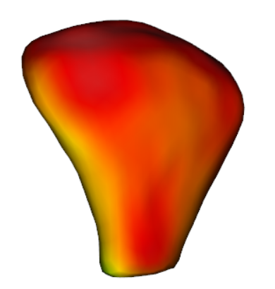
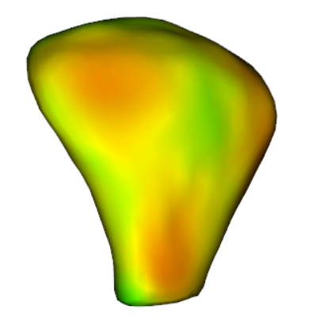
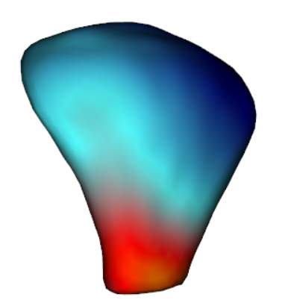
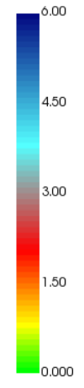

SVA: Shape Variation Analyzer Priscille de Dumast¹, Clement Mirabel¹, Beatriz Paniagua², Marilia Yatabe¹, Antonio Ruellas¹,
Nina Tubau¹, Martin Styner³, Lucia Cevidanes¹, Juan C. Prieto³
1. University of Michigan, Ann Arbor, United States
2. Kitware, Carrboro, United States;
3. University of North Carolina, Chapel Hill, United States
INTRODUCTION
Patients with OA present a variety of symptoms including pain, limited jaw movement, grinding, clicking, and deviation on opening. There is no method to quantify morphology for early diagnosis, assessment of disease progression and treatment effects.
The primary motivation of this work is to develop a noninvasive technique to provide information about bony changes and disease changing in Temporo-Mandibular Joint (TMJ) Osteo Arthritis (OA), using Shape Analysis.
We present Shape Variation Analyzer (SVA), a shape analysis tool using deep learning to assess disease progression.
METHODS
Fig 5. SMOTE resampling in feature space.
RESULTS
a)
b)
c)
Fig 1. Volume rendering of skull. The surface of the condyle is shown in red.
Fig 6. Accuracy during training. Testing accuracy was 92%.
CONCLUSIONS
Using shape features only favors the classification task, i.e., no position or orientation is used to train the network.
This classification approach seems promising, as it may help us increase our understanding about
shape changes that TMJ OA patients undergo during the course of the disease.
Source code is available at
https://github.com/DCBIA-OrthoLab/ShapeVariationAnalyzer
Fig 3. a) SPHARM: regular triangles, 1002 points. b) Landmarks placed on homologous regions for each model. c) Before (top) - after (bottom) GROUPS alignment, similar regions coded by color.
a)
b)
REFERENCES
c)
[1] Yushkevich, P. A., Piven, J., Cody Hazlett, H., Gimpel Smith, R., Ho, S., Gee, J. C. and Gerig, G., “User-Guided 3D Active Contour Segmentation of Anatomical Structures: Significantly Improved Efficiency and Reliability,” Neuroimage 31(3), 1116–1128 (2006).
[2] Japkowicz, N. and Stephen, S., “The class imbalance problem: A systematic study,” Intelligent data analysis 6(5), 429–449 (2002).
[3] Kalladka, M., Quek, S., Heir, G., Eliav, E., Mupparapu, M. and Viswanath, A., “Temporomandibular joint osteoarthritis: diagnosis and long-term conservative management: a topic review,” The Journal of Indian Prosthodontic Society 14(1), 6–15 (2014).
[4] Chawla, N. V., Bowyer, K. W., Hall, L. O. and Kegelmeyer, W. P., “SMOTE: synthetic minority over-sampling technique,” Journal of artificial intelligence research 16, 321–357 (2002).
[5] Cevidanes, L., Hajati, A.-K., Paniagua, B., Lim, P., Walker, D., Palconet, G., Nackley, A., Styner, M., Ludlow, J., Zhu, H. and others., “Quantification of condylar resorption in temporomandibular joint osteoarthritis,” Oral Surgery, Oral Medicine, Oral Pathology, Oral Radiology, and Endodontology 110(1), 110–117 (2010).
[6] Lyu, I., Kim, S. H., Seong, J.-K., Yoo, S. W., Evans, A. C., Shi, Y., Sanchez, M., Niethammer, M. and Styner, M. A., “Group-wise cortical correspondence via sulcal curve-constrained entropy minimization,” Information processing in medical imaging: proceedings of the... conference 23, 364, NIH Public Access (2013).
[7] Styner, M., Oguz, I., Xu, S., Brechbühler, C., Pantazis, D., Levitt, J. J., Shenton, M. E. and Gerig, G., “Framework for the statistical shape analysis of brain structures using SPHARM-PDM,” The insight journal(1071), 242 (2006).
[8] Paniagua, B., Cevidanes, L., Walker, D., Zhu, H., Guo, R. and Styner, M., “Clinical application of SPHARM-PDM to quantify temporomandibular joint osteoarthritis,” Computerized Medical Imaging and Graphics 35(5), 345–352 (2011).
Fig 2. Randomly selected subject samples for each group shown in red. In yellow, the average shape from the control group rendered transparent. G1. Overgrowth, G2. Close to Normal, G3. Degeneration 1, G4. Degeneration 2, G5. Degeneration 3, G6. Degeneration 4
Fig 4. Visualization of shape features. a) Mean curvature b) Surface normals. c) Distance from each point to corresponding points in the average shape for each group. Total number of features per point is 11, i.e., 1002x11.
2018 University of North Carolina

