Slide 1

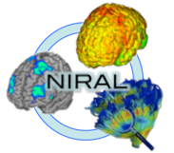
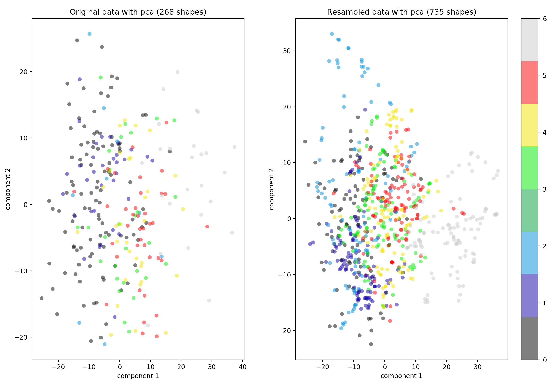
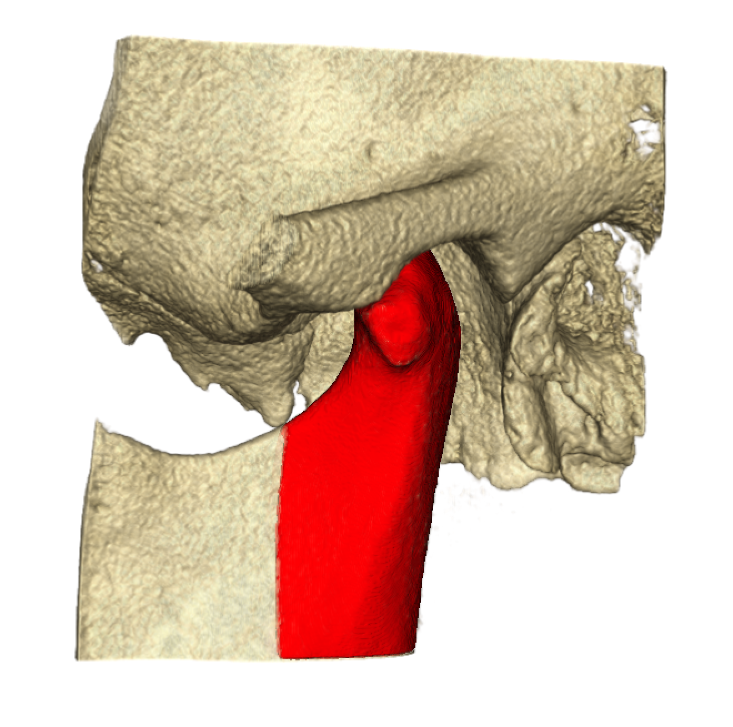
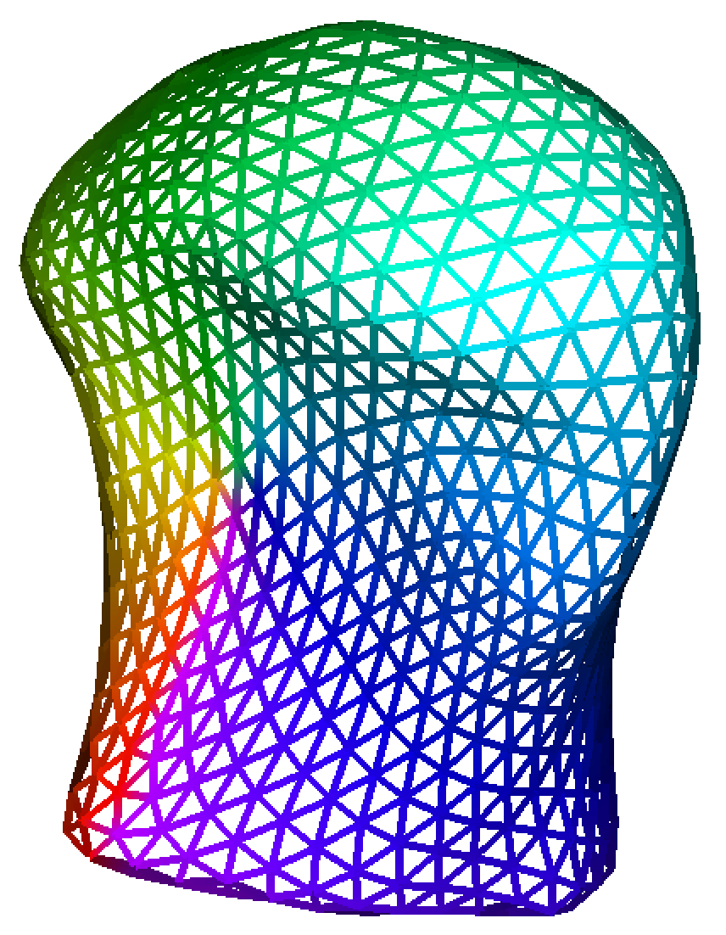
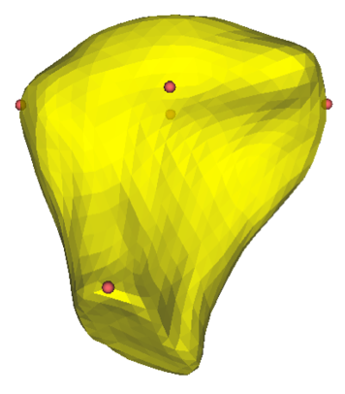
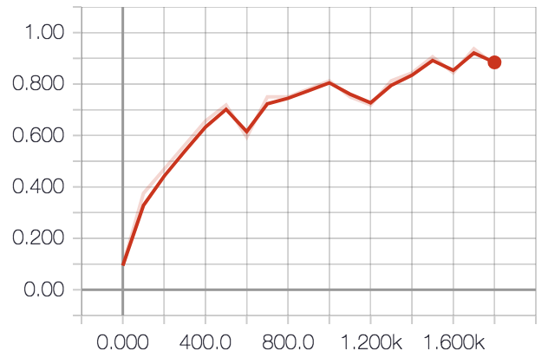
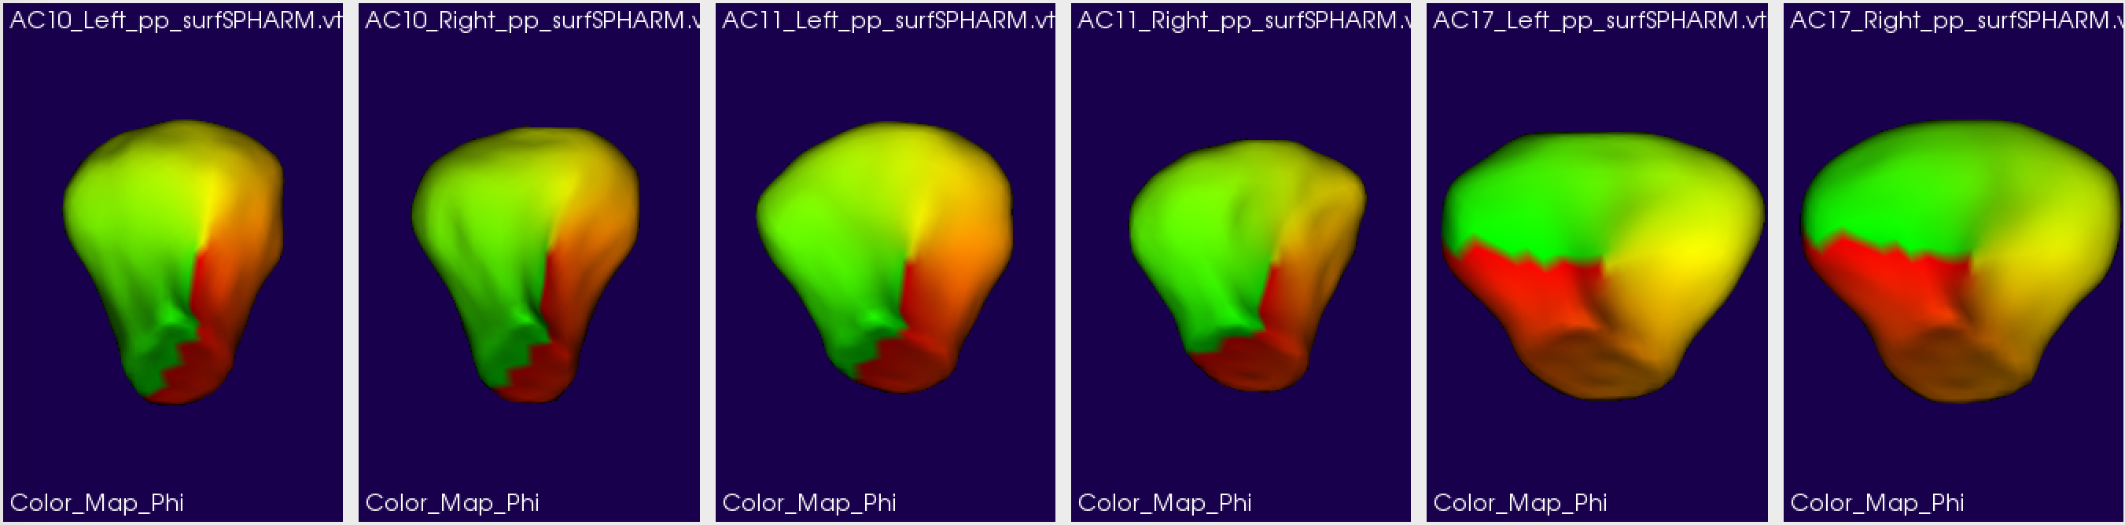
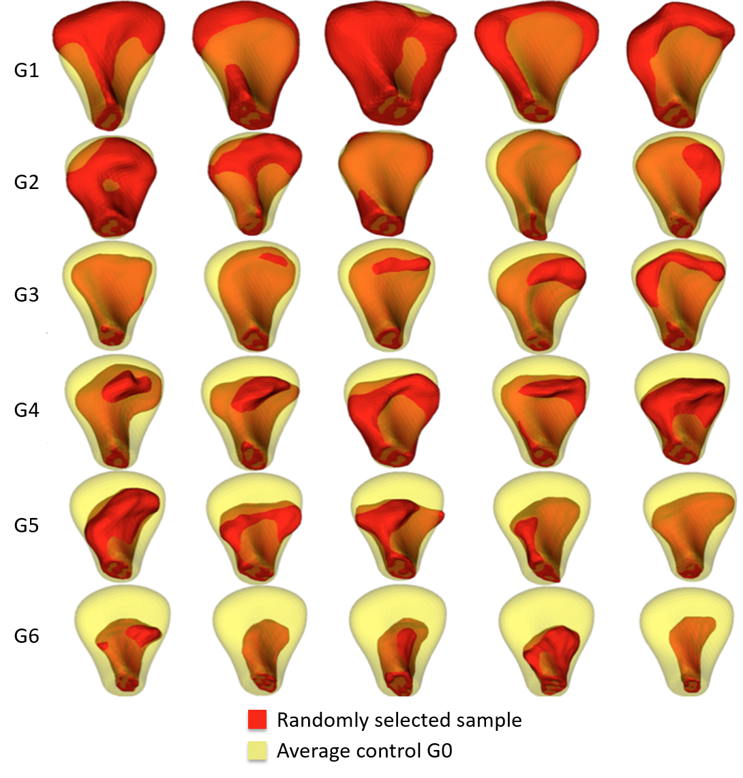
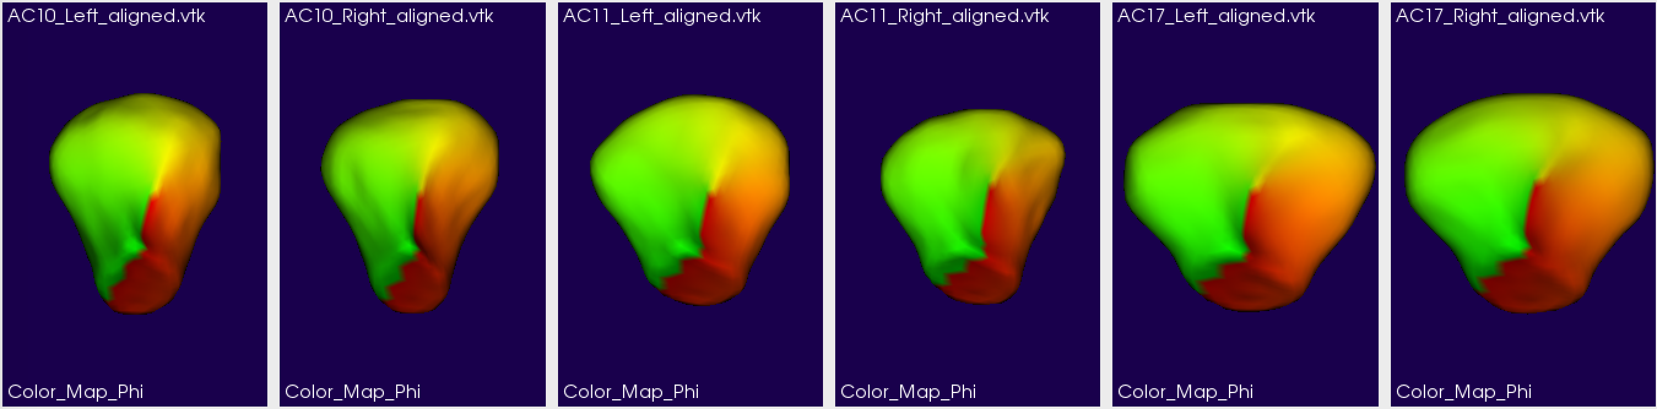
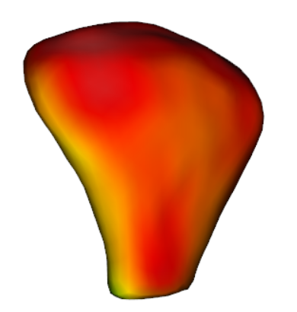
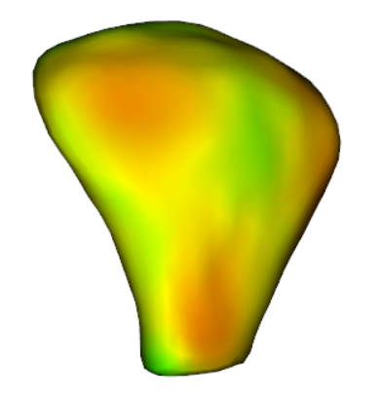
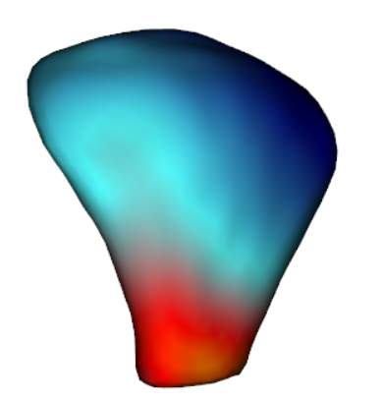
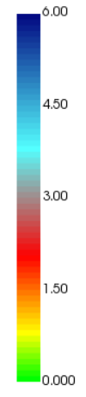
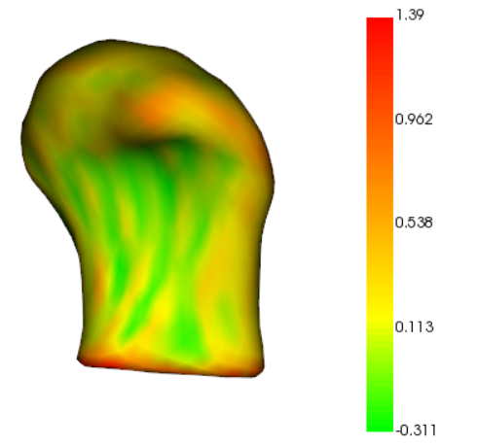
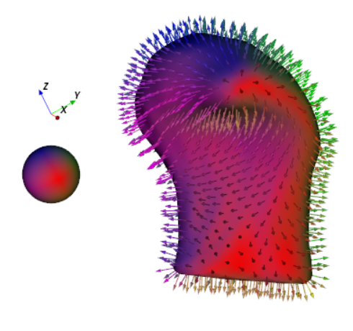

SVA: Shape Variation Analyzer Juan C. Prieto, Beatriz Paniagua, Marilia S. Yatabe, Antonio C.O Ruellas, Liana Fattori, Luciana Muniz, Martin Styner, and Lucia Cevidanes NIRAL, University of North Carolina, Chapel Hill
INTRODUCTION
Patients with OA present a variety of symptoms including pain, limited jaw movement, grinding, clicking,
and deviation on opening. There is no method to quantify morphology for early diagnosis, assessment of disease progression and treatment effects.
The primary motivation of this work is to develop a noninvasive technique to provide information about bony changes and disease changing in Temporo-Mandibular Joint (TMJ) Osteo Arthritis (OA), using Shape Analysis.
We present Shape Variation Analyzer (SVA), a shape analysis tool using deep learning.
METHODS
RESULTS
Fig 1. Volume rendering of skull. The surface of the condyle is shown in red.
CONCLUSIONS
REFERENCES
[1] Collaboration, O. S. et al., “Estimating the reproducibility of psychological science,” Science 349(6251), aac4716 (2015).
[2] DB, T., J, B., C, B., and et al, “Sharing clinical trial data: A proposal from the international committee of medical journal editors,” JAMA 315(5), 467–468 (2016).
[3] Krishnankutty, B., Bellary, S., Kumar, N. B., and Moodahadu, L. S., “Data management in clinical research: An overview,” Indian Journal of Pharmacology 44(2), 168–172 (2012).
[4] Cevidanes, L., Hajati, A.-K., Paniagua, B., Lim, P., Walker, D., Palconet, G., Nackley, A., Styner, M., Ludlow, J., Zhu, H., and Phillips, C., “Quantification of condylar resorption in temporomandibular joint osteoarthritis,” Oral Surgery, Oral Medicine, Oral Pathology, Oral Radiology, and Endodontology 110(1), 110 – 117 (2010).
[5] Paniagua, B., Cevidanes, L., Walker, D., Zhu, H., Guo, R., and Styner, M., “Clinical application of spharm- pdm to quantify temporomandibular joint osteoarthritis,” Computerized Medical Imaging and Graphics 35(5), 345 – 352 (2011).
[6] Danaele Puechmaille, M. S. and Prieto, J. C., “Civility: Cloud based interactive visualization of tractography brain connectome,” in [SPIE Medical Imaging], International Society for Optics and Photonics (2017).
[7] Styner, M., Oguz, I., Xu, S., Brechbuehler, C., Pantazis, D., Levitt, J., Shenton, M., and Gerig, G., “Frame- work for the statistical shape analysis of brain structures using spharm-pdm,” (07 2006).
Fig 2. Randomly selected subject samples for each group shown in red. In yellow, the average shape from the control group rendered transparent. G1. Overgrowth, G2. Close to Normal, G3. Degeneration 1, G4. Degeneration 2, G5. Degeneration 3, G6. Degeneration 4
2017 University of North Carolina

