Slide 1
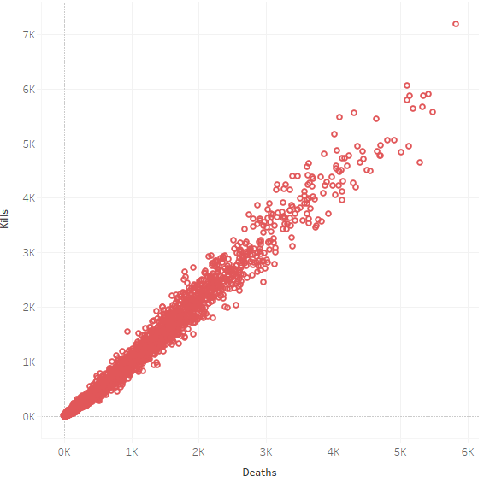

Predictive Analytics in Advanced eSports
Connor Broyles, Robert Kelley
Affiliation: Bellarmine University Data Science Program
Abstract
Objectives
Results
Results
Utilizing a comprehensive dataset, including player statistics and team performance metrics, I constructed a decision tree classifier to forecast win-loss results. My objective was to gather the predictive accuracy of the model and its potential utility for players and fantasy league players in strategizing and improving gameplay and understanding. The model showed me that the model can be useful in predicting win/losses of games via stats, offering insights that could transform competitive play and decision-making processes in esports and fantasy leagues for all players.
Develop a Robust Model: Create a model that is accurate and reliable when predicting game outcomes and stats
Enhance Player and Non-Player understanding of the game: Allow for people who do or do not play Valorant to understand the game’s stats and allow use for playing the game or fantasy league play
Improve player training: Allow stats to be used in order to predict their own stats and see what needs to be improved on
Widen viewer engagement in eSports: Allow for people not inovled in VCT and other esports to be able to be engaged and excited to watch online broadcast of professional play.
Model is Predicting 0 for Loss and 1 for Win
R-Squared of -.97 and MSE of .69 (Room for improvement)
Model is Predicting a number
R-Squared of .99 and MSE of .22 (Too perfect to be true)
Conclusion/Future Works
References
Introduction
For this project further exploration options like Random forest models and possibly more would be desired to see if other models will give slightly better results that are more trustworthy. This topic of eSports can be expanded upon greatly and really help people who not only play eSports but also watch professional eSports for fun. This type of model be used in Fantasy leagues and personalized coaching of players and possibly individual coaching in the future.
This project revolved around the game “Valorant”. The project provides predictive analytics by creating a model that will forecast game outcomes and player/team statistics. By understanding and anticipating the dynamics of team and player performances in game; coaches, players, and fantasy league players, will gain significant strategic advantages and enhance players experiences. This project can widen the field of esports analytics and allow a wider scope of people to understand and find enjoyment in Valorant and predictive analytics.
Python (And It’s Libaries)
Microsoft Excel
Tableau
Visual Studio Code
Kaggle Datasets
GitHub
GitHub CoPilot & ChatGPT
Materials & Methods
Gathered Data via Kaggle Dataset on Professional Valorant eSports.
Scrubbed/Clean data in order to develop into a model
Using Decision Tree Models to formulate initial model with predictive win/loss
Attempted two different models to see possible differences
One model for predicting win loss and one model for predicting eliminations
Contact Info
Connor Broyles: cgoodman2@bellarmine.edu
Robert Kelley:
rkelley@bellarmine.edu

