Slide 1
Valorant esports Predictive Data analytics
Connor Broyles
DS-450-01
5/02/2024
Professor Kelley

Slide 2
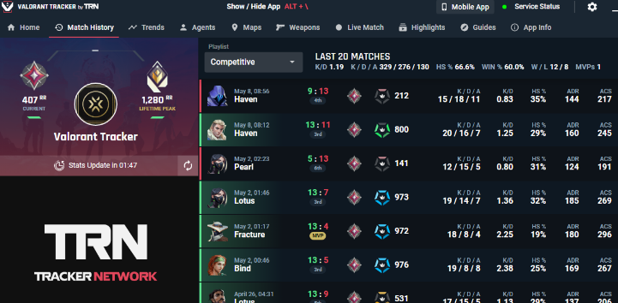

Overview
eSports Focused: Valorant
Valorant Professional Data
Kaggle Dataset
Goal: Fantasy eSports / Coaching
Initial Goal: Predicting Win/Loss
Main priority: Allow anyone and everyone to use my models

Slide 3
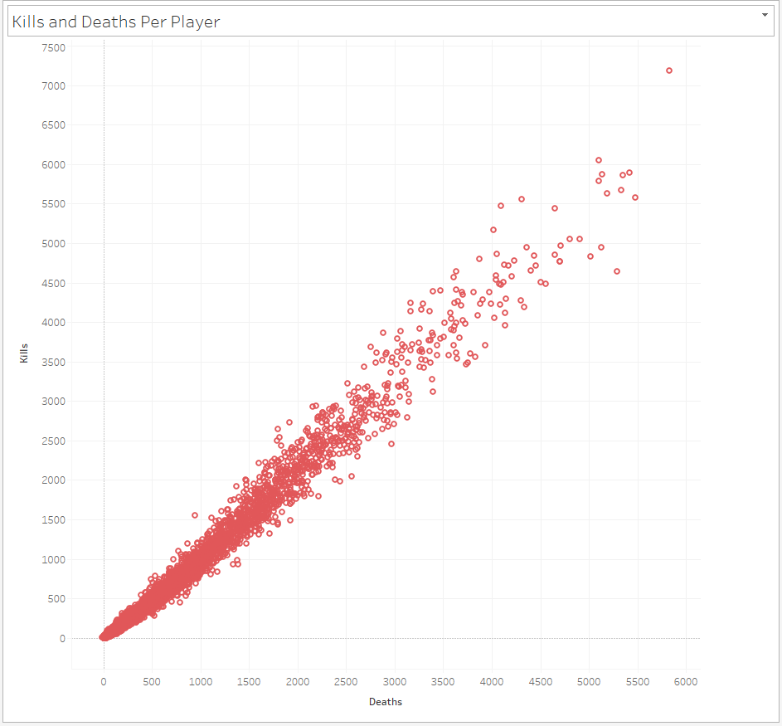
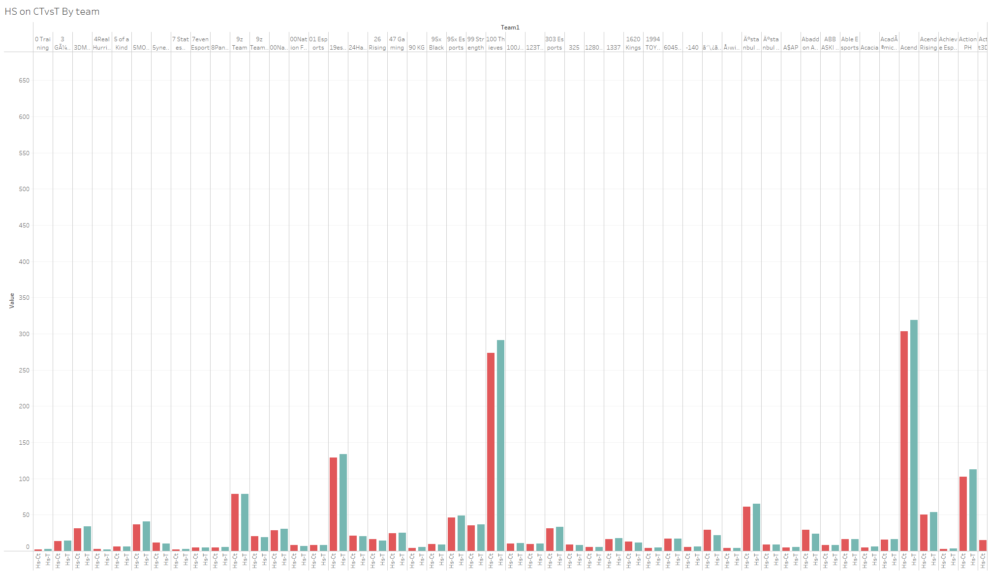
Exploratory Data Analysis
Took a single col csv into a workbook
Mostly Clean Data
Only a few cols above 50% NA values
Took time to understand:
Act, hs, fk, ct, t, kmds, acs-ct, etc…
Readable once labels were created
Taken from pros (Little outliers)
Consistent

Slide 4
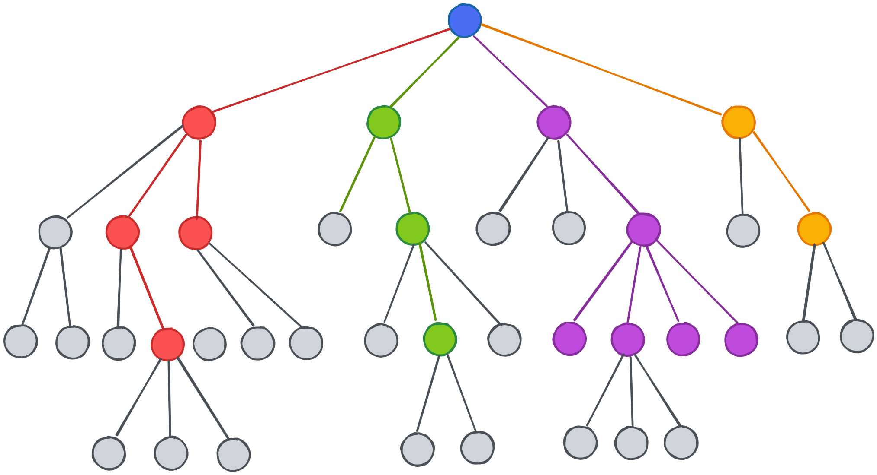

Methods / Modeling
Went with what I know
Decision Tree Model Attempts
Goal was to get basic stats:
Win / Loss
Be easy and readable
Be used to be helpful to players and nonplayers alike
Used Non-Team-Specific Stats

Slide 5

Preliminary Results
First Model: Predicting Win/Loss:
R2: -.975, MSE: .694
Second Model: Predicting Eliminations:
R2: .99, MSE: .235
Results shifted my thinking for “App”
At the time of posters – Bare Bones Models
Little understanding of results at the time

Slide 6
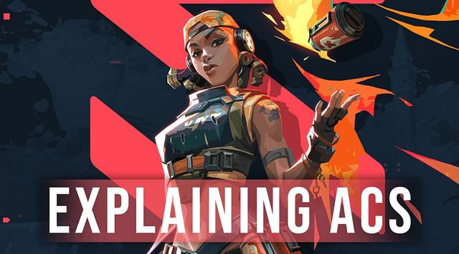

Final Results
Went From W/L to one stat
Final Model: Predicting Average Combat Score:
MSE: 19.24, Accuracy: 90.33%
Felt Much More comfortable with this
Created a PH Neutral Model of LR:
Super high MSE
R2 -10.6
For other less important stats the results were not much better with LR

Slide 7
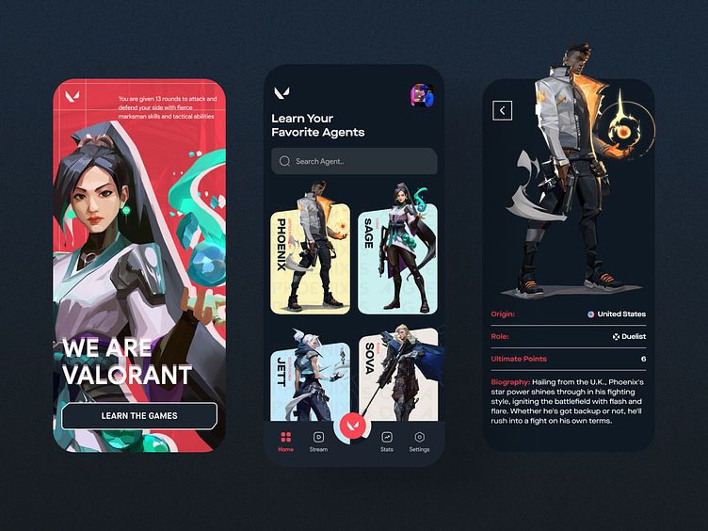
Conclusion
Much happier with Decision Tree for combination stats
(Numerical plus Categorical)
The goal of the “App” is still very plausible
Understand to use specific models for certain stats
Accomplishes the goal of basic predications
Can be used in VCT or Personal Coaching

Slide 8

Reflection
Played it safe with decision tree models
Still Learned a lot about decision tree
Wish I took the ML class
Project showed me I can know very little and still make something useable
Found myself knowing “Data Science Communication” (Real world app)

Slide 9

Questions?
Thank you
Demo Link: https://www.youtube.com/watch?v=atvFFehpPj8

