Slide 1
Stranded – a Text-Based Adventure
Connor DeLuca

Slide 2
What is it?
Basically, a sci-fi version of those escape room games that were very common during the time when graphics were more difficult to design and run.
The goal is for the user to be able to play through a choose-your-own adventure style story that punishes or rewards the player for various actions.

Slide 3
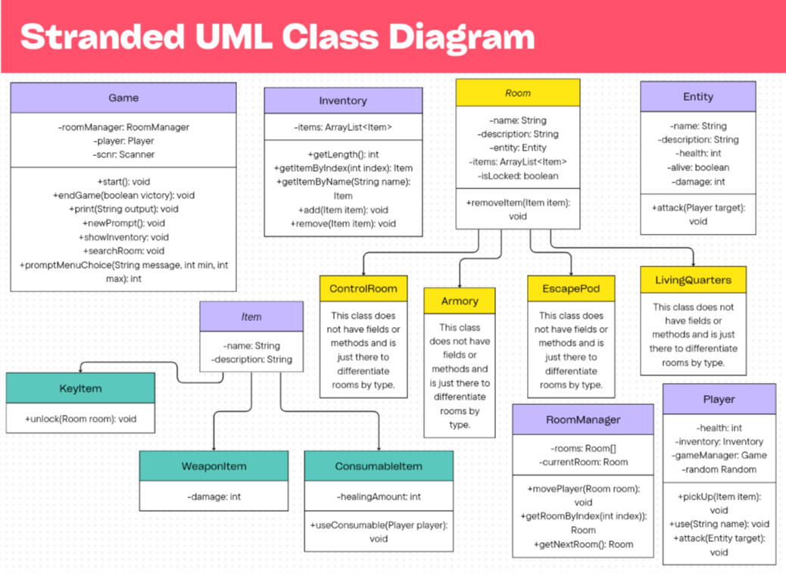

Slide 4
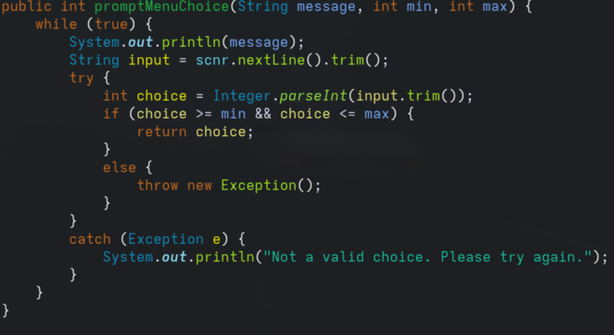
Polymorphism and Exception Handling?

