Slide 1
Music Genre Classification
Connor Herring

Slide 2
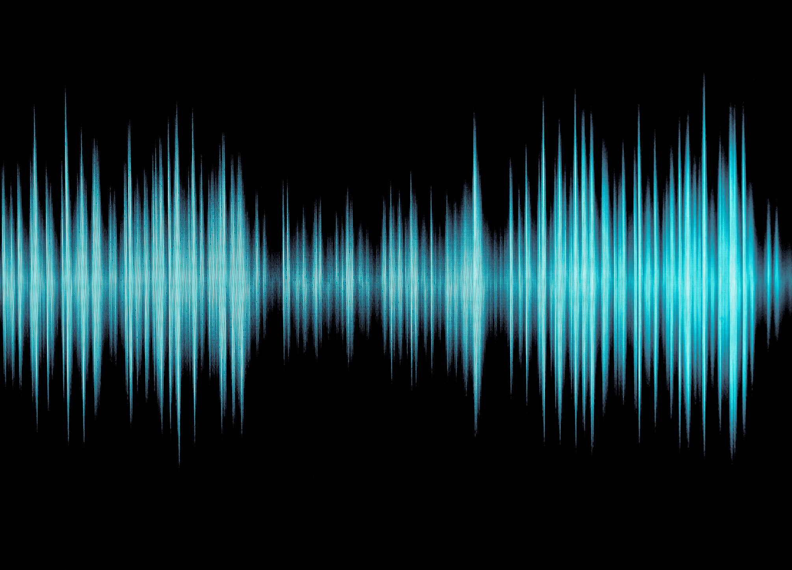
Goal
Can we predict the genre of music based on certain features contained in an audio file?
Dataset: features extracted from 30 seconds of wav files from 1000 tracks spanning 10 genres

Slide 3
Features
Tempo
Beats
Chroma short time fourier transform
Rmse
Spectral centroid
Spectral bandwidth
Rolloff
Zero crossing rate
Mfcc (20 coefficients)
28 total features

Slide 4
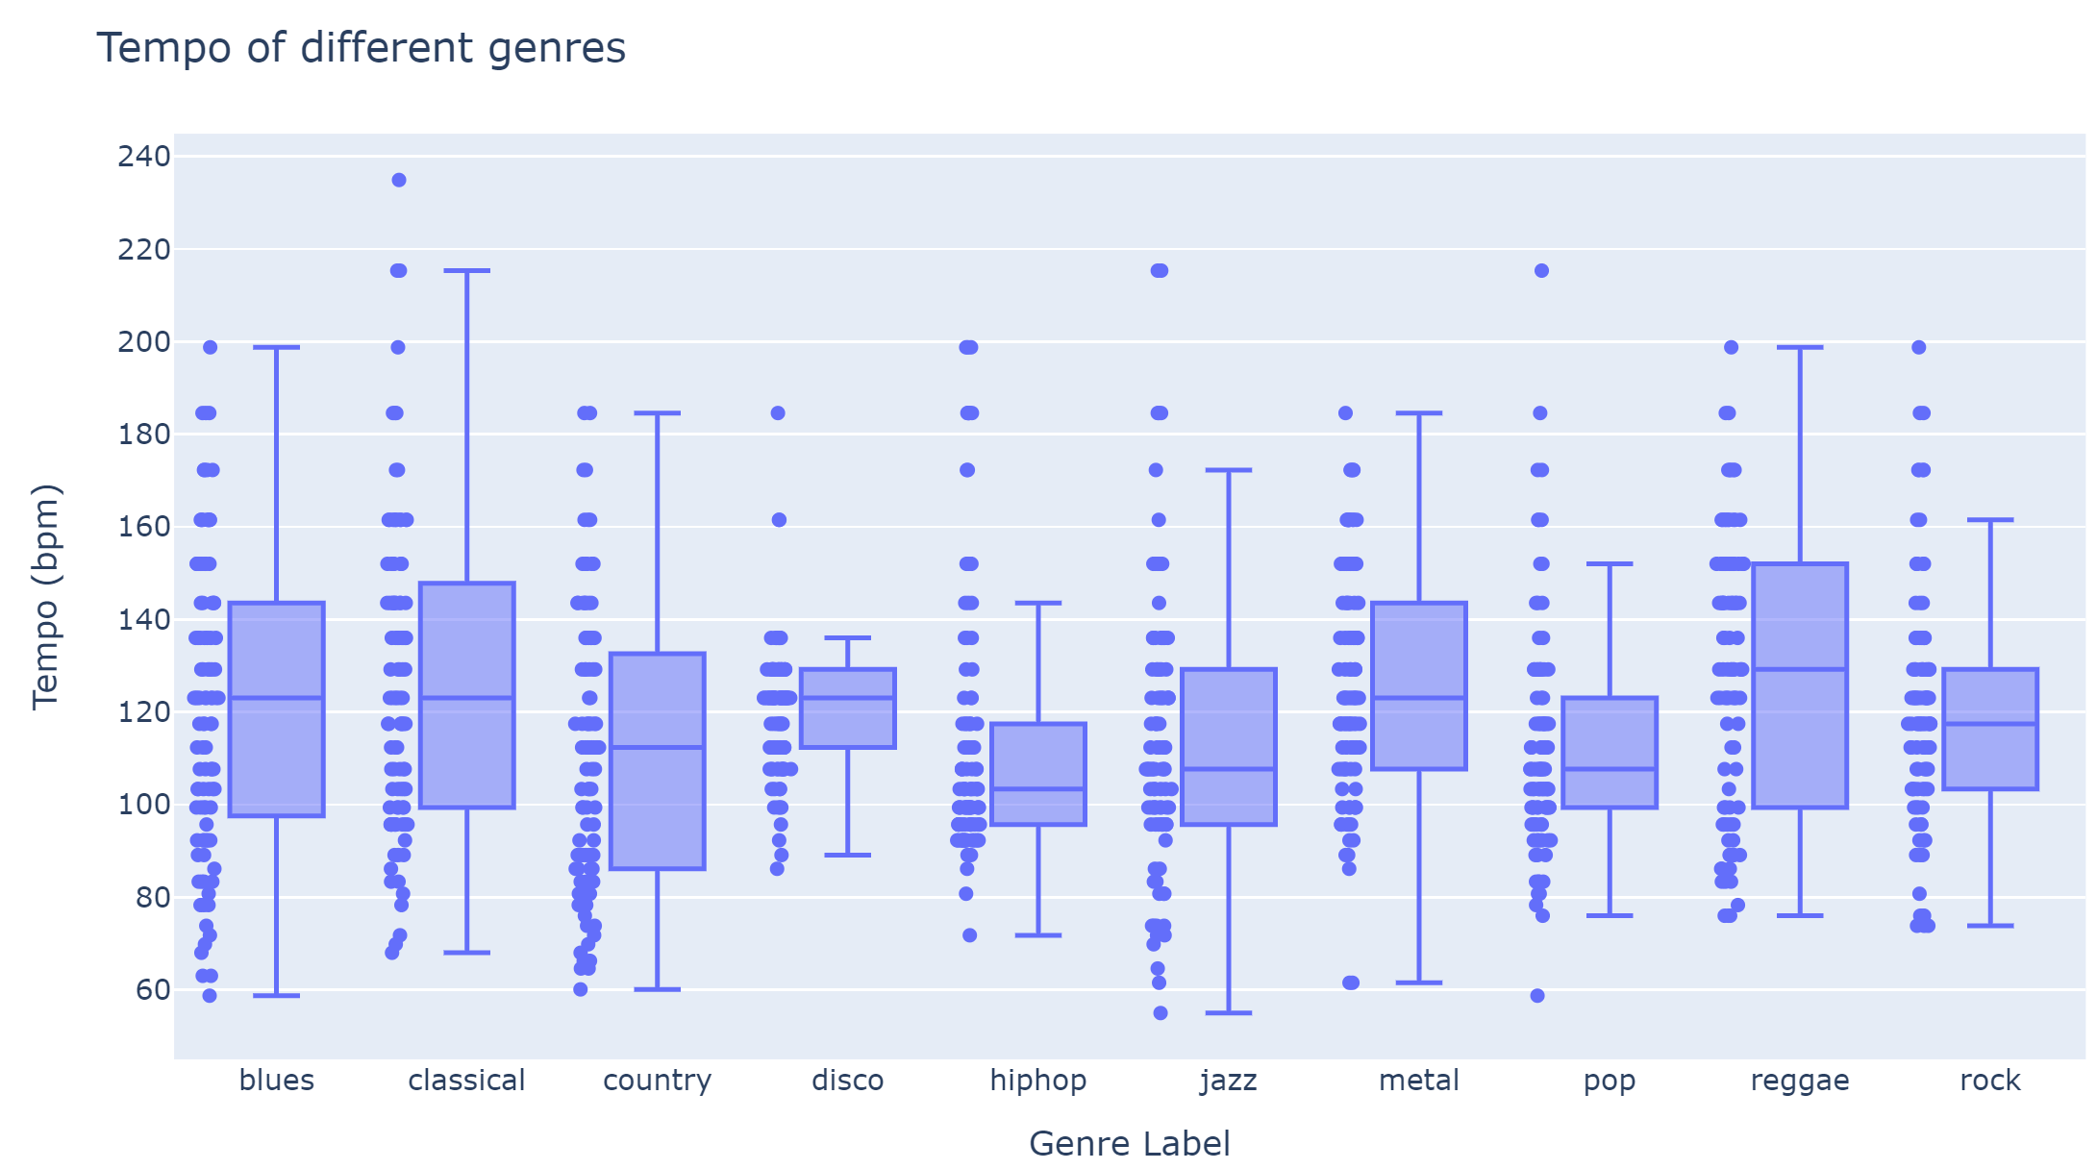

Slide 5
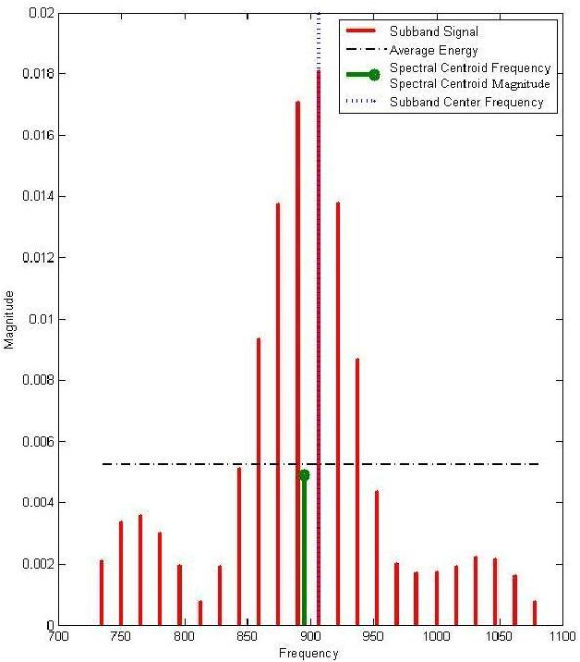

Spectral Centroid
$$SC=\frac{\sum{f\left(n\right)x(n)}}{\sum{x(n)}}$$
Where x(n) is weighted frequency of bin n, f(n) is center frequency of that bin
“center of mass” of spectral frequency

Slide 6
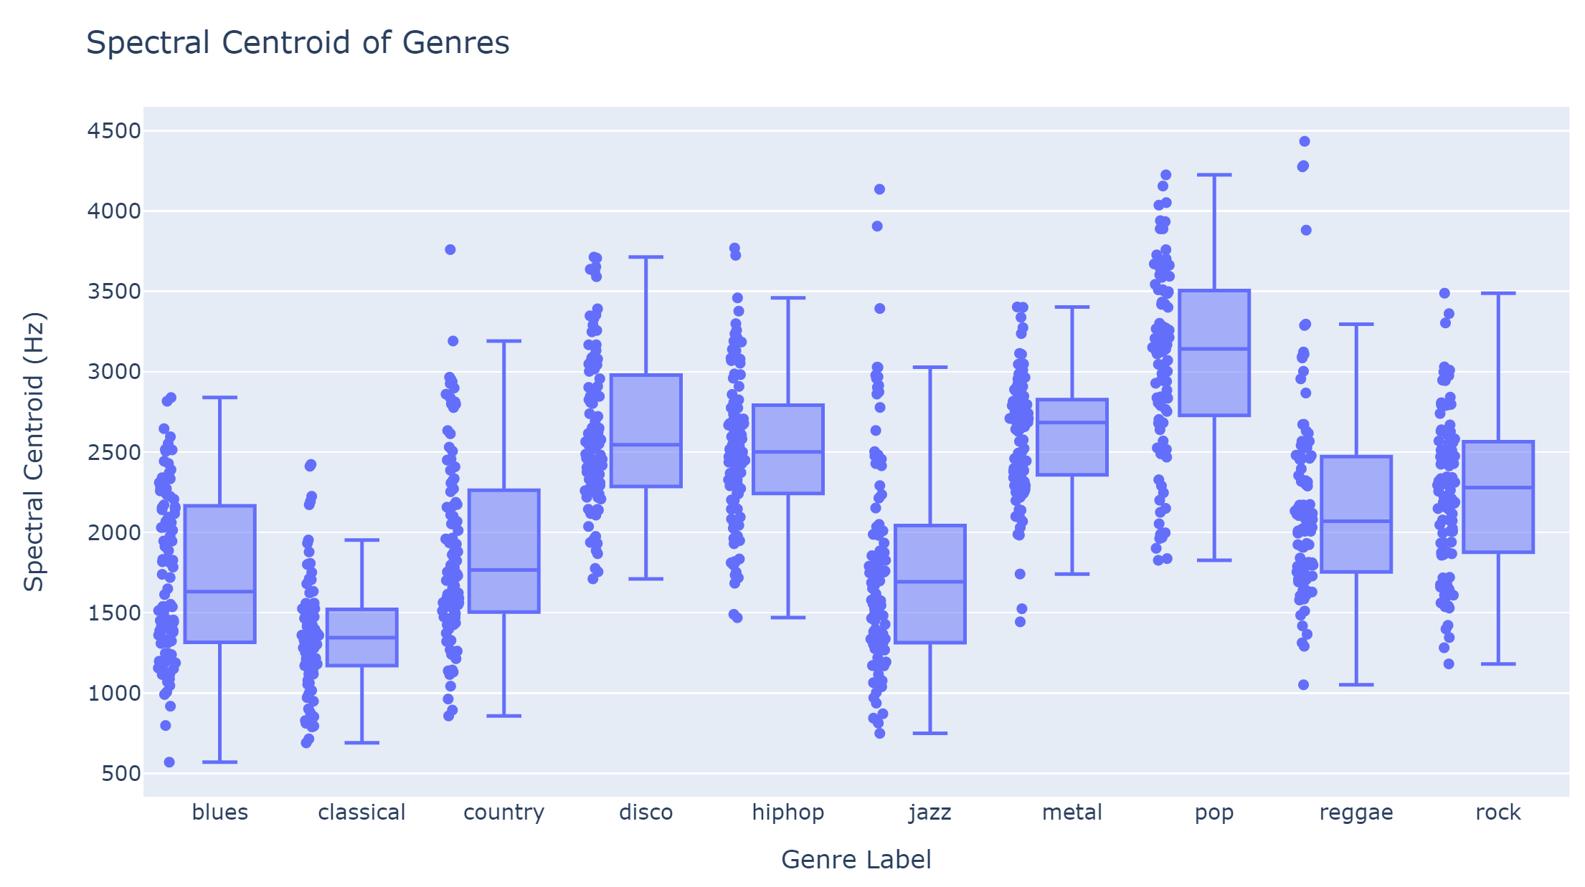

Slide 7
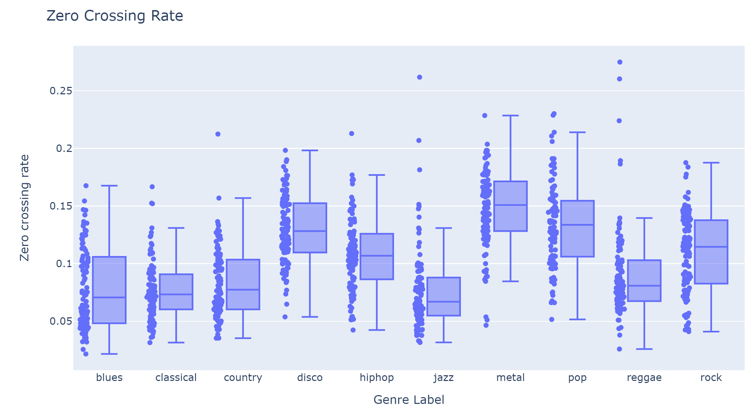

Slide 8
Procedure used for models
Models
Neural Network
-search for best activation function, alpha, hidden layers
Support Vector Machine
-search for kernel, C param, gamma
Training data
Validation data
Test
data
Sample dataframe (85% of total data), split again 85/15 (train/validation)
Remaining 15% used at the end for testing models

Slide 9
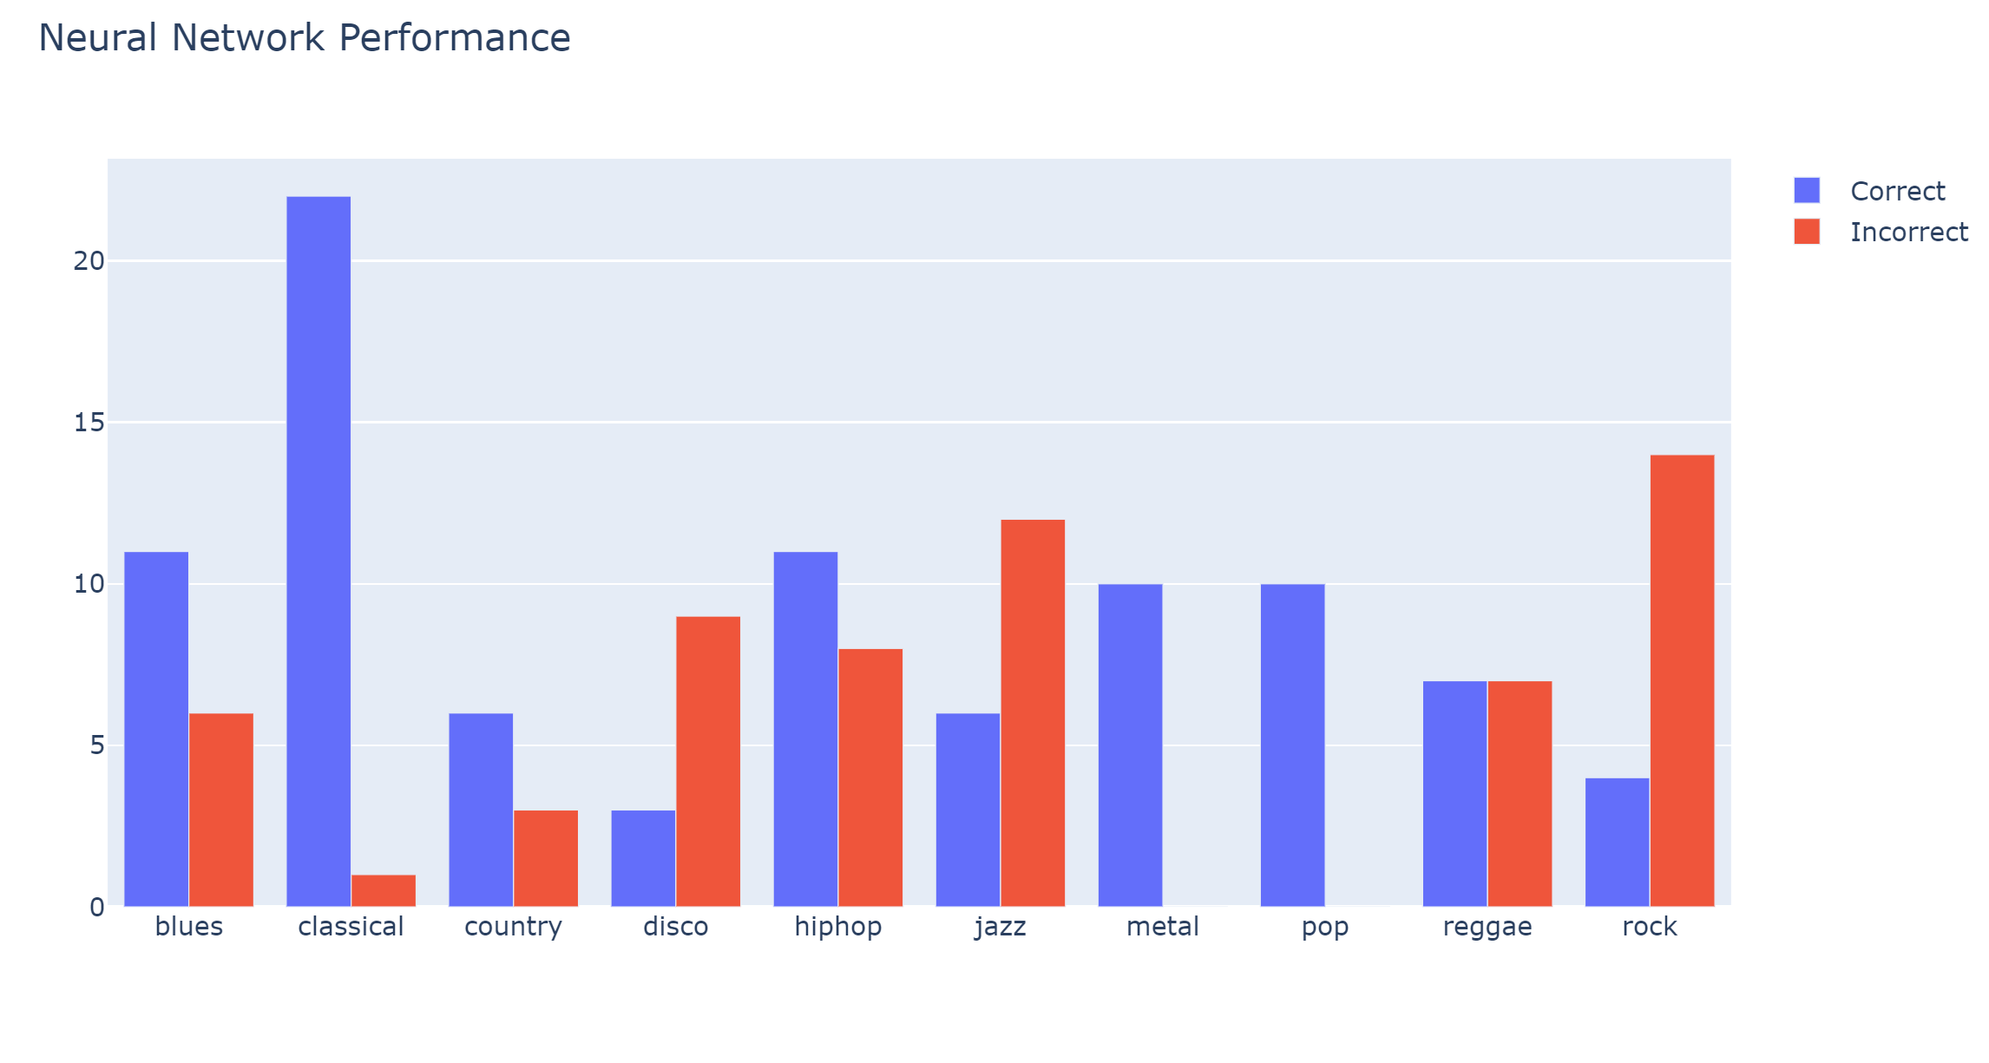
6 metal
3 reggae
2 country
2 hip hop
1 pop
Accuracy
59 % Train
49 % Validation
60 % Test
CV
Logistic activation best
Hidden layers 1000

Slide 10
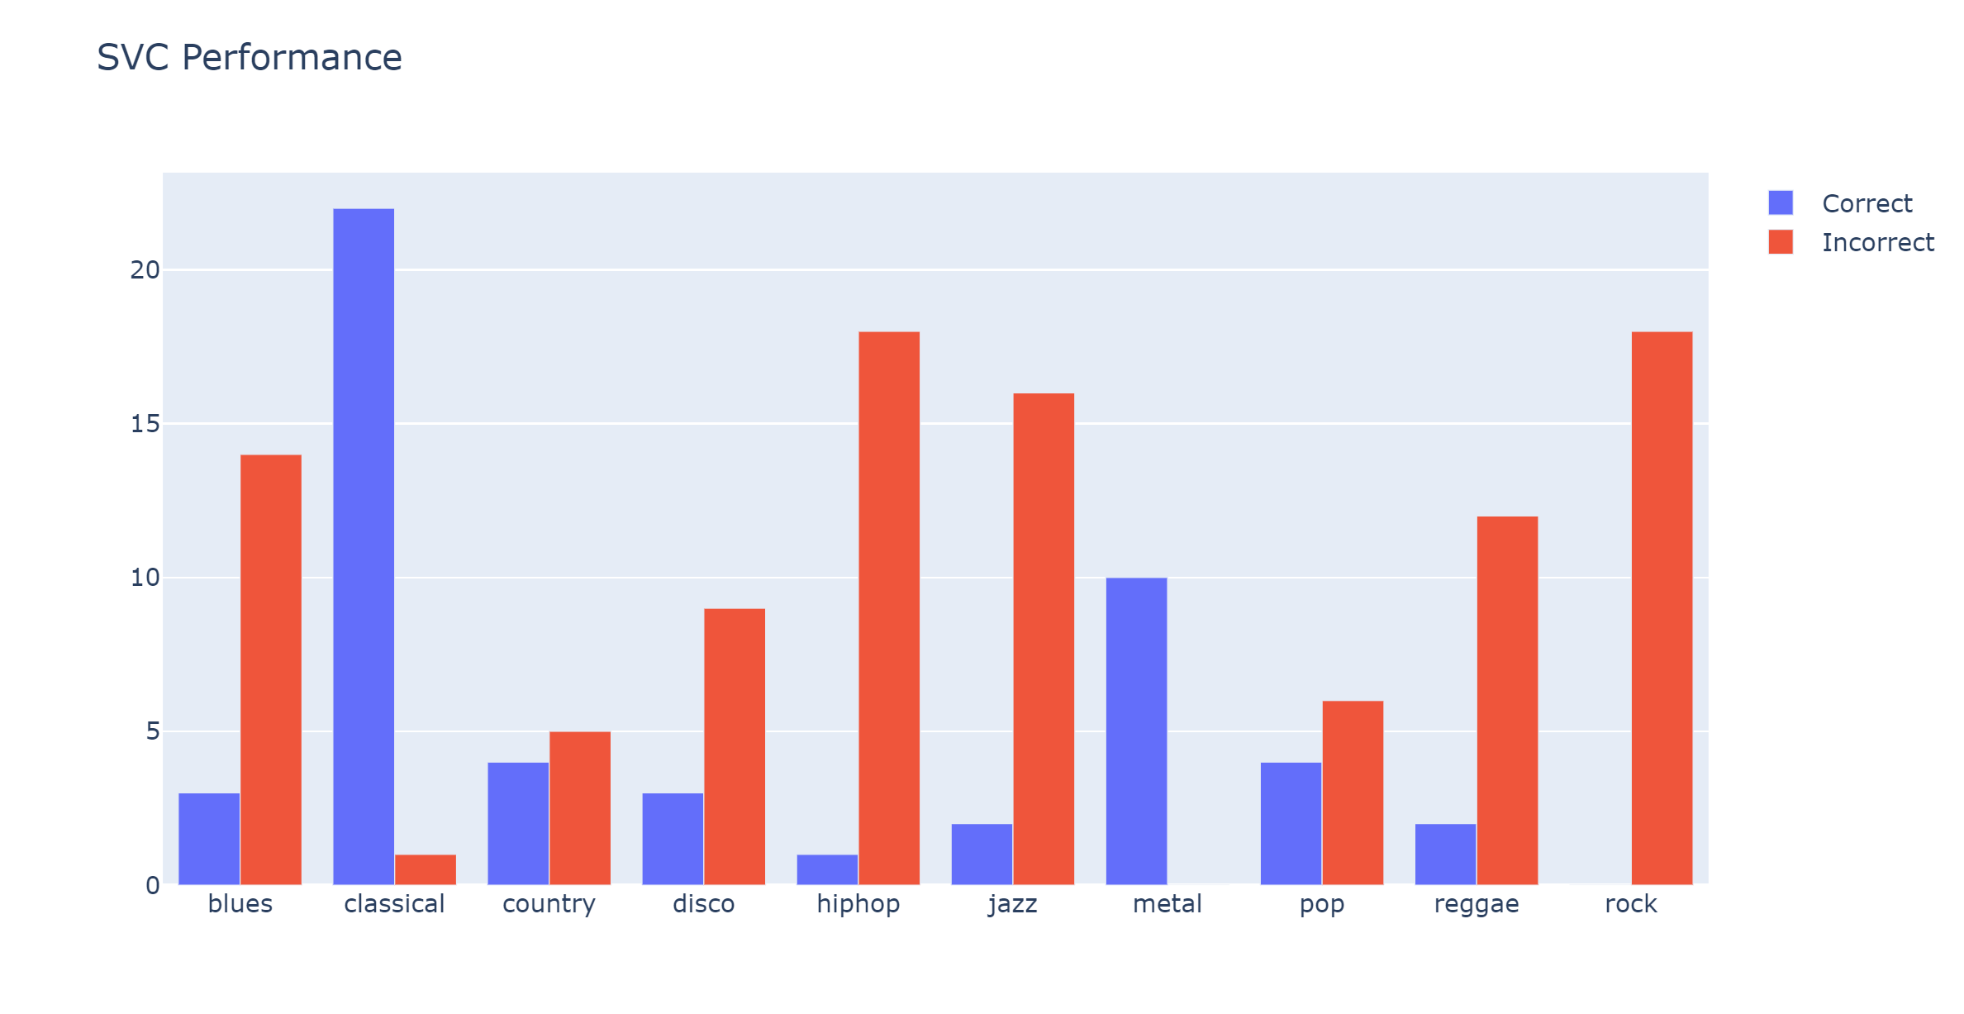
5 metal
3 reggae
3 country
3 jazz
2 pop
1 blues
1 hip hop
Accuracy
37 % Train
27 % Validation
34 % Test
CV
Polynomial kernel best
C=0.01
Gamma = 1e-6

Slide 11
Song | My Classification | Neural Network | Support Vector Machine
Immigrant Song- Led Zeppelin | Rock | Hip hop | Country
Clair de lune- Claude Debussy | Classical | Classical | Classical
Jamming- Bob Marley | Reggae | Reggae | Jazz
Rhinestone Cowboy- Glen Campbell | Country | Country | Country
You should be dancing- Bee Gees | Disco | Pop | Disco
Take Five- Dave Brubeck | Jazz | Reggae | Jazz
Electric Relaxation- Tribe Called Quest | Hip Hop | Reggae | Jazz
Enter Sandman- Metallica | Metal | Hip hop | Disco
Pride and Joy- Stevie Ray Vaughn | Blues | Hip hop | Hip Hop
Billie Jean- Michael Jackson | Pop | Hip hop | Pop
30 % correct
50 % correct

Slide 12
Conclusions
Additional features could help (length of track, track title, lyrics)
Would require substantial user input, not as “pure” as analyzing audio signal
Larger dataset may help
Overall, music is subjective and hard to classify

