Slide 1
Prediction of Dye Sensitized Solar Cell Performance
Connor Herring

Slide 2
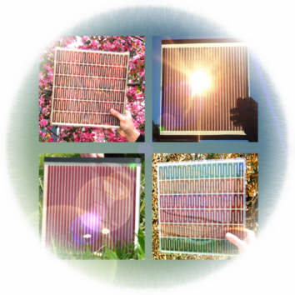
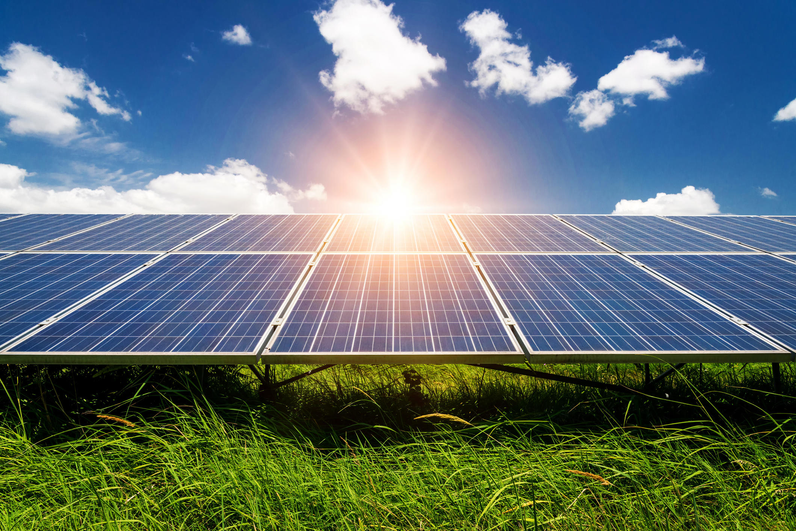
Dye-sensitized solar cell (DSSC)

Slide 3
DSSC Structure and Operation
Sunlight
ITO
TiO₂
e-
Photosensitive dye
I-
I₃-
Electrolyte
(redox couple)
Load
Pt
(counter electrode)
e-
ITO

Slide 4

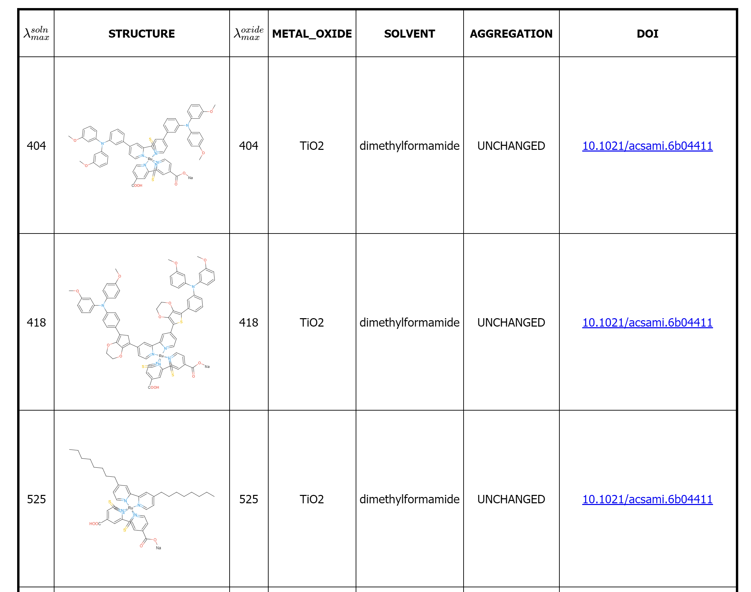
DSSC Database
Open circuit voltage (mV)
Short circuit current (mA/cm²)
Power conversion efficiency
Electrolyte
Active area of cell (cm²)
Cosensitizer
Semiconductor
Dye loading (mmol/cm²)
Exposure time
Solar conditions (mW/cm²)
SMILES
Dye class

Slide 5
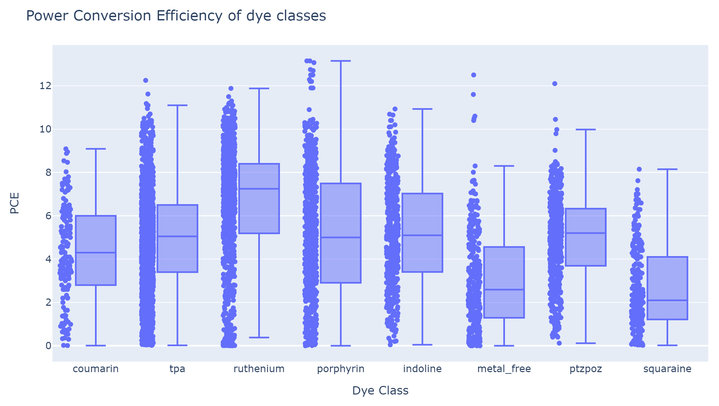

Slide 6
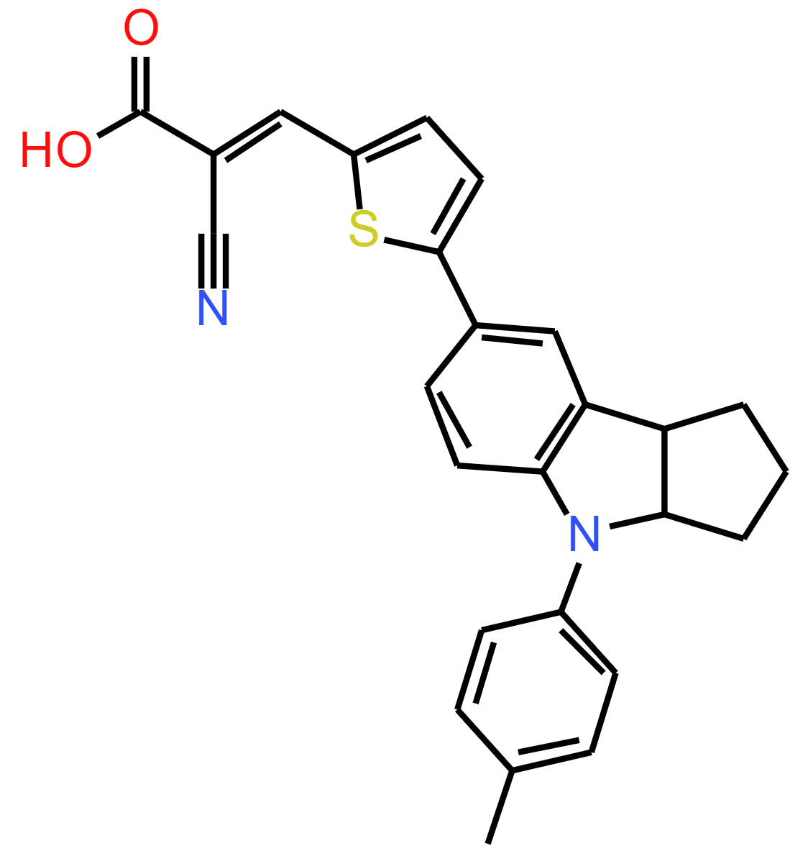
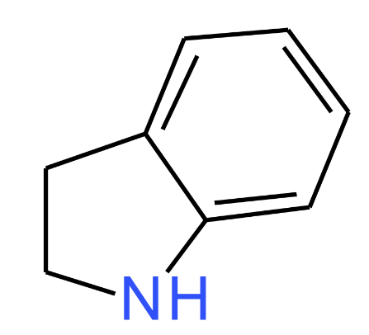
SMILES
Simplified molecular-input line-entry system
Depth first traversal of chemical graph
C1CNC2=CC=CC=C21
CC1=CC=C(C=C1)N1C2CCCC2C2=C1C=CC(=C2)C1=CC=C(S1)\C=C(/C#N)C(O)=O

Slide 7

Additional Feature Generation
['S', 'N', 'O', 'C', '=', 'I', '-', ‘+’]
Number of bonds
Number of atoms
Number of heavy atoms
Molecular weight

Slide 8
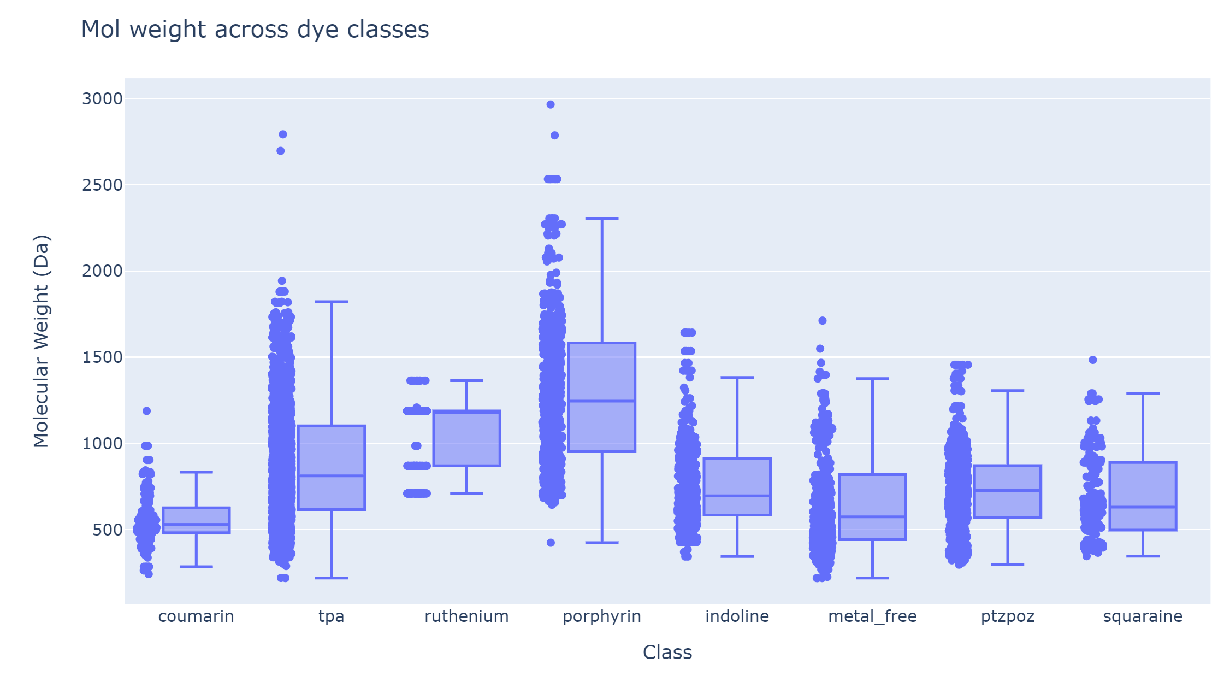

Slide 9
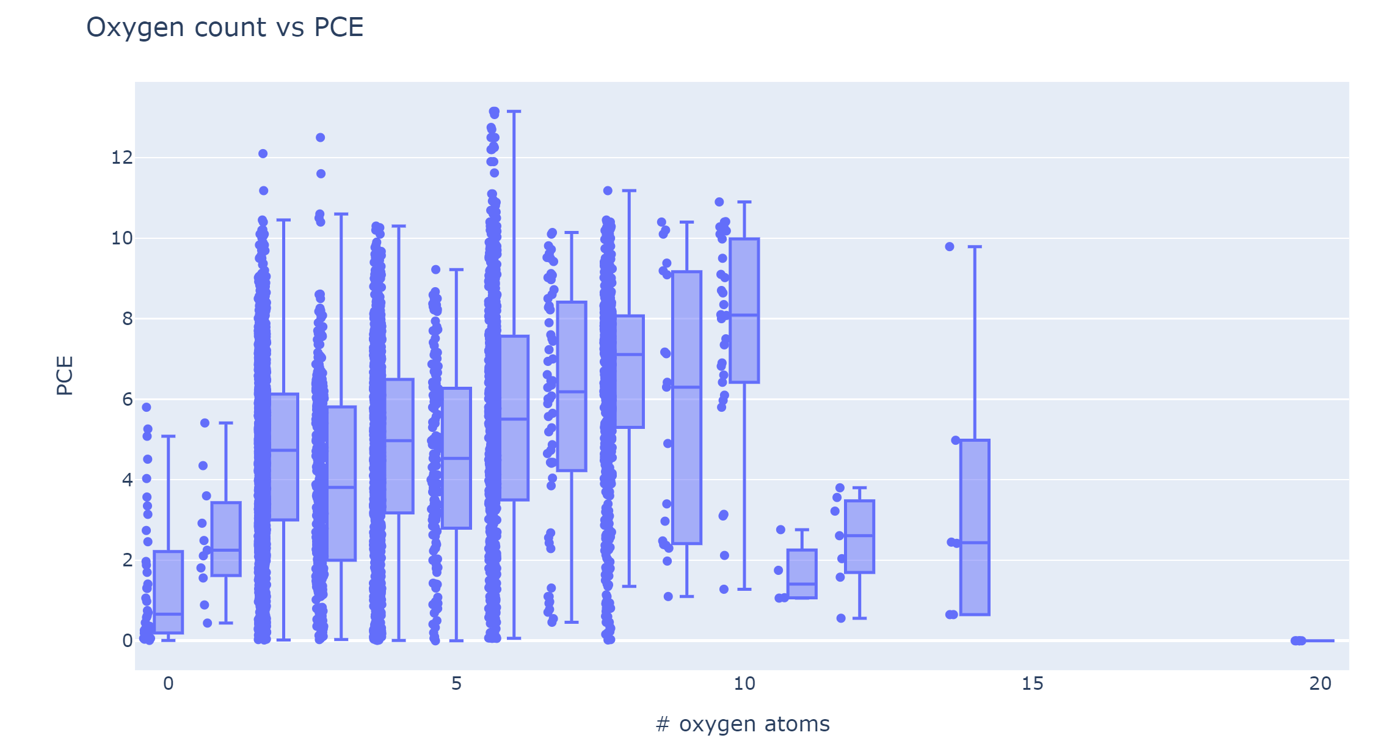

Slide 10
Train-Test Procedure
Random Forest Regressor
-search for max_depth, n_estimators, min_samples_split
Folds = 8
N_iterations = 15
Training data
Validation data
Test
data
Sample dataframe (80% of total data), split again 80/20 (train/validation)
Remaining 20% used at the end for testing model

Slide 11
Random Forest Results
N_esetimators = 1000
Max_depth = 50
min_samples_split = 10
Dataset | RMSE | Score
Train | 0.3 | 0.95
Validation | 2.14 | 0.65
Test | 2.33 | 0.65

Slide 12
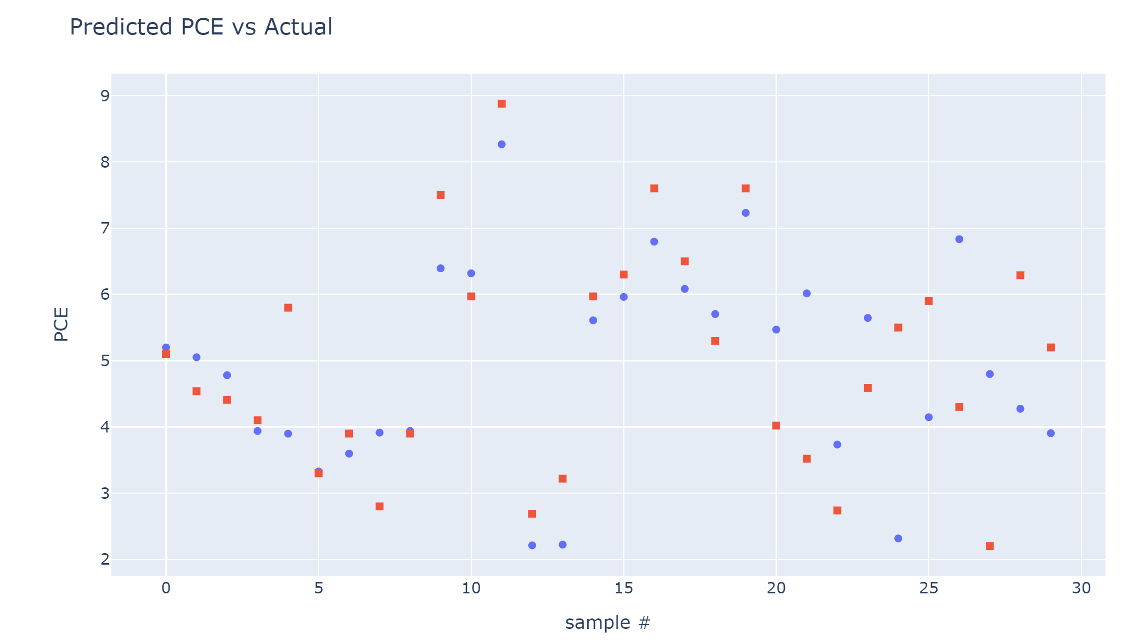
Test Dataset: Random Forest Results
Predicted
Actual

Slide 13
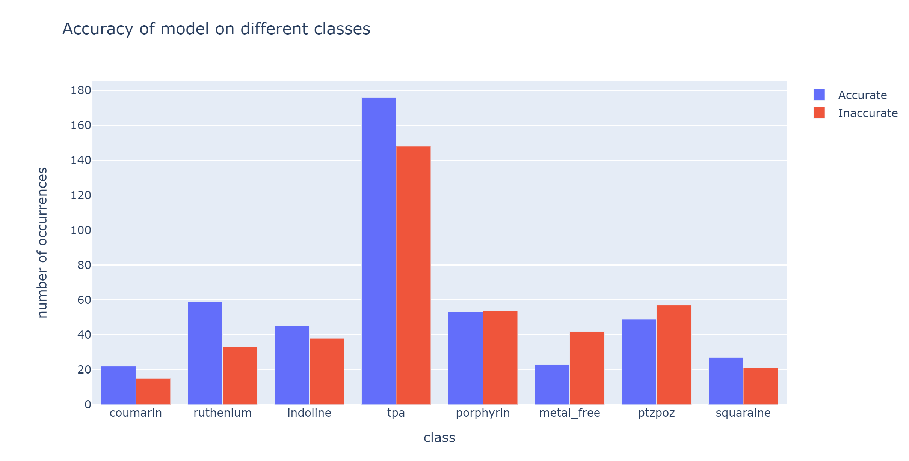
*accurate = within 20% of real value

Slide 14
Future Work
Better feature generation for dye structures
Better filling in of missing data
Apply trained model to database of dyes to predict which structures could maximize PCE
JSC
VOC

Slide 15
Thank You!

