Slide 1
How to Hike in the Pacific Northwest
@JohnLaTwC

Slide 2
Finding a Hike

Slide 3
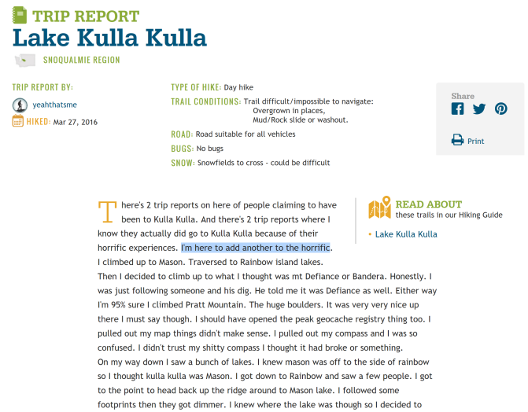
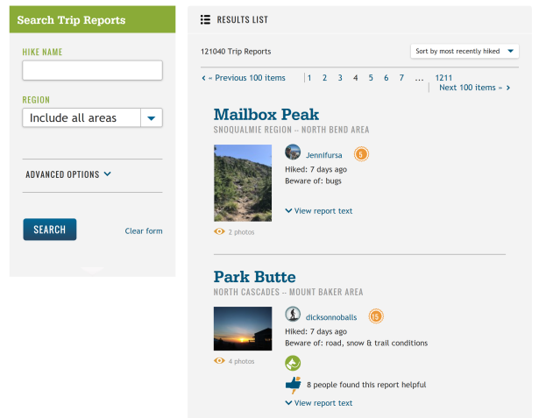
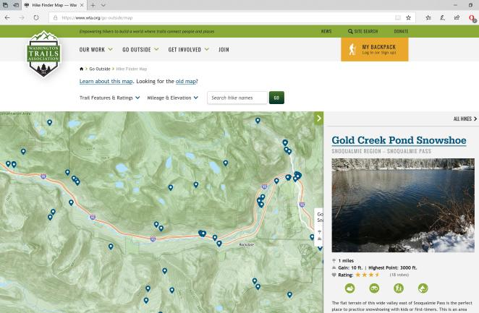
WTA

Slide 4
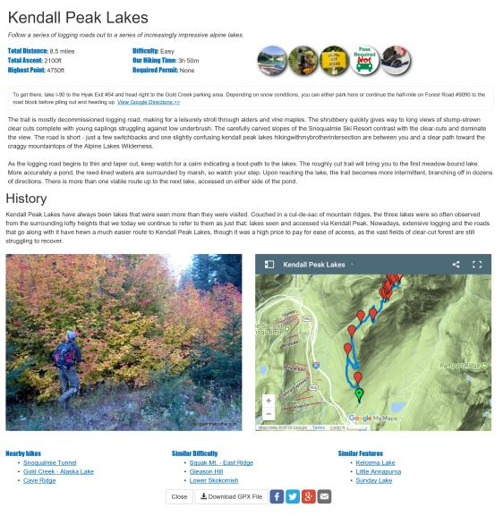

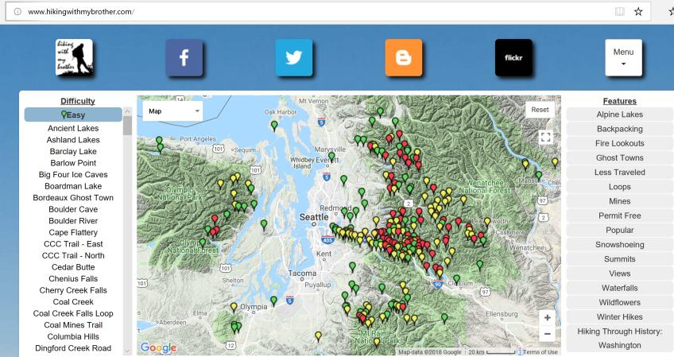
HikingWithMyBrother.Com

Slide 5
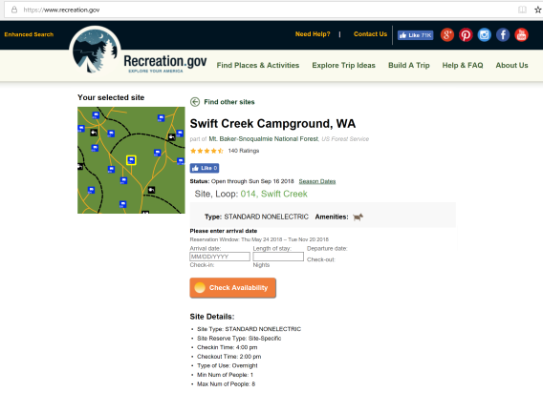
Car Camping

Slide 6
Stuff You Need

Slide 7
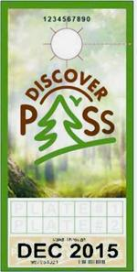

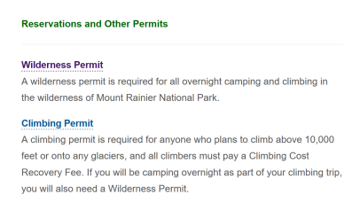
Passes & Permits

Slide 8
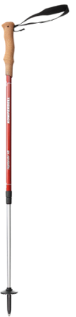



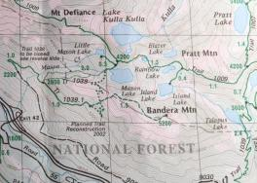

Common Stuff

Slide 9
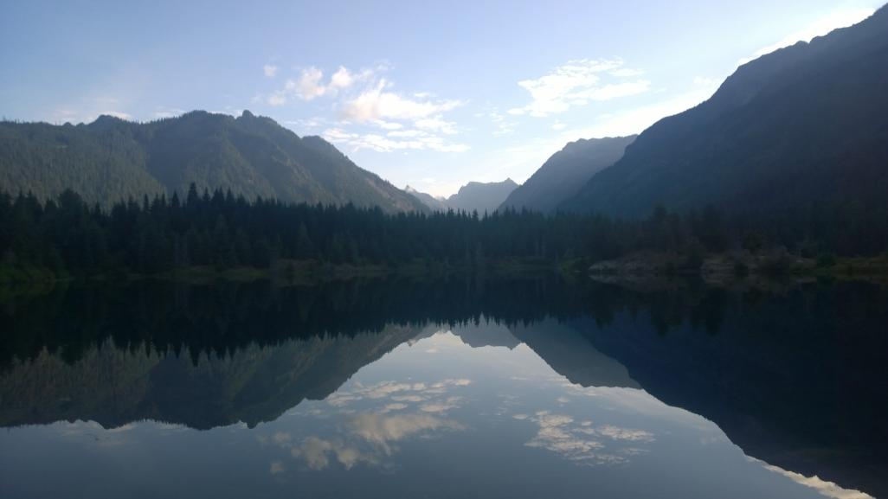
Gold Greek Pond
https://www.wta.org/go-hiking/hikes/gold-creek-pond

Slide 10
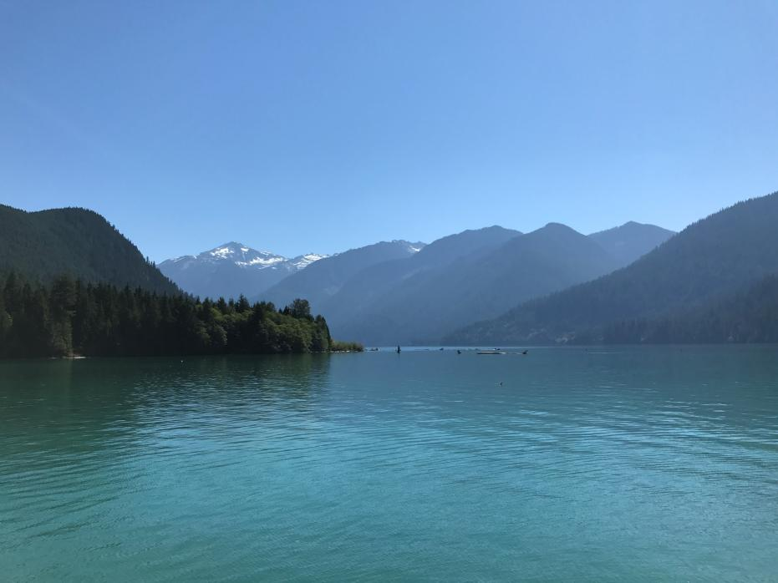
Baker Lake

Slide 11
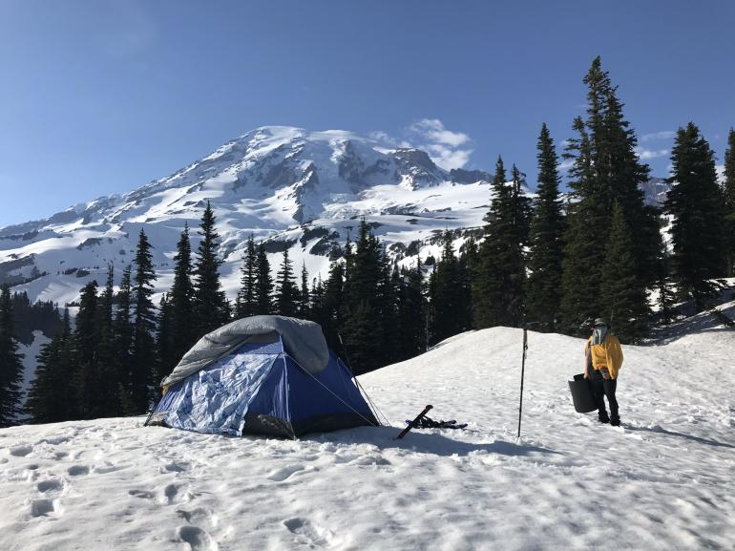
Mazama Ridge, Mount Rainier

Slide 12
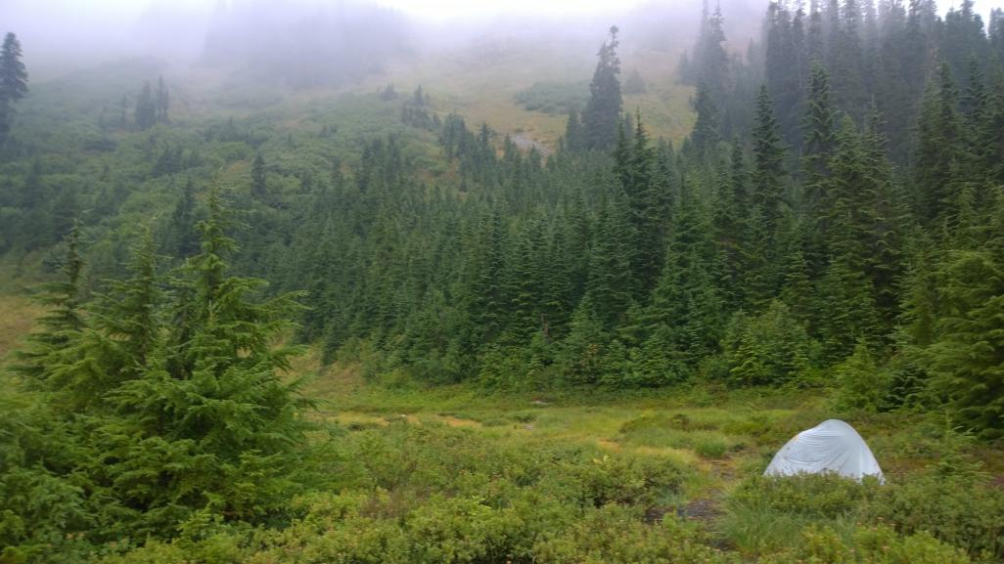
Joe Lake

Slide 13
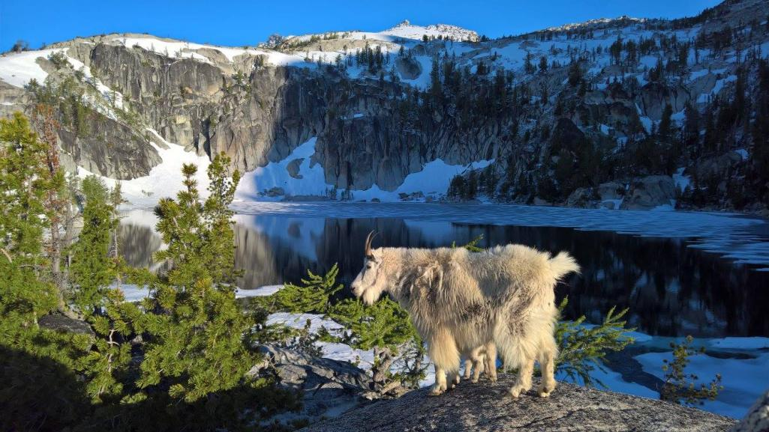
Lake Viviane, The Enchantments

Slide 14
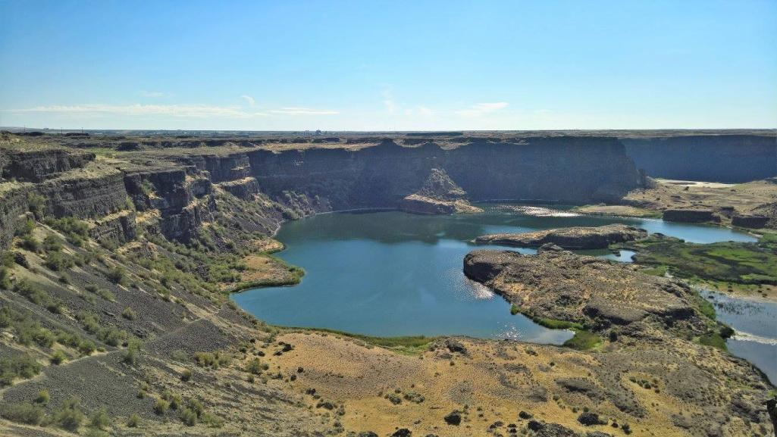
Dry Falls, WA

Slide 15
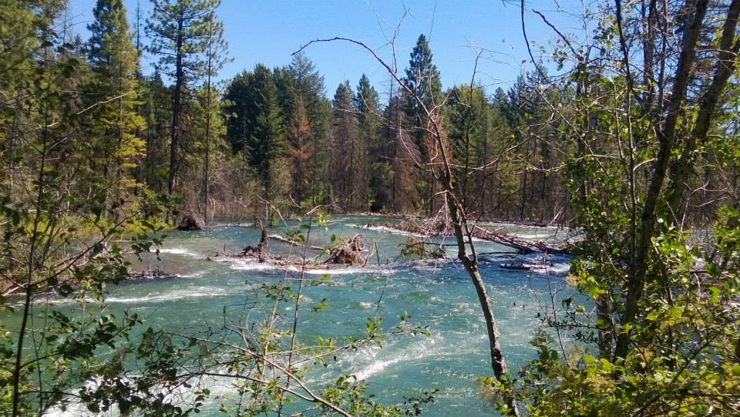
Cle Elum river, Suncadia

Slide 16
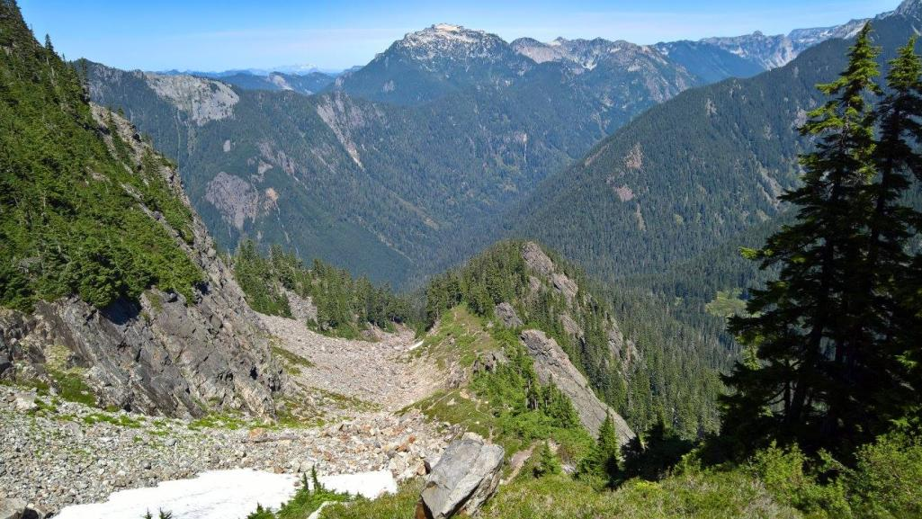
Red Pass, Cascade Crest Trail

Slide 17
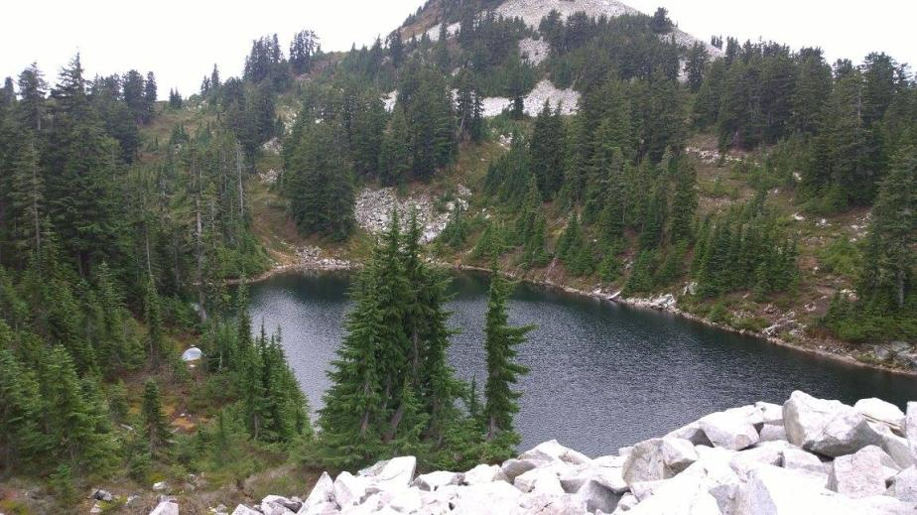
Ridge Lake

Slide 18
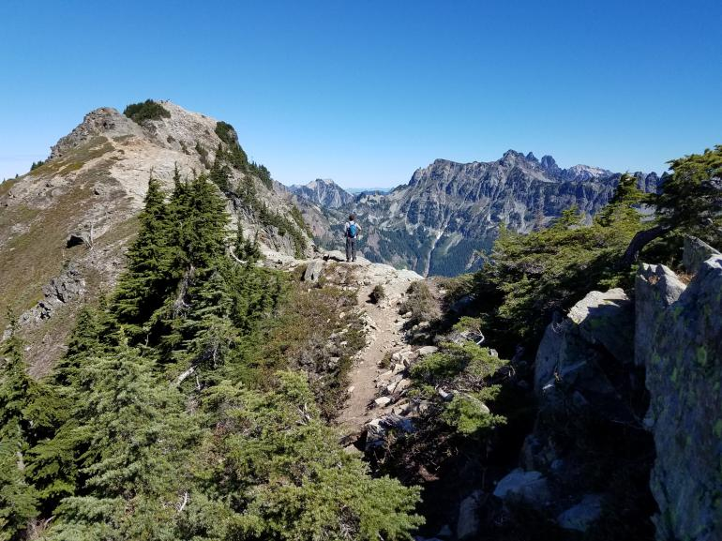
Alta Mountain

Slide 19
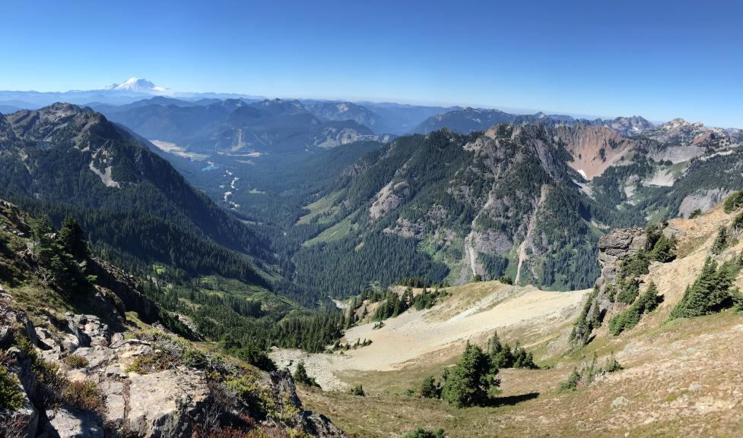
Gold Creek Valley

Slide 20
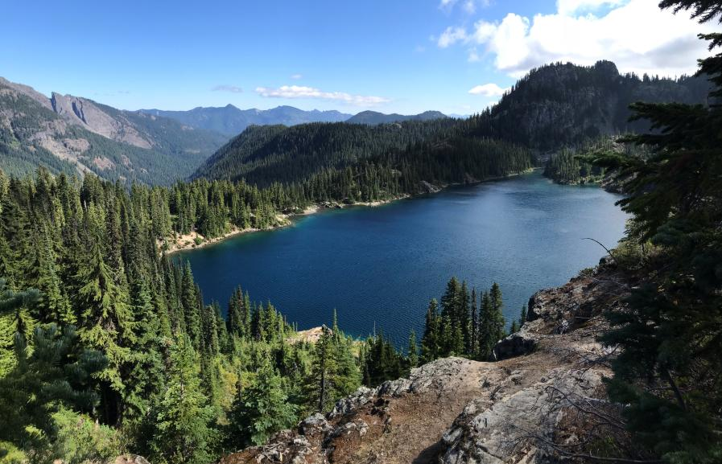
Rachel Lake

Slide 21
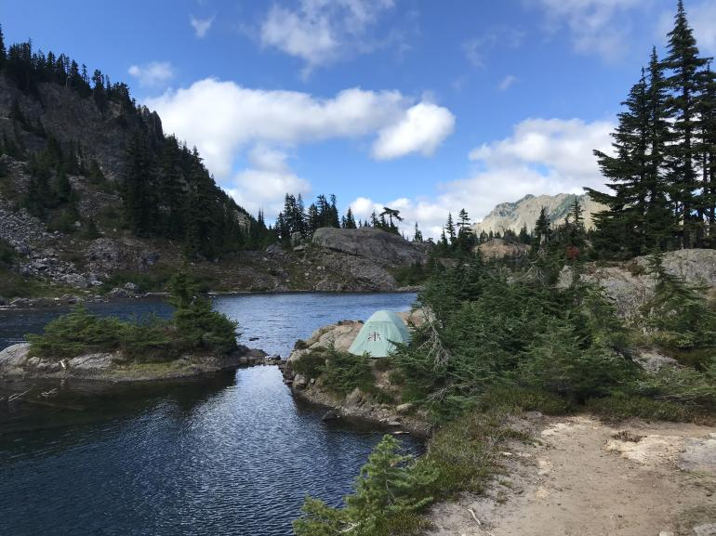
Rampart Lakes

Slide 22
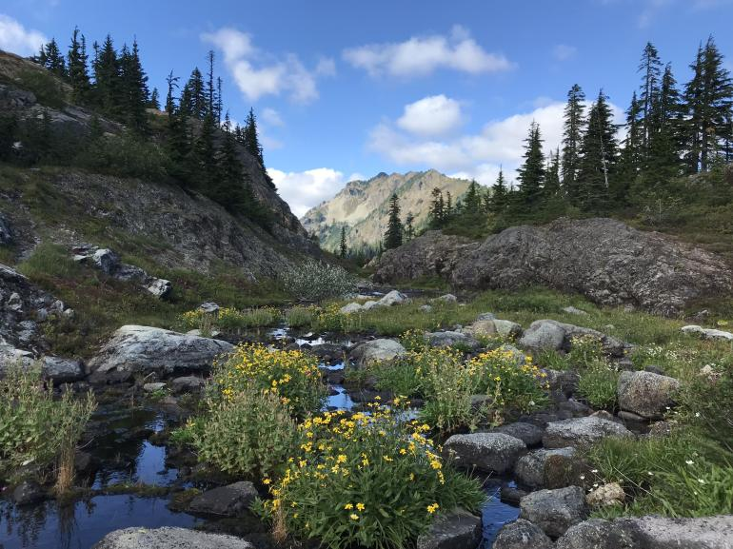
Rampart Lakes

Slide 23
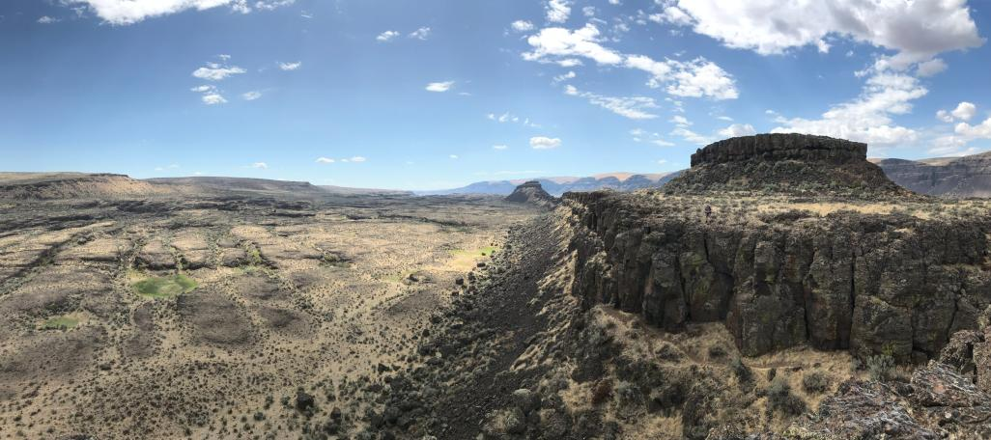
The Great Blade

Slide 24
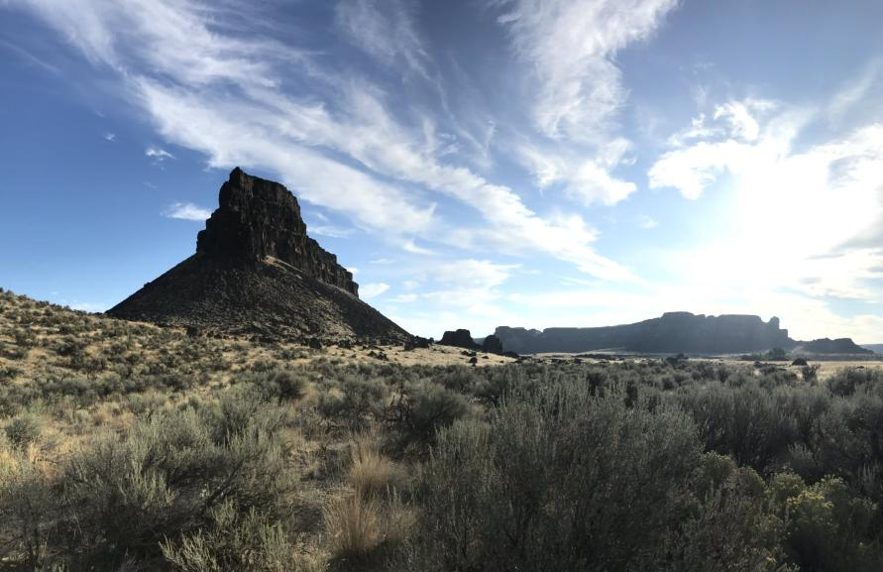
Umatilla Rock

Slide 25
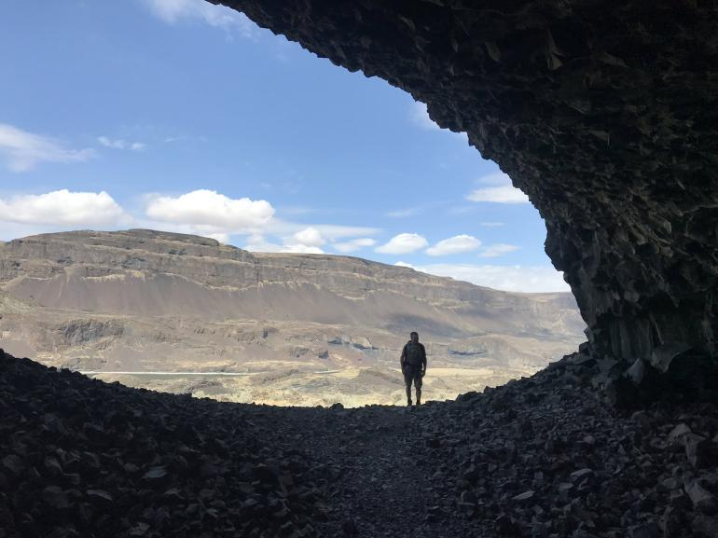
Lake Lenore Caves

Slide 26
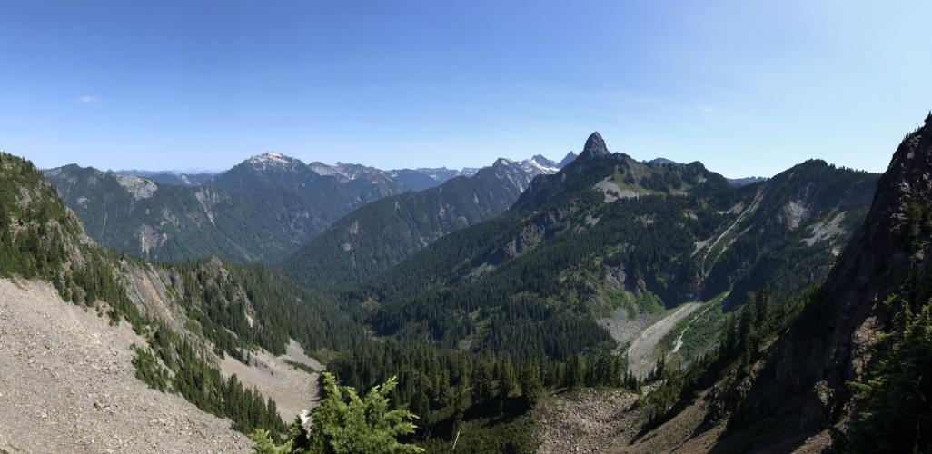
Mount Thomson

Slide 27
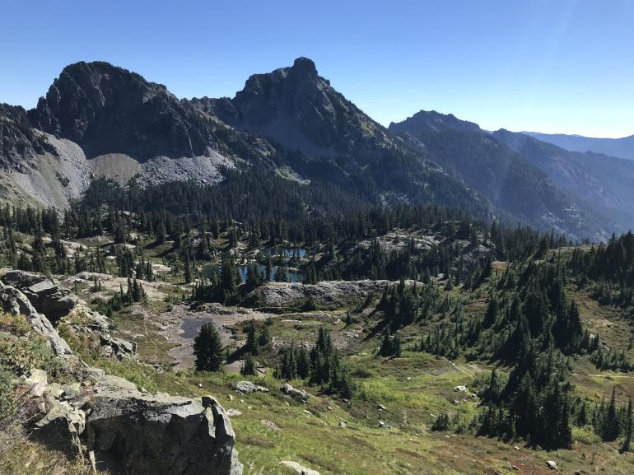
Lila Lake

Slide 28
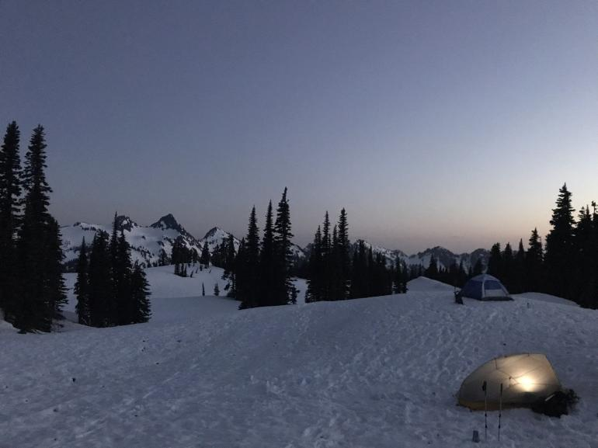
Mazama Ridge

Slide 29
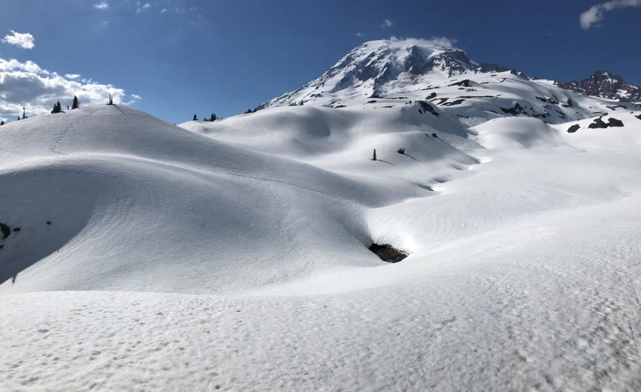
Mount Rainier

Slide 30
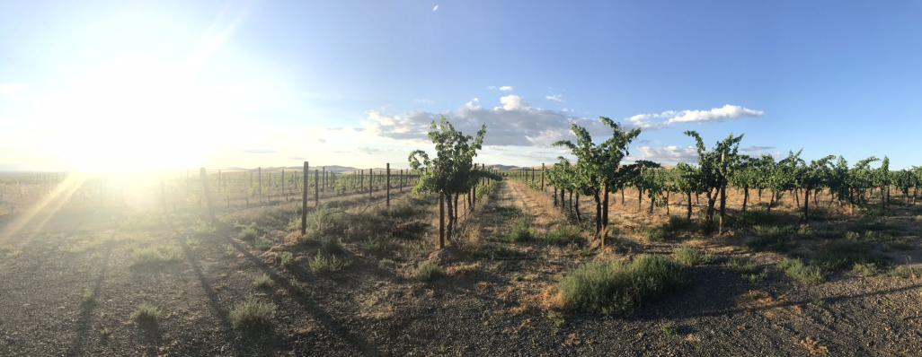
Zillah WA

Slide 31
Great Stuff in Town!
Redmond Watershed
Evans Creek Preserve
Coal Creek / Red Town Trailhead
Weowna Park Trails
Mercer Slough Nature Park
Cougar / Tiger / Squak Mountain

Slide 32
Remember
Enjoy the solitude of a solo hike & hike with friends and co-workers
“Hike your own hike”
Comparison is the thief of joy
Beat the crowds – go early / weekday

