Slide 1
Thesis Update
23 February 2026
Connor Emmons

Slide 2
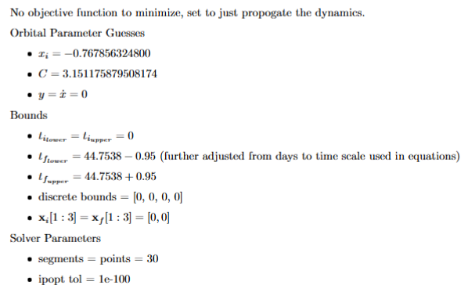
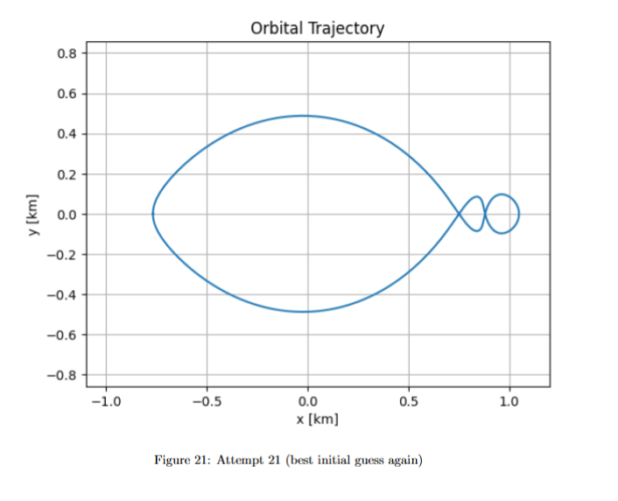
Good Initial Guess for (1,1) Cyclers

Slide 3
Methodology
Screenshot given orbit in paper and convert pixel coordinates to (x,y) points for each day marker
Guess velocities at each point by taking the average of 2 slopes of secant lines: one with the next point, one with the previous point
Wasn’t confident in this method but did work for this case, TBD if robust enough for other families
Originally set optimization to minimize time, but ended up using no optimization function for final result

Slide 4
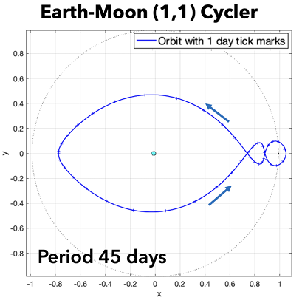
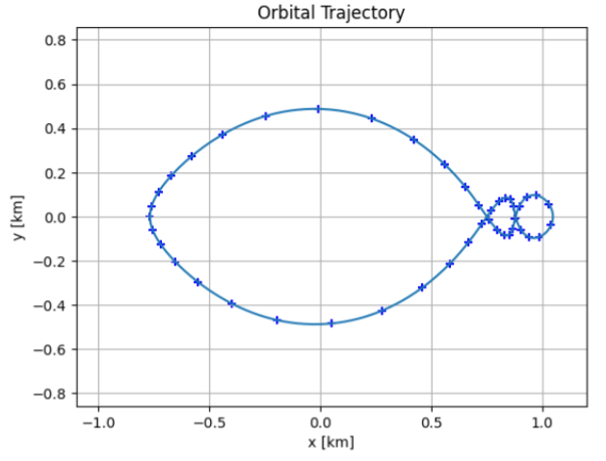
Comparison to Orbit in Paper

Slide 5
Points of Concern
How to tell if the orbit is correctly following given dynamics
Perhaps computing the Jacobi constant at each timestep to confirm conservation throughout the orbit
Generating new orbits that haven’t been found yet would be difficult with the method used
May not be applicable if the goal is a study of perturbations only

Slide 6
Looking Forward
Add control via thrust to explore the thrust-first approach to generating orbits
Will have to happen eventually anyways to get delta V estimates on maintenance
Find a good way to check orbits/refine until correct
Jacobi constant analysis is probably a good starting point
Generate a good initial guess for the other cycler families
Would like to implement original method of finding the initial conditions but not sure of utility
Begin perturbation analysis with the Sun

Slide 7
Questions for Advisor
Master’s Thesis Scope – What do you want to see?
YAPSS techniques and practices – What values are rigid, what values are flexible, and what are the limits of pure dynamic modeling?

