Slide 1
Thesis Update
02 March 2026
Connor Emmons

Slide 2
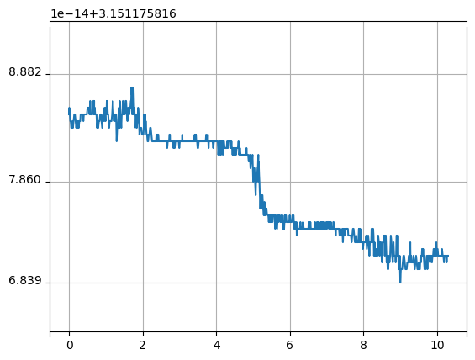
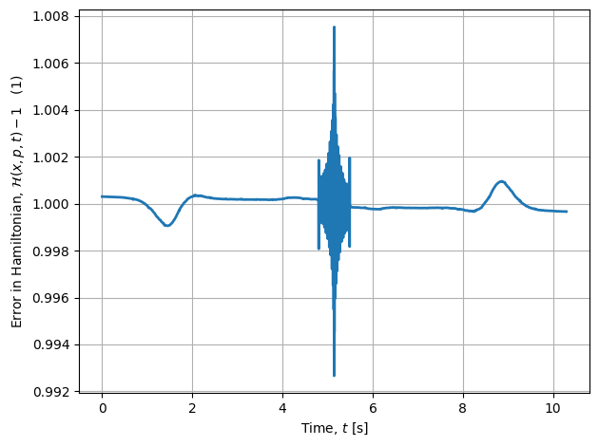
Hamiltonian vs Jacobi Constant
Jacobi
Hamiltonian

Slide 3
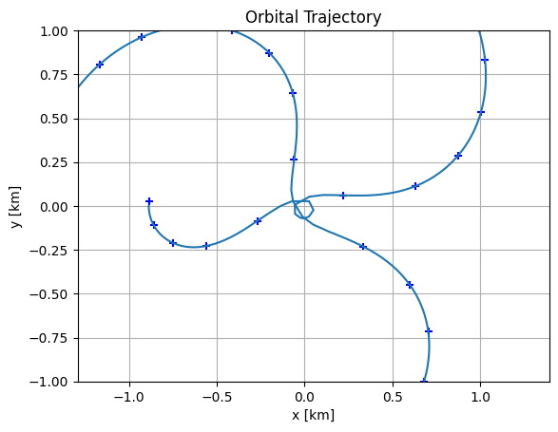
Changing Mesh Size
Attempted to change mesh to segments, points = 100, 10
No good

Slide 4
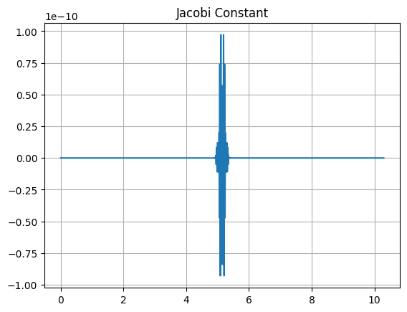
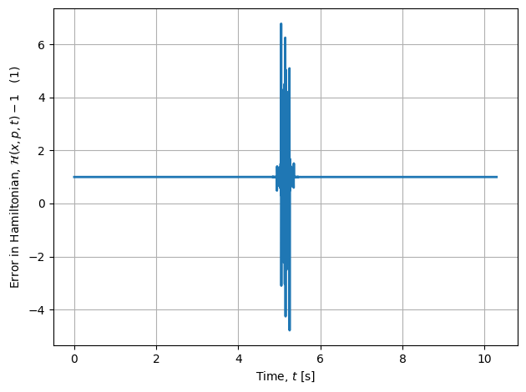
Iterative Solution
Jacobi
(difference to mean)
First generate the original good orbit, then use the state and time from that orbit as the initial guess for a second solution with a mesh of 100, 10
Jacobi constant got worse, but still within good ranges
Shapes of Jacobi and Hamiltonian match for this case
Hamiltonian

Slide 5
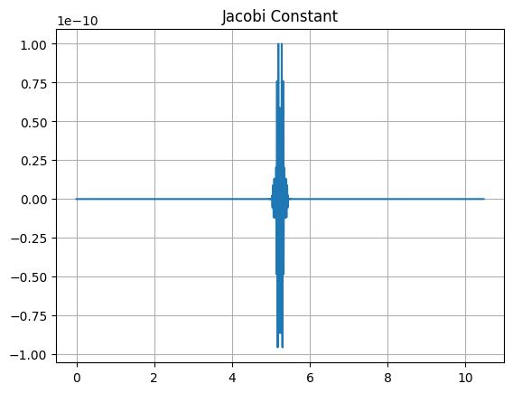
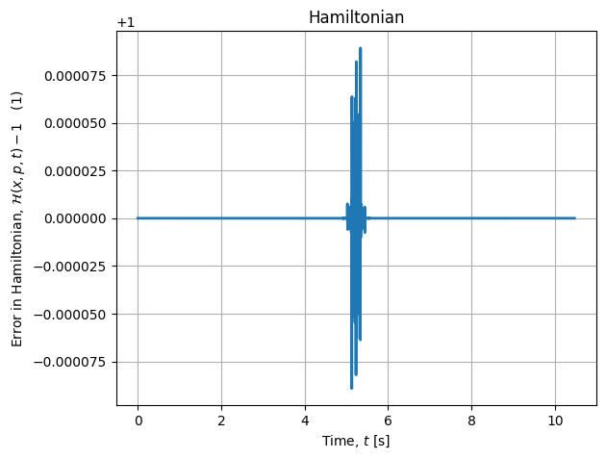
Iterative Solution Refined
(difference to mean)
For the second solution, in addition to adjusting the mesh, remove the bounds on the final time (reset to 0, infinity)
This orbit was off of the period stated in the paper by ~1.7% (~18 hours)
Hamiltonian getting better
The original solution takes ~20 seconds to run, the second solution takes ~5 seconds to run

Slide 6
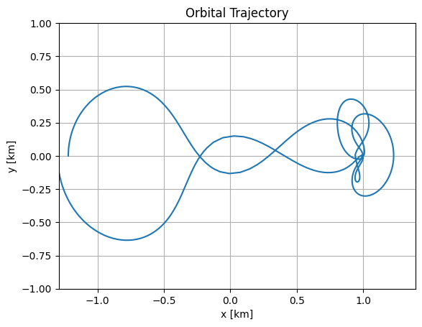
Attempted Relaxation of Tolerance
Attempted to relax ipopt tol to 1e-16 from 1e-100 to reduce run times
No good

Slide 7
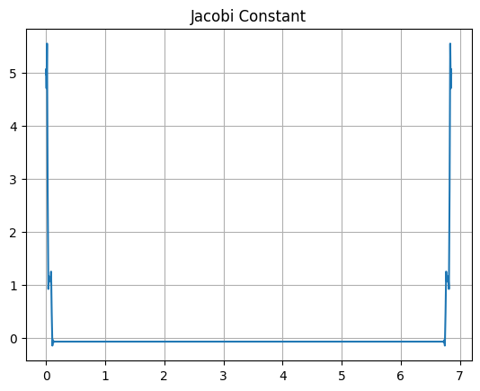
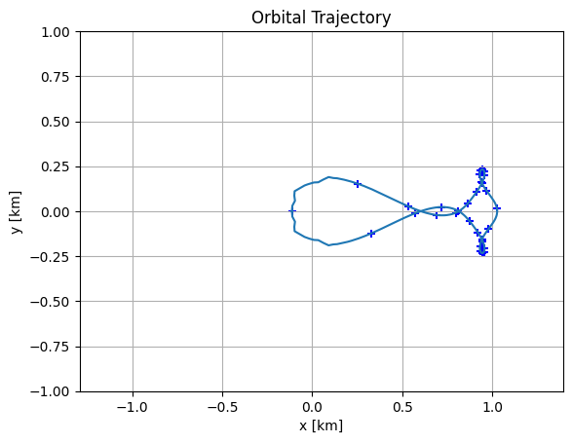
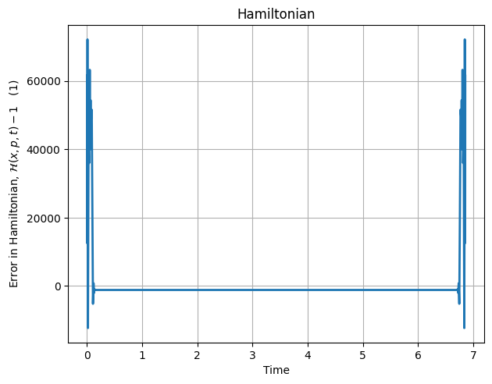
Attempted New Mesh with No tf Bounds
(difference to mean)
Remove final time bounds and try one solution but with a mesh of 100, 10
Orbit is no good, but Jacobi and Hamiltonian agree

Slide 8
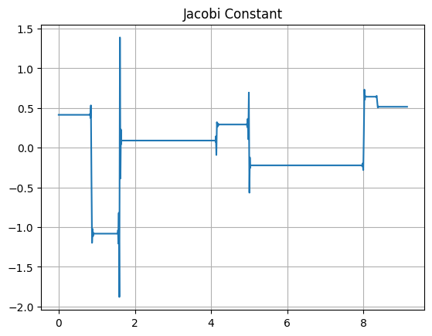
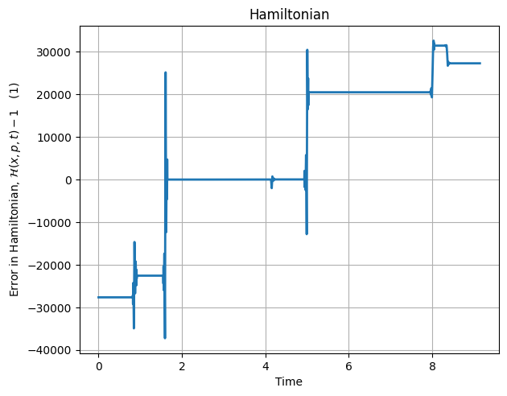
Attempted New Mesh with Loose tf Bounds
(difference to mean)
Reinstated bounds, but gave an interval of +- 5 days (good orbits are generated with 0.95 difference)
Solution still bad, but Jacobi and Hamiltonian still match-ish

Slide 9
Discussion
Jacobi and Hamiltonian agreeance seems dependent on the mesh used
100, 10 gives good agreeance, but 30, 30 does not
Testing with different bounds shows that big changes on one graph reflect big changes in the other, but the magnitude and direction are not necessarily the same
Discuss recent results
Jacobi value vs Hamil offset, deviation vs Hamil deviation
Not sure how to feel about iterative solution
Hamiltonian and Jacobi in much closer agreeance (good) but period is worse (bad)
Could come down to how accurate the period given in the paper is and/or how much to trust other people’s work

Slide 10
Future Work
Implement in 3D
More testing of Jacobi vs Hamiltonian
Which one is a better predictor of a “good” orbit?
Should they agree?
Might be necessary to evaluate orbit generation in 3D
Once 3D is implemented, try to find off-axis cyclers
At some point, have to model other cyclers for completeness

