Slide 1
Lefschetz Thimble Quantum Monte Carlo for Spin Systems
Connor Mooney, Jacob Bringewatt, Lucas Brady
Gorshkov Group meeting
August 20, 2021

Slide 2
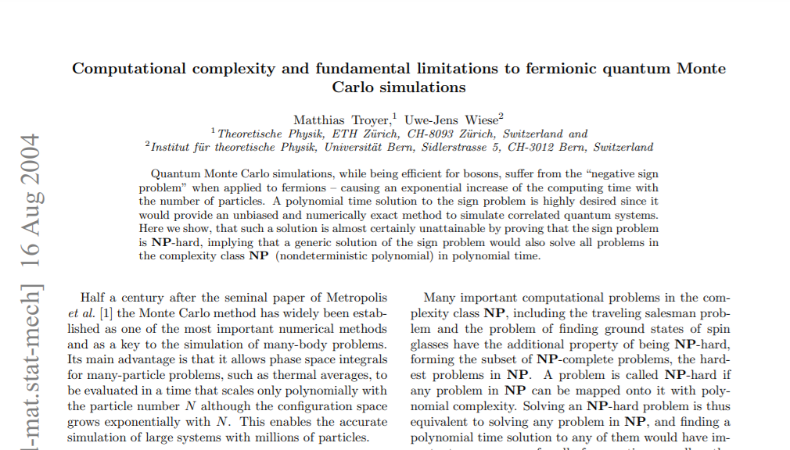
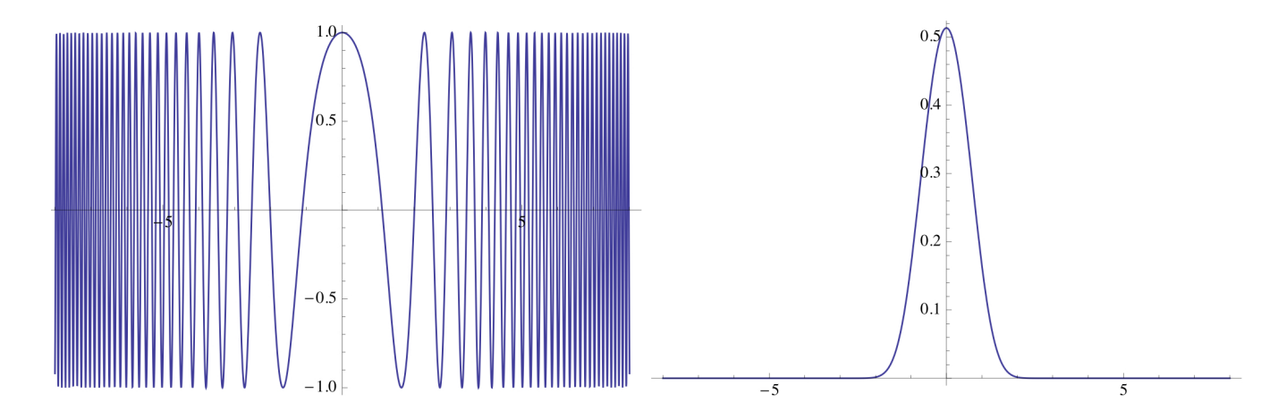
Overview
The Sign Problem: Numerical instabilities due to oscillations in phases of Boltzmann weights

Slide 3
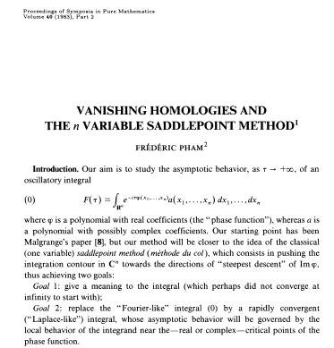
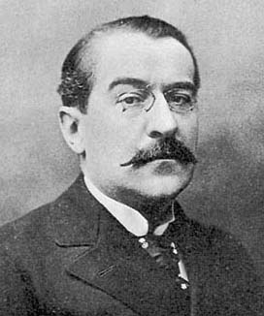
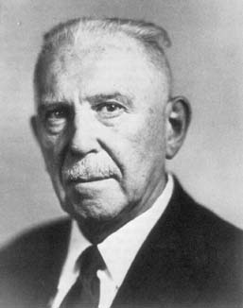
Overview
Picard-Lefschetz Theory: A part of Algebraic Geometry that studies topology via critical points of holomorphic maps
  Lefschetz Thimbles: Multidimensional stationary phase manifolds attached to critical points of a function
  Semi-classical expansion: Expanding path integrals
  as sums over Lefschetz thimbles attached to
  classical paths (critical points)

Slide 4
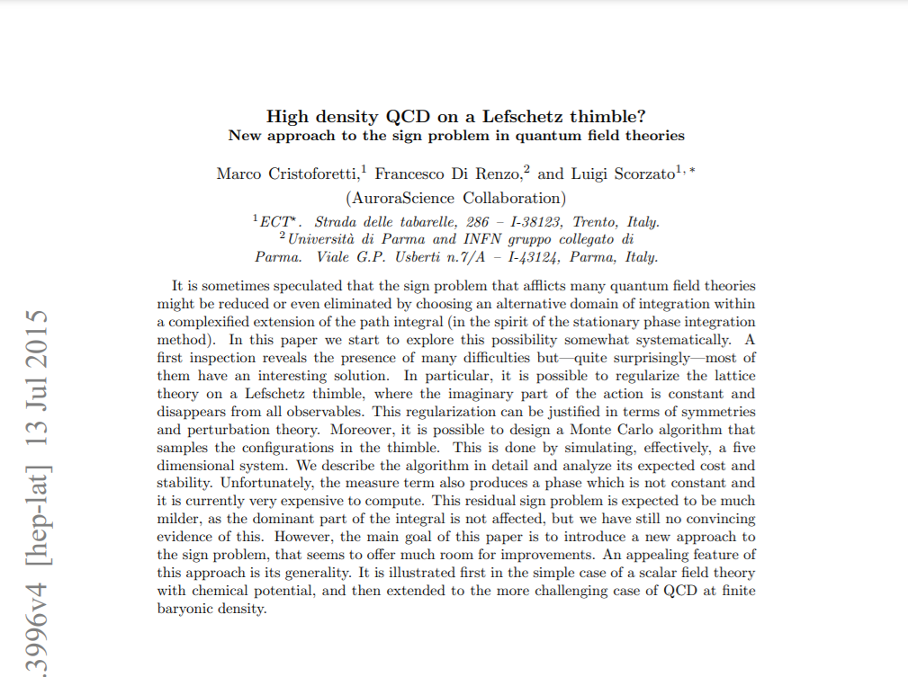
Overview
Lefschetz Thimble Monte Carlo: Monte Carlo methods mitigating the sign problem with Picard-Lefschetz Theory. Works for Hilbert spaces with continuous bases (i.e. position)

Slide 5
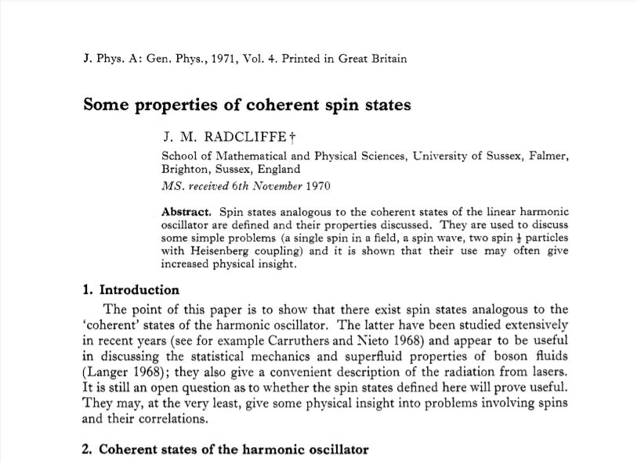
Overview
Spin Coherent States: A continuous overcomplete family spanning the spin Hilbert space and resolving the identity

Slide 6
The Sign Problem

Slide 7
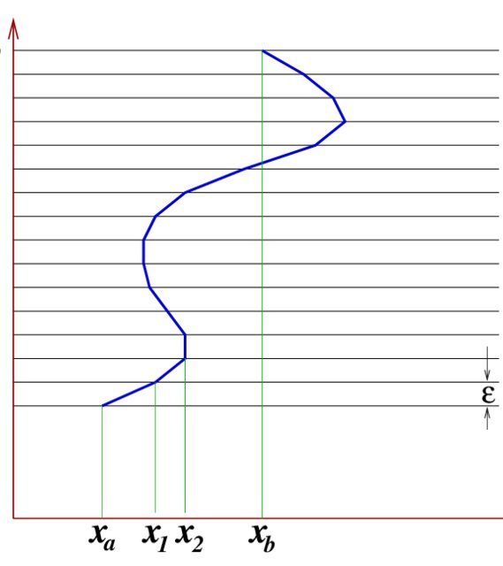
Path Integrals
“Sum over histories”
In limit, we can split up diagonal and off-diagonal parts:

Slide 8
Path Integral Quantum Monte Carlo
We can sample over trajectories with
distribution
Monte Carlo simulations
Expectations

Slide 9
Reweighting
What if isn’t always real?
The answer: Reweighting
- Sample w.r.t weight’s magnitude
- Push the phase into the observable

Slide 10
The Sign Problem
where
Take samples
At constant relative error, the number of samples needed scales exponentially with particle number and inverse temperature
Troyer and Wiese, arXiv:cond-mat/0408370

Slide 11
Countermeasures
Stoquastic Hamiltonians: non-positive real off-diagonal entries
No sign problem
Basis dependent
z-basis
y-basis
Curing generally is NP hard
Curing the sign problem: Finding a basis in which is stoquastic
Mitigation strategies:
  Diagrammatic Monte Carlo
  Majorana Monte Carlo
  Stochastic Quantization
  Fixed-Node Quantum Monte Carlo
  arXiv:0802.2923
  arXiv:1805.08219
  arXiv:0810.2089
  PRL.72.2442

Slide 12
Picard-Lefschetz Theory

Slide 13
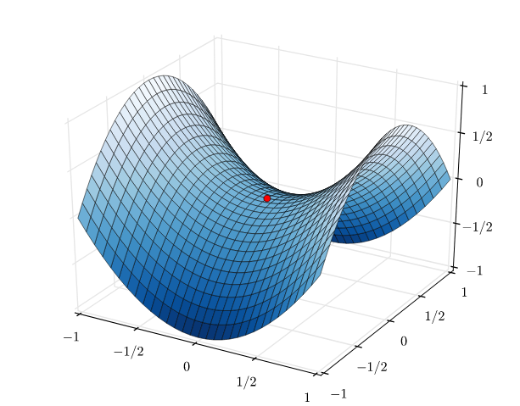
Saddle-Point Method
Given improper integral
Replace with
Given a saddle point with non-zero second derivative, we deform the contour through the point, where is constant.
  Also the steepest descent for
No longer oscillatory
Arfken et al. Mathematical Methods for Physicists: A Comprehensive Guide

Slide 14
Setup
-dimensional improper integrals
We promote to , holomorphic on ( )
Assume has nondegenerate critical points, i.e. its critical points have nonsingular Hessian
  is a Morse function
Call higher dimensional contours integration cycles

Slide 15
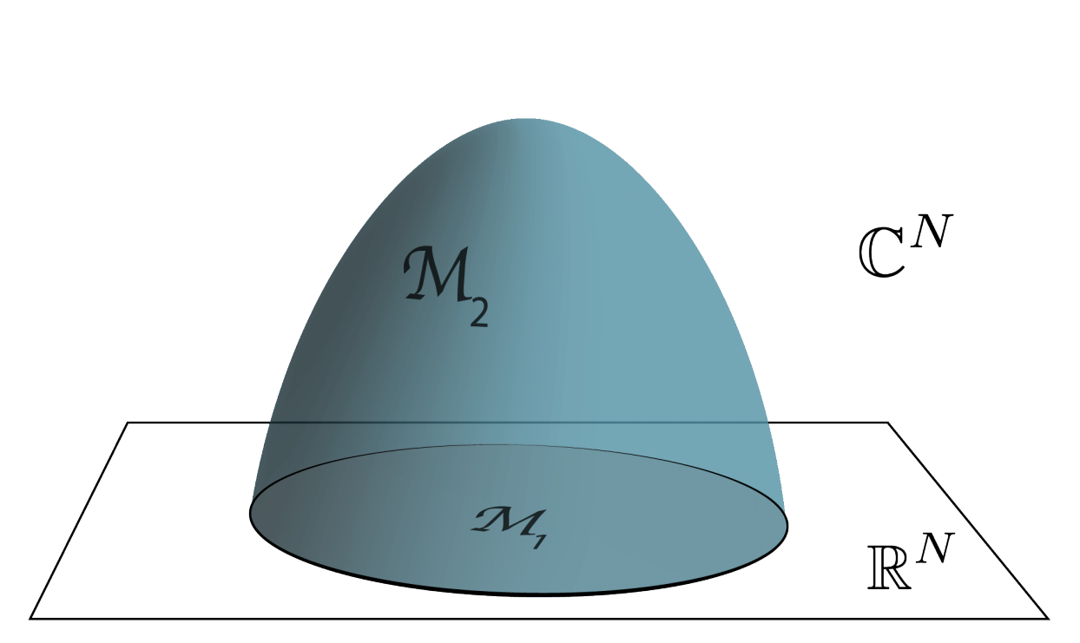
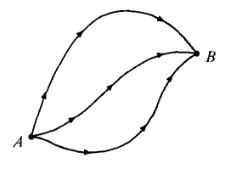
Cauchy’s Theorem
“If is analytic in a simply connected region , then for any closed curve completely in the region, .”
Path independence
Improper integrals
Higher dimensions

Slide 16
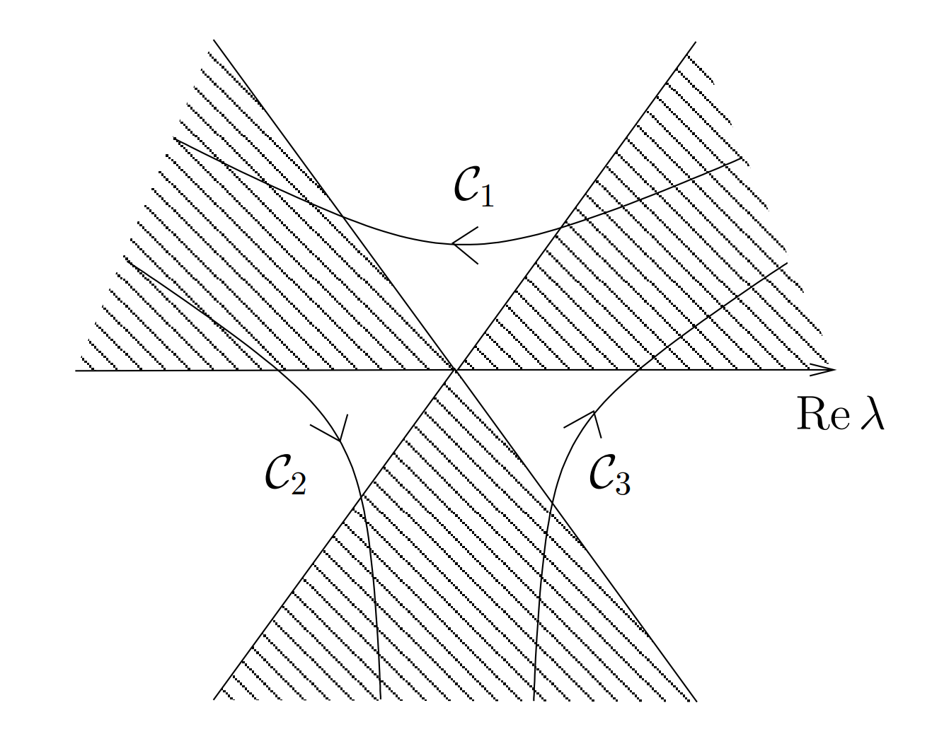
Improper Contour Integrals
Complex functions behave differently asymptotically in different regions of complex space
Infinite ends of improper cycles have to be in the regions where the function goes to 0
  Contours with ends in the same region are equal
    Not deforming through singularity at infinity
Want to describe equivalence classes of cycles
Witten, arXiv: 1001.2933

Slide 17
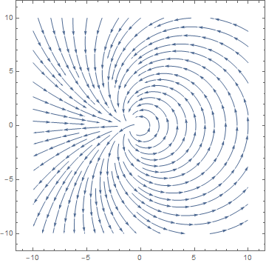
The Holomorphic Flow
Let and let the metric be
Gradient flow: &
Let denote flowed by
Imaginary part stays constant!
Flow preserves equivalence class

Slide 18
Lefschetz Thimbles
Call the critical points
Lefschetz thimble:
  Unstable manifold
  Steepest ascent of from
Anti thimble:
  Stable manifold
Imaginary part constant
No sign problem integrating on

Slide 19
Thimble Decomposition
(anti) thimbles have same dimension as original cycle
Morse (in)equality: There are the same number of critical points and equivalence classes of cycles
Intersection pairing:
We can show the thimbles are linearly independent:
Thus, thimbles form a “basis” for the equivalence class of convergent cycles
Pham, doi: 10.1090/pspum/040.2

Slide 20
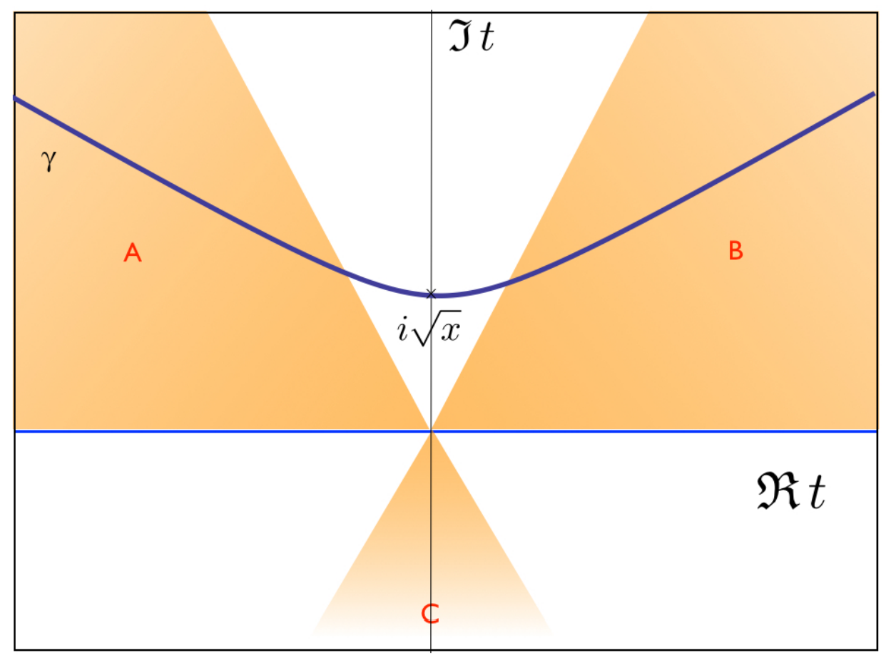
Example: The Airy Function

Slide 21
Lefschetz Thimble Monte Carlo

Slide 22
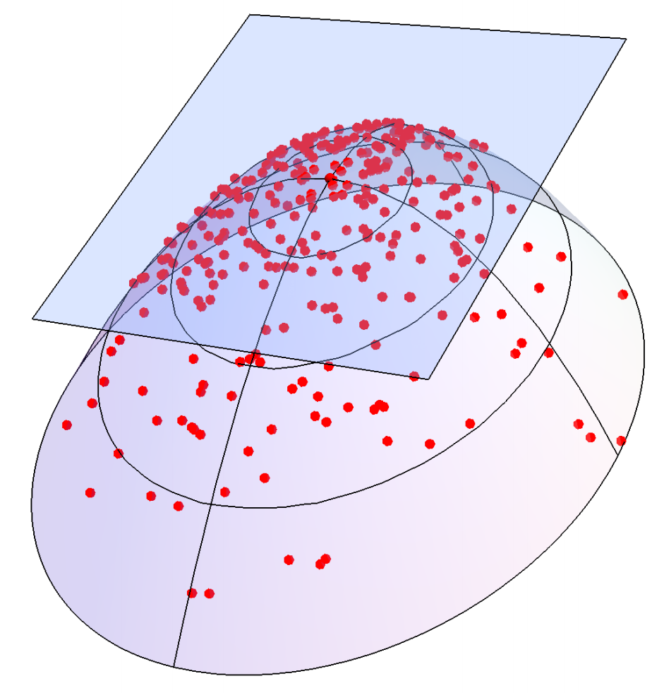
The Contraction Algorithm
Sampling a thimble: Need a basis for tangent space
  -Takagi vectors: such that
  for positive real
Start with
Flow, calculate
Propose point and calculate
Alexandru et al., arXiv: 2007.05436

Slide 23
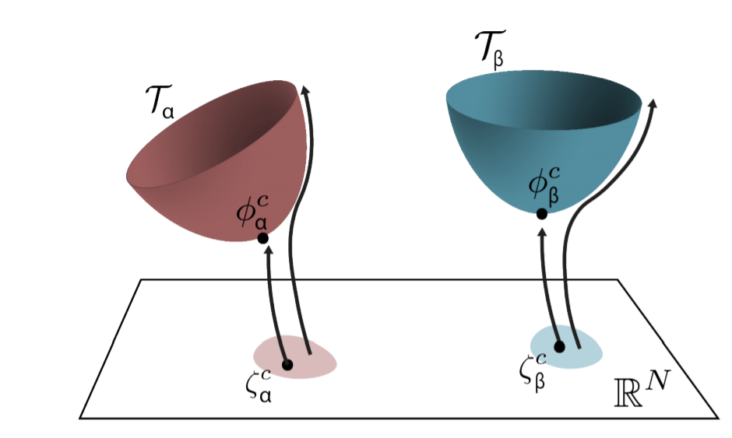
Generalized Thimble Algorithm
What if there are multiple thimbles?
Start with real point
Flow, calculate
Propose new real point and calculate

Slide 24
Computational Concerns
Trapping
The Jacobian
Inter-thimble sign problem

Slide 25
Application to Spin Systems
Wait a second...

Slide 26
Spin Coherent States

Slide 27
Spin Coherent States
Euler angle representation:
Max spin eigenstate along
Can view as spin ½ particles
aligned along and
Saturates Uncertainty Principle
Not Good Enough
Resolution of the Identity:
Altland and Simons, Condensed Matter Field Theory

Slide 28
Spin Coherent States
Euler angle vs. Rotation around axis:
Expand trig and combine into ladder operators:
Arbitrary complex number
Arecchi et al., PRA.6.2211

Slide 29
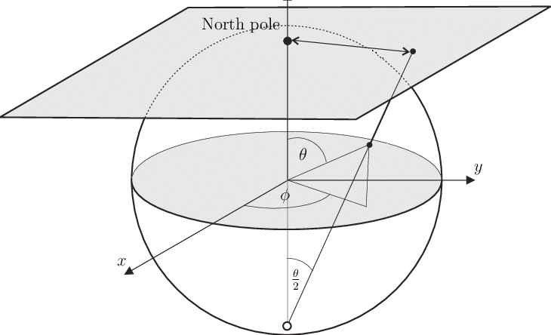
The Stereographic Parametrization
If , goes to canonical coherent states
Closest as possible to classical state
Saturates Uncertainty Principle
Radcliffe, doi: 10.1088/0305-4470/4/3/009

Slide 30
Spin Coherent State Path Integral
Not holomorphic, so expand and
Push volume form into exponential too
Continuous form not entirely well-founded
More accurate at higher spins
arXiv: quant-ph/9807005
arXiv: cond-mat/0111139
Altland and Simons; Kochetov, doi: 10.1063/1.530913

Slide 31
Spin Coherent State Path Integral
Expanded out:
First term Berry Phase
Spin operators for :
Diverge if

Slide 32
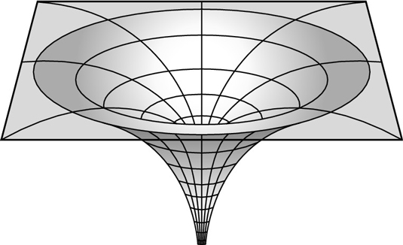
Holomorphic Flow Blow-up
Flows can blow up in finite time!
For us, at
Potentially also at
Numeric breakdown
Sometimes tuning isn’t enough

Slide 33
Gradient Flow without Blow-ups
Change metric so distance blows up at singularities too
Gradient flow decelerates at singularities
Trade-off: sign problem vs. blow-up
Tanizaki et al., arXiv: 1706.03822

Slide 34
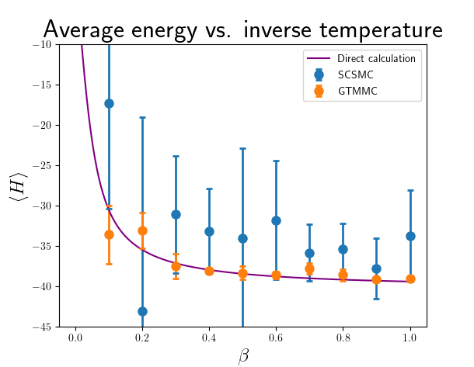
Our Results
Notes:
Explain what the graphs show, why they’re encouraging, why the quantities are relevant, et cetera

Slide 35
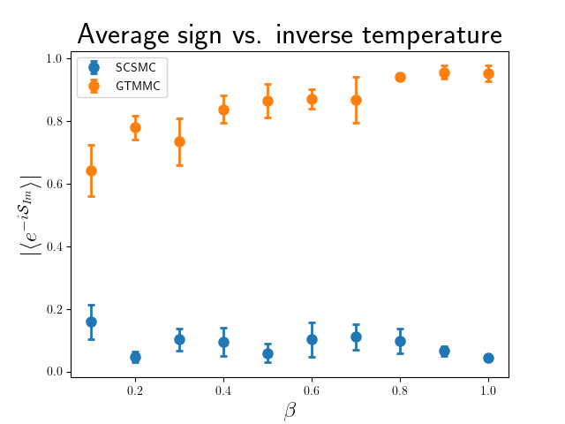
Our Results
Notes:
Explain what the graphs show, why they’re encouraging, why the quantities are relevant, et cetera

Slide 36
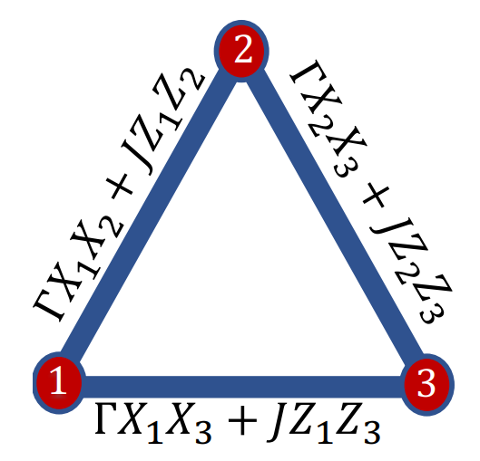
Future Directions
So far, just proof of concept
Multi-spin systems
Actual sign problems
  Frustrated triplet
Mitigate, not solve

Slide 37
Backup Slides

Slide 38
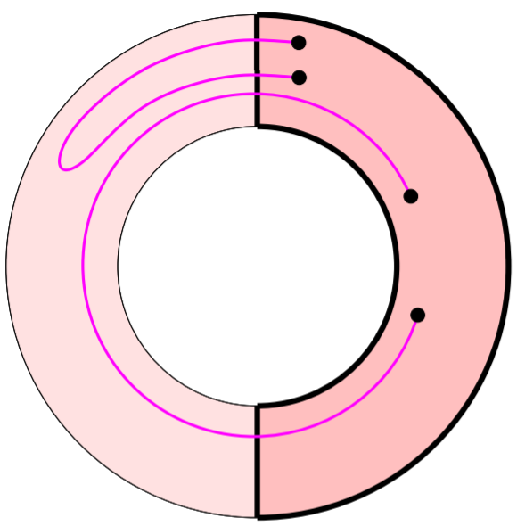
Relative Homology
All relative to subspace
Relative -cycles are -dimensional hypersurfaces with either no boundary or boundary in
Relative -boundaries are the -hypersurfaces which, up to -hypersurfaces in , are boundaries of -hypersurfaces.
Every relative boundary is a relative cycle
Define , as integer-coefficient
formal sums of relative cycles, boundaries
relative homology group:
Hatcher, Algebraic Topology; Edelsbrunner & Harer, Computational Topology

Slide 39
Relative Homology
Define
Assume large- limit
are convergent integration cycles for
are cycles that integrate to 0 for
are equivalence classes of convergent cycles partitioned by value of their
integral
Witten, arXiv: 1001.2933; Zorbach, Computing Path Integrals Using Lefschetz Thimbles

Slide 40
Thimble Decomposition
(anti) thimbles have same dimension as original cycle - is a perfect Morse function
Morse (in)equality: If dimension ,and critical points,
Intersection pairing:
Thus,
Pham, doi: 10.1090/pspum/040.2

Slide 41
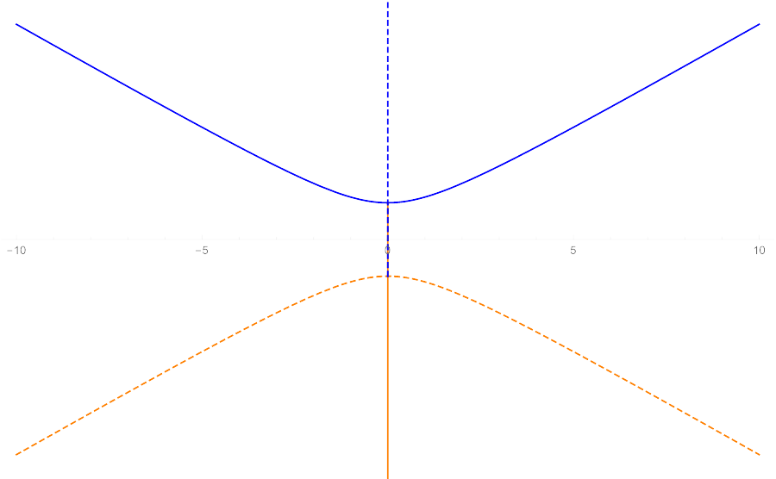
A Caveat
I’ve lied to you
Flows between critical points
if we have Stokes Rays
Thimbles don’t form basis
Only possible if
Not really a problem
Zorbach, Computing Path Integrals Using Lefschetz Thimbles

