Slide 1




Lefschetz Thimble Quantum Monte Carlo for Spin Systems
Connor Mooney, Jacob Bringewatt, Lucas Brady
NIST SURF Colloquium 2021
August 4, 2021
Notes:
Thank SURF organizers
Thank Lucas and Jake
Briefly introduce self if not already
name
college
major

Slide 2
Overview
The Sign Problem: Numerical instabilities due to oscillations in Boltzmann weights
Lefschetz Thimble Methods: Mitigation strategies involving deforming integration contours onto cycles of stationary phase
Notes:
Explain we are simulating quantum systems with classical computers

Slide 3
Quantum Mechanics
Quantum states – Complex vectors
    For spin, is finite
The Hamiltonian Operator
Thermal equilibrium
    Partition Function:
    Expectation:
This is all Linear Algebra!

Slide 4
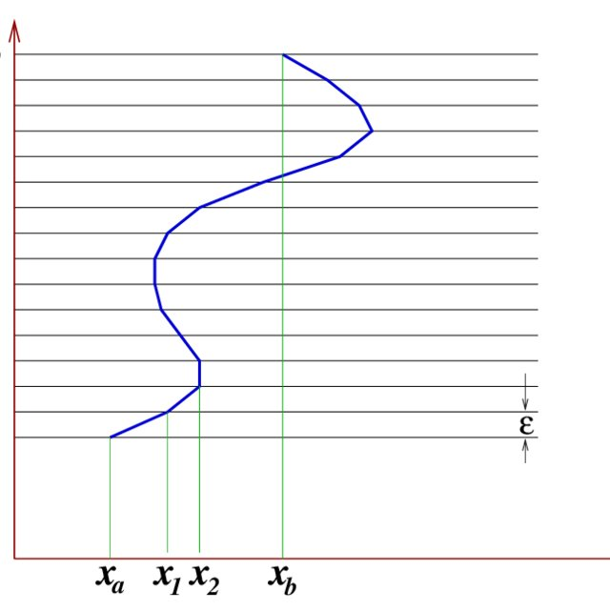
Path Integrals
Assume .
Then,
Now, define
The Action
Quantum → Classical

Slide 5
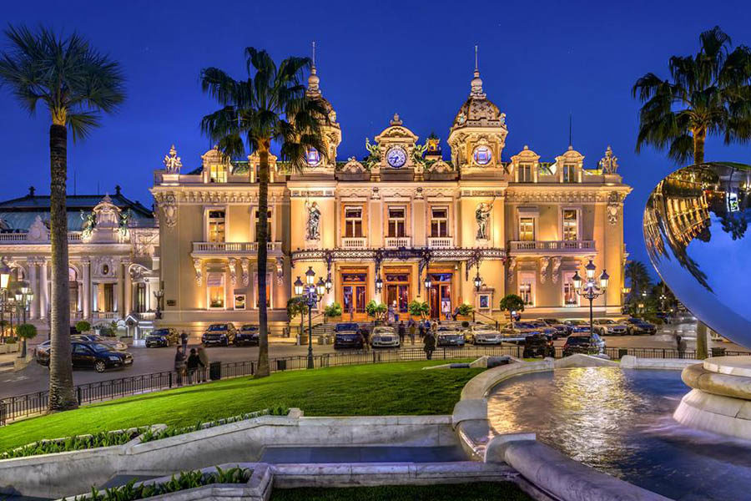
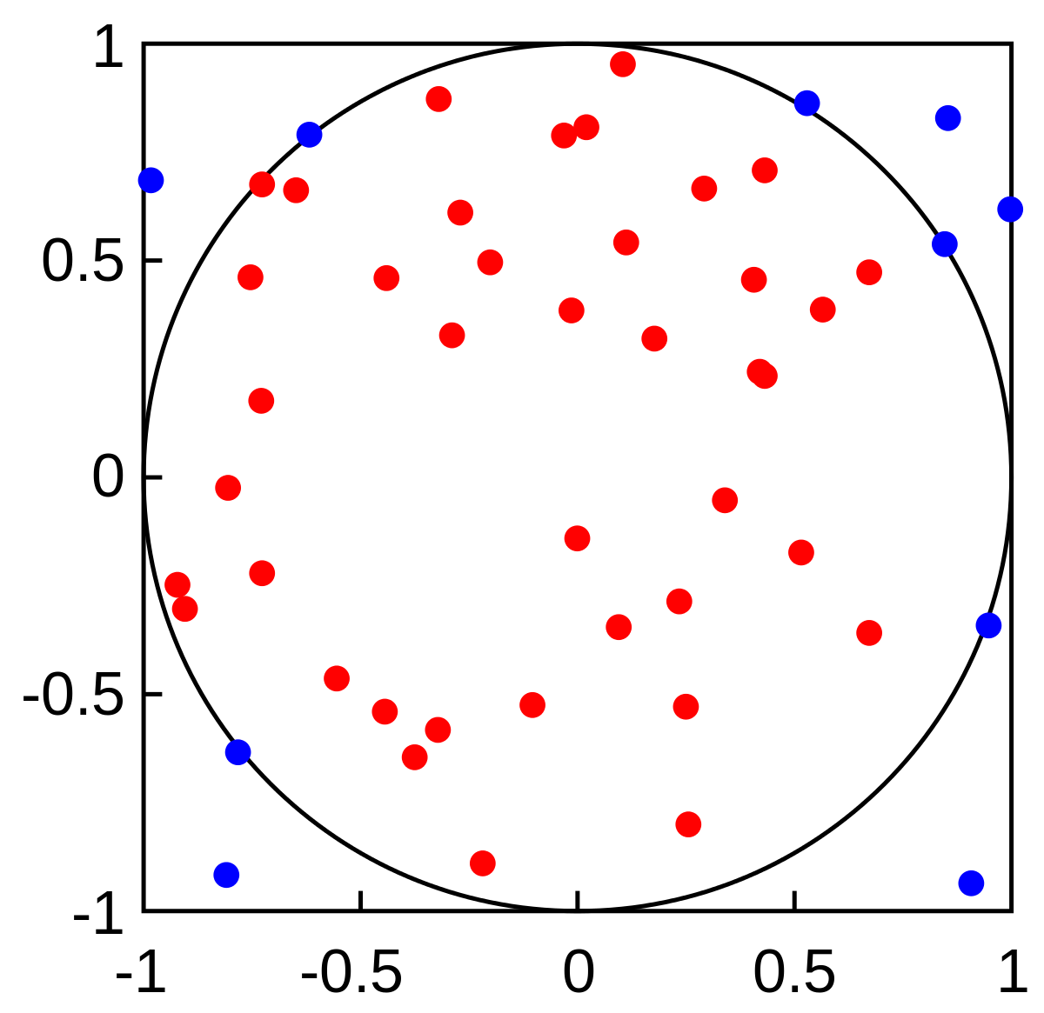
Monte Carlo Simulations
Random sampling for calculations
Metropolis-Hastings
  Given function , samples with proportional probability
  2 step process:
    Generate next point in step randomly according to
    Accept with probability
      Else,
Metropolis et al., doi: 10.1063/1.1699114; Hastings, doi: 10.2307/2334940

Slide 6
The Sign Problem
How do you sample if ?
The answer: Reweighting
If fluctuates a lot, we’re in trouble
Solving generically is NP-hard
Troyer and Wiese, arXiv: cond-mat/0408370

Slide 7
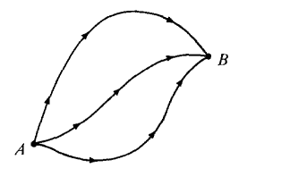
Cauchy’s Theorem
“If is analytic in a simply connected region , then for any closed curve completely in the region, .”
Path independence
Contour deformation
Higher dimensions
Notes:
Make sure to

Slide 8
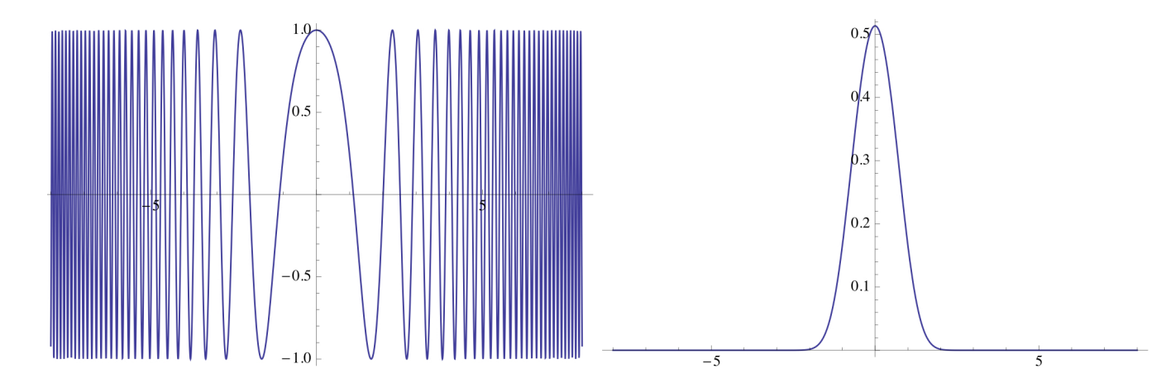
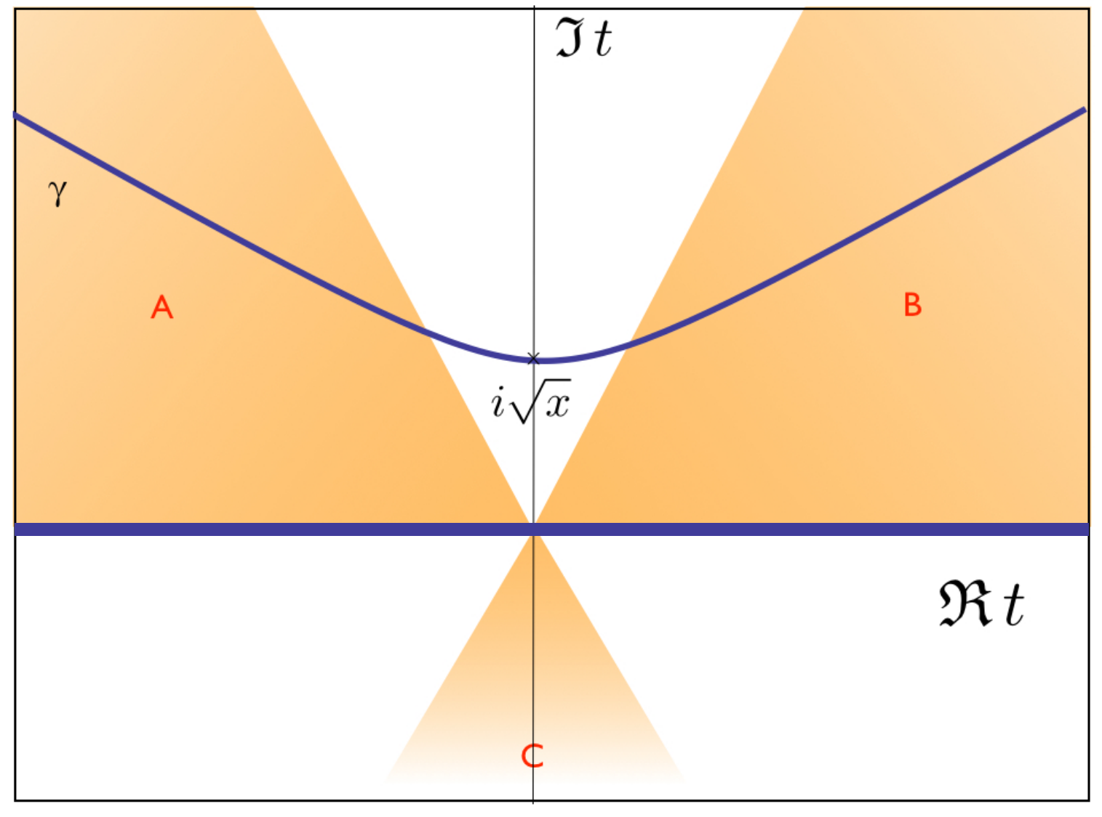
Lefschetz Thimbles
Known to help in HEP!
Pham, doi: 10.1090/pspum/040.2; Witten, arXiv:1001.2933; Alexandru et al., arXiv: 2007.05436
Notes:
We’re porting it over to spin systems

Slide 9
Spin Coherent States
One big problem:
Spin states are discrete!
Need to make continuous
The answer: Spin coherent states
Closest to classical spin possible
Can resolve the identity
Radcliffe, doi: 10.1088/0305-4470/4/3/009
Notes:
Make sure to emphasize the discrete part

Slide 10
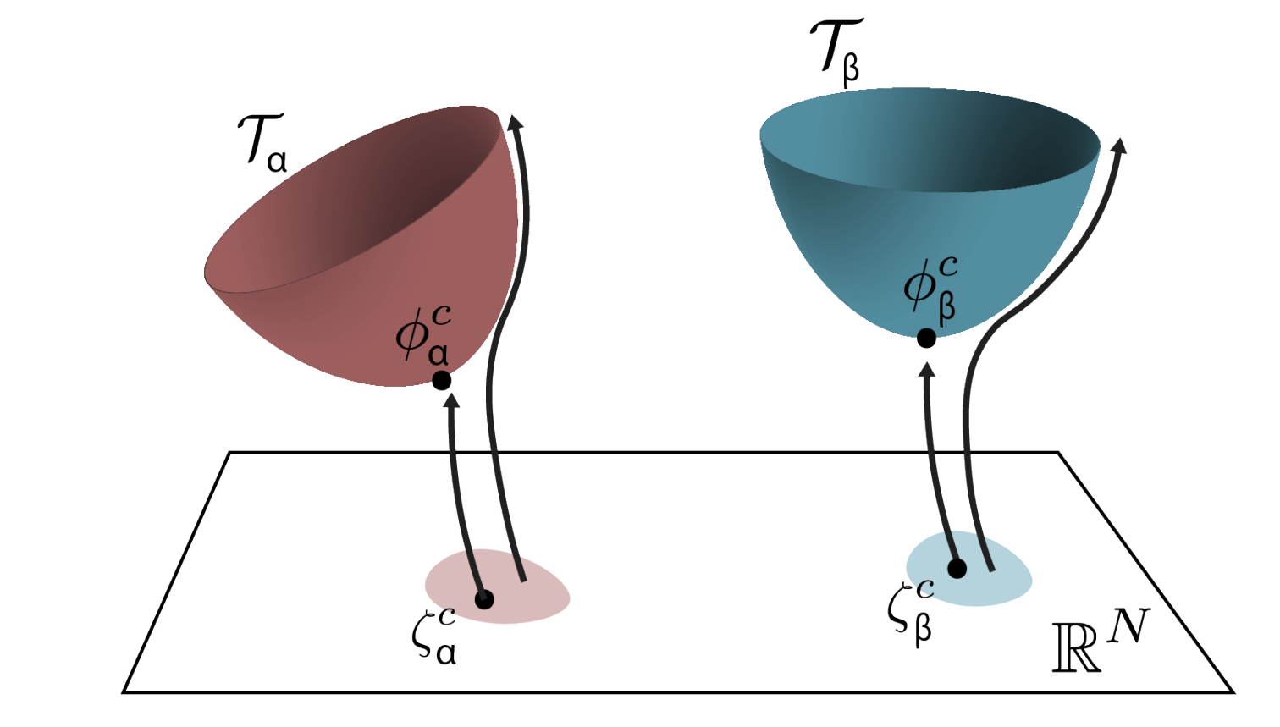
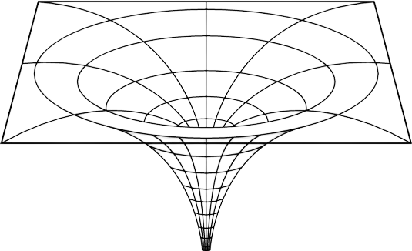
Our Results
Challenges:
  Singularities
  Trapping
Tanizaki et al., arXiv:1706.03822

Slide 11
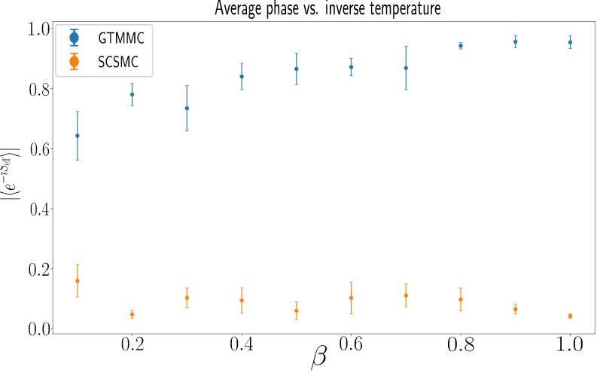
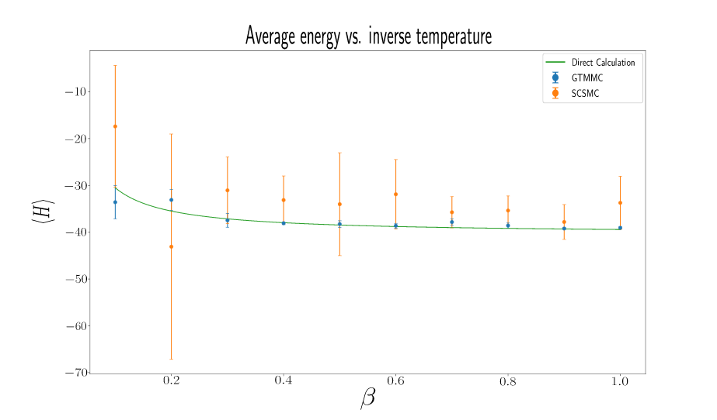
Our Results
Still, the results are encouraging!
Notes:
Explain what the graphs show, why they’re encouraging, why the quantities are relevant, et cetera

Slide 12
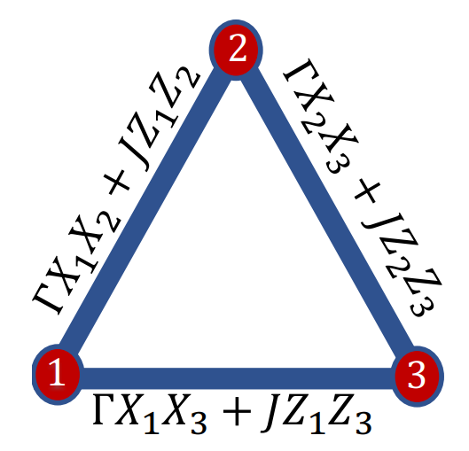
Future Directions
So far, just proof of concept
Multi-spin systems
Actual sign problems
  Frustrated triplet
Mitigate, not solve

Slide 13
Thank you for listening!
Any Questions?
tmooney2@gmu.edu
lucas.brady@nist.gov
jbringew@umd.edu

Slide 14
Backup Slides

Slide 15
Path Integral Quantum Monte Carlo
How about expectations?
Note: Not right for off-diagonal in discrete limit!
We can run Monte Carlo to sample w.r.t. !

