Slide 1
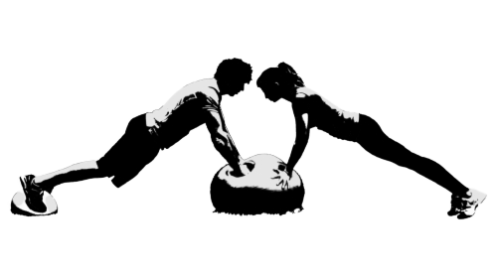
Week 8 Standup
Witness The Fitness

Slide 2
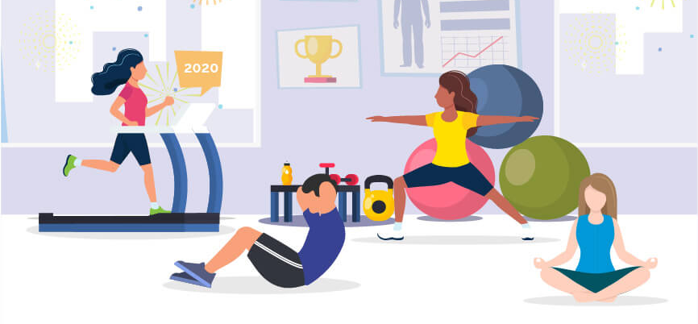
Research Area
How can we improve the connection between new and experienced gym-goers in a non-competitive gym environment?

Slide 3
Research - Surveys
Interviews with a total of 10 general everyday gym users
70% Participants cited “awkwardness” a major factor in not collaborating in exercise
80% integrated digital technology when exercising at the gym
Mobile Phone, Smart Watch, Smart Biometric Device
Majority of participants noted when exercising with friends their motivation to exercise increased
40% suggested the idea of a competitive or gamified environment in the gym as appealing
With the follow up to this question some users expressed this could be demotivating when they underperform

Slide 4
Research - Interviews
Interviews with a total of 10 general everyday gym users
Age range (19 - 36), Male and Female, mixed experiences
General feedback was that they wanted to socialise but found it difficult
Consensus that technology can help overcome fear
Find it hard to know if someone wants to talk or not
Scared of rejection, so don’t communicate

Slide 5
Research - Existing systems
MyZone: Inclusive heart rate system - gamification of RPE output (https://www.myzone.org/)
Garmin Connect: App or Web tracking of excursion for exercise (https://connect.garmin.com/modern/)

Slide 6
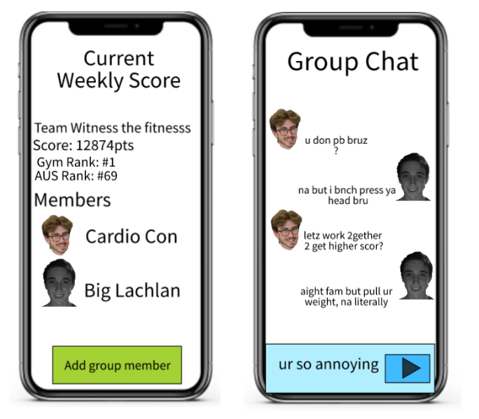
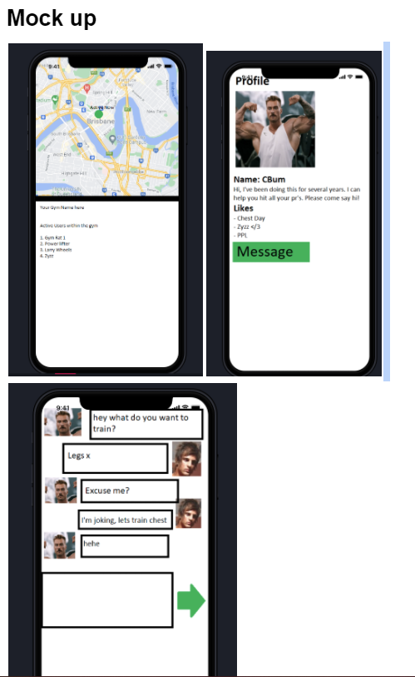
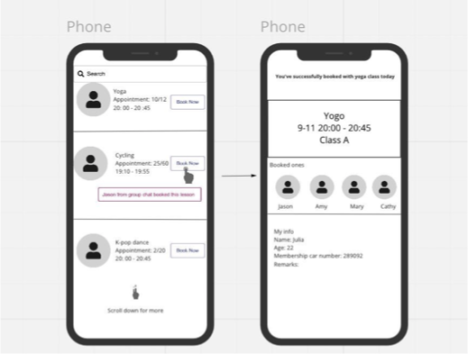
Design Ideas
Tinder-esque matchmaking system
Check in alters the “online” status of a gym-goer
Automatic timeout after 60 minutes
Users are notified if both are check in at the gym
Messaging feature -> see when people are responding
Leaderboards
Sign up to a group and enter leaderboard - use wilks score
Gym can configure competitions with prizes / achievements
Every user have a profile
Name
Age
“Interests” in the gym
Experience
Preferred training times

Slide 7
Where To Next?
Create a low-fidelity prototype and run user testing sessions
Refine features of design based on qualitative and quantitative feedback
Interviews
Paper prototype sessions
Begin creating working prototype
Bootstrap web-app as mobile app
Determine what functionality must be dynamic or static
Continue compiling GitHub documentation of work

Slide 8
Thank You
Q&A

