Slide 1

Passenger Saver
based on Uber Surge Multipliers
13 Point
Oct.8
Peng Zheng/Jinli Yan/Xipeng Chai/Haoming Lin/Yanjun Ding/Yuntian Zhang
Uber

Slide 2
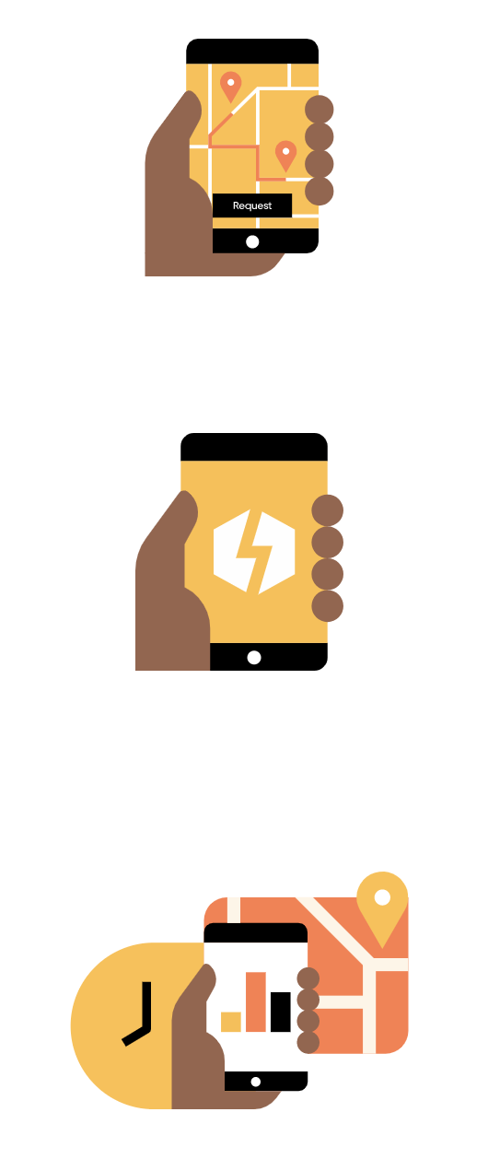
What’s Surge
Demand for rides increases
Prices go up
Riders pay more or wait
https://www.uber.com/us/en/drive/partner-app/how-surge-works/

Slide 3
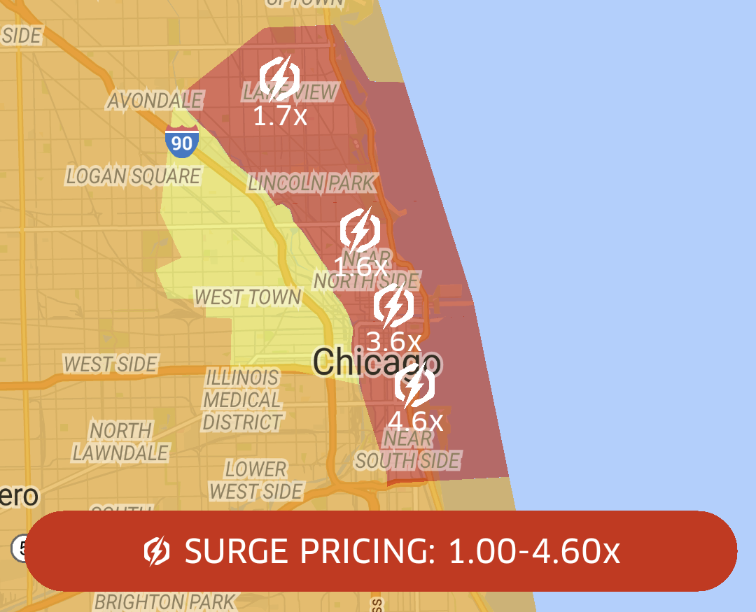
What’s Done Today
Different surge multiplier in different areas according to demand for riders.

Slide 4
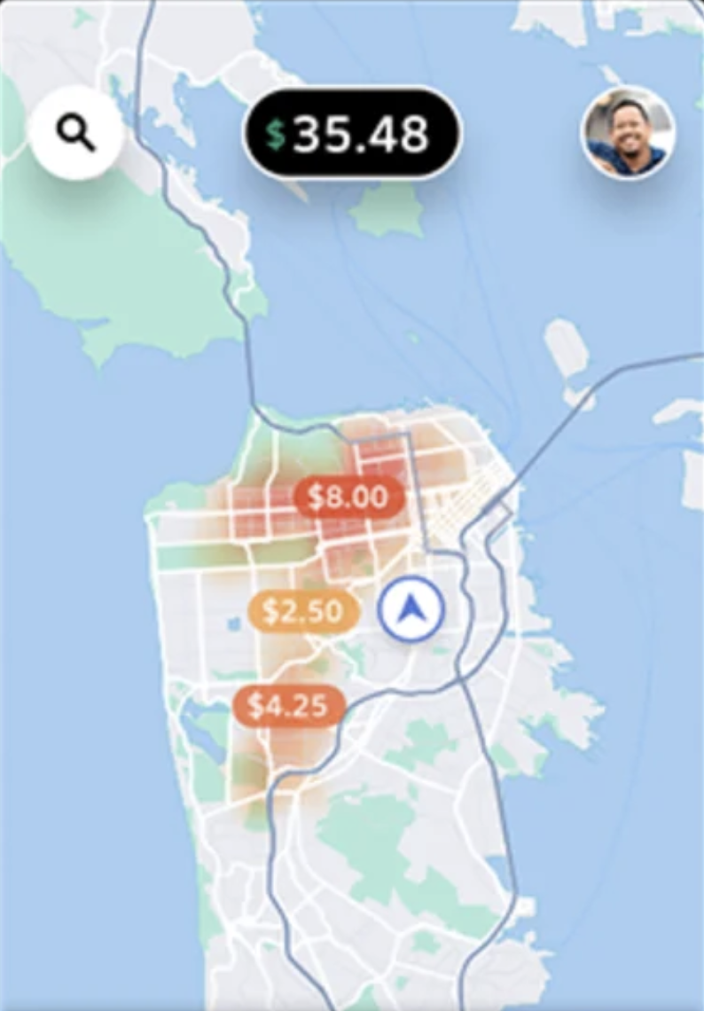
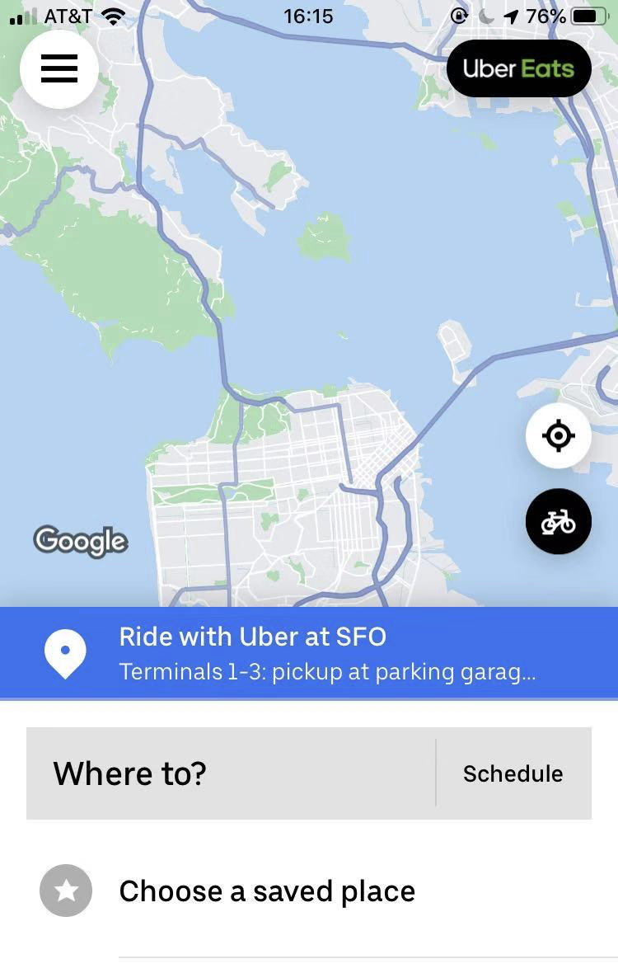
What’s Limitation
Only drivers know
Passengers know nothing
https://www.uber.com/us/en/drive/partner-app/how-surge-works/

Slide 5
What’s our purpose
Only drivers know
Passengers ALSO KNOW
https://www.uber.com/us/en/drive/partner-app/how-surge-works/

Slide 6
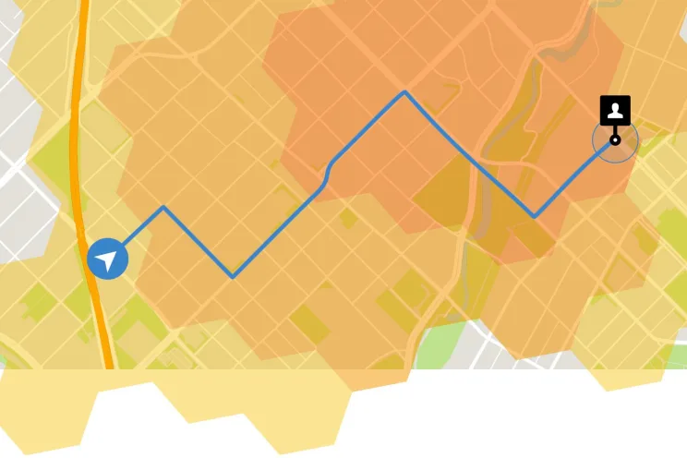
What’s our purpose & Who cares
Surge
Multiplier
1.5x
1.2x
1x
https://www.uber.com/us/en/drive/partner-app/how-surge-works/

Slide 7

What’s the impact
Surge
Multiplier
1.5x
1.2x
1x
https://www.uber.com/us/en/drive/partner-app/how-surge-works/

Slide 8
What’s difference and impact
Surge
Multiplier
1.5x
1.2x
1x
Reduce pressure in high demand areas
https://www.uber.com/us/en/drive/partner-app/how-surge-works/

Slide 9
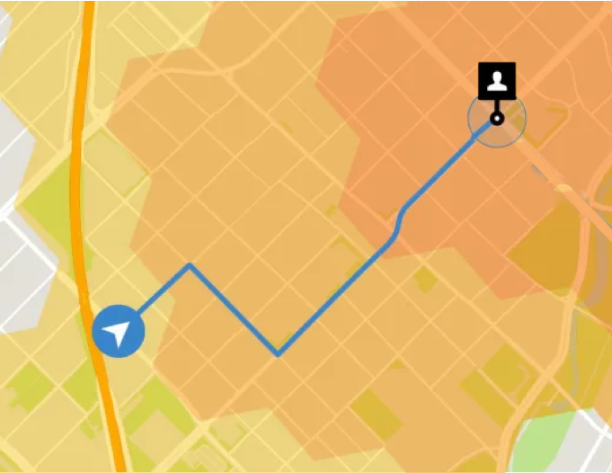
Risks and payoffs
The whole region has high surge, users aren’t able to save money anymore.

Slide 10
What’s new &
How much will it cost?
We dig out the value of surge multipliers to predict the price area and help passengers save money. With Uber database, we can collect data and analyze them.
Approach ：
Using longitude and latitude classified by surge multiplier, we visualize different areas with borders and areas.
Cost ：NULL

Slide 11
Timeline
Data Collection & Wrangling
Interface designed
“Midterm”
“Final Exam”
Oct.15th - Oct.30th
Nov.15th - Nov.30th
Oct.1st - Oct.14th
Nov.1st - Nov.14th
Program refined & Final Demo
Program designed

