Slide 1
March 2nd 2023
Mini Argus Timex Sensitivity Analysis: Timestacks & A Look at Foam Persistence Through Time

Slide 2
Tabular Wave Data and Methodology
Three timestacks are shown (1Hz, 10s, and 10s w/ 90s on the Y Axis)
The 1Hz timestack is then used to show foam persistence time in the surf zone
This information is displayed alongside concurrent tabular wave data and wave spectra taken from CDIP Buoy 433.
Collect | UTC Time | Wave Height (m) | Dominant Period (s) | Average Period (s) | Direction (deg)
1663005397544 | Mon 12 Sept 2022 9:32 | 1.44 | 14.29 | 9.45 | 73
1663080831409 | Tue 13 Sept 2022 6:30 | 1.38 | 14.29 | 10.38 | 86
1663869541385 | Thu 22 Sept 2022 9:29 | 0.8 | 11.76 | 7.54 | 125
1663948741409 | Fri 23 Sept 2022 7:29 | 2.3 | 6.67 | 5.45 | 20
1664117941403 | Sun 25 Sept 2022 6:29 | 0.64 | 9.09 | 5.88 | 83
1664395141403 | Wed 28 Sept 2022 11:29 | 1.49 | 5.56 | 4.5 | 12

Slide 3
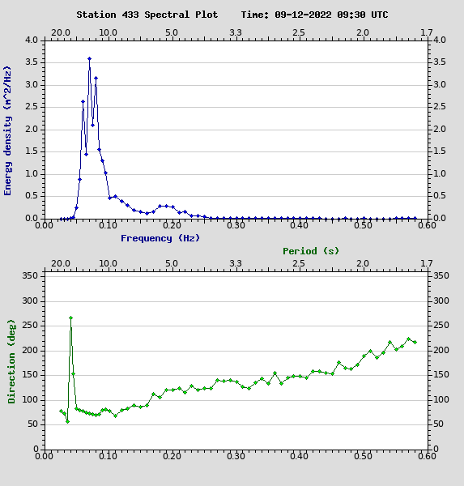
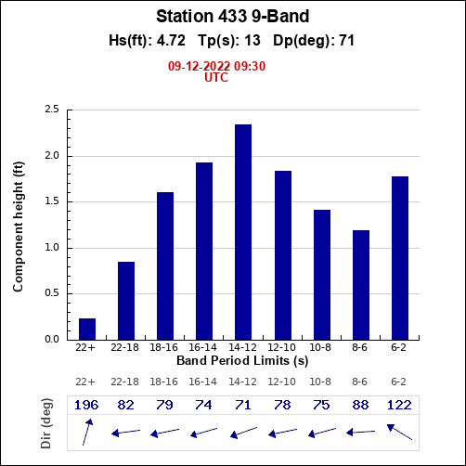
1) Collect 1663005397544
Collect | UTC Time | Wave Height (m) | Dominant Period (s) | Average Period (s) | Direction (deg)
1663005397544 | Mon 12 Sept 2022 9:32 | 1.44 | 14.29 | 9.45 | 73
1663080831409 | Tue 13 Sept 2022 6:30 | 1.38 | 14.29 | 10.38 | 86
1663869541385 | Thu 22 Sept 2022 9:29 | 0.8 | 11.76 | 7.54 | 125
1663948741409 | Fri 23 Sept 2022 7:29 | 2.3 | 6.67 | 5.45 | 20
1664117941403 | Sun 25 Sept 2022 6:29 | 0.64 | 9.09 | 5.88 | 83
1664395141403 | Wed 28 Sept 2022 11:29 | 1.49 | 5.56 | 4.5 | 12

Slide 5
14s
25s
19s
14s
20s
12s

Slide 6
2) Collect 1663080831409
Collect | UTC Time | Wave Height (m) | Dominant Period (s) | Average Period (s) | Direction (deg)
1663005397544 | Mon 12 Sept 2022 9:32 | 1.44 | 14.29 | 9.45 | 73
1663080831409 | Tue 13 Sept 2022 6:30 | 1.38 | 14.29 | 10.38 | 86
1663869541385 | Thu 22 Sept 2022 9:29 | 0.8 | 11.76 | 7.54 | 125
1663948741409 | Fri 23 Sept 2022 7:29 | 2.3 | 6.67 | 5.45 | 20
1664117941403 | Sun 25 Sept 2022 6:29 | 0.64 | 9.09 | 5.88 | 83
1664395141403 | Wed 28 Sept 2022 11:29 | 1.49 | 5.56 | 4.5 | 12

Slide 7
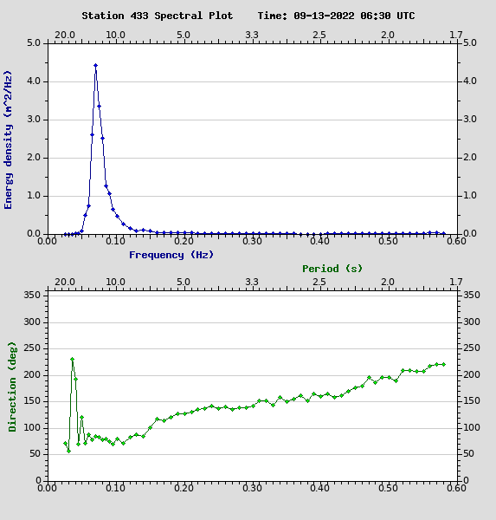

Slide 8
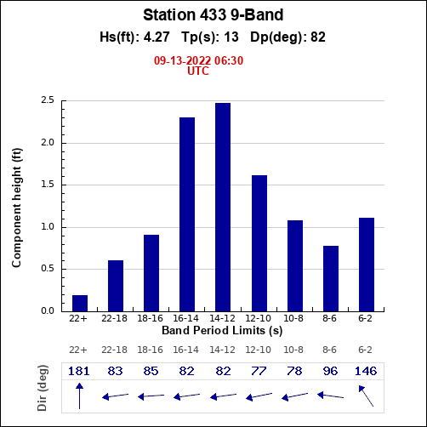
16s
17s
16s

Slide 9
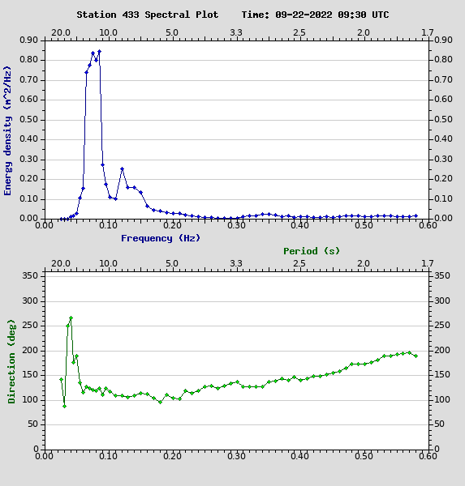
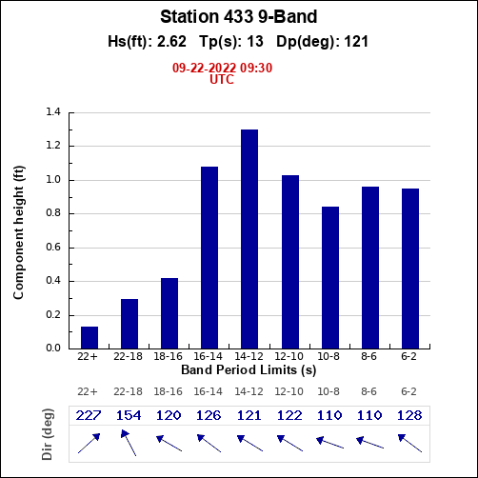
3) Collect 1663869541385
Collect | UTC Time | Wave Height (m) | Dominant Period (s) | Average Period (s) | Direction (deg)
1663005397544 | Mon 12 Sept 2022 9:32 | 1.44 | 14.29 | 9.45 | 73
1663080831409 | Tue 13 Sept 2022 6:30 | 1.38 | 14.29 | 10.38 | 86
1663869541385 | Thu 22 Sept 2022 9:29 | 0.8 | 11.76 | 7.54 | 125
1663948741409 | Fri 23 Sept 2022 7:29 | 2.3 | 6.67 | 5.45 | 20
1664117941403 | Sun 25 Sept 2022 6:29 | 0.64 | 9.09 | 5.88 | 83
1664395141403 | Wed 28 Sept 2022 11:29 | 1.49 | 5.56 | 4.5 | 12

Slide 11
12s
12s

Slide 12
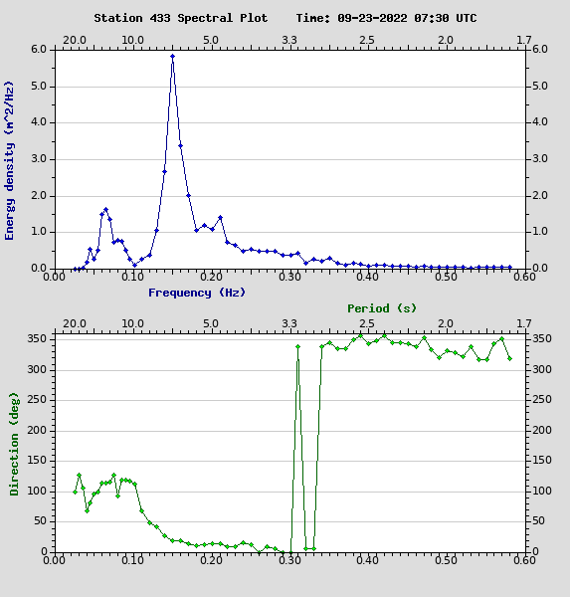
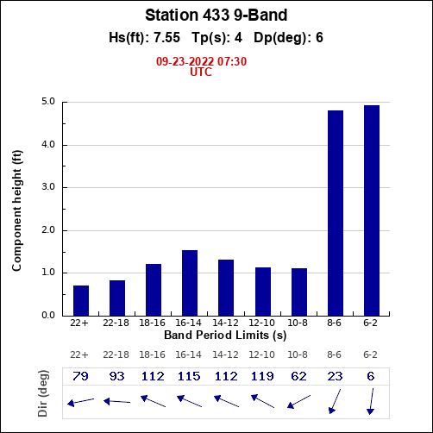
4) Collect 1663948741409
Collect | UTC Time | Wave Height (m) | Dominant Period (s) | Average Period (s) | Direction (deg)
1663005397544 | Mon 12 Sept 2022 9:32 | 1.44 | 14.29 | 9.45 | 73
1663080831409 | Tue 13 Sept 2022 6:30 | 1.38 | 14.29 | 10.38 | 86
1663869541385 | Thu 22 Sept 2022 9:29 | 0.8 | 11.76 | 7.54 | 125
1663948741409 | Fri 23 Sept 2022 7:29 | 2.3 | 6.67 | 5.45 | 20
1664117941403 | Sun 25 Sept 2022 6:29 | 0.64 | 9.09 | 5.88 | 83
1664395141403 | Wed 28 Sept 2022 11:29 | 1.49 | 5.56 | 4.5 | 12

Slide 14
5s
5s

Slide 15
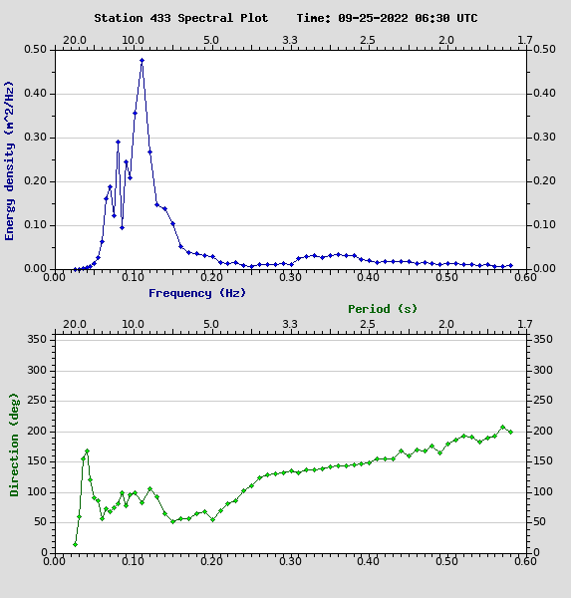
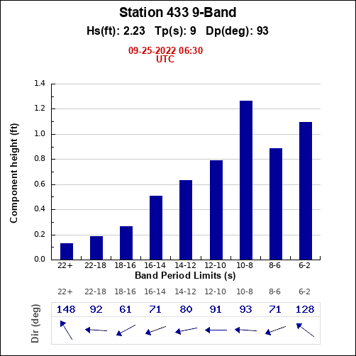
5) Collect 1664117941403
Collect | UTC Time | Wave Height (m) | Dominant Period (s) | Average Period (s) | Direction (deg)
1663005397544 | Mon 12 Sept 2022 9:32 | 1.44 | 14.29 | 9.45 | 73
1663080831409 | Tue 13 Sept 2022 6:30 | 1.38 | 14.29 | 10.38 | 86
1663869541385 | Thu 22 Sept 2022 9:29 | 0.8 | 11.76 | 7.54 | 125
1663948741409 | Fri 23 Sept 2022 7:29 | 2.3 | 6.67 | 5.45 | 20
1664117941403 | Sun 25 Sept 2022 6:29 | 0.64 | 9.09 | 5.88 | 83
1664395141403 | Wed 28 Sept 2022 11:29 | 1.49 | 5.56 | 4.5 | 12

Slide 17
14s
11s
14s

Slide 18
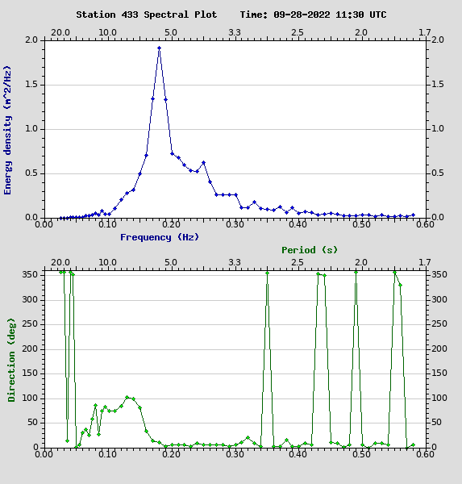
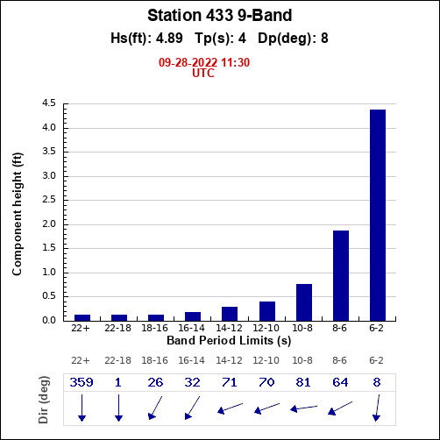
6) Collect 1664395141403
Collect | UTC Time | Wave Height (m) | Dominant Period (s) | Average Period (s) | Direction (deg)
1663005397544 | Mon 12 Sept 2022 9:32 | 1.44 | 14.29 | 9.45 | 73
1663080831409 | Tue 13 Sept 2022 6:30 | 1.38 | 14.29 | 10.38 | 86
1663869541385 | Thu 22 Sept 2022 9:29 | 0.8 | 11.76 | 7.54 | 125
1663948741409 | Fri 23 Sept 2022 7:29 | 2.3 | 6.67 | 5.45 | 20
1664117941403 | Sun 25 Sept 2022 6:29 | 0.64 | 9.09 | 5.88 | 83
1664395141403 | Wed 28 Sept 2022 11:29 | 1.49 | 5.56 | 4.5 | 12

Slide 20
3s
3s

Slide 21
Conclusion
Foam persistence seems to be related to period.
Difficult to measure, but when you measure delta time over the bar, you can see that the intense foam signal persists at times that correspond with the prominent period bins shown in the corresponding 9 band plot.
It also appears that if the wave hits the outside sandbar, and reforms, the inner white water signature will be smaller.
Deriving the period/speed of individual waves from imagery is a process that is probably already done, but this work has implications for choosing the average or dominant period measurement when making engineering products that utilize linear wave theory, the Stockdon equation, etc…

